Slide 1
Optimizing a Neural Network
Name: Mark Klinchin
School: Lower Moreland High School
Grade: 11
Year in PJAS: 5th

Slide 2
Problem
What amount of layers and neurons per layer are optimal for a multilayered perceptron to learn on?

Slide 3
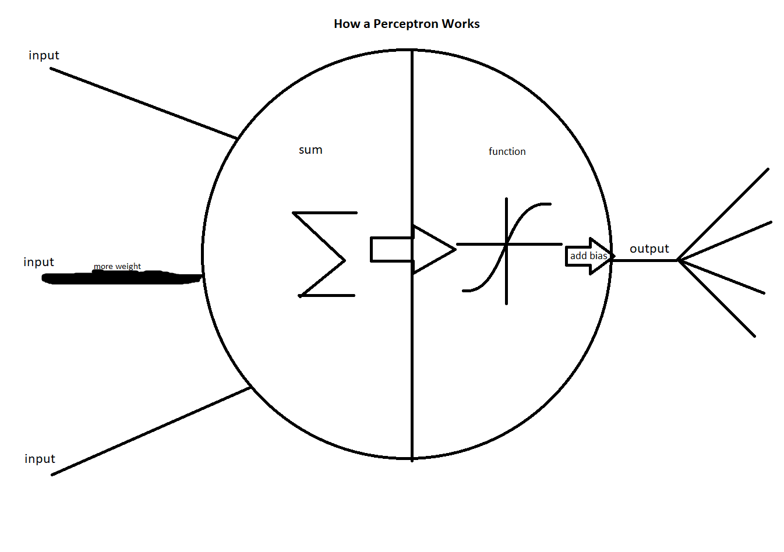
Research I: How a Neural Network Works
Perceptron
Inputs
Adds
Applies function and bias
Outputs
Layer
Many unconnected perceptrons
Can be input (outputs to new layer, inputs from dataset) or output (inputs, does not output to new layer)
Layer that is not input or output layer is called hidden layer
Connecting Layers
Every neuron’s input is the output of every neuron in the previous layer

Slide 4
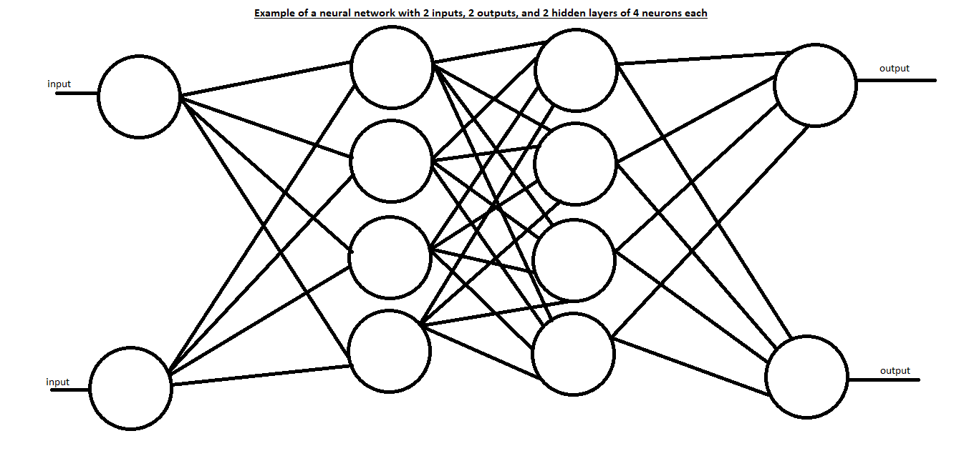
Research I: How a Neural Network Works
Connecting layers, continued
Each input of a neuron is multiplied by a weight
Weight is effectively weight of a connection between neurons
Initial conditions
Dataset: set number of inputs, set number of known outputs
Each weight and bias (collectively parameter) is set to a random number
Backpropagation
Error quantified: difference between desired and actual output is squared, all neuron’s square differences added together
Derivative of error with respect to parameter is calculated for each parameter, used to determine how to shift

Slide 5
Research II: How to Optimize Neuron and Layer Count
Layer Count
0 hidden layers: can solve linearly separable problems
1 hidden layer: can solve most other problems (continuous function)
2 hidden layers: any other problem
>2 hidden layers: unnecessary, but can solve any problem
Neuron per layer count
No strict rules, only rules of thumb
Neuron count should be between input and output
Neuron count should be less than twice the neurons in the input layer

Slide 6


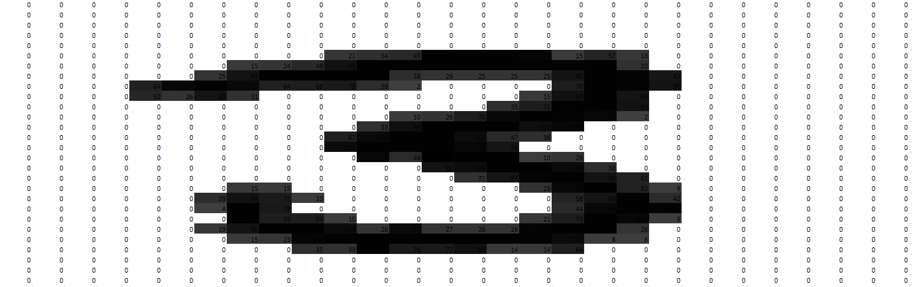
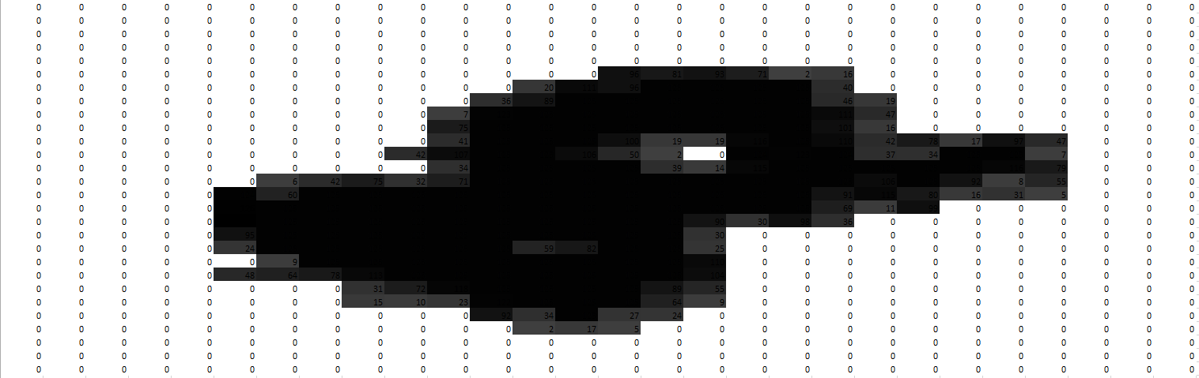
Research III: How the Networks Will Be Tested
What
How
Task: read handwritten digits
Input: 728 values 0-128 (grayscale pixels of 28x28 image)
Output: 10 values (each representing digit 0-9)
MNIST Database
Database of 60,000 handwritten digits
Goal: minimize mean square error after 5 iterations
Iteration: seeing each example once
Java 8
Neuroph
Java library which helps build neurons, layers, and neural networks

Slide 7
Hypothesis
Hypothesis: Based on the research, the optimal configuration of hidden layers and neurons per layer for a neural network processing 728-pixel images of hand-written digits is 2 hidden layers of at least 10 neurons each.
Layer count: 2
Neuron per layer count: >10
Null hypothesis: Having 2 hidden layers would perform the same as any other amount of layers, and whether a network has more than 10 neurons or not will not affect performance

Slide 8
Experiment I: Setup
Tools used
Platform: Java
Dataset: MNIST (Mixed National Institute of Standards and Technology) dataset of images of handwritten digits
Neural network library: Neuroph (Java library for building neural networks)
Convert the MNIST dataset into training set
Input
File: each pixel is byte, must be converted to value
Values placed in int[] length 724
Output
Each corresponding value is byte in different file, must be converted to corresponding digit
Digit value placed in int[] length 10
All values except correct digit value are set to 0
Correct digit value is set to 1

Slide 9
Experiment I: Setup
Generate each network
Multilayer perceptron
Weighted sum, sigmoid function
Use backpropagation
Make a network for each
Hidden layer count: from 0 to 3
Neuron per hidden layer count: 1 to 67
Test each network
5 iterations
Mean square error of last number after 5 iterations is result for each network

Slide 10
Experiment II: Variables
Independent variable: Number of hidden layers and neurons per hidden layer
Dependent variable: Mean square error of network
Control variables
Type of network used (multilayered perceptron)
Input function used (weighted sum)
Transfer function used (sigmoid)
Learning rule used (backpropagation)

Slide 11
Data

Slide 12
Data
Layer count
Average mean square error decreases by several orders of magnitude until 2 hidden layers are used
After 2, little change in mean square error
Hidden layer count | Mean square error
0 | 2.560087719
1 | 0.062516914
2 | 0.0000161504064683076
3 | 0.0000156722619046229

Slide 13

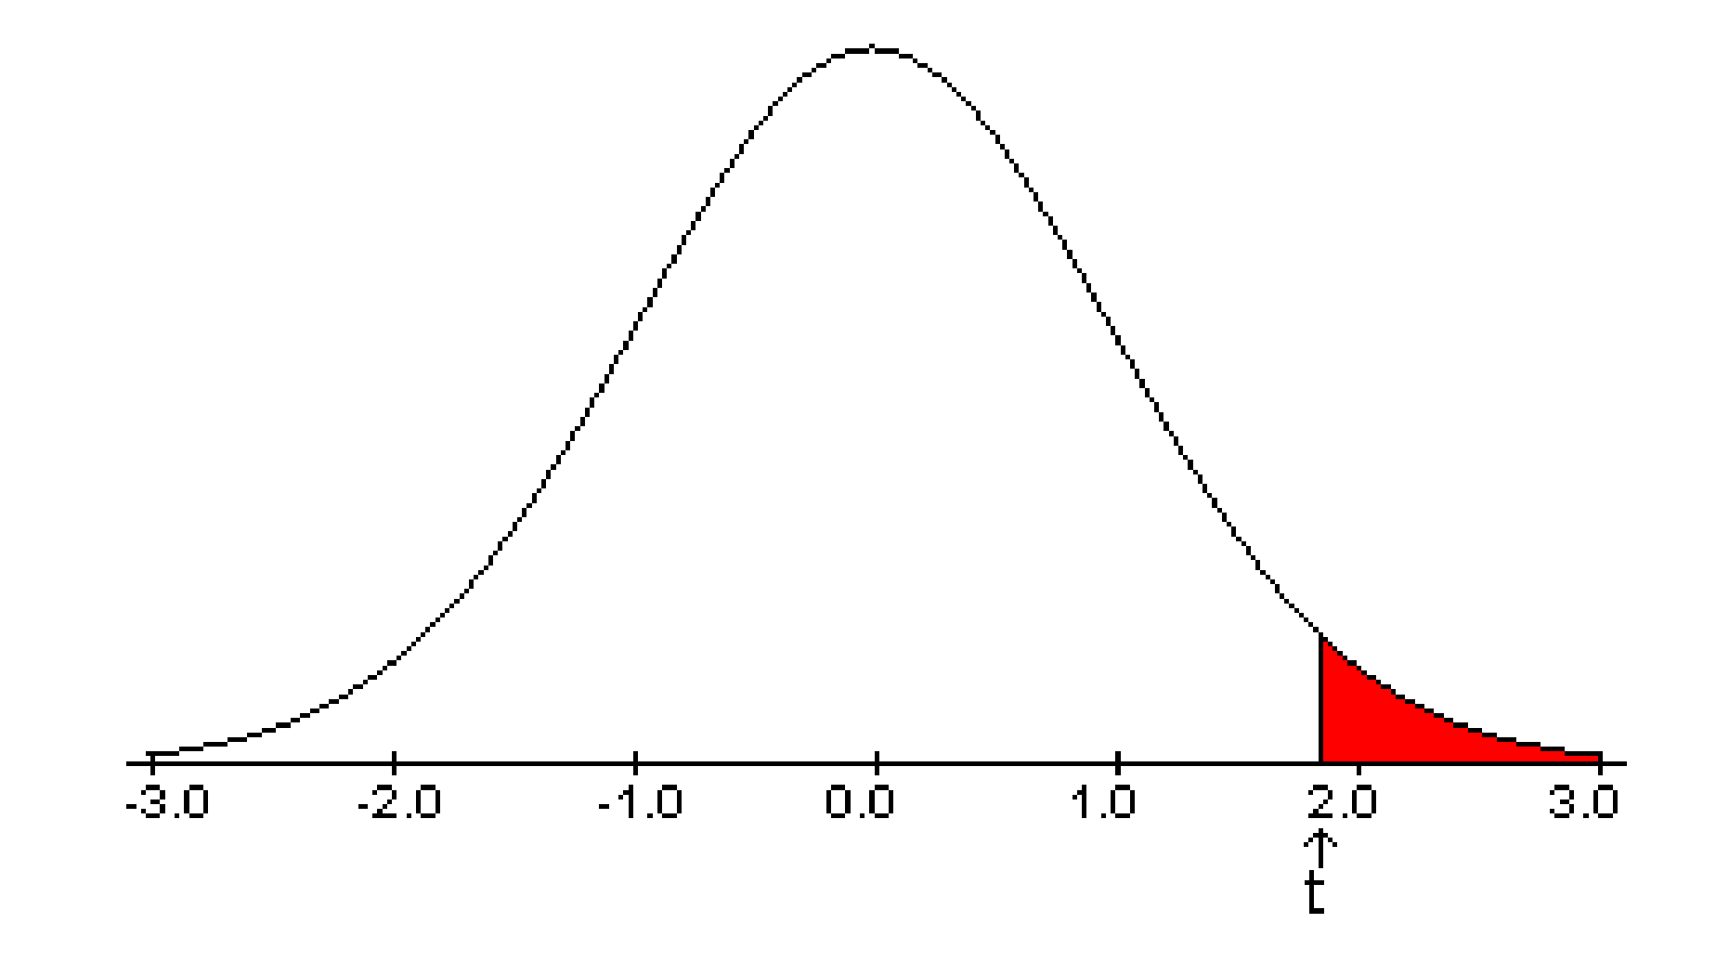
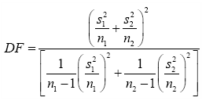
Data
Neurons Per Layer Count
Average mean square error generally decreases as neuron count increases
2-Sample T-Test
α=0.05
If p<α, reject null hypothesis
If p>α, fail to reject null hypothesis
Results: fail to reject null hypothesis
Means | 1-10 Neurons | 11-67 neurons | Standard deviations | 1-10 Neurons | 11-67 neurons
0 | 2.55 | 2.570175439 | 0 | 0.72456884 | 0.75260617
1 | 0.125027721 | 6.10685E-06 | 1 | 0.39527497 | 3.4274E-06
2 | 2.79556E-05 | 4.34524E-06 | 2 | 2.6058E-05 | 1.7504E-06
3 | 2.71381E-05 | 4.2064E-06 | 3 | 2.6354E-05 | 1.6028E-06
Average | 0.668770704 | 0.642547524 | Average | 0.27997405 | 0.18815324
Number of hidden layers | P-value
0 | 0.53159845
1 | 0.17167283
2 | 0.00209085
3 | 0.00297335
Average | 0.38939395

Slide 14
Conclusions
Hypothesis acceptance
Optimal number of hidden layers: null hypothesis accepted
More than 10 neurons is better than less than 10: fail to reject null hypothesis
Possible errors
Too many iterations
Task too simple
Overfitting
If the investigation were to be done again
Make less iterations
Make harder task (read handwritten letters)
Test how many iterations it takes to achieve certain error rate
Test layer count between 2 and higher number (10), find optimal layer count

Slide 15
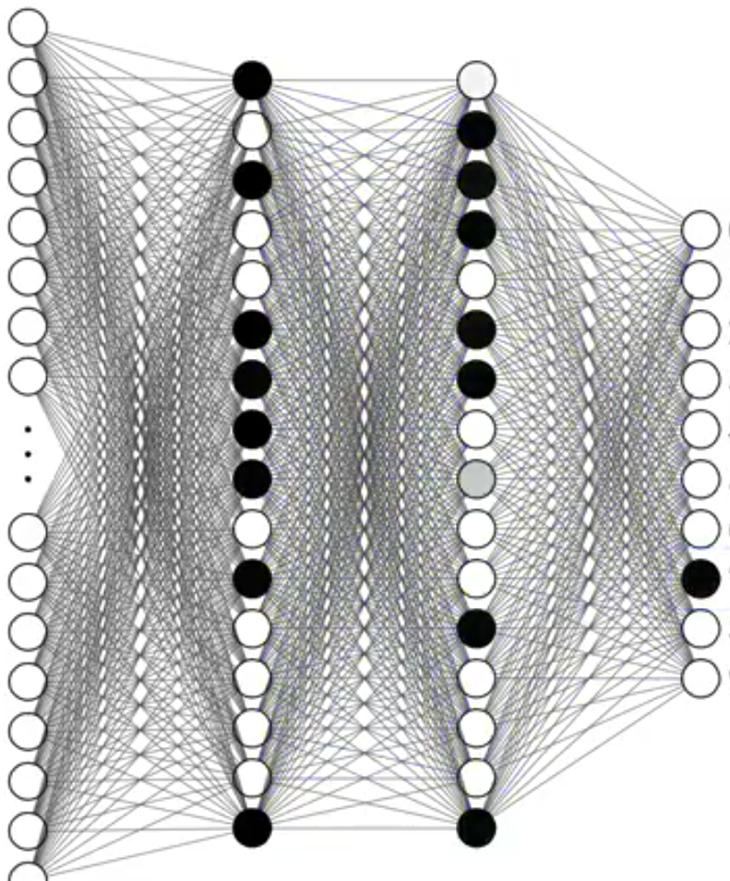
Conclusions
Further study
Optimizing other types of neural networks (CNN, Kohonen)
Comparing network types
Practical application
Perform tasks computers can solve, humans cannot program
Example: handwritten message reading, facial recognition, video recommendation

Slide 16
Works Cited
Heaton, Jeff. Introduction to Neural Networks with Java. 2nd ed., Heaton Research Inc. Google Books, books.google.com/books?id=Swlcw7M4uD8C&printsec=frontcover&dq=introduction+neural+network+java&hl=en&sa=X&ved=0ahUKEwjnq9_-z7LYAhXyQt8KHW5hA2sQ6AEIKTAA#v=onepage&q=hidden%20layers&f=false.
Hyndman, Robert. “How to Choose the Number of Hidden Layers and Nodes in a Feedforward Neural Network?” Stack Exchange, Stack Exchange, 20 July 2010, 12:15, stats.stackexchange.com/questions/181/how-to-choose-the-number-of-hidden-layers-and-nodes-in-a-feedforward-neural-netw/1097#1097.
LeCun, Yann, et al. THE MNIST DATABASE of Handwritten Digits. yann.lecun.com/exdb/mnist/.
Nielsen, Michael A. “CHAPTER 1: Using Neural Nets to Recognize Handwritten Digits.” Neural Networks and Deep Learning, Determination Press, 2015, neuralnetworksanddeeplearning.com/chap1.html.
Sanderson, Grant, director. Deep Learning. YouTube, 5 Oct. 2017, www.youtube.com/watch?v=aircAruvnKk&list=PLZHQObOWTQDNU6R1_67000Dx_ZCJB-3pi.
Sarle, Warren S. “How Many Hidden Units Should I Use? .” Comp.ai.neural-Nets FAQ, Advameg, Inc., 27 Mar. 2014, 2:11, www.faqs.org/faqs/ai-faq/neural-nets/part3/section-10.html.
Sevarac, Zoran, et al. “Neuroph.” Source Forge, 2.94, neuroph.sourceforge.net/index.html.
SimpleDreamful. “How to Determine the Number of Layers and Nodes of a Neural Network.” Stack Overflow, Stack Exchange, Feb. 2016, stackoverflow.com/questions/35520587/how-to-determine-the-number-of-layers-and-nodes-of-a-neural-network.

Slide 17
THE END

