Slide 1

IRIS HACKS IV · 2026
CreekReady
Official alert in.
Clear household plan out.
Henderson Damian Mejia Gonzales · Solo entrant
Notes:
0:00–0:12 — An emergency alert is only useful if a household can act on it. CreekReady turns the warning a family already received into a clear, source-linked plan.
[Sources]
- docs/assets/creekready-cover.png — generated editorial illustration; not a live event or product screenshot.
- README.md — project positioning and tagline.
[/Sources]

Slide 2
CREEKREADY
The alert arrives. The household must still decide.
In Cedar Creek, the last mile may include an older adult, a pet, limited mobility—or no vehicle.
But what do we do next?
COMMUNITY-WIDE WARNING
01
Who needs help first?
02
What should be staged now?
03
When should we stop planning and follow officials?
The official alert must cover the whole community.
02
Notes:
0:12–0:32 — Community alerts are necessarily broad. The action gap appears when a specific household has to account for people, pets, mobility, or transportation without losing the original official signal.
[Sources]
- https://www.co.bastrop.tx.us/page/em.wildfire_mitigation_program — local Bastrop County preparedness context.
- https://www.ready.gov/plan — FEMA household planning guidance.
- README.md — CreekReady problem statement and supported household constraints.
[/Sources]

Slide 3
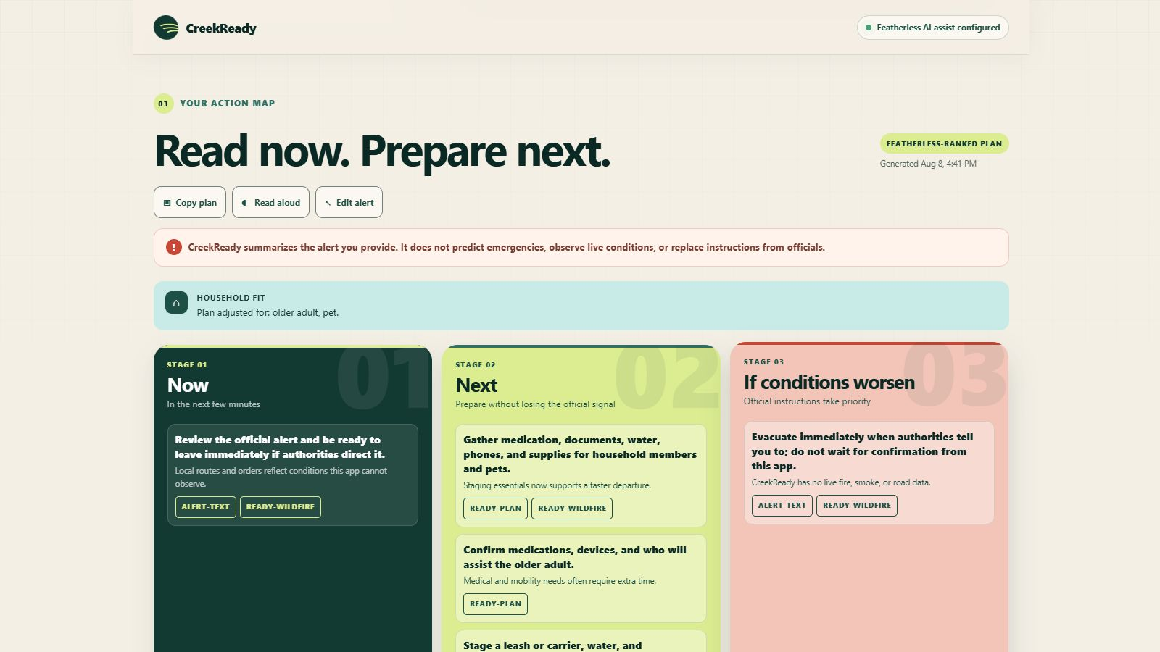
CREEKREADY
One alert. The whole plan in view.
Real CreekReady result: Featherless-ranked actions, household fit, three stages, and official sources.
03
Notes:
0:32–1:08 — This is a real CreekReady result from the fictional wildfire sample with older adult and pet selected. The first view exposes the Featherless-ranked mode, household fit, all three decision stages, and source IDs; the deterministic fact panel and bounded-AI receipt remain inspectable below.
[Sources]
- docs/assets/creekready-desktop-result.png — real local CreekReady interface capture using a fictional sample; not a live warning.
- README.md — demonstrated workflow, modes, and current limitations.
- creekready/service.py; creekready/provider.py; creekready/catalog.py — deterministic fact ownership, bounded ranking, and vetted action catalog.
- https://www.weather.gov/safety/flood; https://www.weather.gov/safety/heat; https://www.ready.gov/wildfires; https://www.ready.gov/plan — official guidance sources surfaced by the app.
[/Sources]

Slide 4
CREEKREADY
AI helps choose the order—not the facts.
A narrow role for Featherless keeps the safety boundary inspectable.
01
02
03
04
Facts stay bounded
AI ranks vetted IDs
Output is validated
Failure is labeled
Displayed place, timing, and official instructions: deterministic extraction, not model output.
Featherless orders exact instruction and action IDs; it cannot author visible guidance.
Schema rules and request-specific allowlists reject malformed, unknown, duplicate, or extra output.
Any provider or validation failure returns the deterministic guided fallback.
No account · no database · no server-side plan storage
04
Notes:
1:08–1:38 — This is the key engineering boundary. Featherless receives parser-selected directive sentences, selected needs/language, and a vetted action catalog, then returns two prose-free ID arrays: prioritized instruction IDs and ranked action IDs. Displayed facts and all visible wording remain server-owned; invalid output fails closed to the deterministic fallback.
[Sources]
- creekready/service.py — deterministic fact panel, server-owned stage and visible wording, provider selection, required-action restoration, and fallback behavior.
- creekready/provider.py; creekready/catalog.py — two-array Featherless ranking contract, request-specific ID allowlists, vetted action catalog, and fail-closed validation.
- creekready/models.py — bounded request and response contracts.
- README.md — exact privacy statement, modes, and current provider behavior.
- https://featherless.ai/docs/quickstart-guide — OpenAI-compatible Featherless integration reference.
[/Sources]

Slide 5
CREEKREADY
What this prototype does not do
THE PROMISE
Official alert in.
It does not authenticate or monitor alerts.
It has no live weather, road, location, or emergency-services feed.
It does not replace the original alert or officials.
Clear household
plan out.
It has no field-validated accuracy metric yet.
The official signal stays in control.
05
Notes:
1:38–2:00 — CreekReady does not create a warning. It helps a household act on one, with the official signal still in control. Close on the complete plan in the live demo: official alert in, clear household plan out.
[Sources]
- README.md — exact current limitations, privacy posture, and no-live-data statement.
- docs/pitch-script.md — closing language and judge-question limitations.
[/Sources]

