Slide 1
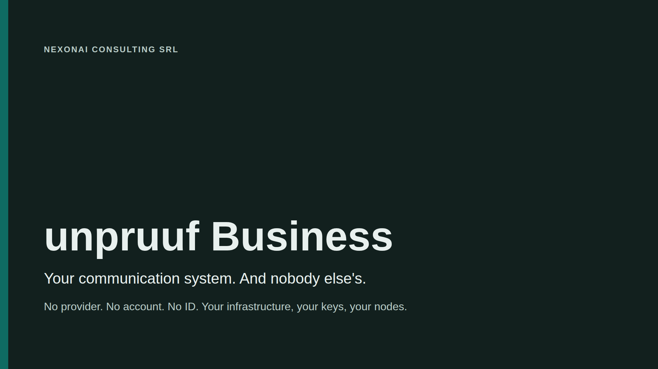
Notes:
Core message: we do not sell a messenger service. We deliver the customer their own communication system. NexonAI runs no servers; the servers always belong to the customer.

Slide 2
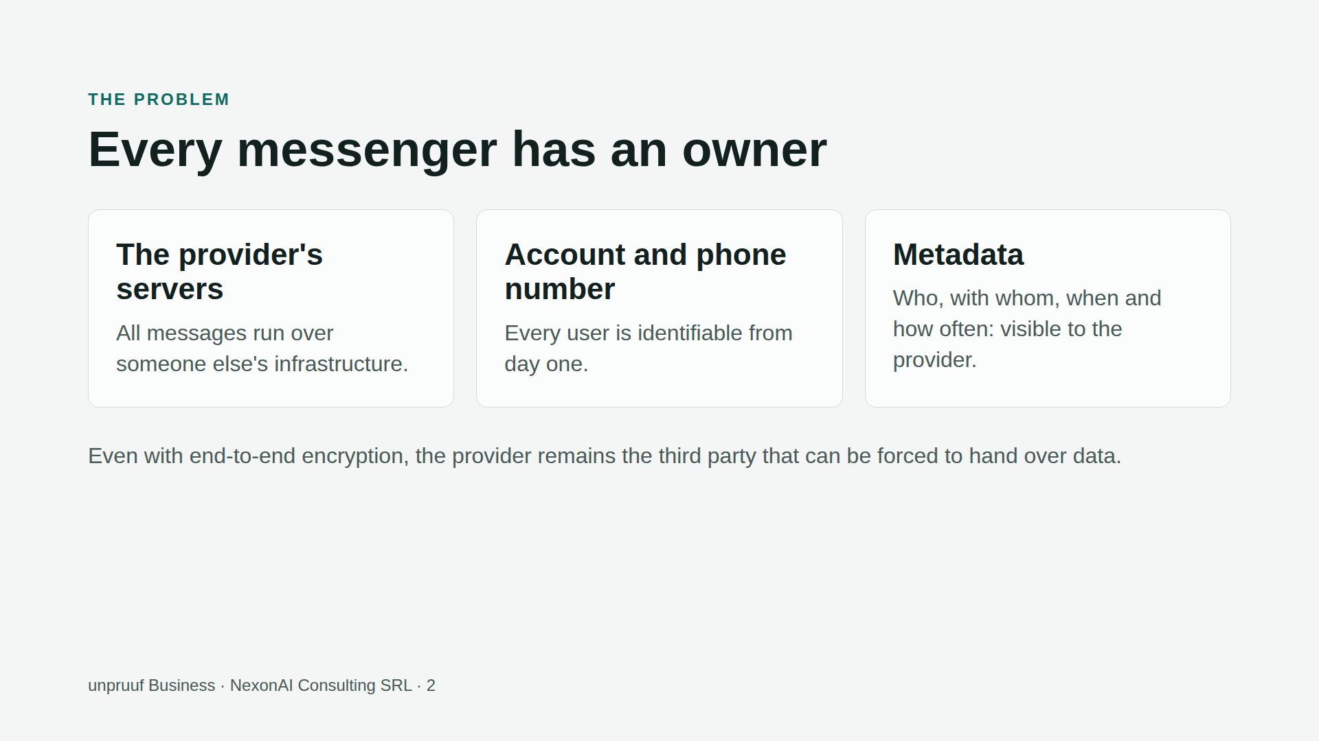

Slide 3
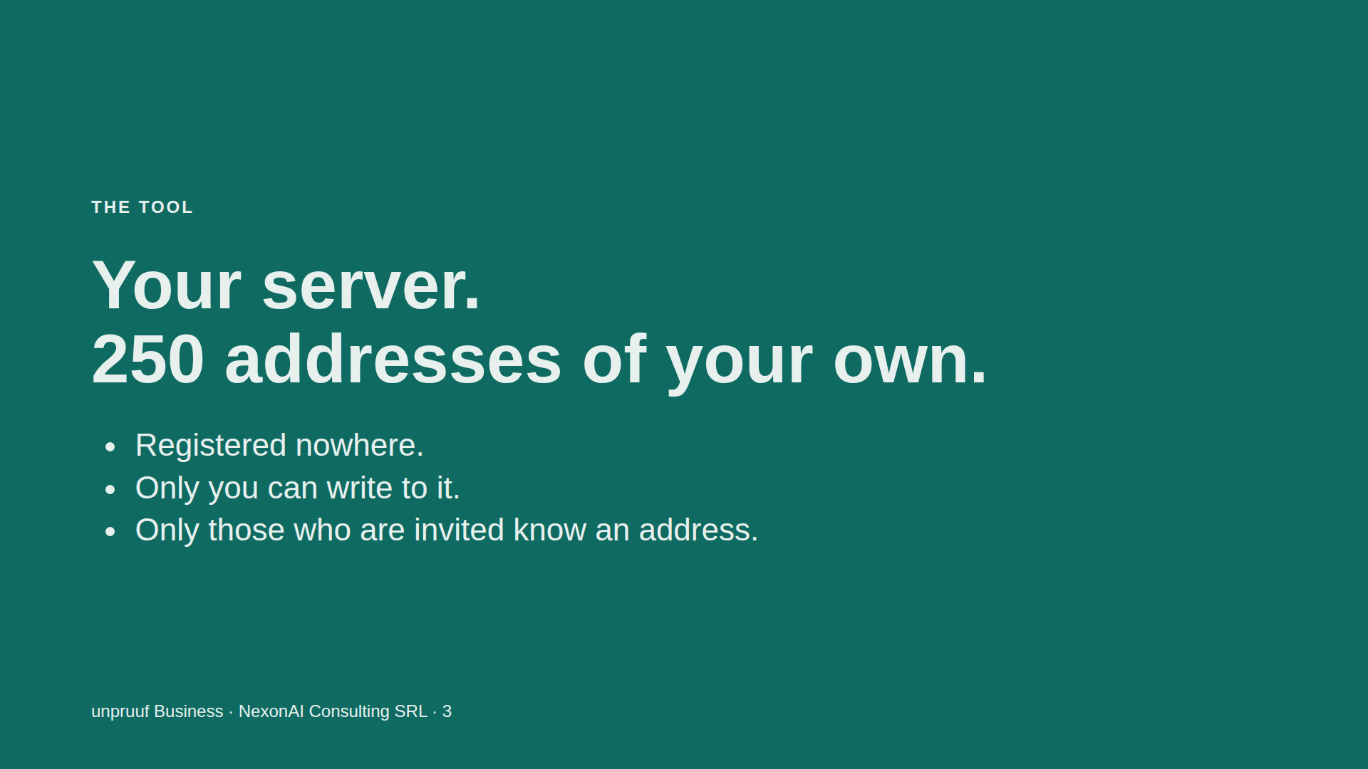
Notes:
The server is the tool: with it, every customer builds their own communication system. It always creates the full licensed number of addresses, at most 250. NexonAI hosts nothing.

Slide 4
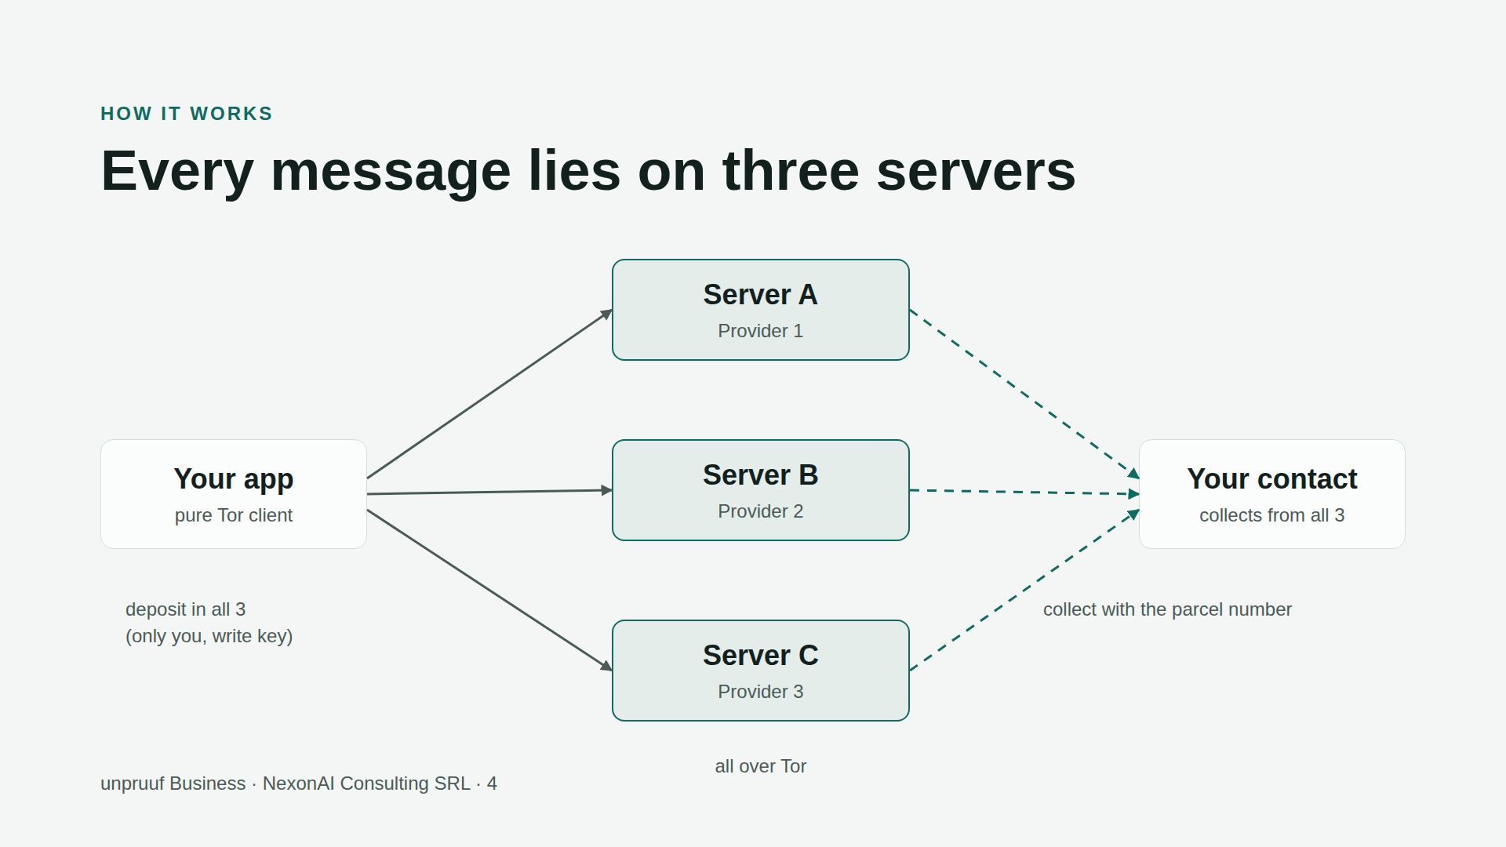
Notes:
Every message goes to all three nodes of the contact, on three different servers. If one or even two fail, the message is still there. The contact checks all three. The way back runs over the contact's nodes.

Slide 5
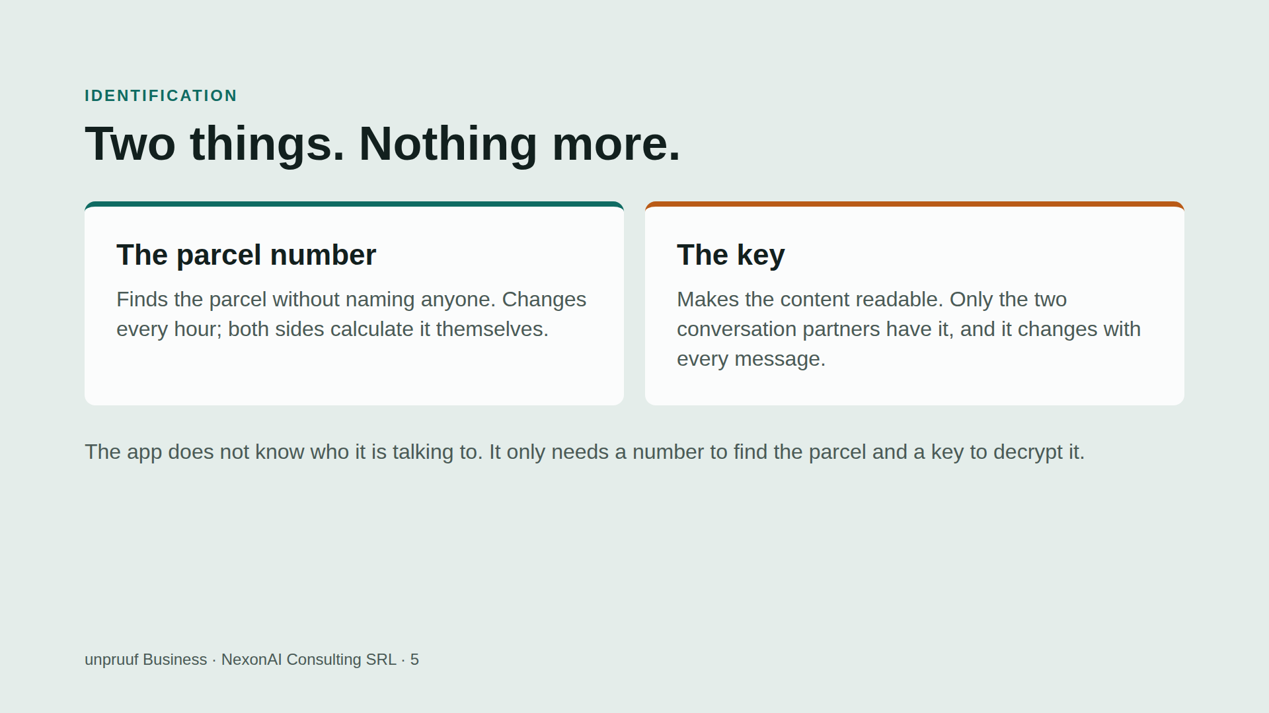

Slide 6
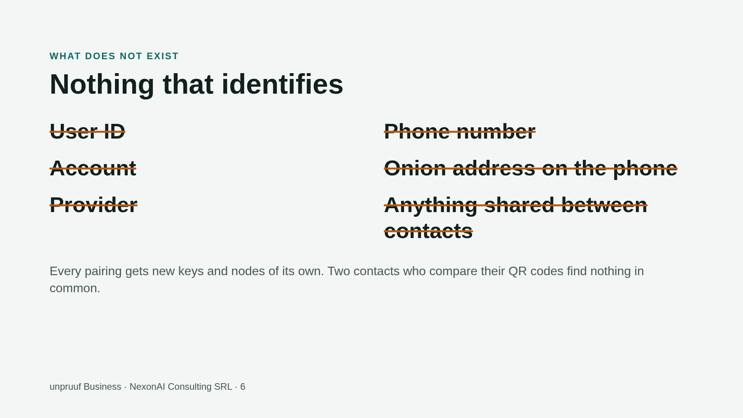

Slide 7
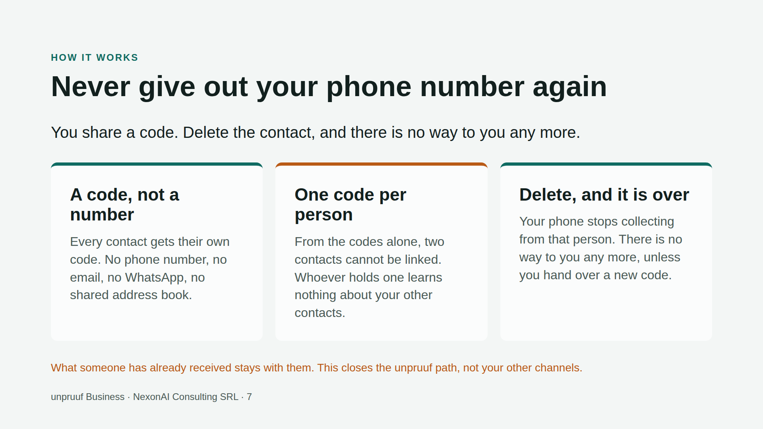
Notes:
In one breath: no phone number, no email. One code per person. Delete the contact and the line is gone. Then the honest limit: what has already been received stays, and other channels are untouched. Do not say it protects against everything.

Slide 8
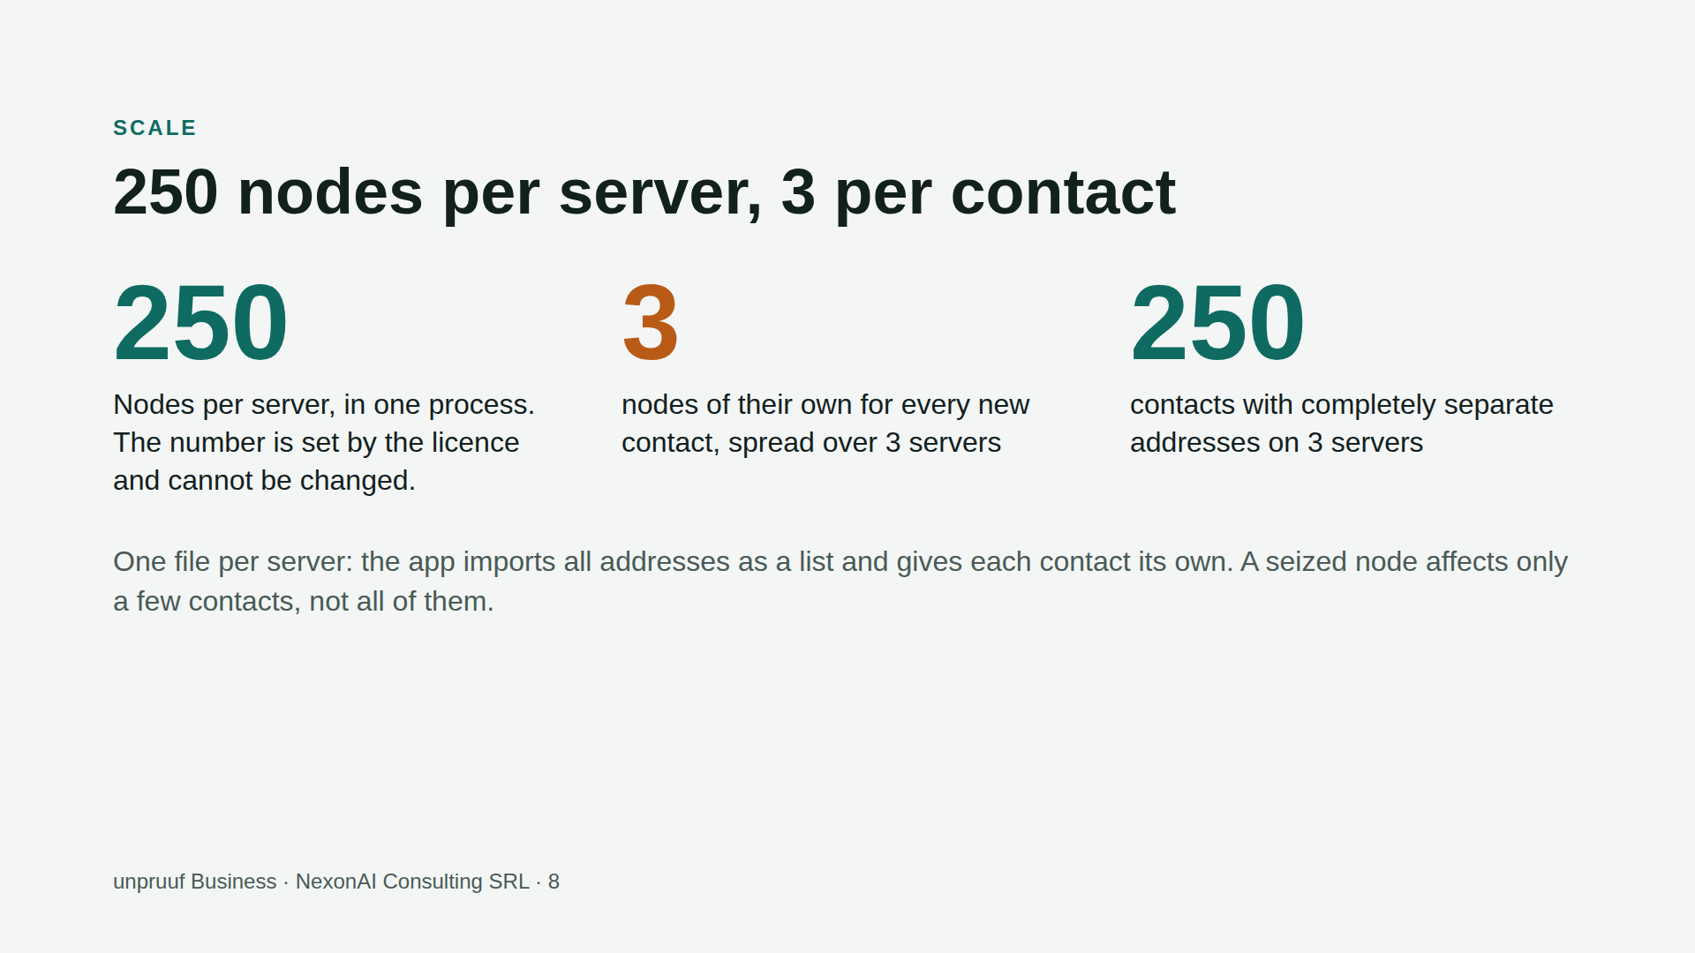
Notes:
Measured without the live Tor network: 500 nodes in one process, about 85 MB of RAM. The network load on a real VPS has not been measured yet. 250 contacts applies with three servers of 250 nodes each, because every contact gets one node per server.

Slide 9
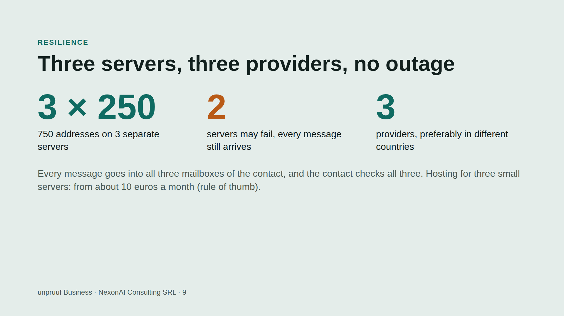
Notes:
The recommendation of three providers in two countries is up to the customer: the app cannot check whether three servers sit with the same host. After a restart every server is locked until the app releases it. While one is locked, the others carry on.

Slide 10
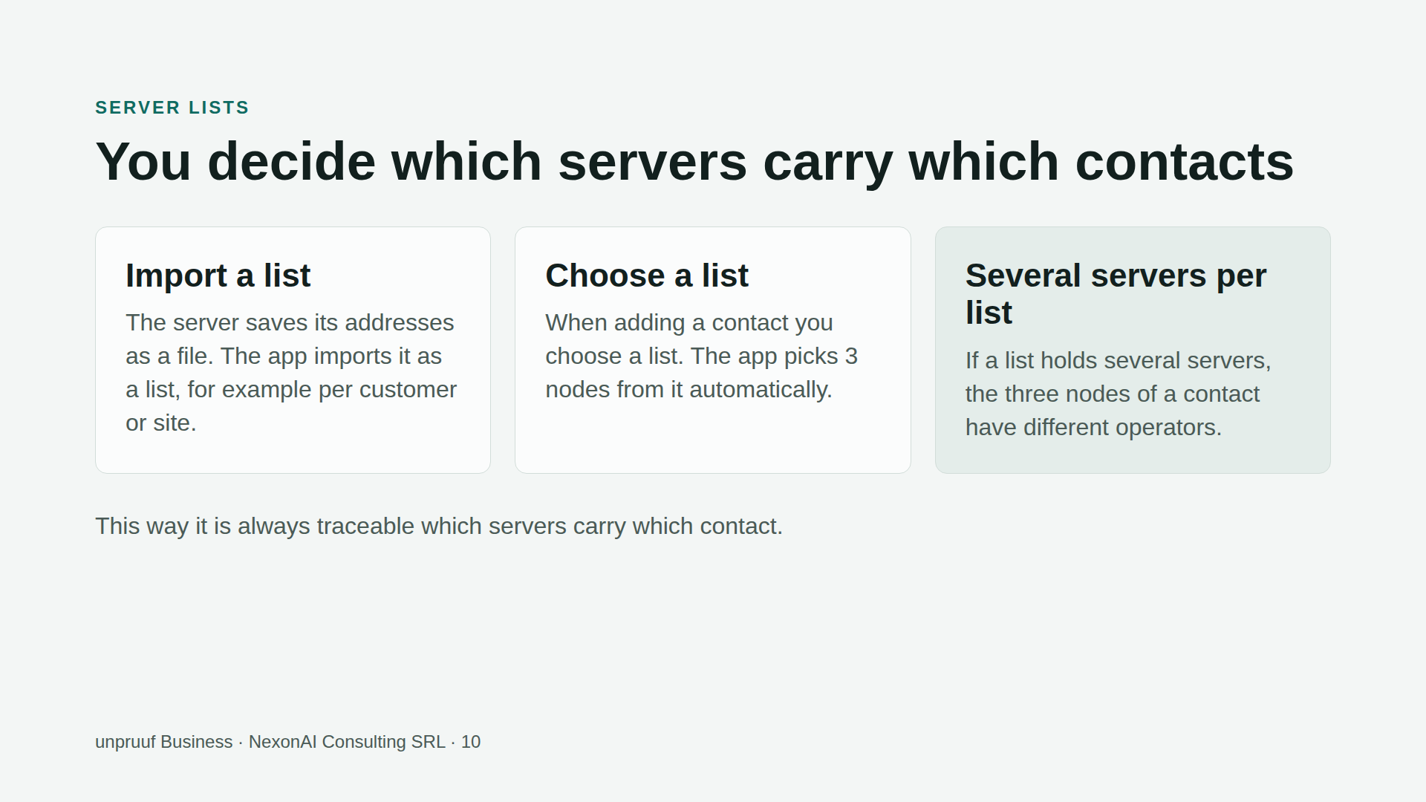
Notes:
A list with only one server puts all three nodes of a contact on the same machine. So put several servers into one list.

Slide 11
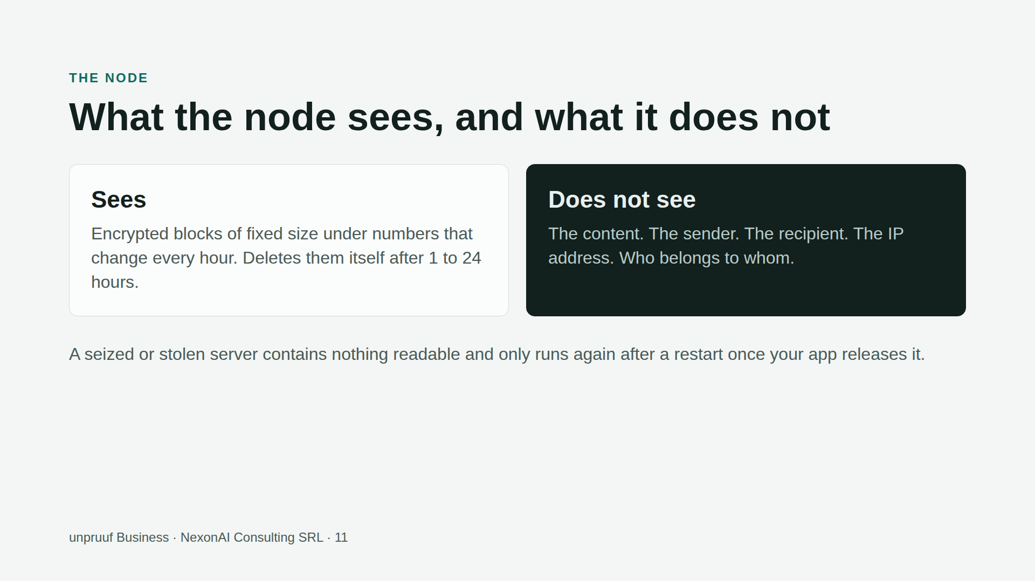

Slide 12
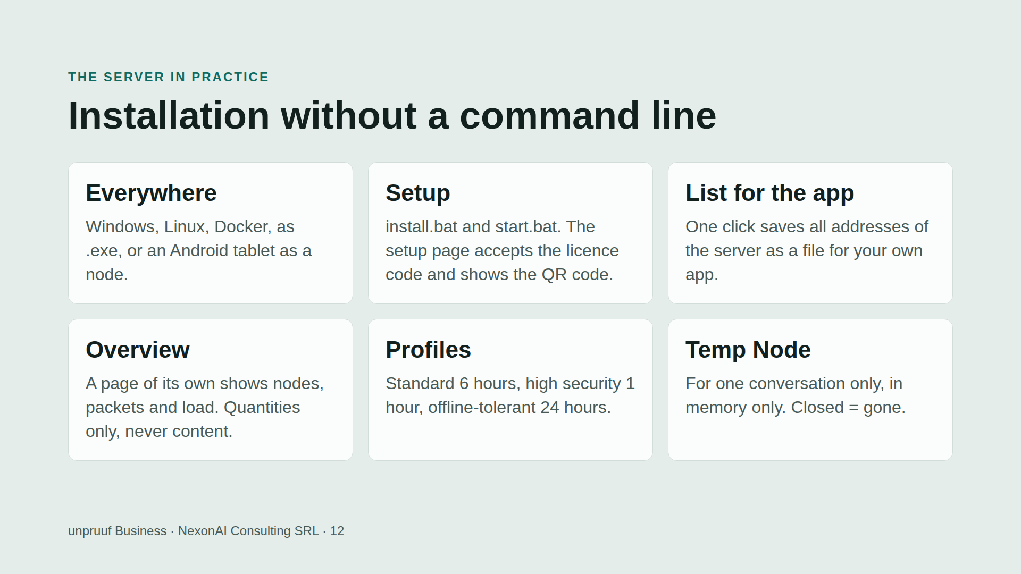

Slide 13
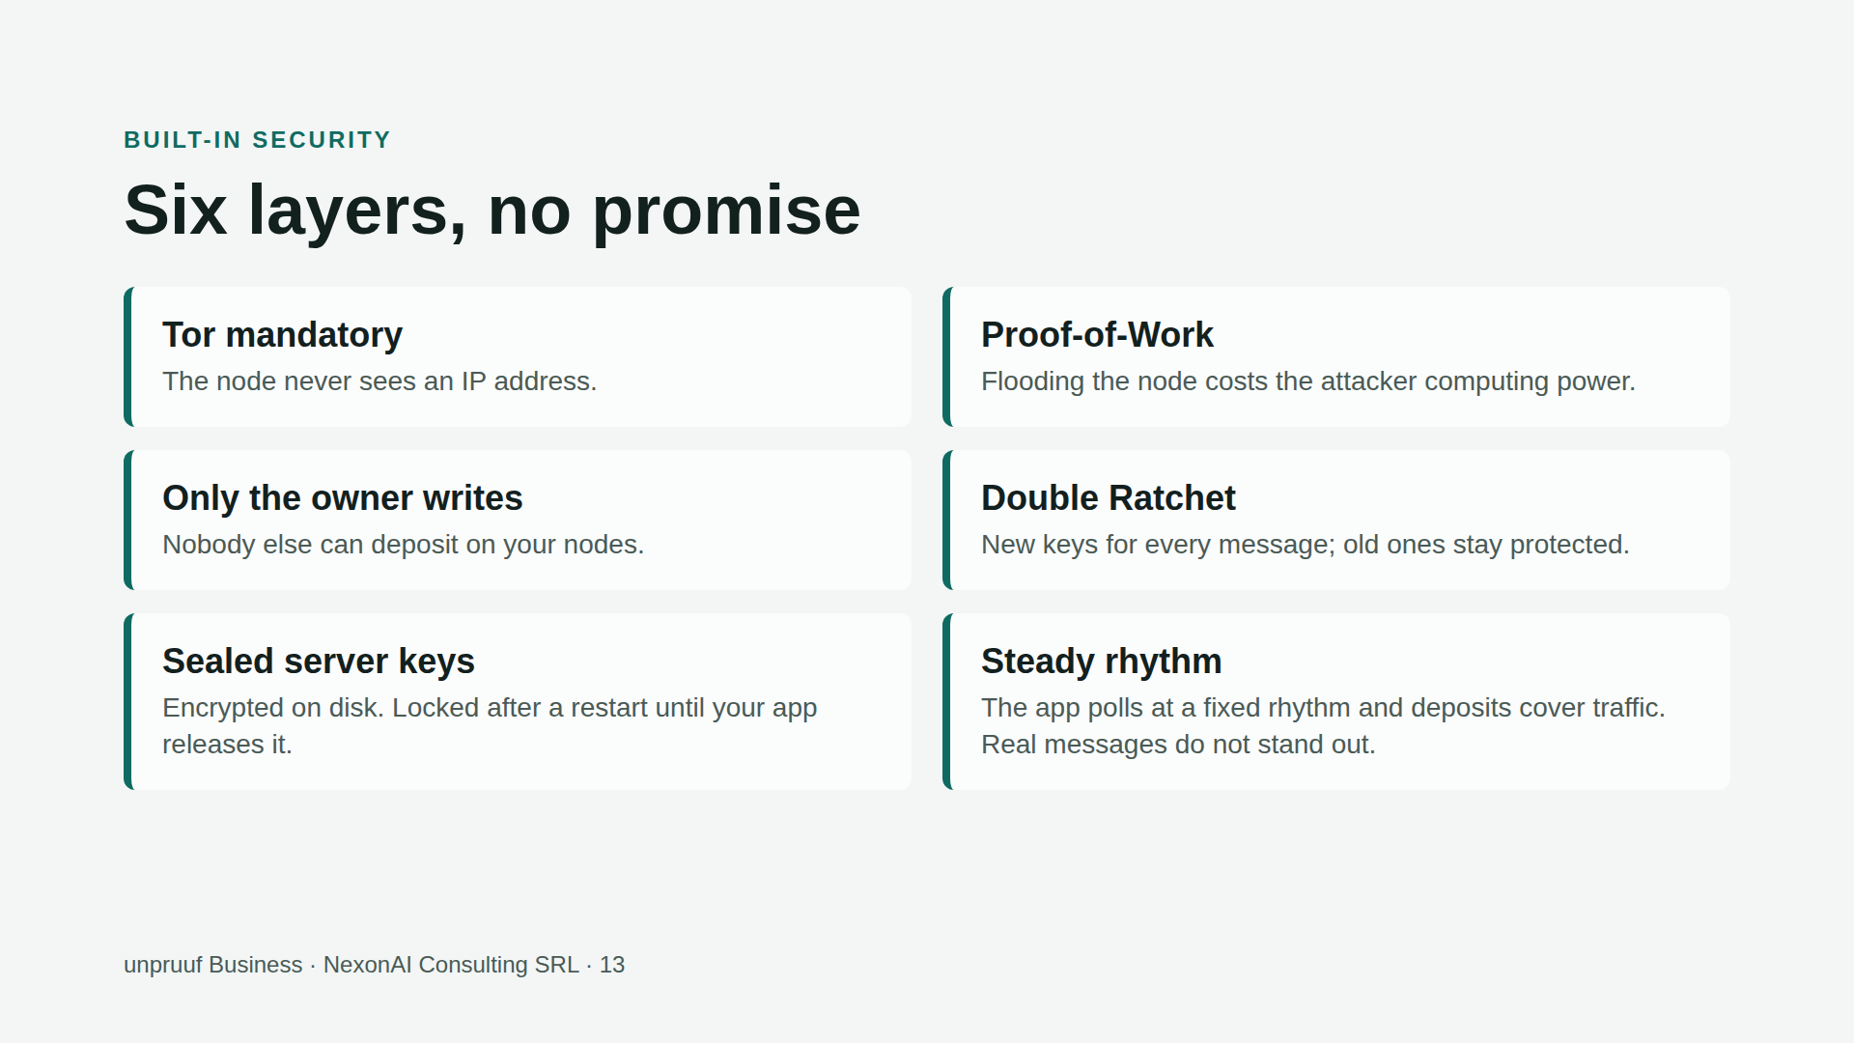

Slide 14
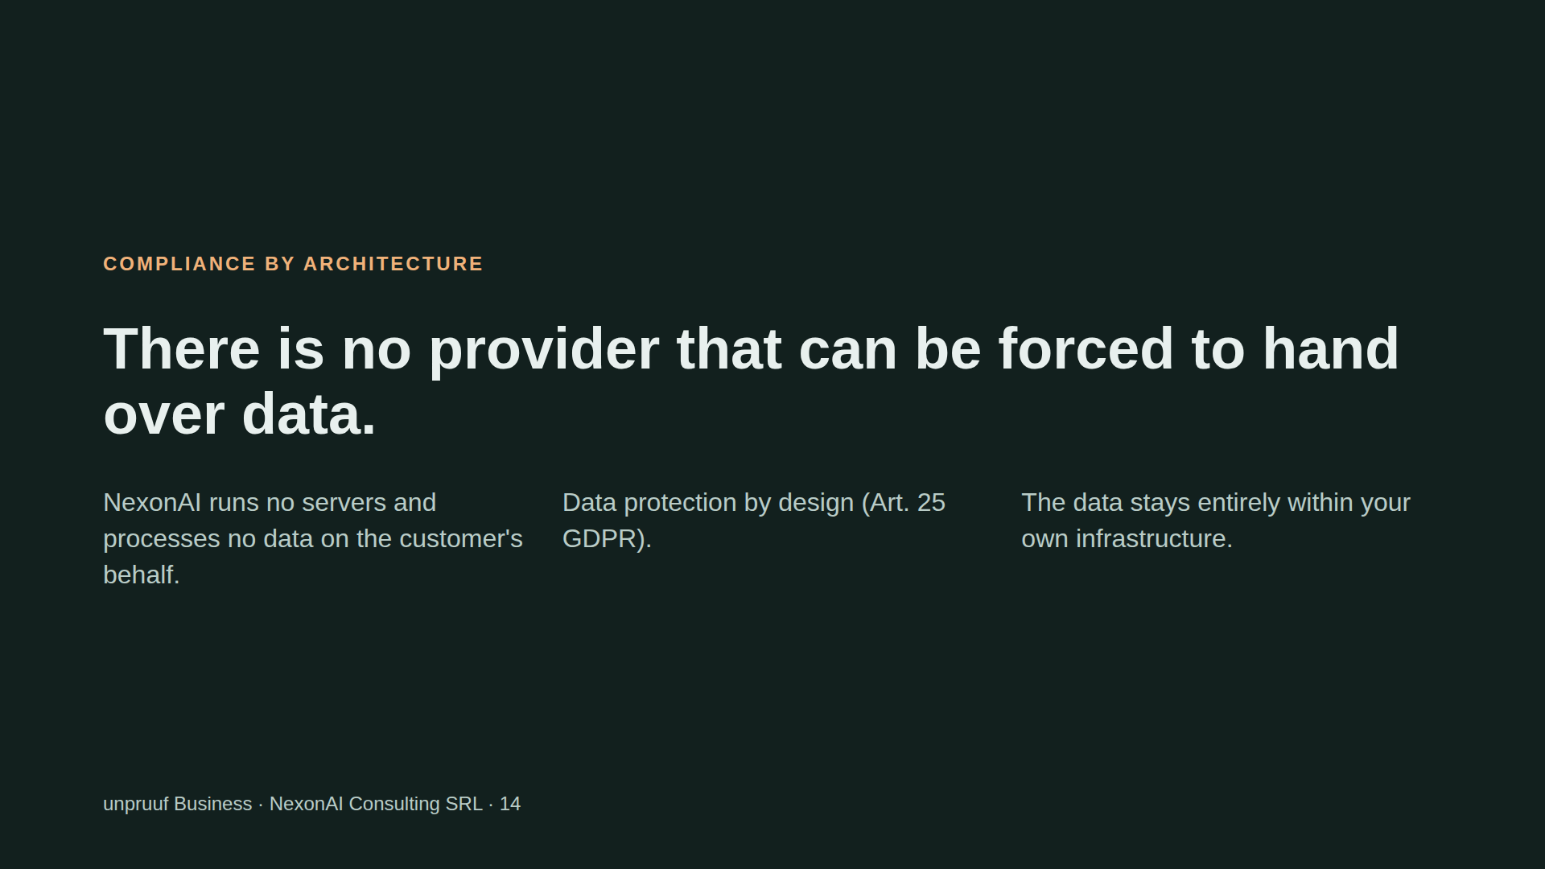
Notes:
Phrase it carefully: we do not say that searches or orders are pointless. We say there is no provider that could hand anything over, and that a seized node contains nothing readable. Have a lawyer confirm the legal assessment.

Slide 15
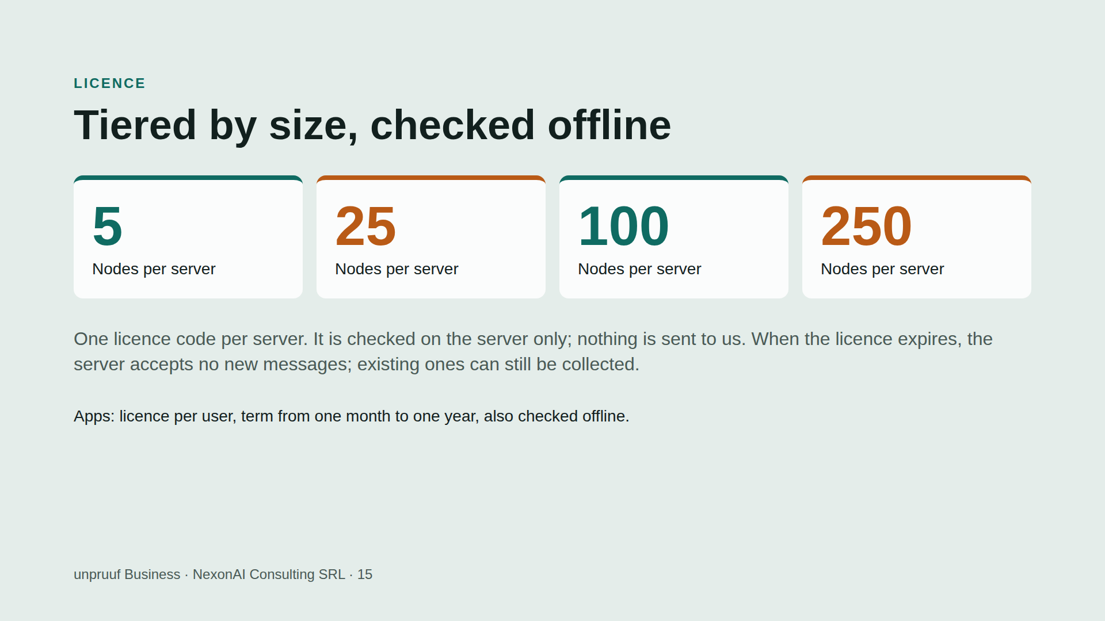
Notes:
The tiers 5, 25, 100, 250 are planned; prices are open. For the customer what counts is the number of contacts with addresses of their own, not the number of nodes. Technically a code can be started on several servers; the limit of one server is in the contract.

Slide 16
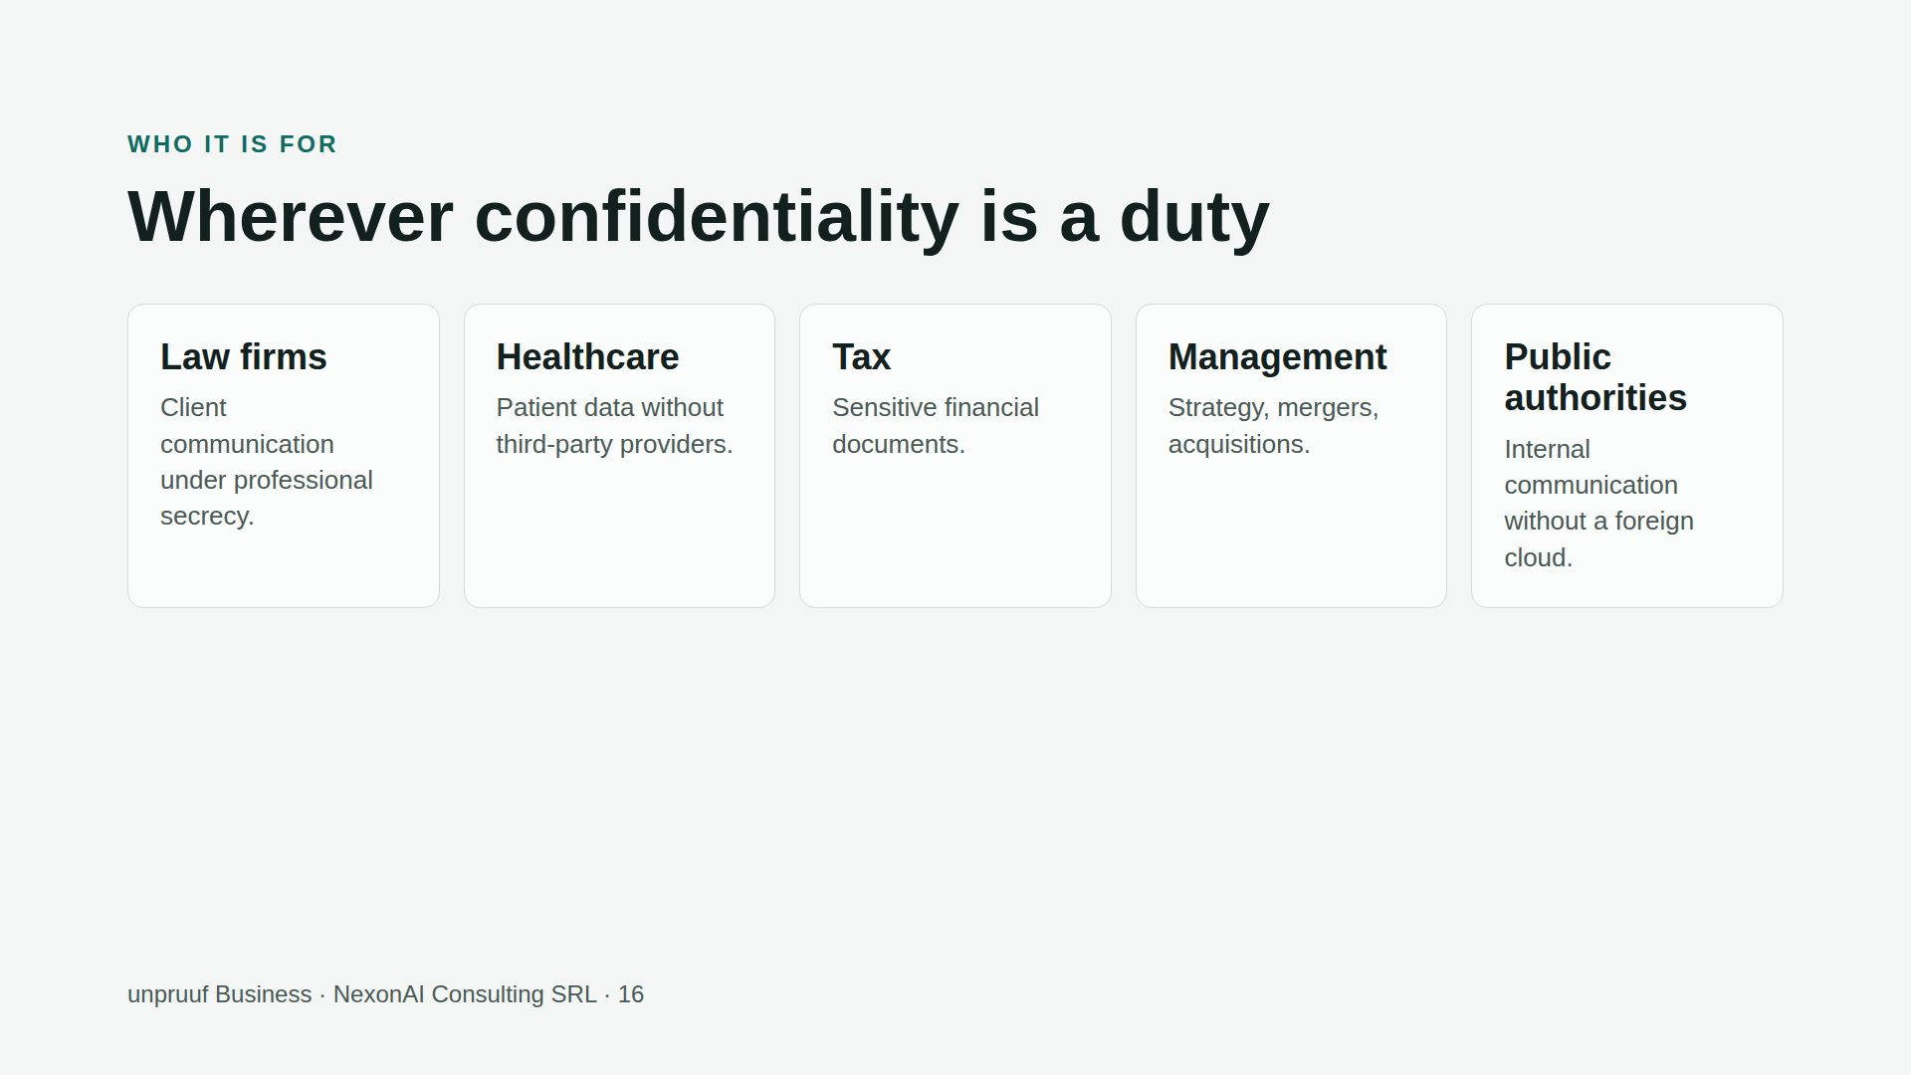

Slide 17
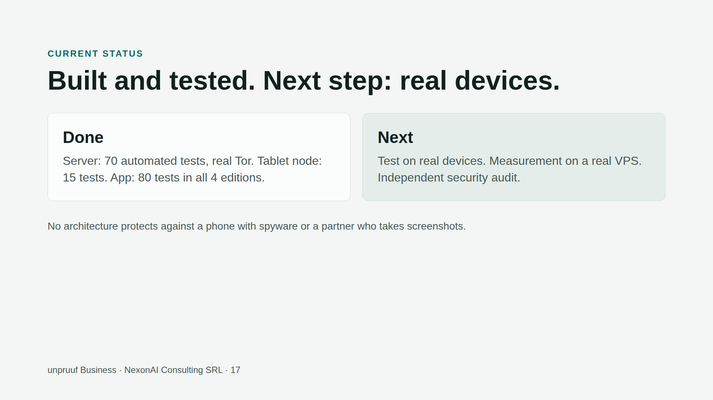

Slide 18


