Slide 1
Compliance through
Absolute Trust
unpruuf Compliance: The ultimate standard for secure, anonymous, identity-free reporting.
We protect employees’ identities. We secure company data.

Slide 2

The Human Barrier: Why do employees choose silence?
The Old Paradigm
The Digital Footprint
The Consequence
Emails, web forms and messaging apps are built for identities. They require accounts, phone numbers or IP addresses.
Every message carries metadata. Every server keeps logs. However secure the platform seems, the sender and the message stay linked.
Fear of retaliation and of data leaks on external servers (Cloud) is the main reason why irregularities are not reported in time.

Slide 3
The Legal Mandate: EU Directive (2019/1937)
Organizations with more than 50 employees and public institutions are required to implement secure internal reporting channels.
50+
7 Days
3 Months
3 Years
Employees
Confirmation
Feedback
Deletion
Obligation to establish an internal reporting channel.
Maximum deadline for confirming receipt of the report to the whistleblower.
Maximum deadline for giving feedback on the measures taken.
Standard period after which the documentation must be deleted (temporary retention, not permanent).

Slide 4
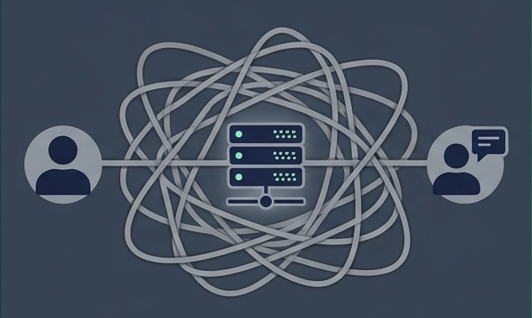
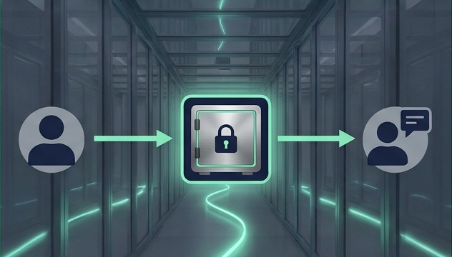
The Paradigm Shift: Decoupling
The Old Method – Failure
The unpruuf Method – Innovation
No direct connection. Complete absence of user identities: no profiles, no e-mail, no member lists. Sender and message are physically decoupled.
Direct connection. Information passes through a central server that sees “who” is talking to “whom”.

Slide 5




100% Anonymity through ‘Digital Safes’
No Traces (Tor Technology)
The system hides the origin. Traffic is camouflaged to look like ordinary web browsing (HTTP Camouflage).
Packet Uniformity
All data packets have exactly the same fixed size. Traffic analysis becomes mathematically ineffective.
No Public IP Addresses
The server operates “in the dark”, only inside the secured network, shielded from external attacks.
Instead of sending a direct message, the user places a “sealed envelope” in a digital safe located on your company’s server.
The real benefit: Zero metadata means zero fear of retaliation.

Slide 6


Bidirectional Anonymous Dialog
The law requires you to give feedback within 3 months. How do you answer someone you do not know?
The Whistleblower
The Compliance Officer
• Remains completely anonymous (“guest” status).
• Receives secure notifications directly in the app, without providing contact details.
• Can ask clarifying questions.
• Can send the 7-day confirmation and the 3-month decision.
Result: Full legal compliance while maintaining trust and source protection.

Slide 7


Data Sovereignty: Zero Custody
Traditional SaaS / Cloud
unpruuf Zero Custody
• Your data sits on someone else’s server.
• The external provider has potential access to logs and messages.
• Centralized target for hackers or data leaks.
• Own Infrastructure: Data arrives directly on hardware you control (or a VPS).
• NexonAI sees nothing: We do not operate central servers, we do not monitor traffic, we hold no copies of your data.
• Local Storage: The Compliance Officer’s app runs on the officer’s laptop, saving the case files locally and encrypted.

Slide 8
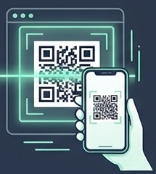
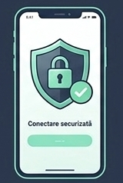
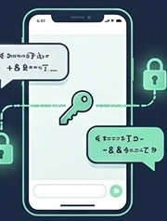
Full Accessibility for Employees
The entire system (App + Node + Endpoint) takes up only ~20 MB. No IT effort for the user.
1
2
3
Secure connection
Scan
Connect
Secure Dialog
The employee scans the QR code from a poster or from the intranet.
The free client app opens (no account creation, no phone number).
The employee starts reporting immediately, using the unique encrypted channel with the Compliance Officer.

Slide 9
Total Control: Custom Rules per Channel
The same secured architecture. Different rules depending on procedure and legal requirements (Privacy by Design).
Documented Profile
Ephemeral Profile
Immutable Profile
(Whistleblowing)
(Journalism / Quick tips)
(Official Complaints)
Rule: Encrypted retention for the duration of the legal periods.
Action: Mandatory deletion 3 years after the case is closed.
Rule: Data stays only in RAM.
Rule: Protocol that cannot be deleted covertly.
Action: Immediate automatic deletion (e.g. within 24 hours).
Action: Personal content can be deleted, but the trace of the action remains.
Function: Time limits set for the response.
Function: Absolute source protection; nothing can be extracted.

Slide 10
Comparative Analysis of Reporting Systems
E-mail & Forms
Messaging
(Signal/WhatsApp)
Web Platforms
(SaaS)
unpruuf Compliance
100% Anonymous (No Account/Phone)
No
No (needs phone/ID)
Yes
Yes
(Total decoupling)
✓
Data Control (Zero Custody)
No (stored at provider)
No
No (external Cloud)
Yes
(On your infrastructure)
✓
Two-Way Anonymous Dialog
No
Partial
Yes
Yes
✓
Deadline Compliance (7 days / 3 months)
Manual
Manual
Automated
Automated in
Dashboard
✓
Metadata and Log Risk
Critical
High
Medium
Eliminated
(Tor routing)
✓

Slide 11

It’s not just an app. It’s a structural guarantee.
When we remove identity from the technical architecture, we remove fear from the human equation.
For the Employee:
For the Compliance Officer:
For the Company:
The freedom to speak without the fear of leaving digital traces.
Precise tools to comply with the law (3-month deadline / deletion after 3 years).
Data never leaves the organization. Zero external custody. Absolute security.

