Slide 1
Compliance without
Identities
unpruuf Compliance: secure, anonymous reporting without identities, on your own servers.
No identities collected. Company data stays on company servers.
Status: not audited, not certified.

Slide 2

The Human Barrier: Why do employees choose silence?
The Old Paradigm
The Digital Footprint
The Consequence
Emails, web forms and messaging apps are built for identities. They require accounts, phone numbers or IP addresses.
Every message carries metadata. Every server keeps logs. However secure the platform seems, the sender and the message stay linked.
Fear of retaliation and of data leaks on external servers (Cloud) is the main reason why irregularities are not reported in time.

Slide 3
The Legal Mandate: EU Directive (2019/1937)
Organizations with more than 50 employees and public institutions are required to implement secure internal reporting channels.
50+
7 Days
3 Months
Limited
Employees
Confirmation
Feedback
Retention
Obligation to establish an internal reporting channel.
Maximum deadline for confirming receipt of the report to the whistleblower.
Maximum deadline for giving feedback on the measures taken.
Records are kept no longer than necessary and proportionate. The exact period follows national law.

Slide 4
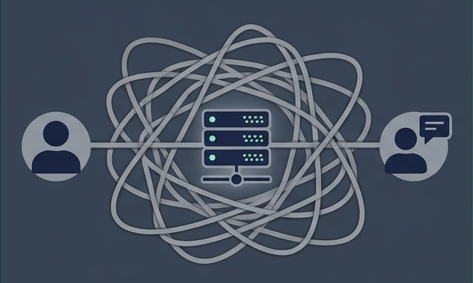
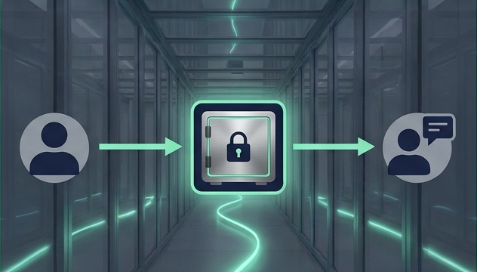
The Design Shift: Decoupling
The Typical Approach
The unpruuf Approach
No direct connection. No user identities by design: no profiles, no e-mail, no member lists. Sender and message are decoupled.
Direct connection. Information passes through a central server that can see who is talking to whom.

Slide 5




No Identities through ‘Digital Safes’
Tor Routing
Traffic runs through Tor, which hides the origin of a message from the server.
Packet Uniformity
All data packets have exactly the same fixed size, so the length of a message is not visible on the wire.
No Public IP Addresses
The server is reachable only as a Tor hidden service, with no public IP address exposed.
Instead of sending a direct message, the user places a “sealed envelope” in a digital safe located on your company’s server.
The goal: minimal metadata, so there is little to hand over.

Slide 6


Two-Way Anonymous Dialog
The law requires you to give feedback within 3 months. How do you answer someone you do not know?
The Whistleblower
The Compliance Officer
• Stays anonymous (“guest” status, no account).
• Receives replies inside the app, without providing contact details.
• Can ask clarifying questions.
• Can send the 7-day confirmation and the 3-month decision.
Result: Deadlines can be met while the reporter stays anonymous.

Slide 7


Data Sovereignty: Zero Custody
Traditional SaaS / Cloud
unpruuf Zero Custody
• Your data sits on someone else’s server.
• The external provider may have access to logs and messages.
• A central point that can be attacked or ordered to hand over data.
• Own Infrastructure: Data arrives directly on hardware you control (or a VPS).
• No access for NexonAI: NexonAI runs no servers, monitors no traffic and holds no copies of your data.
• Local Storage: The Compliance Officer’s app runs on the officer’s laptop, saving the case files locally and encrypted.

Slide 8

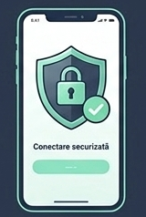

Easy for Employees
App plus server node. No IT effort for the employee.
1
2
3
Secure connection
Scan
Connect
Secure Dialog
The employee scans the QR code from a poster or from the intranet.
The free client app opens (no account creation, no phone number).
The employee starts reporting immediately, using the unique encrypted channel with the Compliance Officer.

Slide 9
Custom Rules per Channel
The same secured architecture. Different rules depending on procedure and legal requirements (Privacy by Design).
Documented Profile
Ephemeral Profile
Immutable Profile
(Whistleblowing)
(Journalism – pilot)
(Official Complaints)
Rule: Encrypted retention for the duration of the legal periods.
Action: Deletion after the retention period set by law and policy.
Rule: Data stays only in RAM.
Rule: Protocol that cannot be deleted covertly.
Action: Immediate automatic deletion (e.g. within 24 hours).
Action: Personal content can be deleted, but the trace of the action remains.
Function: Time limits set for the response.
Function: Designed so that little remains to be extracted.

Slide 10
Reporting Channels by Design Property
E-mail & Forms
General Messengers
Hosted Web
Platforms (SaaS)
unpruuf Compliance
Identity needed to report
Yes
Often (phone/ID)
Varies
No
(no identities)
✓
Where the data lives
At the provider
At the provider
Provider cloud
Your own servers
✓
Anonymous two-way dialog
No
Limited
Varies
Yes
✓
Deadline tracking (7 days / 3 months)
Manual
Manual
Often built in
In the
dashboard
✓
Metadata and logs
Kept by mail server
Depends on provider
Kept by provider
Minimal by design
(Tor routing)
✓
General categories, not named products. unpruuf is not audited and not certified.

Slide 11

Not just an app. A design principle.
When we remove identity from the technical architecture, we reduce fear in the human equation.
For the Employee:
For the Compliance Officer:
For the Company:
Room to speak up without leaving a trail of identities.
Tools to keep the legal deadlines (7 days / 3 months).
Data stays on your own servers. No external custody.
Status: not audited, not certified.

