Slide 1
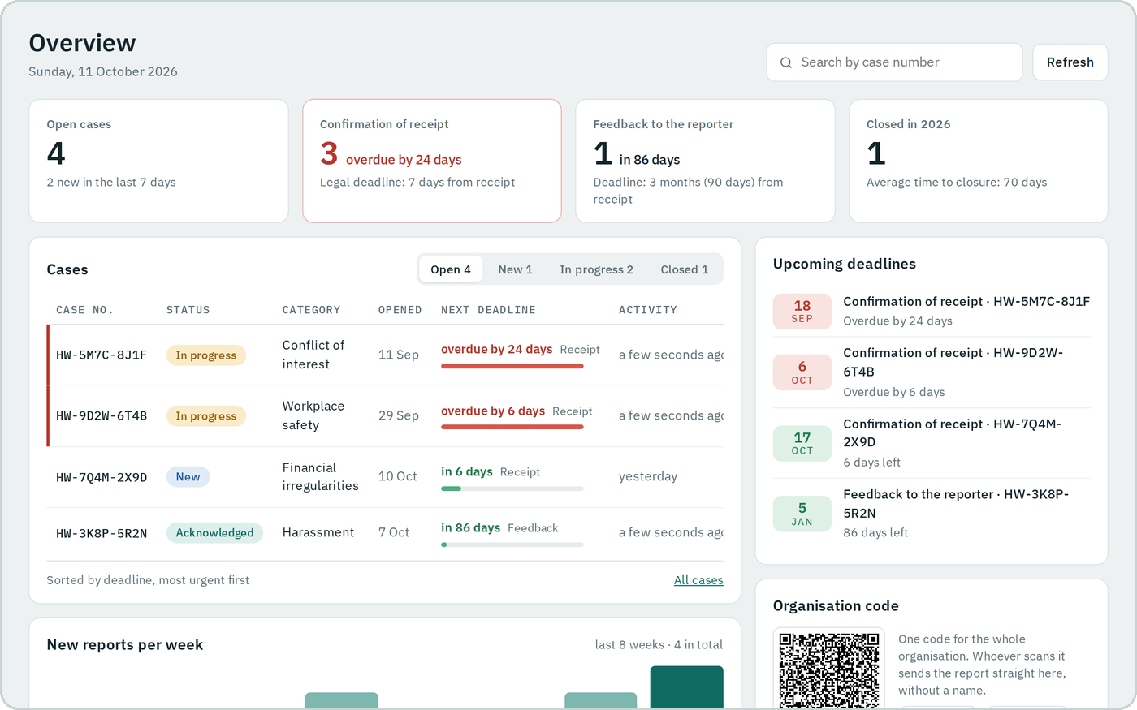
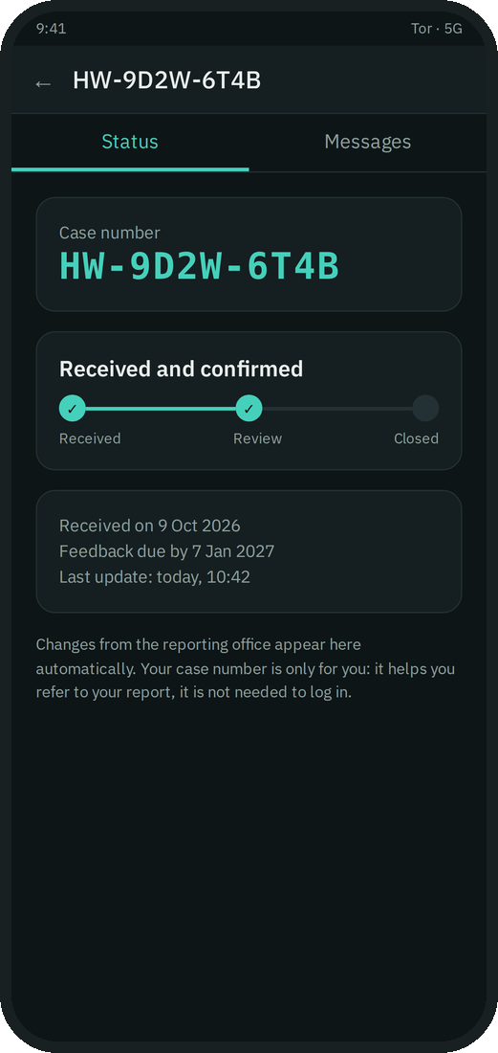

UPDATES AND PERSPECTIVES · 14 OCTOBER 2026
Communication without identities
unpruuf and safeline: the whistleblower channel for your organisation
Screens: real dashboard, demo data · Phone: illustration
Gabriel Hategan · NexonAI Consulting SRL
Notes:
Start page · 0:00–0:20
Good day, and thank you for the invitation.
I will show you briefly what we are building: a communication solution without identities and, on top of it, a whistleblower channel.

Slide 2

THE SERVER
The server belongs to the customer
The customer gets the server solution from us, ready to start. It is their server.
1
Completely anonymous addresses that only they know.
2
The customer's server
Nothing stays on the server: after 24 hours at most, everything is gone.
3
NexonAI: no access
The precondition for everything: every customer runs their own servers. Otherwise third parties are involved. NexonAI runs nothing.
1 / 7
Notes:
1 · 0:20–1:20
Our customer gets the server solution from us, ready to start. It is their server: they run it themselves.
The precondition for everything: every customer runs their own servers. Otherwise third parties are involved. NexonAI runs nothing and has no access.
The server works with completely anonymous addresses that only the customer knows and decides who gets them.
And nothing stays there: whatever arrives on the server is gone after 24 hours at most.

Slide 3
THE PRINCIPLE
The principle: a mailbox system
1
No identities
No accounts, no names, no phone numbers.
THE SERVER
Anna
puts in
picks up
Ben
2
No direct connections
Nobody writes directly to anyone. There is no line between two people.
Anna's mailbox
Ben
puts in
picks up
Anna
3
The mailbox
I put the message into my mailbox, on my server, and give my contact the details to pick it up. The same the other way round.
Ben's mailbox
What stays in the mailbox is gone after 24 hours at most.
2 / 7
Notes:
2 · 1:20–2:50
The principle is simple and has three parts.
First: no identities. No accounts, no names, no phone numbers.
Second: no direct connections. Nobody writes directly to anyone, so there is no line between two people.
Third: the mailbox principle. I never write directly. I put the message into my mailbox, on my server, and give my contact the details to find the server, pick up the message and read it. The same happens the other way round: Anna puts into her mailbox, Ben picks up from there. Ben puts into his, Anna picks up.
What stays in the mailbox is gone after 24 hours at most.

Slide 4
WHAT THE SERVER KNOWS
What the server knows: almost nothing
If someone breaks into the server
They find encrypted packets, all the same size, at most 24 hours old. That is all.
packet 9f2c71ab04e86d3c5b1a…
size 4096 B
expires in 5 h 12 min
content ▒▒▒▒▒▒▒▒▒▒▒▒ encrypted
from does not exist
to does not exist
name does not exist
1
If a court orders the server seized
The seized server gives the same: nothing readable, no names, no history. The case files are not on it.
2
If someone asks NexonAI
We have nothing to hand over: we do not run the server, we have no access and we have no copy.
3
Illustration, random values
Whoever breaks in finds data junk. With us there is no vault worth cracking.
3 / 7
Notes:
3 · 2:50–4:00
What does the server know? Almost nothing.
On it sit encrypted packets, all the same size, each with an expiry time. From whom, to whom, with what content, what names: that is not there.
If someone breaks into the server, they find encrypted packets at most 24 hours old. Data junk. With us there is no vault worth cracking.
If a court orders the server seized, it gets the same: nothing readable, no names, no history. The case files are not on the server.
If someone asks NexonAI: we have nothing to hand over. We do not run the server, we have no access and we have no copy.
[If someone asks: a server sees that and when a packet arrives and how big it is, not the content. If a request is about content, it goes to the organisation, which has the data.]

Slide 5
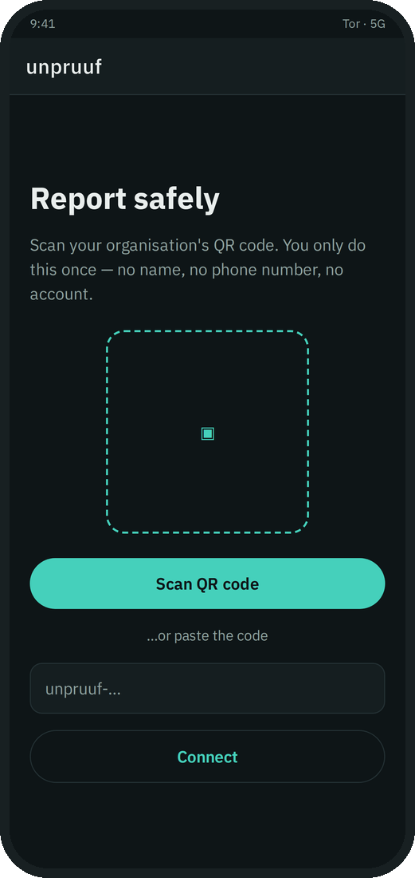
SAFELINE
Screens: real dashboard, demo data · Phone: illustration
safeline: three products
The mobile app
The server
The dashboard
for employees
the organisation's own
for the compliance officer
READY FROM US
The legal deadlines, already in the dashboard: 7 days and 3 months
A case number for every report
The confirmation of receipt goes out by itself
The organisation's QR code, ready to hand out
✓
✓
✓
✓
4 / 7
Notes:
4 · 4:00–4:50
Our compliance solution is called safeline. It has three products: the mobile app for employees, the organisation's server and the dashboard for the compliance officer.
No accounts, no names, no phone numbers.
And it comes ready from us: the legal deadlines are already in the dashboard, receipt within 7 days and an answer within 3 months. Every report gets a case number by itself, the confirmation of receipt goes out automatically, and the organisation's QR code is ready to hand out. The customer does not have to set up any of this.

Slide 6
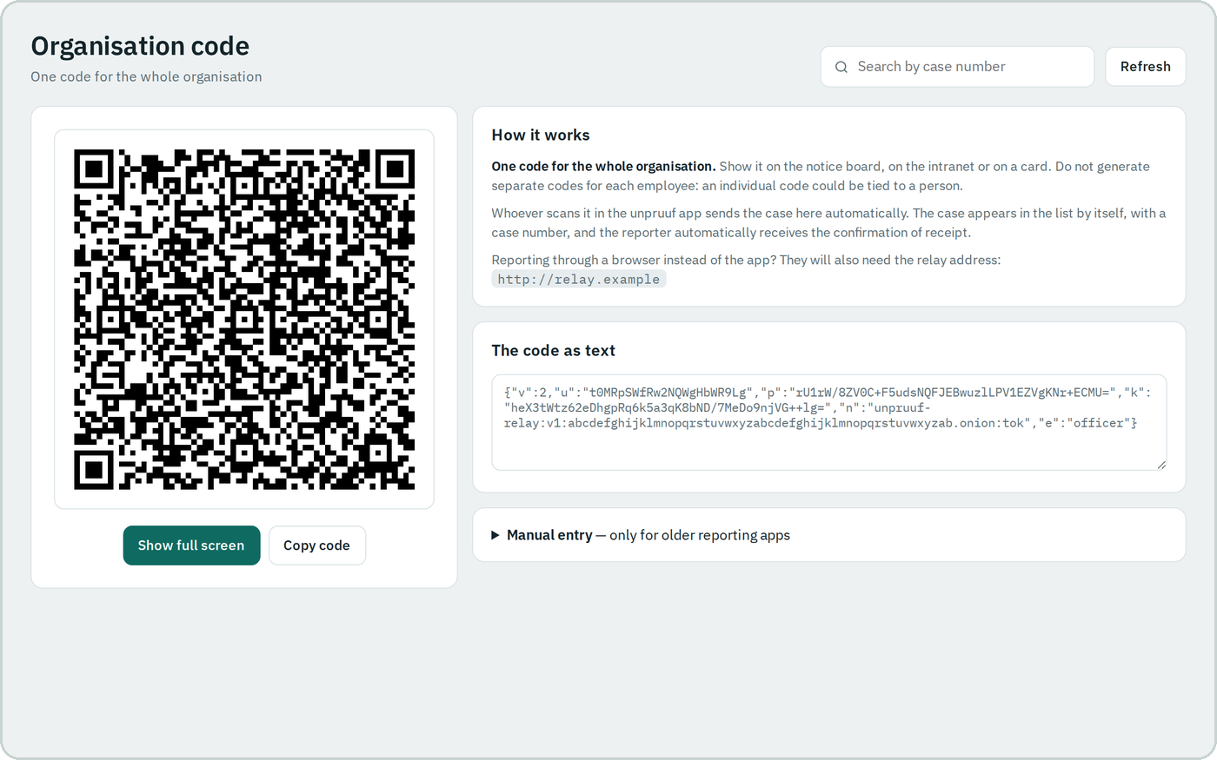
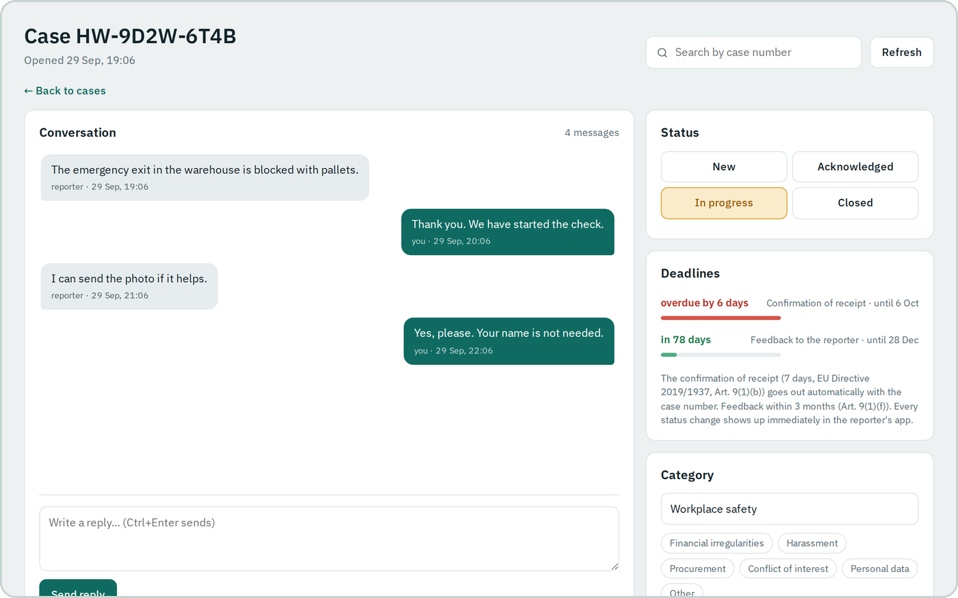
HOW IT WORKS
Screens: real dashboard, demo data · Phone: illustration
One QR code. One case in the dashboard.
›
›
1 · The QR code
2 · Scan and send
3 · In the dashboard
the officer generates it, employees receive it
a new case, without a name and without an account
with a case number, stored on receipt
The confirmation of receipt goes out by itself, with the case number. The dashboard has no delete function.
5 / 7
Notes:
5 · 4:50–6:00
The compliance officer generates a QR code, which is handed out to the employees. They scan it with the app, create a new case right away and send it, without a name and without an account.
The case appears in the dashboard with a case number. Received cases are stored on receipt. The dashboard has no delete function.
The legal deadlines are already loaded, nobody sets them: receipt within 7 days, an answer within 3 months, under Law 361/2022, for organisations with at least 50 employees.
[If someone asks about deletion: today a case stays as it was received. A delete function with a retention period is next.]

Slide 7
THE DATA
Only the customer has their data
GDPR
INTERNAL AUDITS
IN GENERAL
• The organisation is the data controller. The data is in one place, with it.
• NexonAI has no access and is normally not a processor.
• The duties stay with the organisation: legal basis, informing people, the record, retention, breach reporting within 72 hours.
• One place to check: the server, the dashboard and the officer's laptop, all with the customer.
• Cases are stored on receipt. The dashboard has no delete function.
• Nothing to request from a third party.
• No third party sits between the reporter and the officer.
• A request from the authorities goes to the organisation, the only one that has the data.
• There is no central account that could be broken into.
We do not claim GDPR compliance. Your data protection officer or a lawyer confirms it.
6 / 7
Notes:
6 · 6:00–7:00
What does this mean for GDPR, for internal audits and in general? That this time only the customer has their data.
GDPR: the organisation is the data controller, and the data is in one place, with it. NexonAI has no access and is normally not a processor. If the server runs at a hosting provider, that provider is the customer's processor. The duties stay with the organisation: the legal basis, informing people, the record of processing, a possible impact assessment, how long a case is kept, and reporting a breach within 72 hours.
Internal audits: one place to check, the server, the dashboard and the officer's laptop, all with the customer. Cases are stored on receipt and the dashboard has no delete function. Nothing needs to be requested from a third party.
In general: no third party sits between the reporter and the officer. A request from the authorities goes to the organisation, the only one that has the data. And there is no central account that could be broken into.
I do not claim GDPR compliance. Your data protection officer or a lawyer confirms it.

Slide 8
HONEST
What I cannot promise you
This is a pilot, not a finished, certified product.
It has not yet been audited by an independent party.
!
!
It does not replace legal advice.
Some parts I have tested in the lab.
!
!
I tell you this openly. Trust starts with what I cannot do.
7 / 7
Notes:
7 · 7:00–7:40
We close with what I cannot promise you, because that is how trust starts.
This is a pilot, not a finished, certified product. It has not yet been audited by an independent party. It does not replace legal advice. And some parts I have tested in the lab.
[Update the last sentence after the real test this week.]

Slide 9
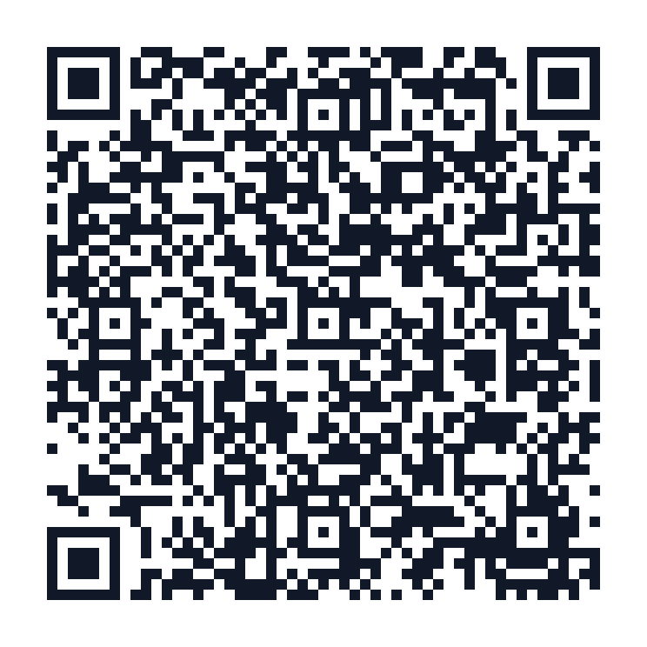
THE PILOT AND THE INVITATION
We start at the University “1 Decembrie 1918” of Alba Iulia
We are looking for 2–3 pilot partners from professions with a duty of confidentiality. We start small, measure, adjust together.
Scan to save the contact
Gabriel Hategan · NexonAI Consulting SRL
gabriel@nexonai.ro
+40 773 829646
Notes:
Last page · 7:40–8:10
We start the pilot at the University “1 Decembrie 1918” of Alba Iulia.
[Before naming it: the university's written yes.]
We are looking for two or three pilot partners from professions with a duty of confidentiality. We start small, measure, adjust together.
Scan the code to save my contact. Thank you.

