Slide 1
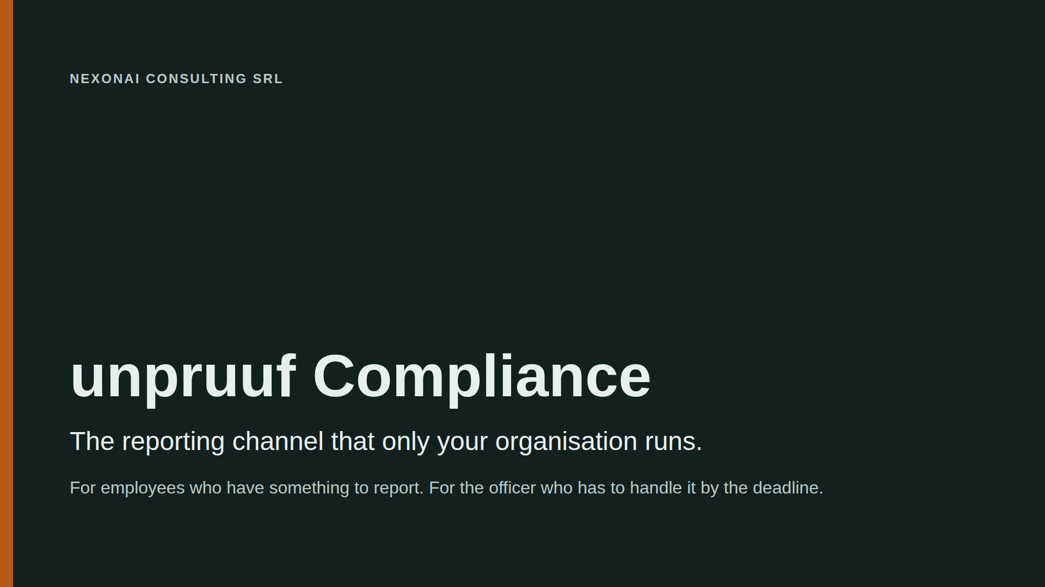
Notes:
Open with the one sentence. Then explain how the system works in three slides, and only then talk about what unpruuf Compliance does for the organisation. Say up front: this is a pilot, not audited, not certified.

Slide 2
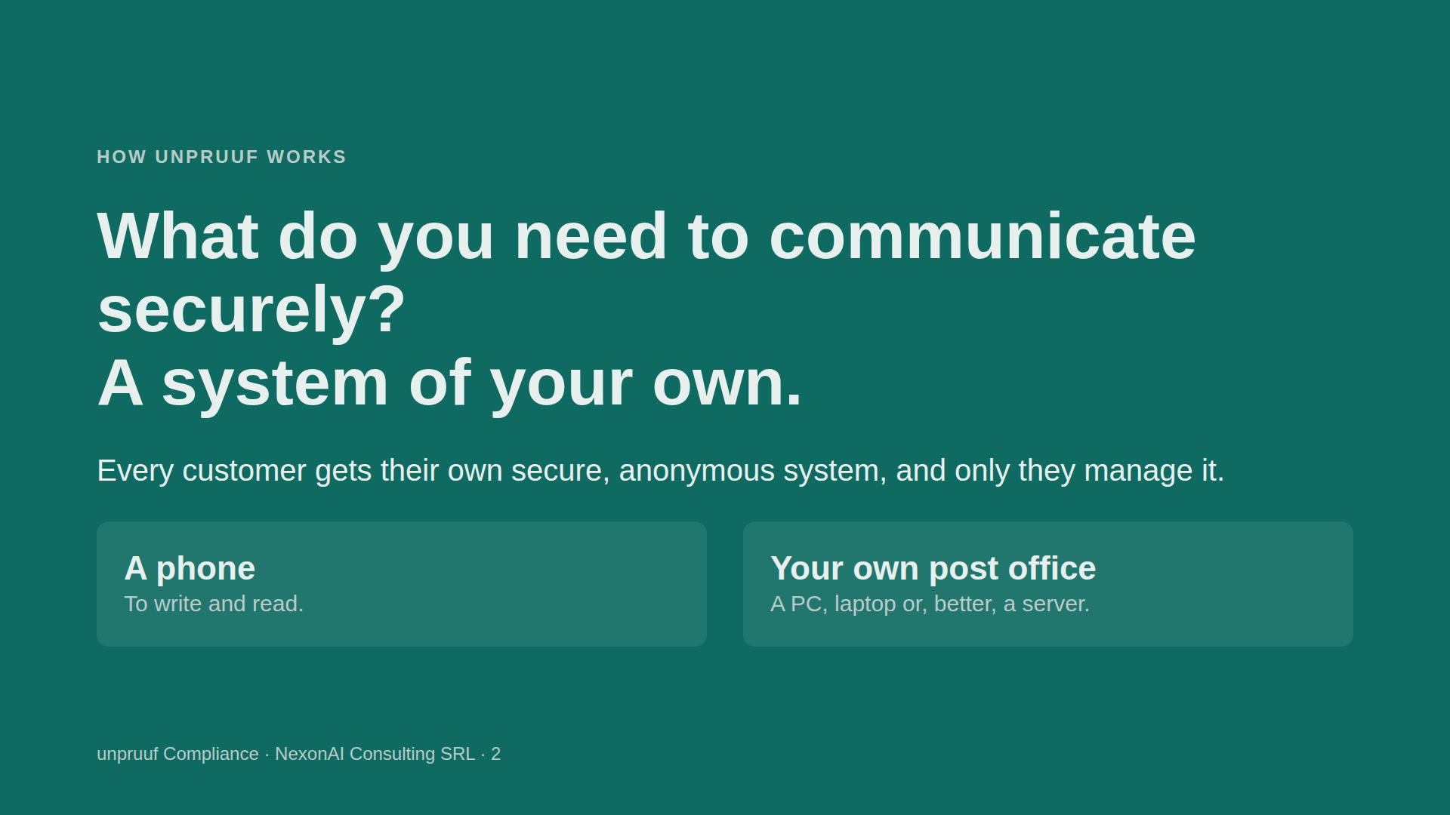

Slide 3
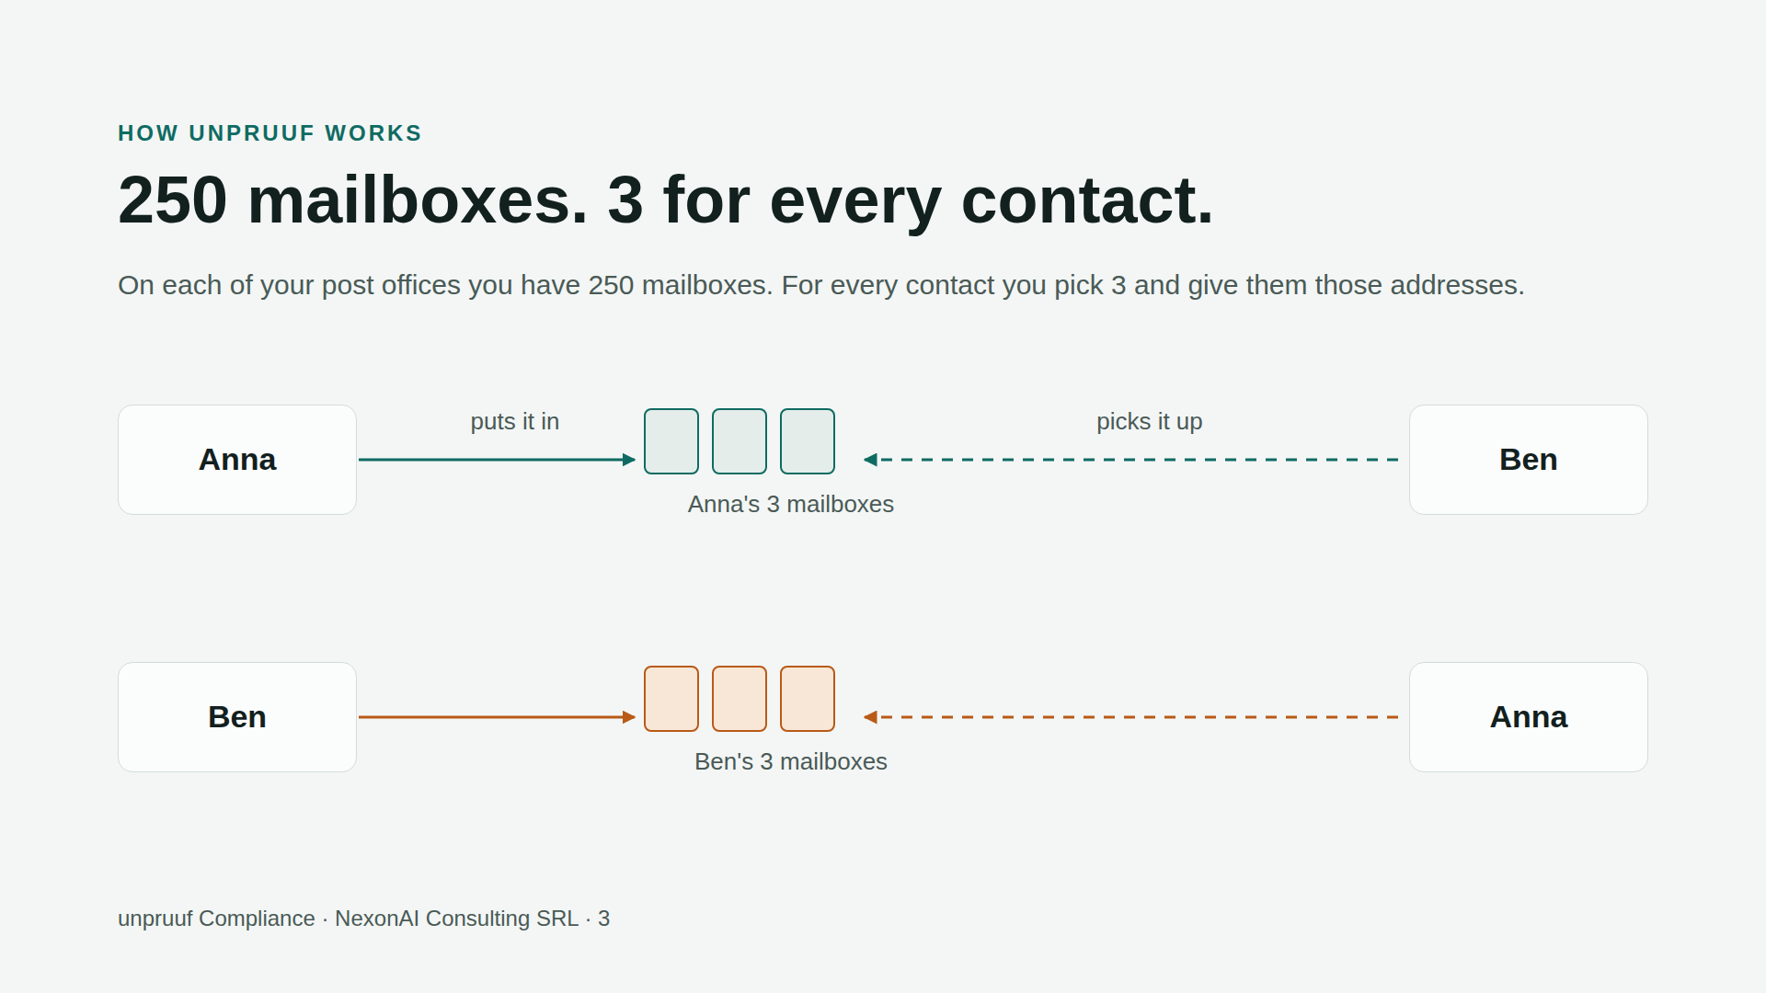
Notes:
Everyone writes only into their own mailboxes. The other person only picks up. The mailboxes do not know who owns them or who picks up. Do not go into keys or protocol details (patent pending).

Slide 4
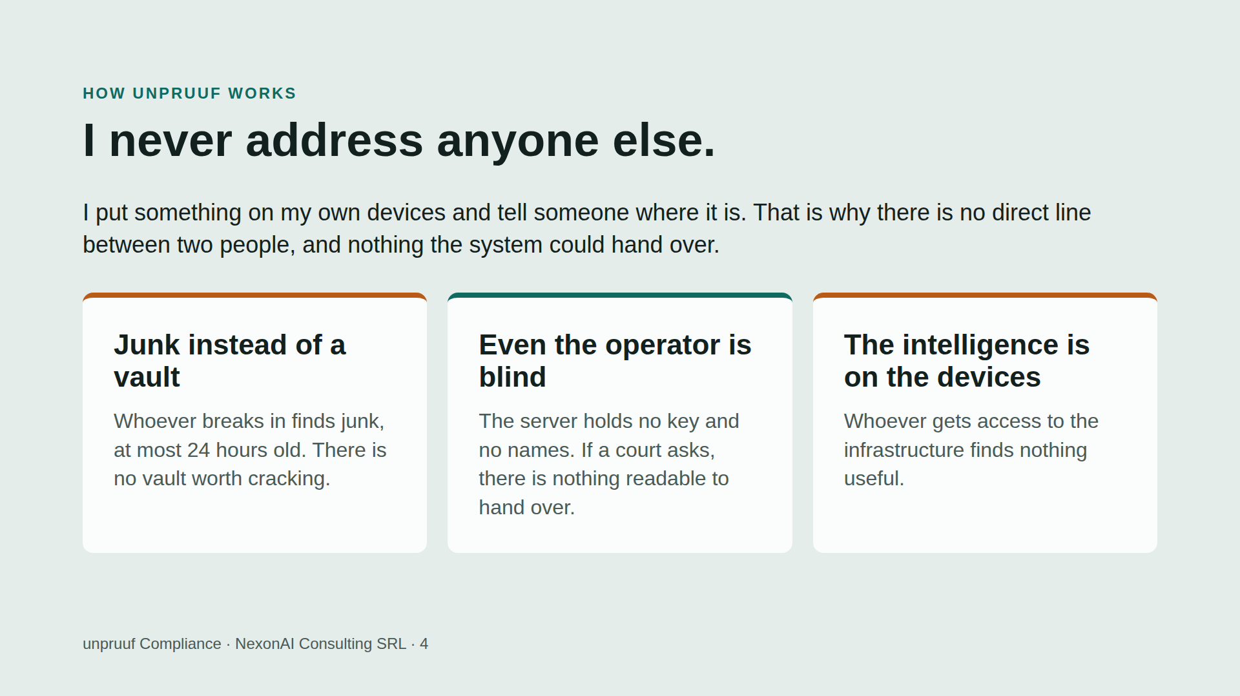
Notes:
Careful wording: we do not say a search or a court order is pointless. We say there is nothing readable to hand over.

Slide 5
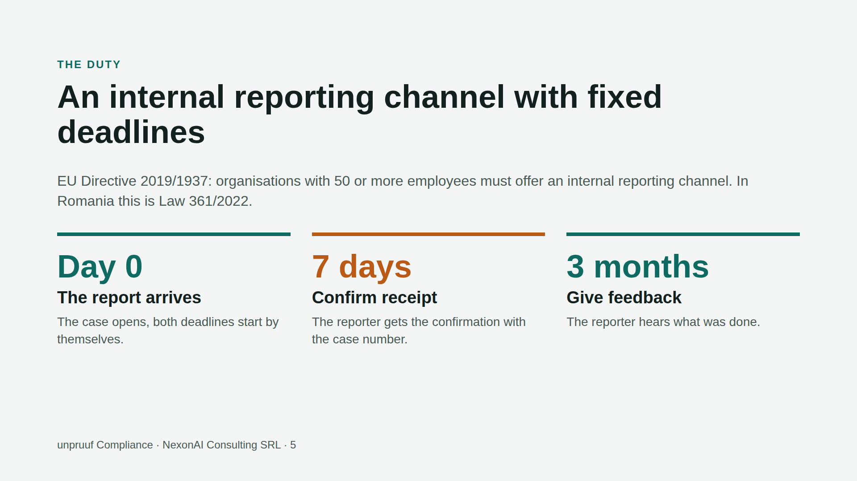
Notes:
Checked 2026-10-08: the directive already applies to organisations with 50 or more employees. In Romania Law 361/2022 has applied since December 2022; for 50 to 249 employees since 17 December 2023. There is no new deadline at year end. Not legal advice.

Slide 6
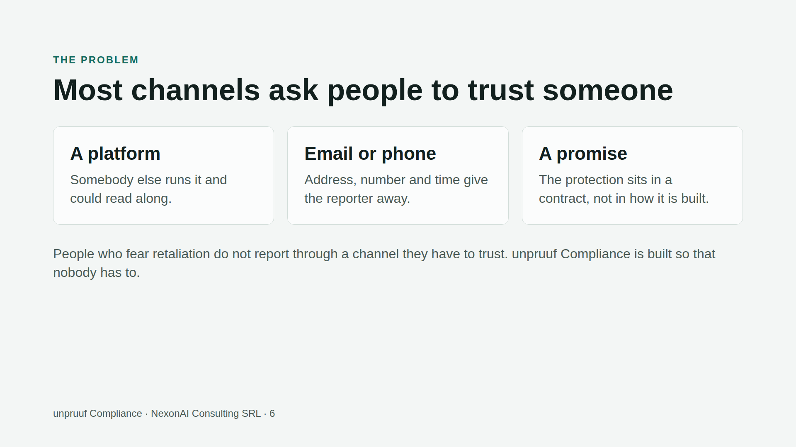

Slide 7
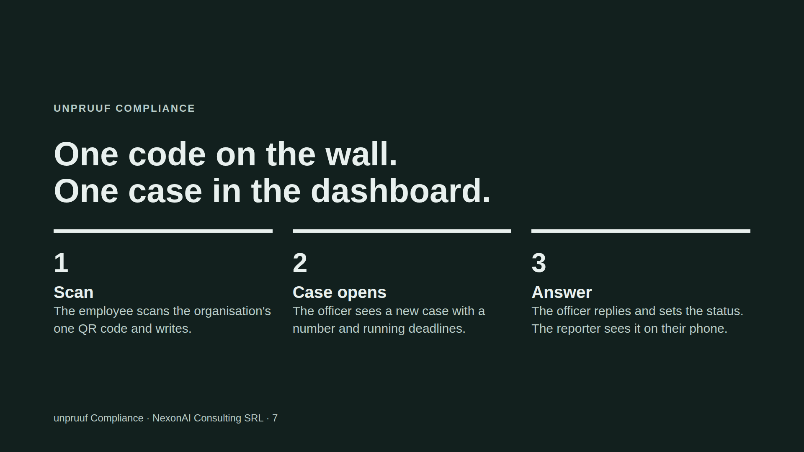
Notes:
This is the sentence to remember: one code on the wall, one case in the dashboard. From here on we talk about what people can do, not about technology.

Slide 8
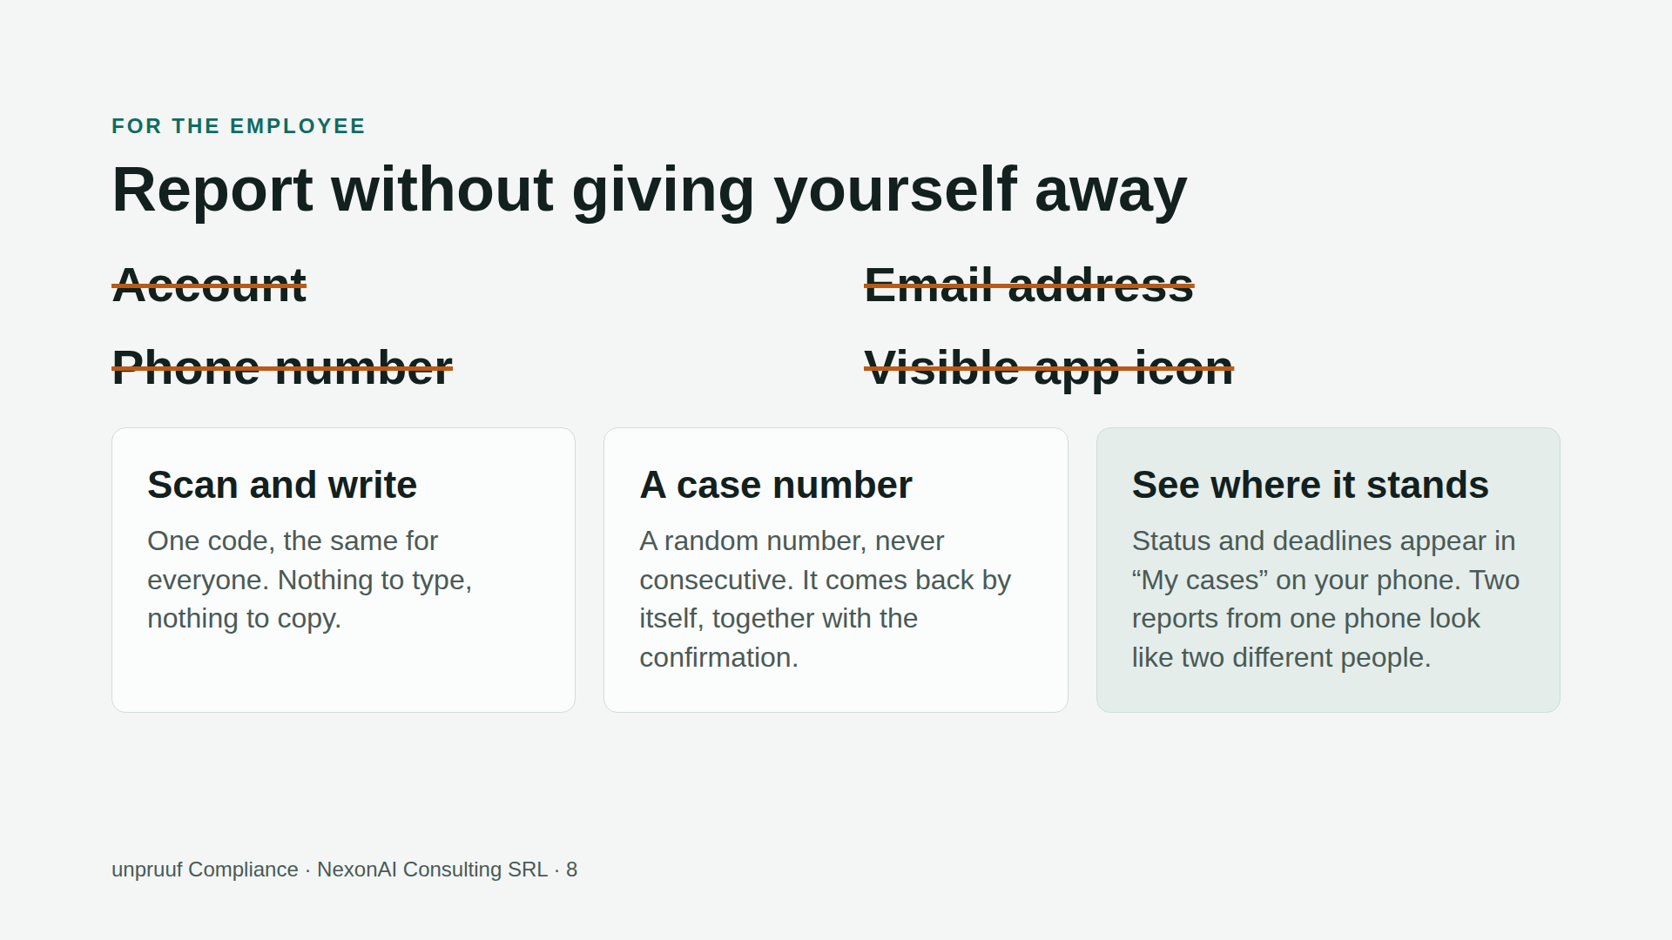
Notes:
If someone loses their phone, they lose their case numbers unless they wrote them down. The browser option needs no installation but protects less; it shows a visible warning.

Slide 9
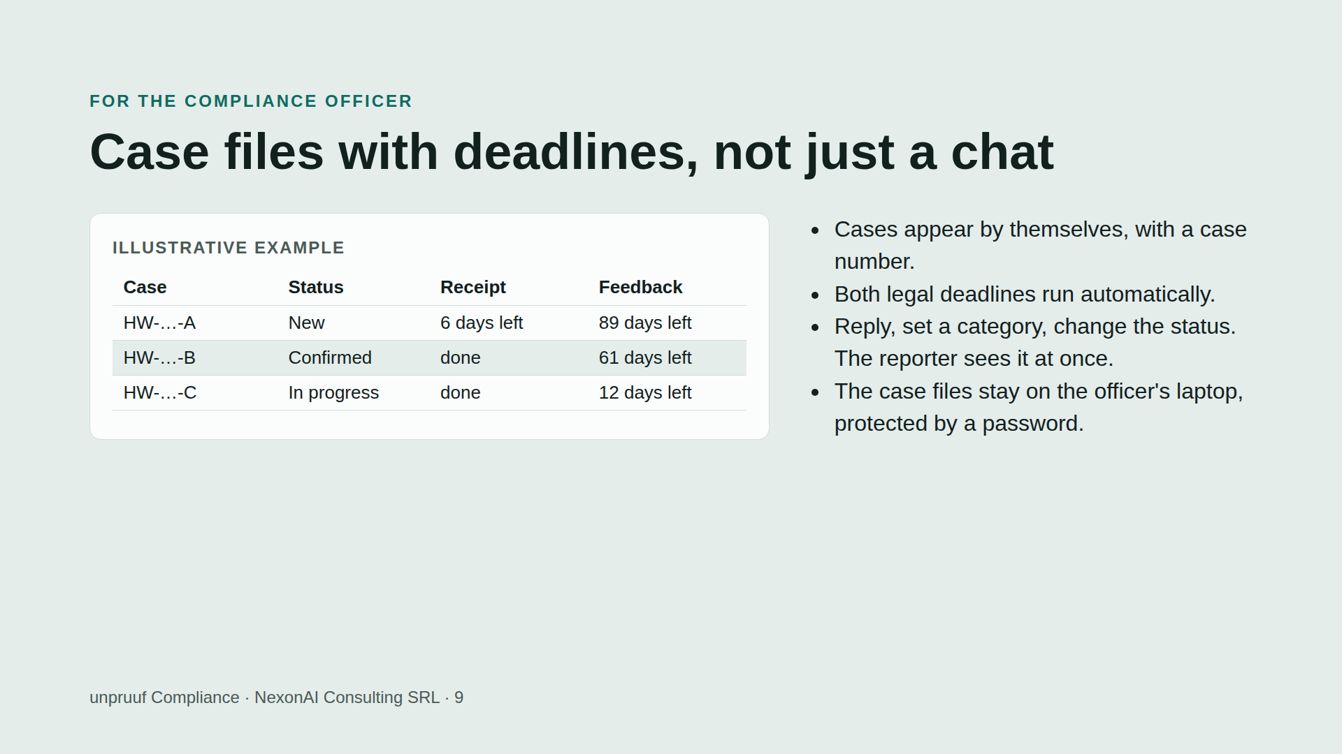

Slide 10
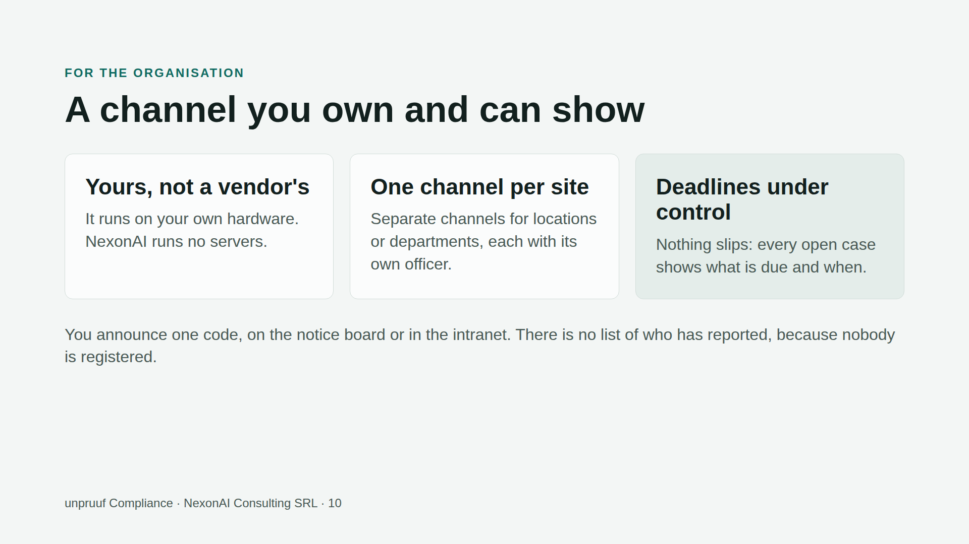

Slide 11
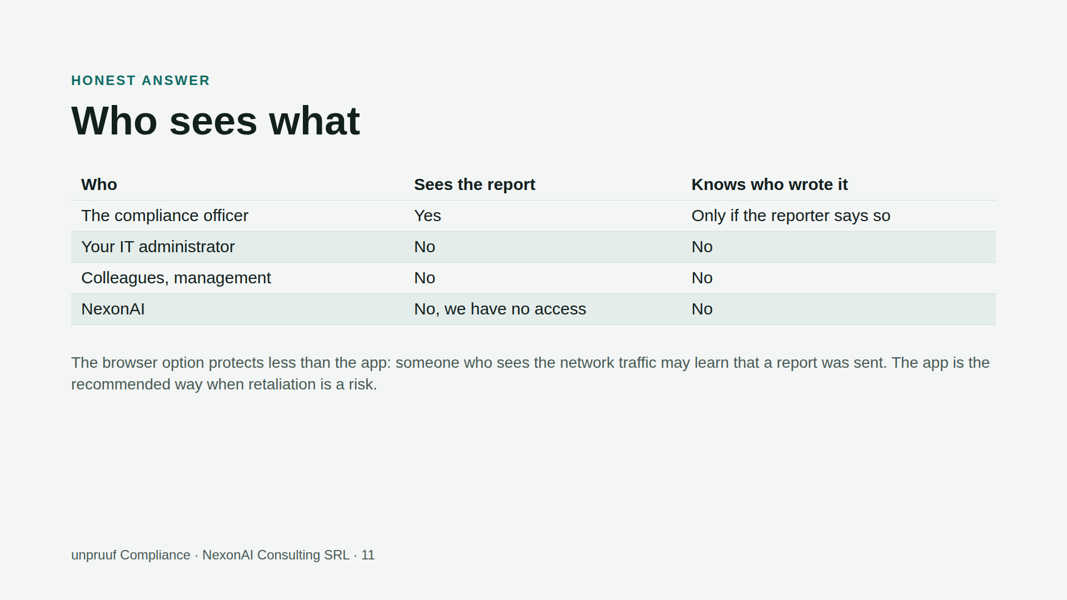
Notes:
Do not claim more. We say: nobody outside the officer can read it, and the system holds no identities. We do not say it is impossible to find out who someone is, for example if the reporter writes their name.

Slide 12
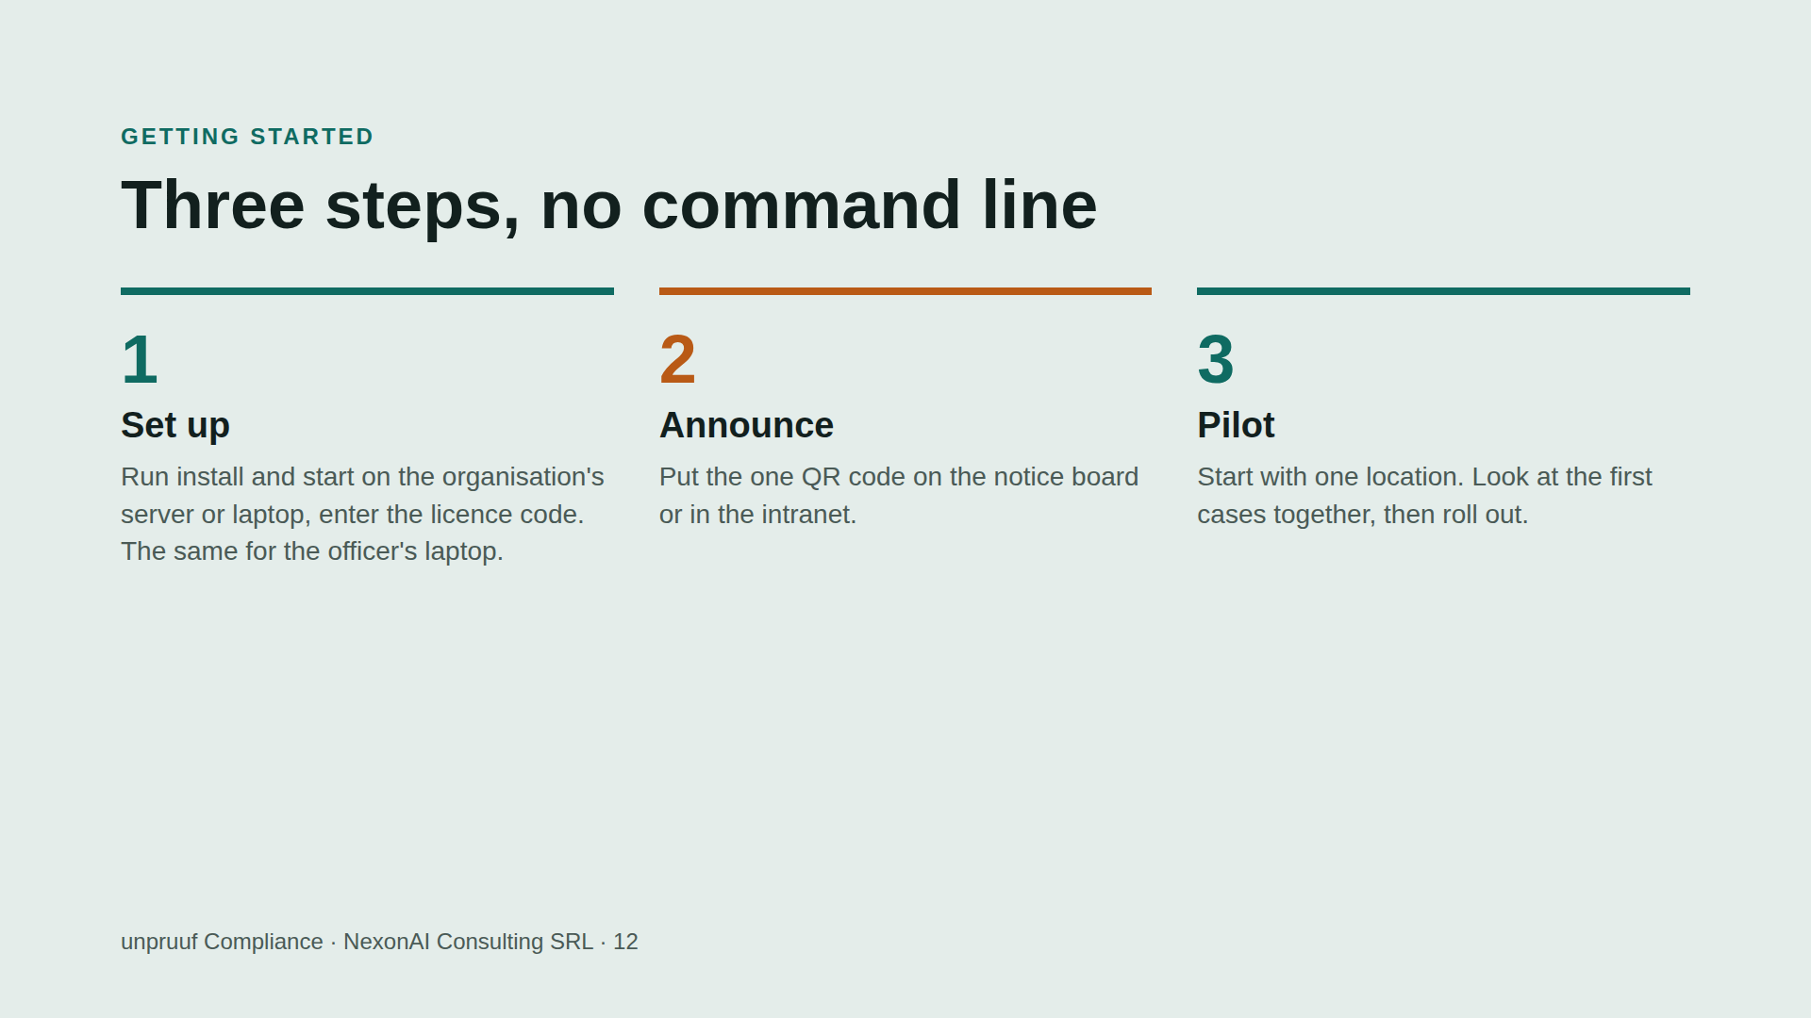

Slide 13
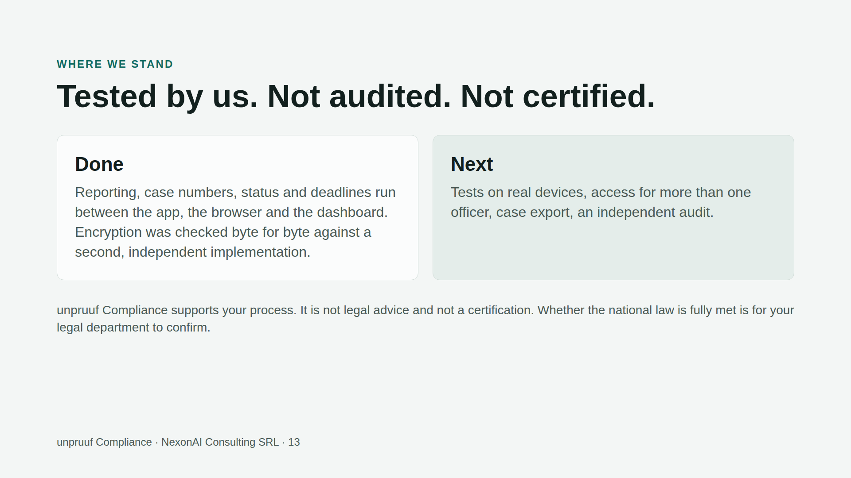

Slide 14
