Slide 1
FOODHUBBIE ERP
Complete Restaurant Management System
5 Key Features + Real Software Screens
Promotional Features → Actual Product Interface → Restaurant ERP Ecosystem
WhatsApp & Contact: 9724649971
One Restaurant. One System. Everything Connected.

Slide 2
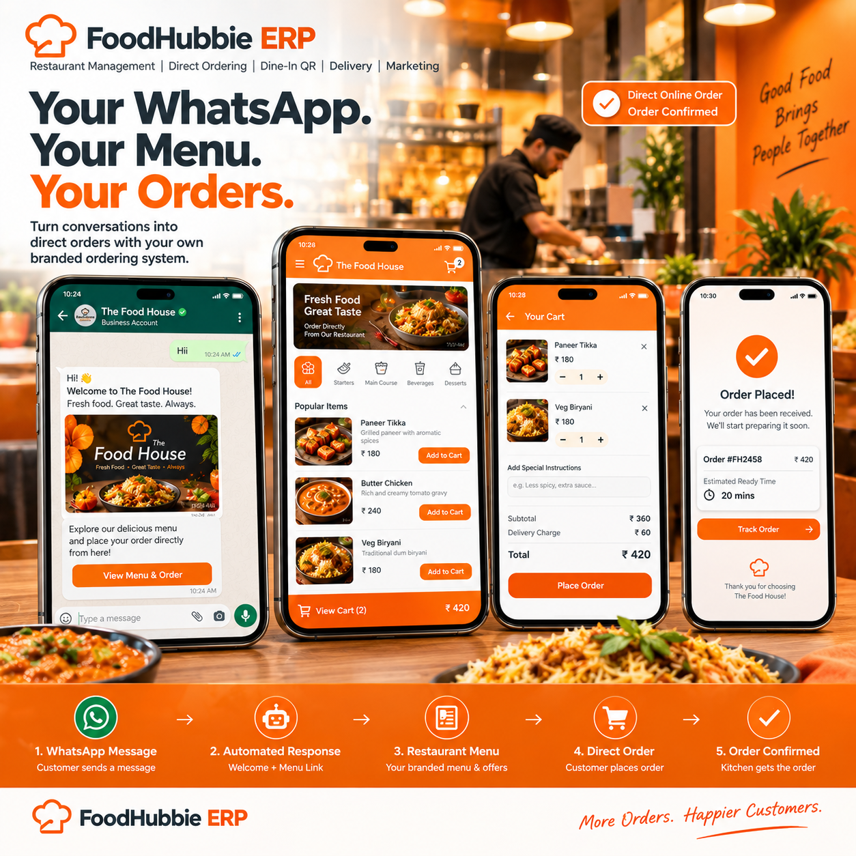
FOODHUBBIE ERP
01 • Automated WhatsApp Ordering
WhatsApp & Contact • 9724649971
01 / 20

Slide 3

FOODHUBBIE ERP
02 • Zero-Waiter QR Table Ordering
WhatsApp & Contact • 9724649971
02 / 20

Slide 4
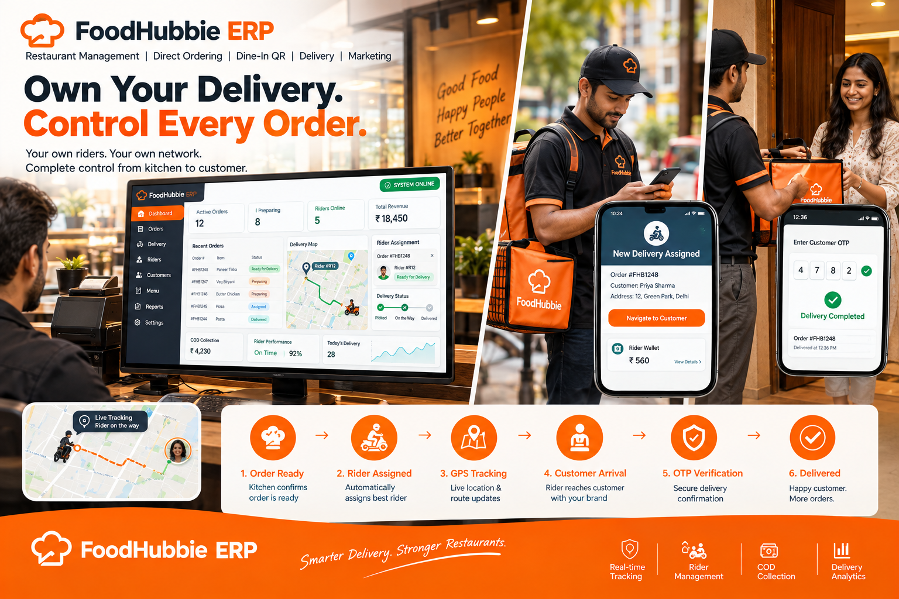
FOODHUBBIE ERP
03 • First-Party Delivery & Rider Management
WhatsApp & Contact • 9724649971
03 / 20

Slide 5

FOODHUBBIE ERP
04 • Customer Marketing & Bulk Promotions
WhatsApp & Contact • 9724649971
04 / 20

Slide 6
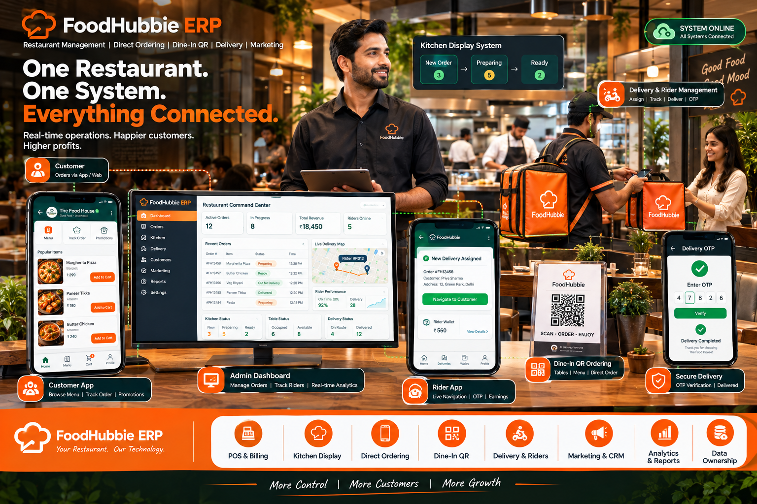
FOODHUBBIE ERP
05 • Real-Time Restaurant Command Center
WhatsApp & Contact • 9724649971
05 / 20

Slide 7
THE ACTUAL FOODHUBBIE ERP SOFTWARE
Real dashboard and application screens
15 uploaded product screenshots
WhatsApp & Contact: 9724649971

Slide 8
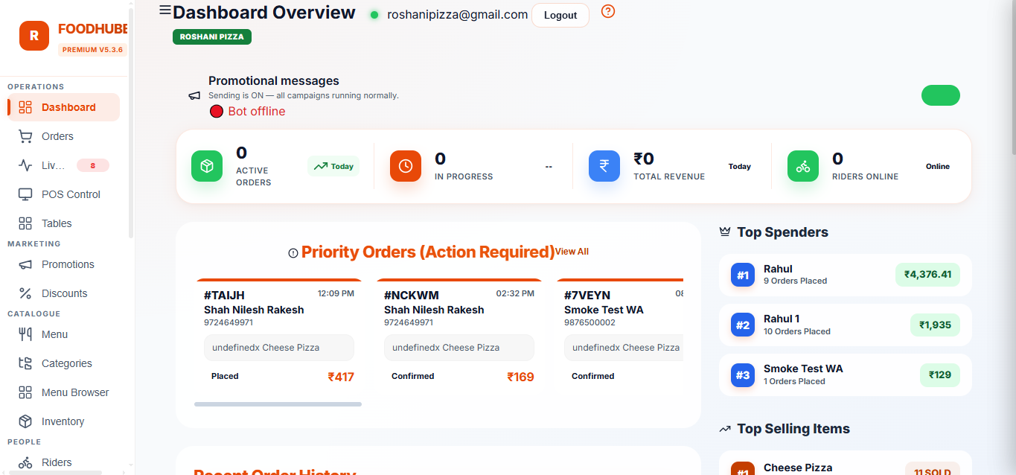
FOODHUBBIE ERP
06 • Dashboard Overview
WhatsApp & Contact • 9724649971
06 / 20

Slide 9
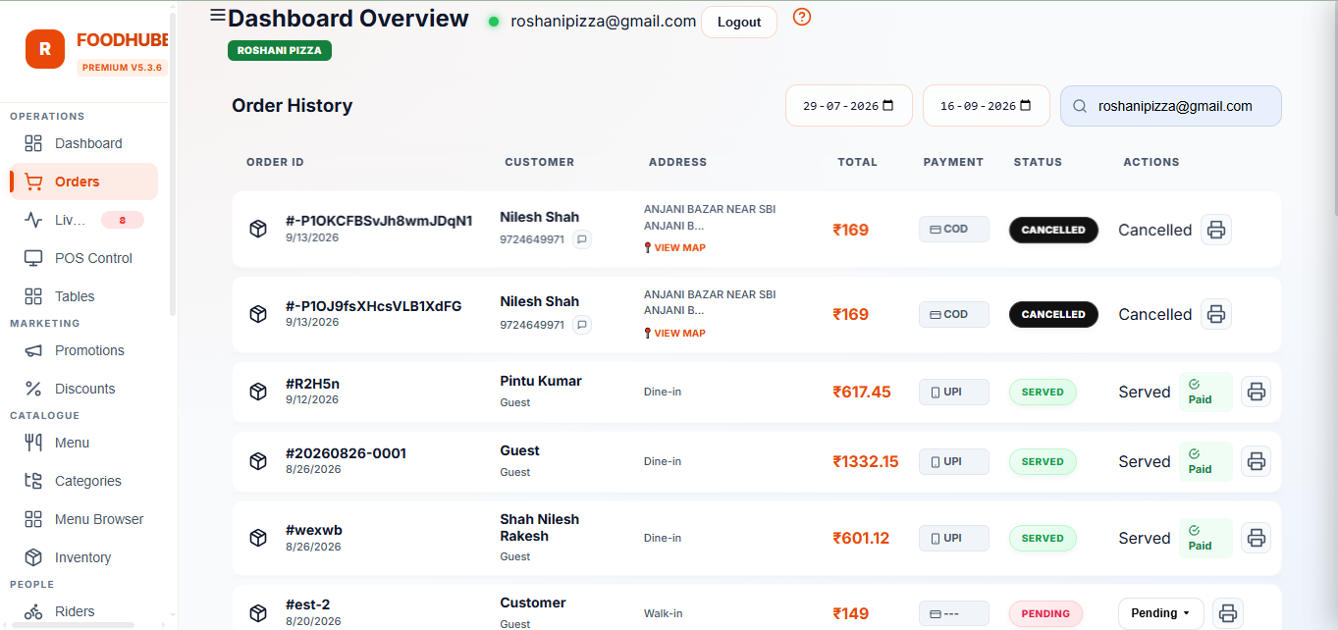
FOODHUBBIE ERP
07 • Orders Management
WhatsApp & Contact • 9724649971
07 / 20

Slide 10
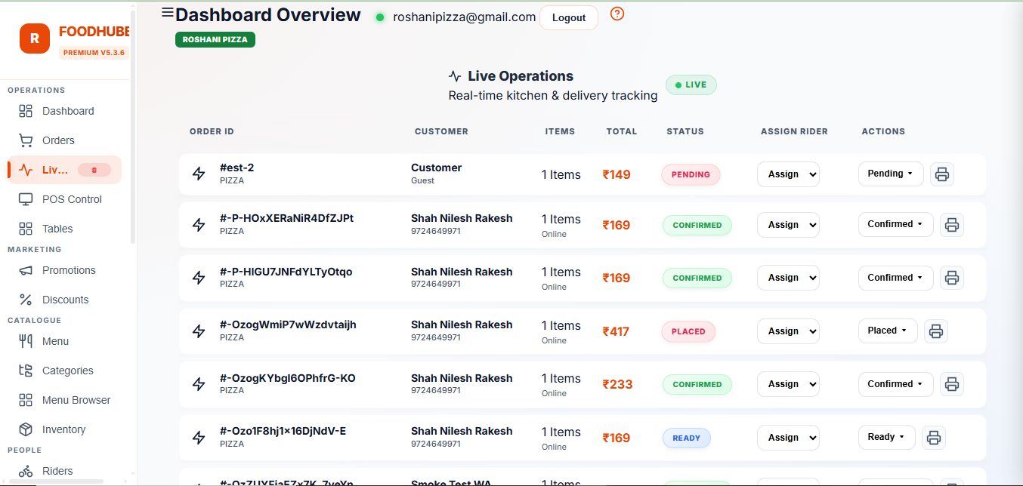
FOODHUBBIE ERP
08 • Live Operations & Order Tracking
WhatsApp & Contact • 9724649971
08 / 20

Slide 11
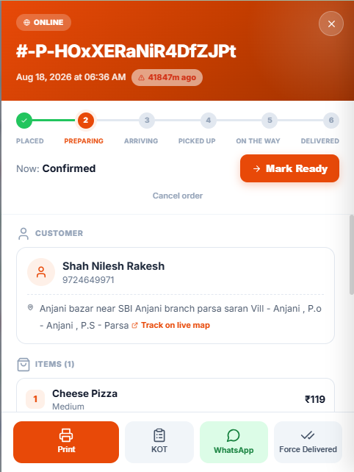
FOODHUBBIE ERP
09 • Order Details & Management
WhatsApp & Contact • 9724649971
09 / 20

Slide 12
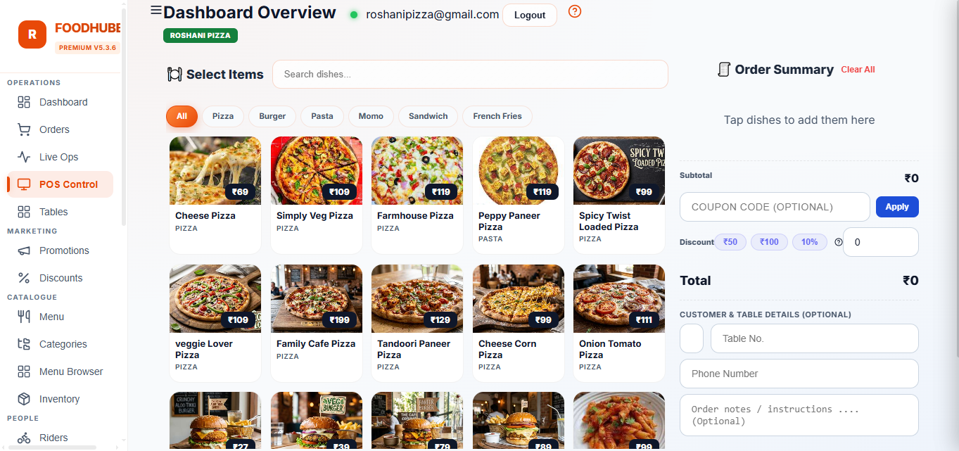
FOODHUBBIE ERP
10 • POS Control
WhatsApp & Contact • 9724649971
10 / 20

Slide 13
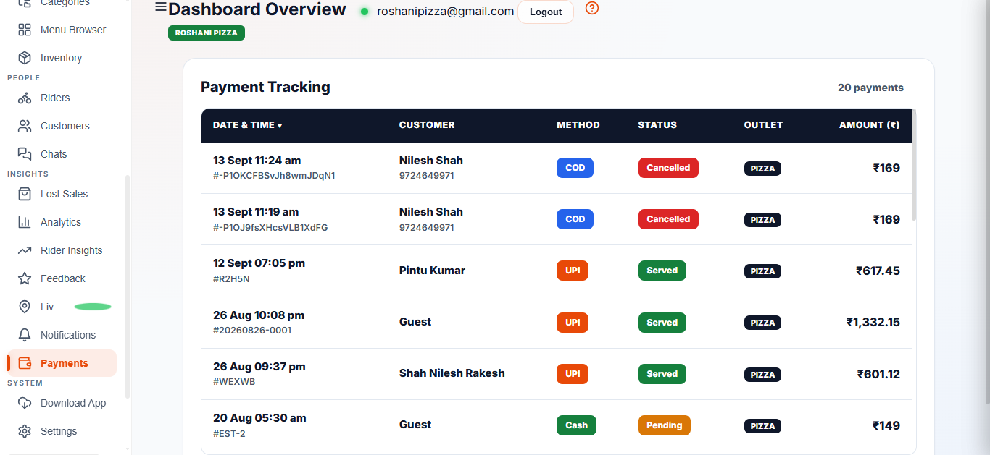
FOODHUBBIE ERP
11 • Payment Tracking
WhatsApp & Contact • 9724649971
11 / 20

Slide 14
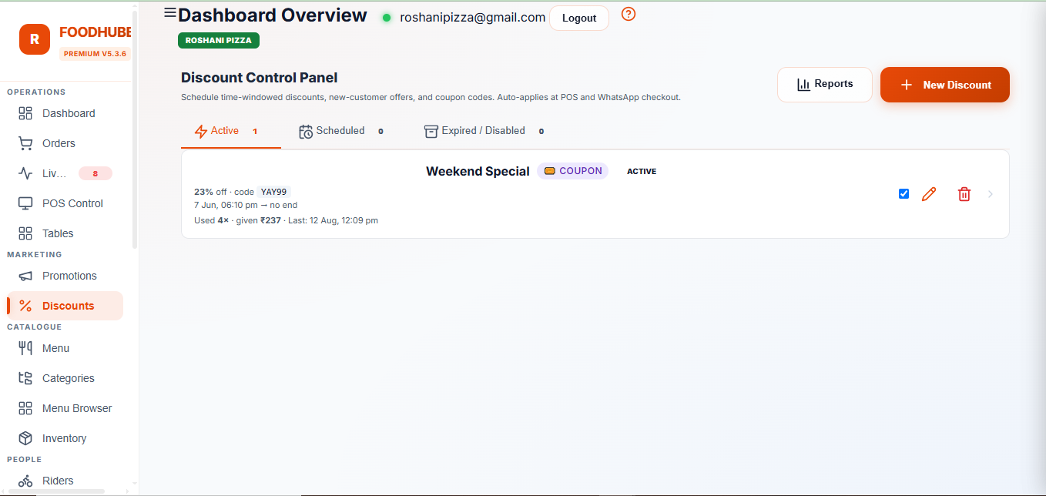
FOODHUBBIE ERP
12 • Discount Control Panel
WhatsApp & Contact • 9724649971
12 / 20

Slide 15
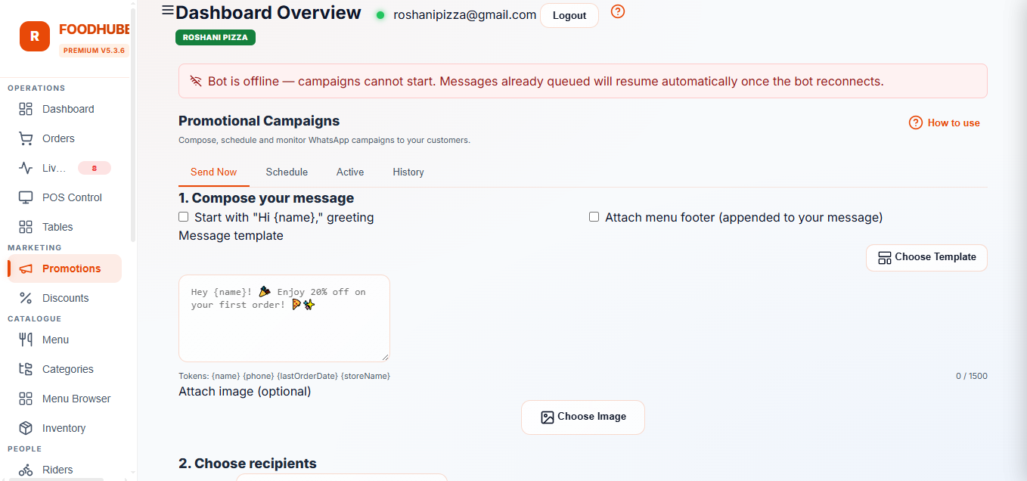
FOODHUBBIE ERP
13 • WhatsApp Promotional Campaigns
WhatsApp & Contact • 9724649971
13 / 20

Slide 16
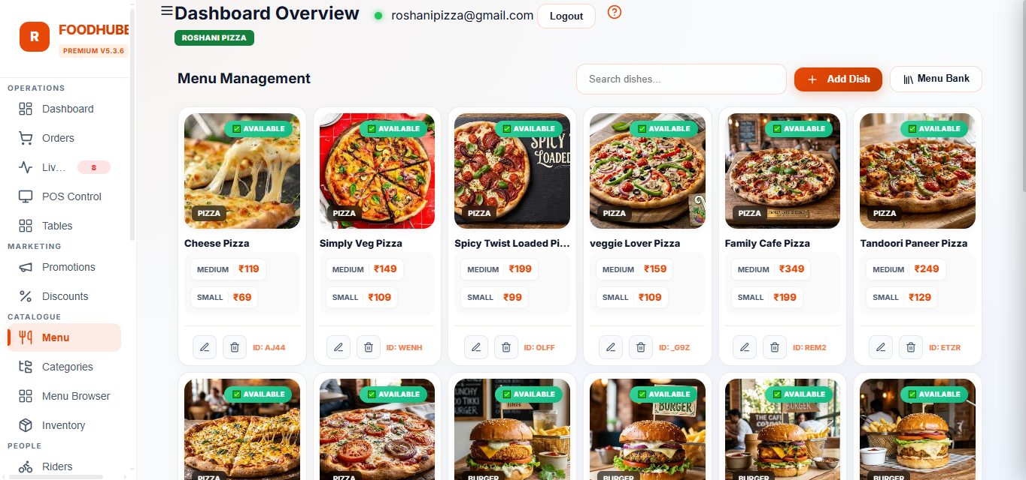
FOODHUBBIE ERP
14 • Menu Management
WhatsApp & Contact • 9724649971
14 / 20

Slide 17
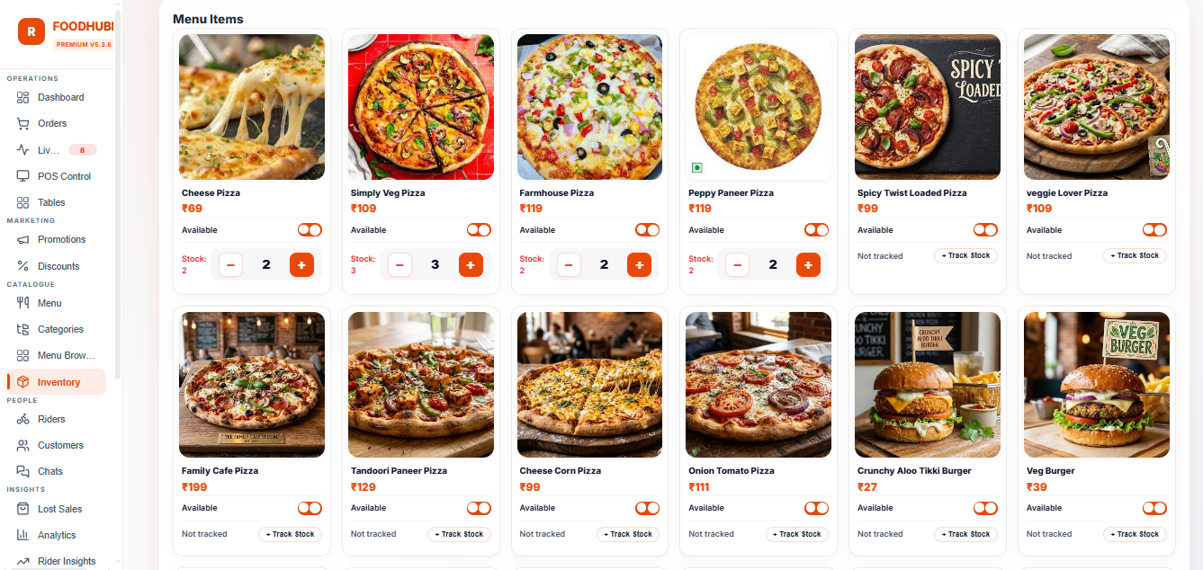
FOODHUBBIE ERP
15 • Menu Availability & Stock Tracking
WhatsApp & Contact • 9724649971
15 / 20

Slide 18
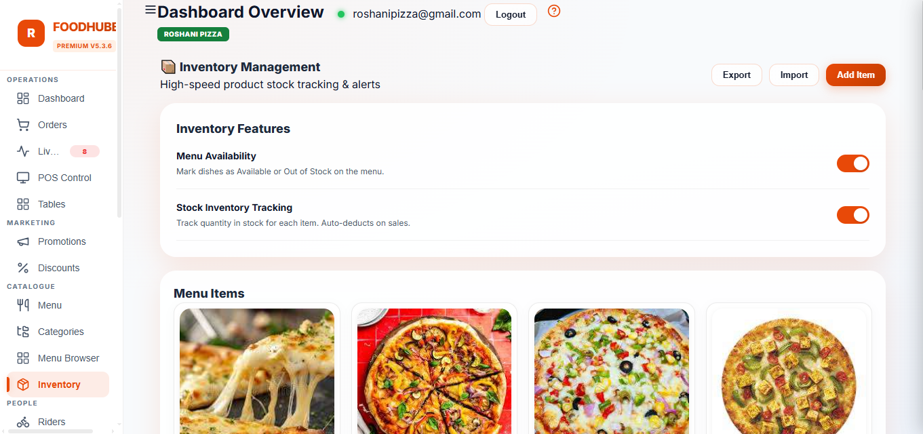
FOODHUBBIE ERP
16 • Inventory Management
WhatsApp & Contact • 9724649971
16 / 20

Slide 19
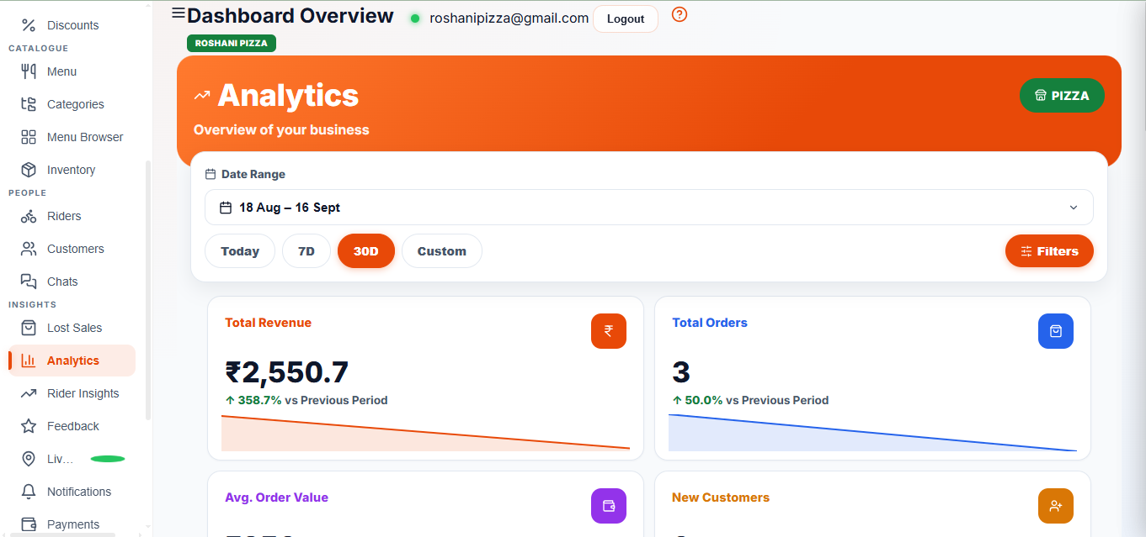
FOODHUBBIE ERP
17 • Analytics — Overview
WhatsApp & Contact • 9724649971
17 / 20

Slide 20
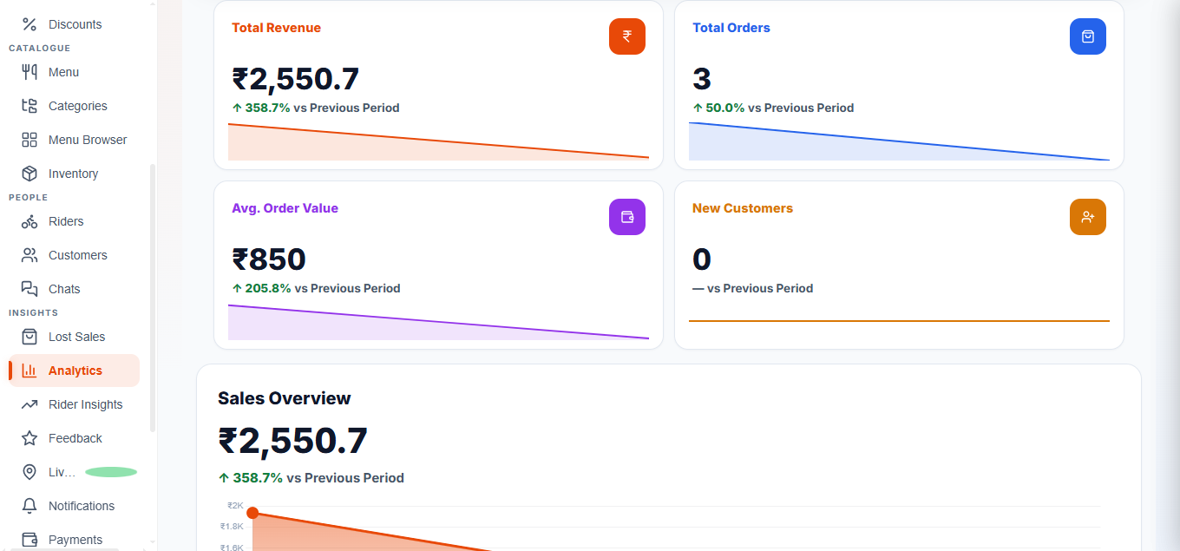
FOODHUBBIE ERP
18 • Analytics — Sales & Highlights
WhatsApp & Contact • 9724649971
18 / 20

Slide 21
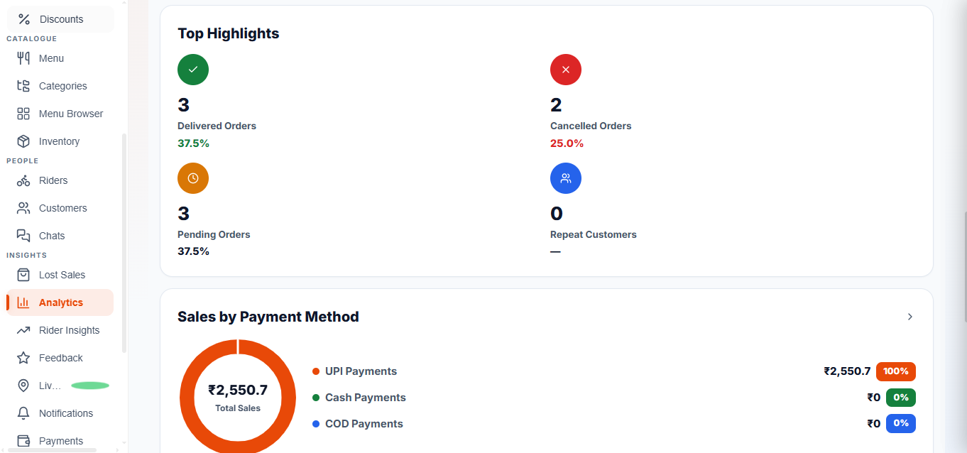
FOODHUBBIE ERP
19 • Analytics — Payment Methods
WhatsApp & Contact • 9724649971
19 / 20

Slide 22
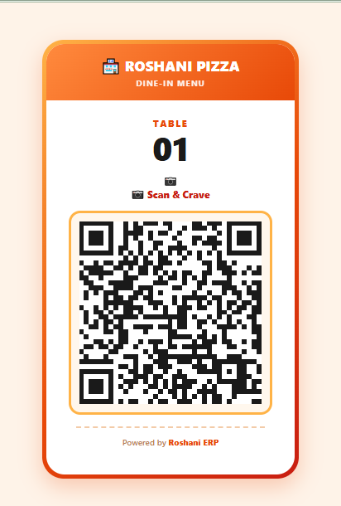
FOODHUBBIE ERP
20 • QR Table Ordering
WhatsApp & Contact • 9724649971
20 / 20

