Slide 1
Dr. Anuj Barolia’s Dental Studio
At Dr. Anuj Barolia’s Dental Studio, we are dedicated to giving you a healthy, confident smile. Located in the heart of Alkapuri, Vadodara, our clinic combines modern dental technology with compassionate care. Dr. Anuj Barodia and his expert team ensure that every patient feels comfortable, informed, and well-cared for throughout their dental journey.

Slide 2
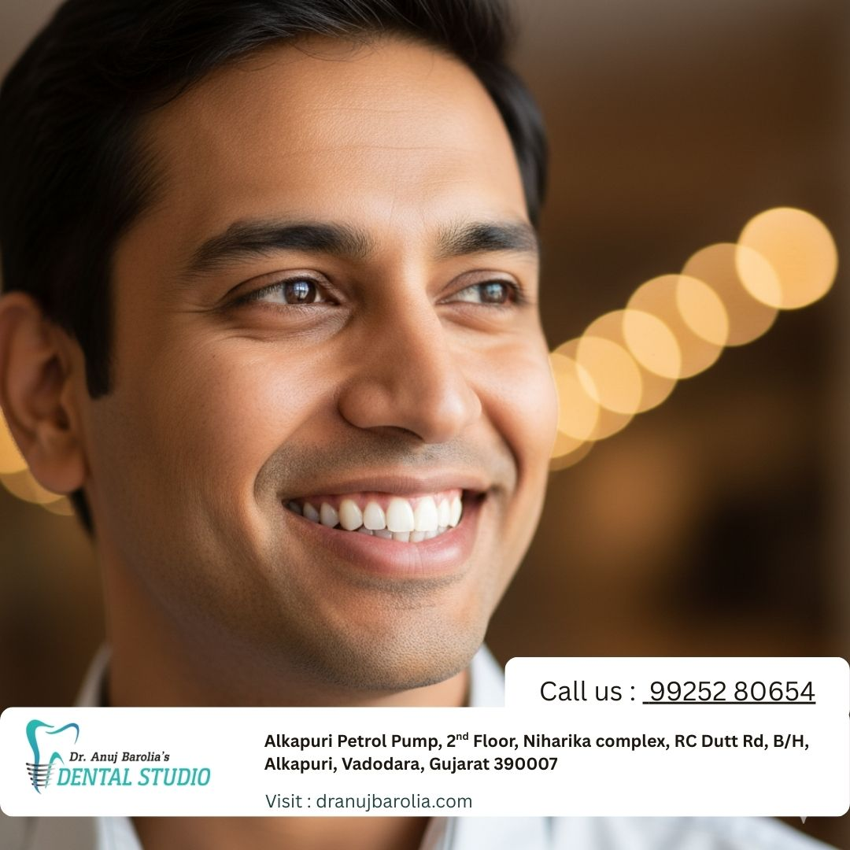
Restore your smile & confidence with dental implants at Dr Anuj Barolia's Dental Studio!

