Slide 1
Class diagram - metamodel

Slide 2
Metamodel
metamodel = abstract syntax
A meta-model typically defines the languages and processes from which to form a model
A metamodel is a model of a modeling language. The metamodel defines the structure, semantics and constraints for a family of models
Model of an actual model of a circuit, system, or software like entity

Slide 3
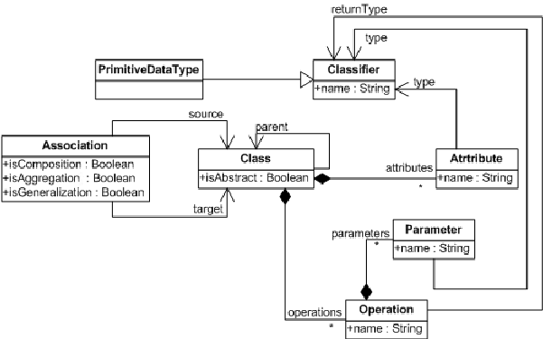
1. Class diagram metamodel
Class diagram specifies a structure of a system by showing the classes, attributes, operations and relationships among them.

Slide 4
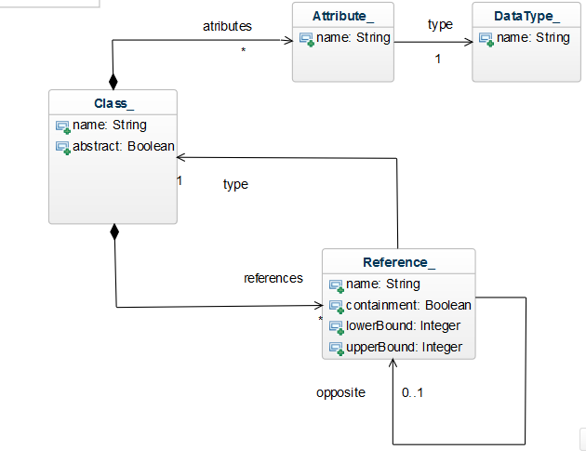
2. Class diagram metamodel

