Slide 1
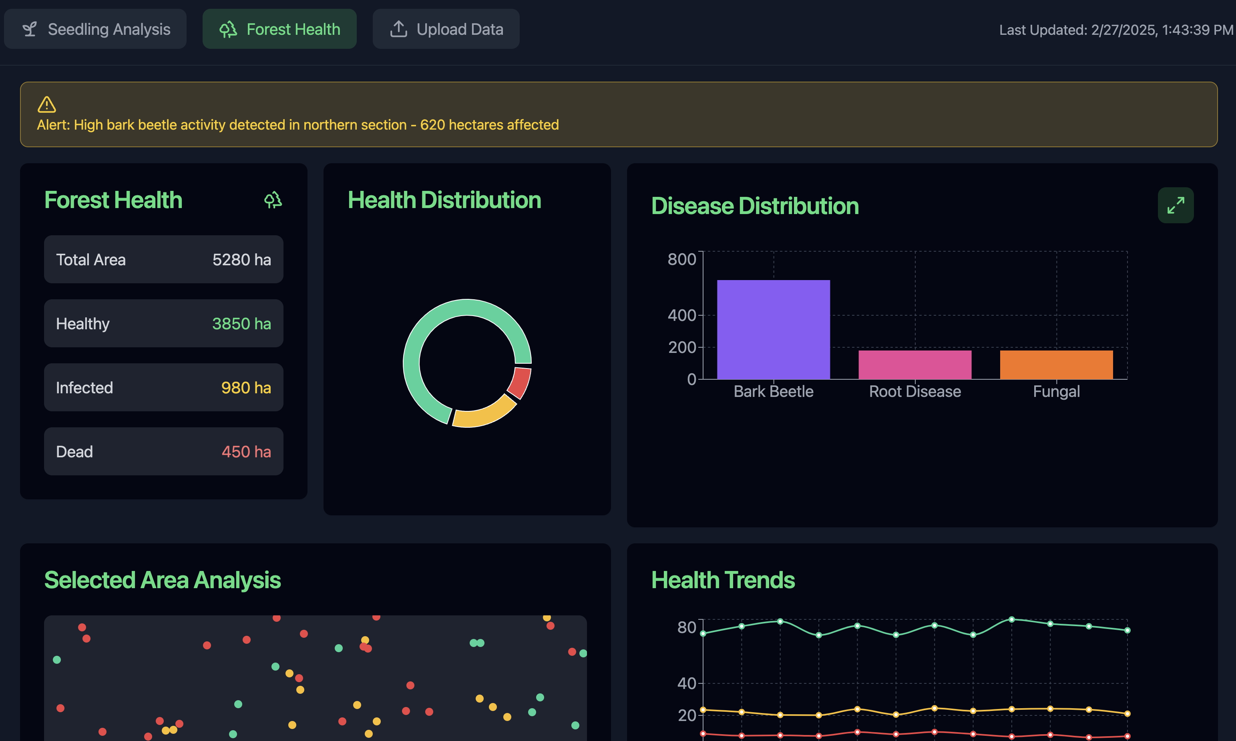
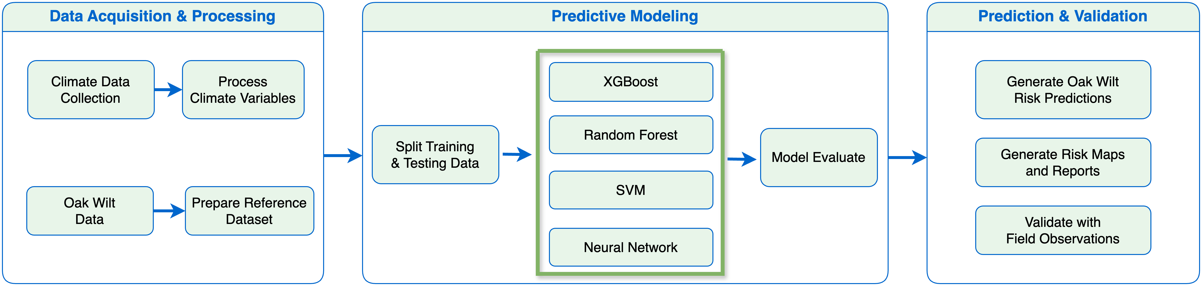
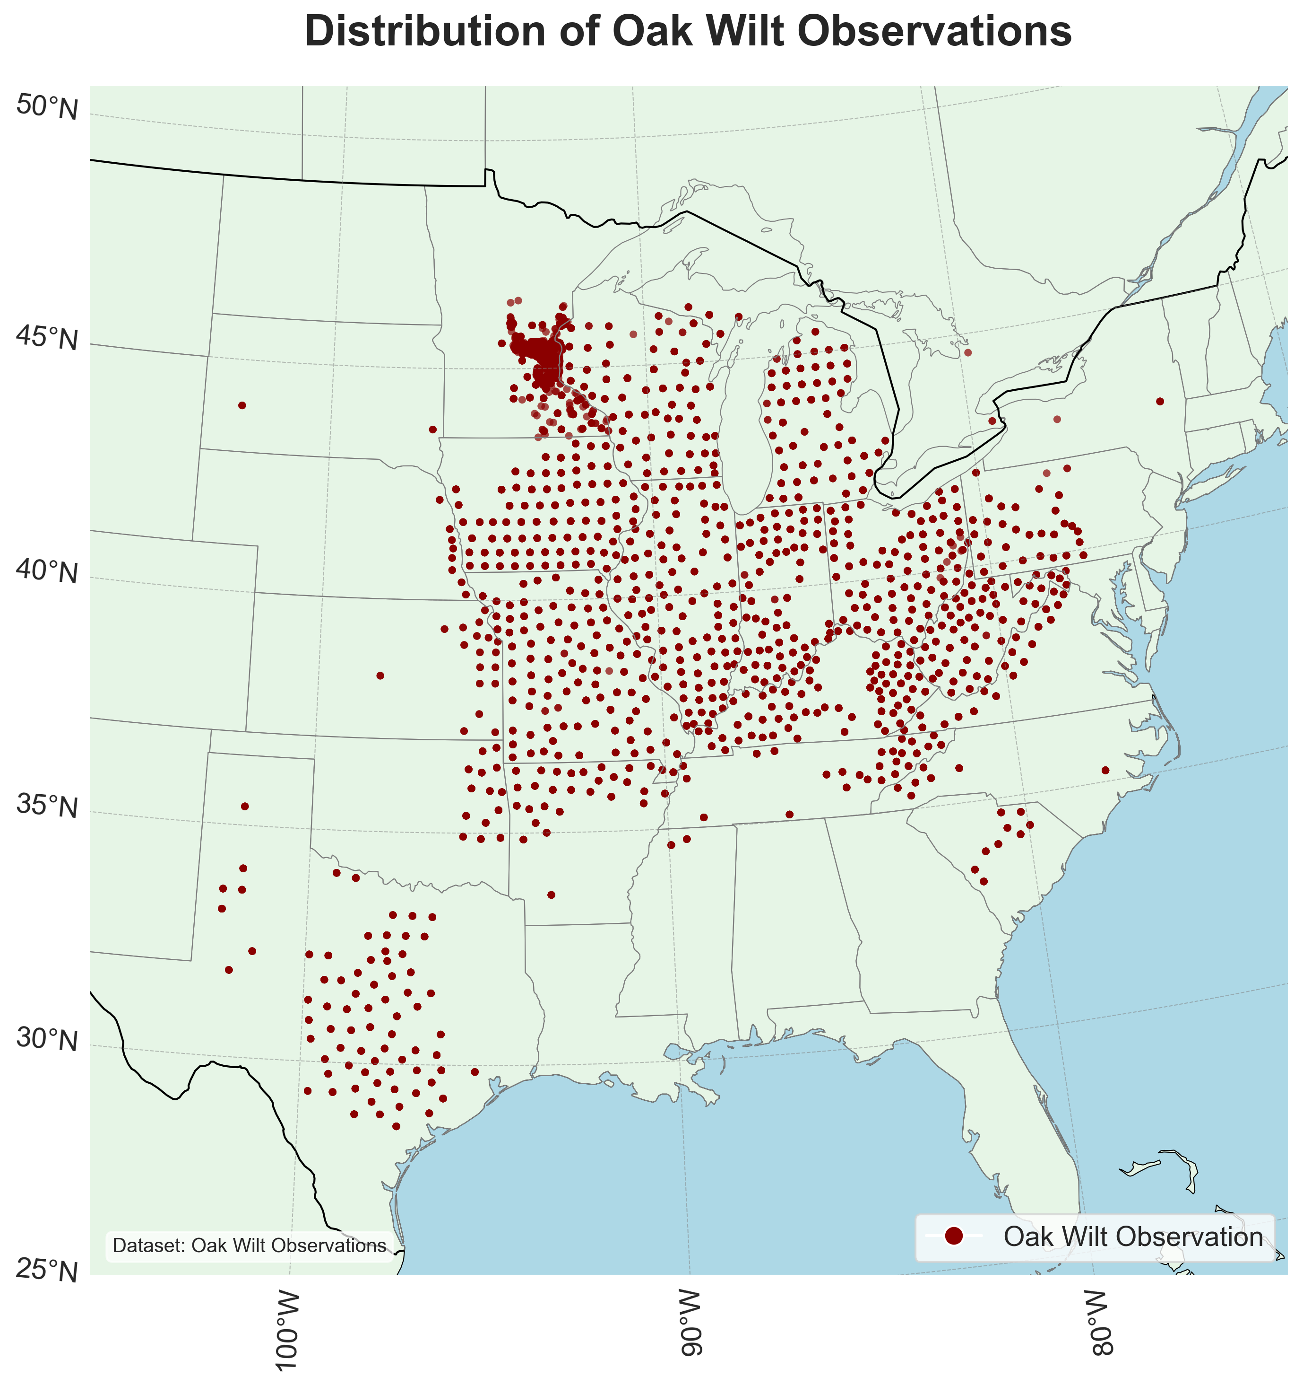
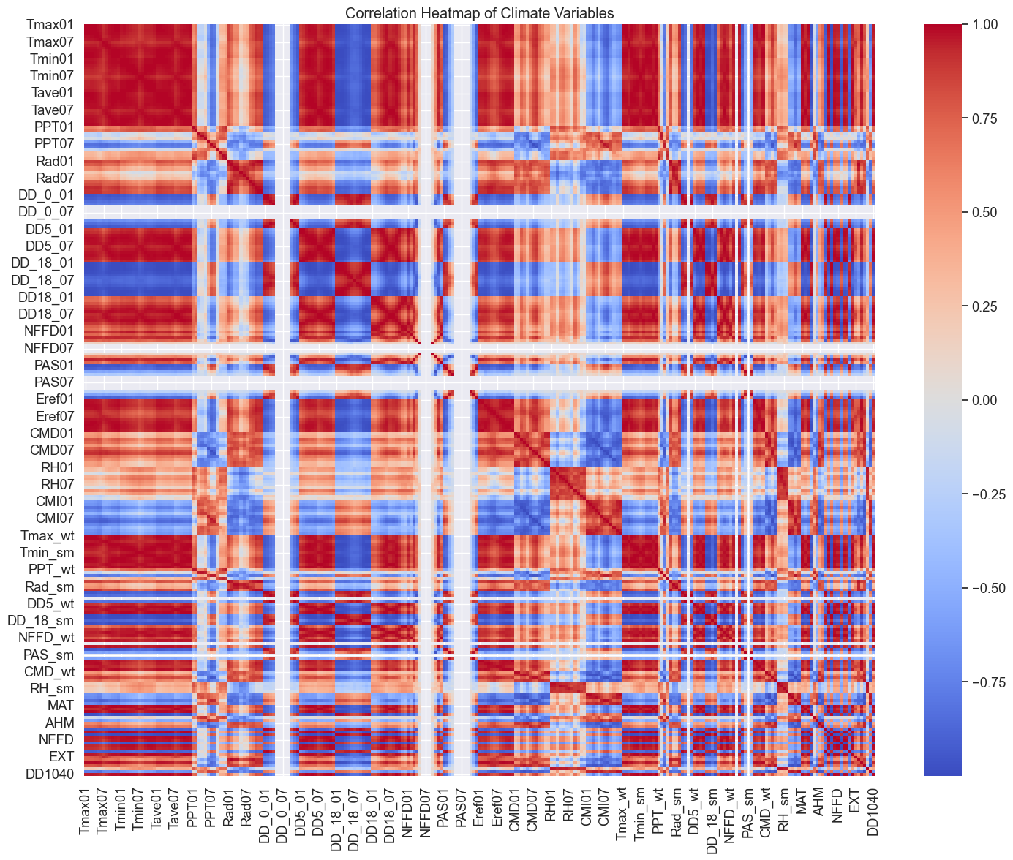
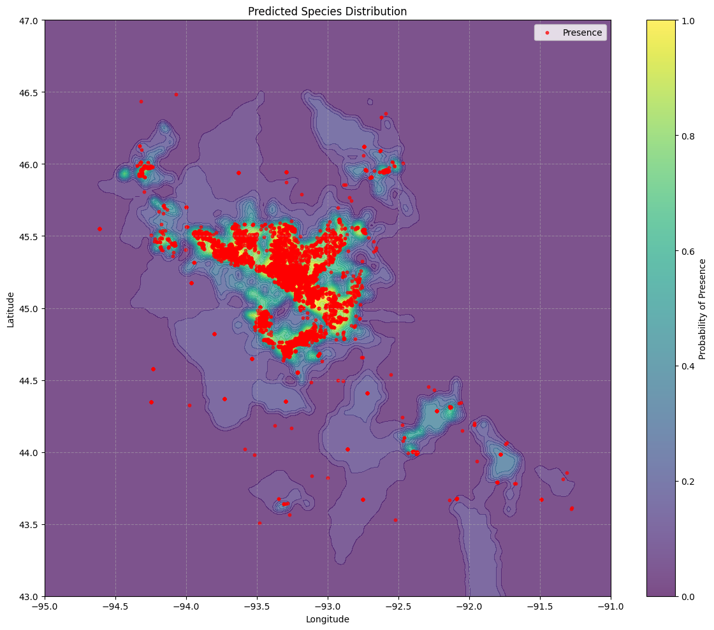
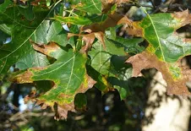
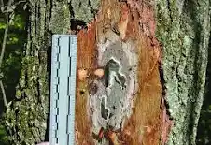
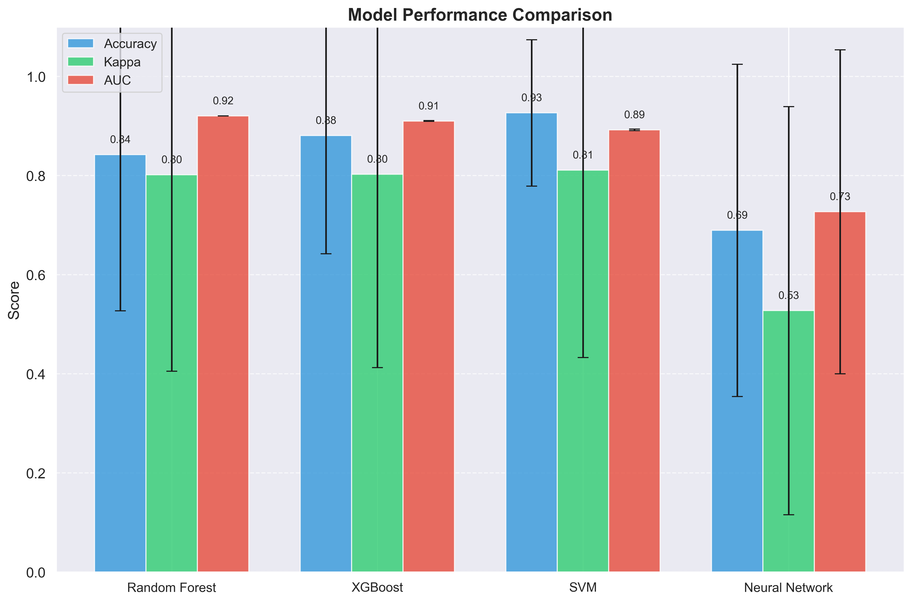
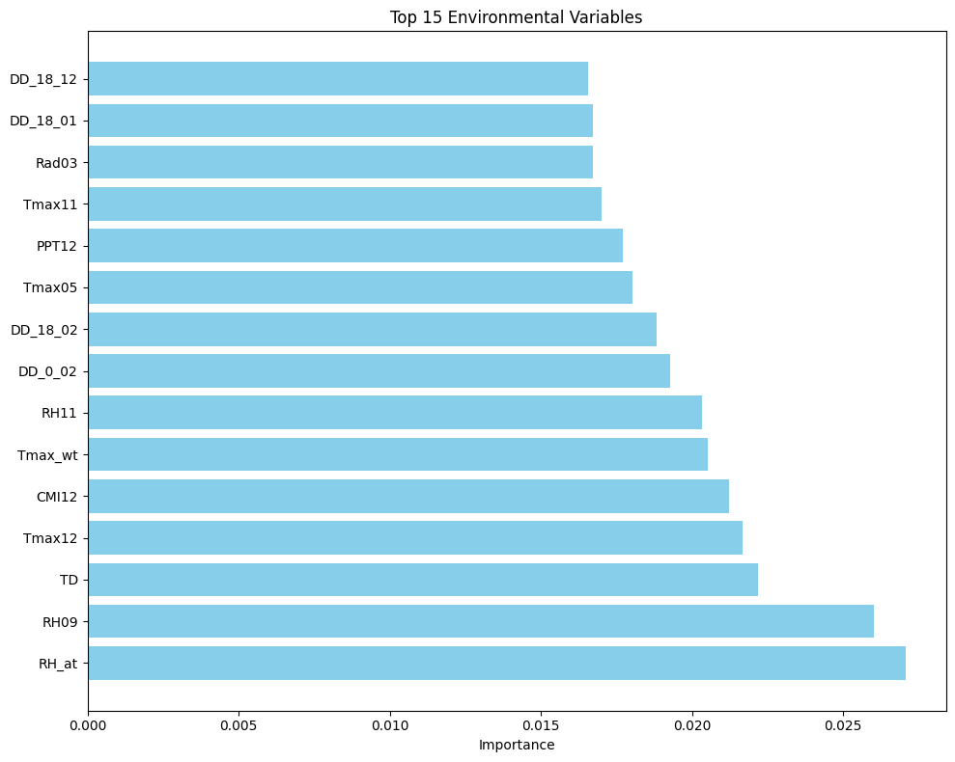
ForestAI: An AI-Powered Platform for Enhanced Forest Resource Assessment and Health Monitoring
Ping Yang¹, Sandeep KC², Chen Ding²*, Yan LI³, Hao Chen², Lana Narine², Richard Cristan², Yuede JI^{4*} ¹Dynamic Pacific LLC., Round Rock, TX;
²College of Forestry Wildlife and Environment, Auburn University, AL;
³Department of Mechanical Aerospace and Biomedical Engineering, University of Tennessee, Konxville, TN;
⁴Department of Computer Science and Engineering, the University of Texas at Arlington, TX;
Abstract
In the southeastern United States, known as the wood basket of the nation, 70% of U.S. reforestation occurs, producing over 25% of the world's pulpwood and 18% of its saw timber, so advanced forest monitoring tools are increasingly critical in this region. To address this need, we developed ForestAI, a web-based platform leveraging artificial intelligence to enhance automated assessment, monitoring and projection of forest resources and health conditions.
ForestAI Platform
ForestAI integrates data from multiple sources, including drone imagery and ground references from the USDA Forest Service's Forest Inventory and Analysis (FIA) and Forest Health Monitoring (FHM) programs, complementing these approaches with AI-driven capabilities for resources assessment and land management. The platform offers an accessible interface for processing and analyzing data through automated species classification, canopy/tree counting, health assessment, etc. Its real-time data processing, computer vision, tree-level visualization and reporting tools support stakeholders ranging from individual landowners to broad scale operators.
Priorities, Pilots, and Goals
Current research priorities include validating the platform's effectiveness with existing data sources and real-world applications, particularly for early detection of pests and diseases. Future development will focus on integrating emerging technologies, high-resolution satellite imagery and structural measurements and advanced drone observations, to improve scalability. This research contributes to modernizing forest monitoring, data analytics, and decision-making support in the southeastern U.S., to enhance forest productivity and resilience while maintaining high standards of accuracy in resource assessment.
Fig. 1. ForestAI Platform Platform
Fig.2. Species Distribution Model Workflow of Oak Wilt Disease as A Pilot Study
Fig.4. Variable Selection
Fig. 3. Oak Wilt Observation in Southeastern United States
Fig.5. Model Comparison
Fig. 6. Model Prediction for the Minnesota State with Future Environment using Climate NA software and public-accessible data.

