Slide 1
Monads Explained for OOP Developers
NextBuild Eindhoven | September 29 | 2018
Mikhail Shilkov

Slide 2
Functional programming
Currying
ADT
Functor
Typeclass
Monads
Referential transparency
Partial application
Applicative
Monoid
Attributes
Higher kinded types
Isomorphism
Higher order function

Slide 3
A MONAD IS JUST A MONOID IN THE CATEGORY OF ENDOFUNCTORS

Slide 4
Douglas Crockford, who found Good Parts in Javascript
Monads are cursed — once you understand monads for yourself you lose the ability to explain them to others

Slide 5
Tomas Petricek, The Alan Turing Institute http://tomasp.net/academic/papers/monads/monads-programming.pdf
Learning monads and writing a monad tutorial has also become an important milestone in learning about theory of functional programming

Slide 6
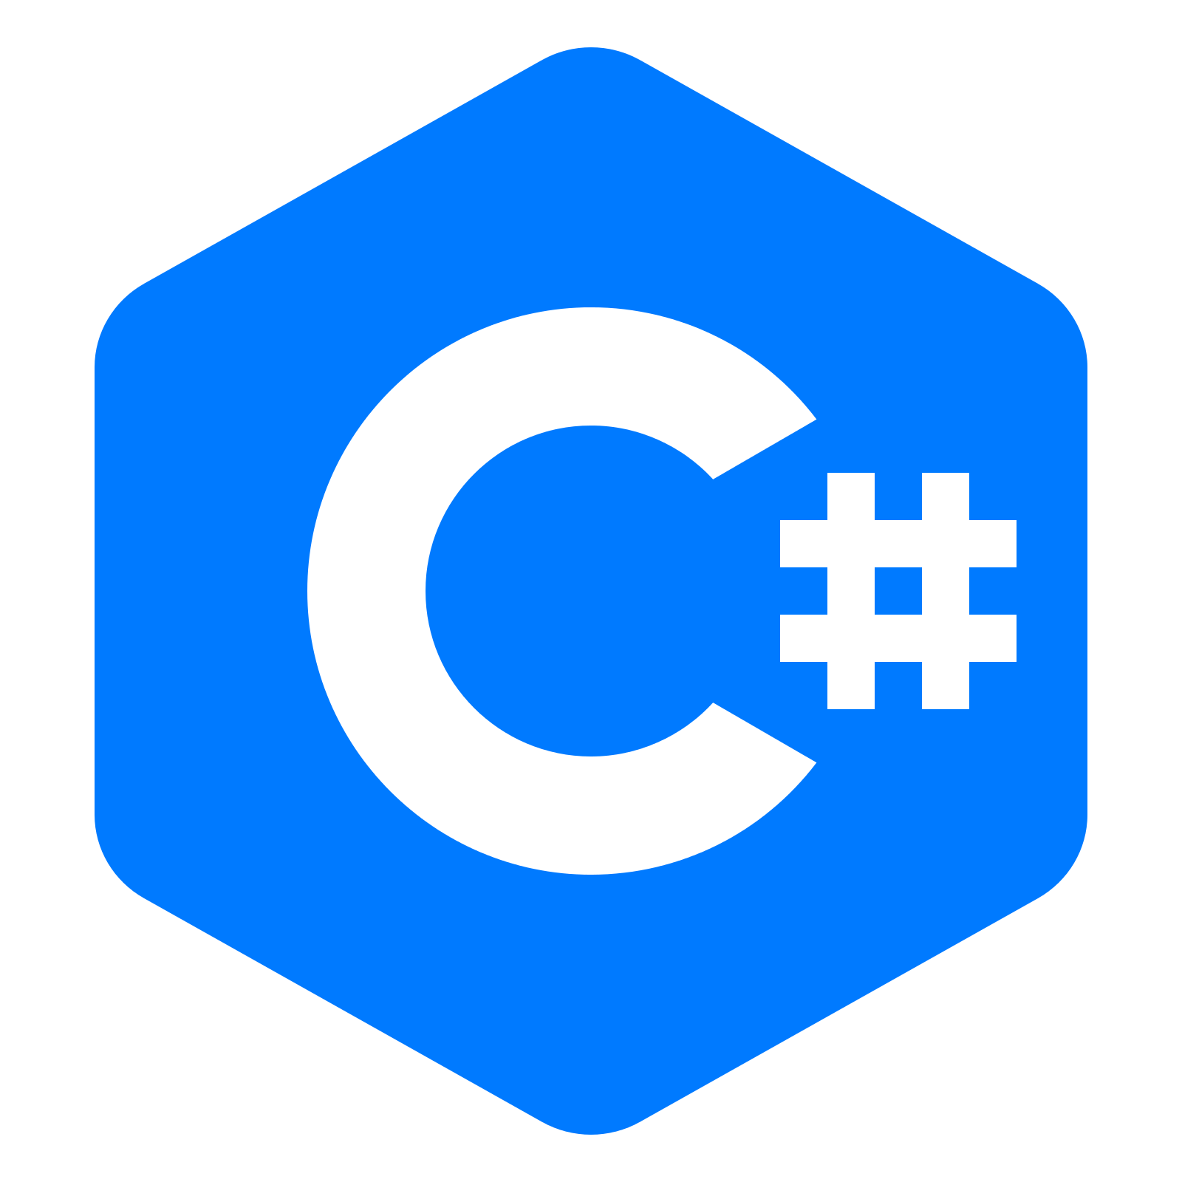


Slide 7
HAPPY STORY OF COMPOSITION

Slide 8
Functions
// Type annotation
func: TypeA -> TypeB
// Static methods
static class Mapper {
static ClassB func(ClassA a) { ... }
}
// Instance methods
class ClassA {
ClassB func() { ... }
}

Slide 9
Sample domain
class Speaker {
Talk nextTalk() { ... }
}
class Talk {
Conference getConference() { ... }
}
class Conference {
City getCity() { ... }
}

Slide 10
Workflow Composition
static City nextTalkCity(Speaker speaker) {
Talk talk = speaker.nextTalk();
Conference conf = talk.getConference();
City city = conf.getCity();
return city;
}

Slide 11
… or shorter
static City nextTalkCity(Speaker speaker) {
return
speaker
.nextTalk()
.getConference()
.getCity();
}

Slide 12


Slide 13
NULL

Slide 14
What is Nullable here?
class Speaker {
Talk nextTalk() { ... }
}
class Talk {
Conference getConference() { ... }
}
class Conference {
City getCity() { ... }
}

Slide 15
Nullable<T>
class Speaker {
Nullable<Talk> nextTalk() { ... }
}
class Talk {
Nullable<Conference> getConference() { ... }
}
class Conference {
Nullable<City> getCity() { ... }
}

Slide 16
Workflow with Nullable’s
static Nullable<City> nextTalkCity(Speaker speaker) {
Talk? talk = speaker.nextTalk();
if (talk != null) {
Conference? conf = talk.getConference();
if (conf != null) {
City? city = venue.getCity();
return city;
}
}
}

Slide 17
… or a bit better
static Nullable<City> nextTalkCity(Speaker speaker) {
Talk? talk = speaker.nextTalk();
if (talk == null) return null;
Conference? conf = talk.getConference();
if (conf == null) return null;
City? city = conf.getCity();
return city;
}

Slide 18
Null propagation operator
static Nullable<City> nextTalkCity(Speaker speaker) {
return
speaker
?.nextTalk()
?.getConference()
?.getCity();
}

Slide 19
Java Optional type
class Speaker {
Optional<Talk> nextTalk() { ... }
}
class Talk {
Optional<Conference> getConference() { ... }
}
class Conference {
Optional<City> getCity() { ... }
}

Slide 20
Workflow with Optional
static Optional<City> nextTalkCity(
Speaker speaker) {
return
speaker
.nextTalk()
.flatMap(talk -> talk.getConference())
.flatMap(conf -> conf.getCity());
}

Slide 21
Workflow with Optional
static Optional<City> nextTalkCity(Speaker speaker) {
return
speaker
.nextTalk() .flatMap(x -> x
.getConference() ).flatMap(x -> x
.getCity() );
}

Slide 22
COLLECTIONS

Slide 23
Collections
class Speaker {
List<Talk> getTalks() { ... }
}
class Talk {
List<Conference> getConferences() { ... }
}
class Conference {
List<City> getCities() { ... }
}

Slide 24
Workflow with Collections
static List<City> allCitiesToVisit(Speaker speaker)
{
var result = new List<City>();
foreach (Talk talk in speaker.getTalks())
foreach (Conference conf in talk.getConferences())
foreach (City city in conf.getCities())
result.Add(city);
return result;
}

Slide 25
LINQ
static List<City> allCitiesToVisit(Speaker speaker) {
return
speaker
.getTalks()
.SelectMany(talk => talk.getConferences())
.SelectMany(conf => conf.getCities())
.ToList();
}

Slide 26
LINQ
static List<City> allCitiesToVisit(Speaker speaker) {
return
speaker
.getTalks() .SelectMany(x => x
.getConferences() ).SelectMany(x => x
.getCities() ).ToList();
}

Slide 27
Java Streams
static List<City> allCitiesToVisit(Speaker speaker) {
return
speaker
.getTalks()
.stream()
.flatMap(talk -> talk.getConferences().stream())
.flatMap(conf -> conf.getCities().stream())
.collect(Collectors.toList());
}

Slide 28
Java Streams
static List<City> allCitiesToVisit(Speaker speaker) {
return
speaker
.getTalks() .stream().flatMap(x -> x
.getConferences() .stream()).flatMap(x -> x
.getCities() .stream())
.collect(Collectors.toList());
}

Slide 29
ASYNCHRONOUS CALLS

Slide 30
C# Task
class Speaker {
Task<Talk> nextTalk() { ... }
}
class Talk {
Task<Conference> getConference() { ... }
}
class Conference {
Task<City> getCity() { ... }
}

Slide 31
Workflow with Task’s
static Task<City> nextTalkCity(Speaker speaker)
{
return
speaker
.nextTalk()
.ContinueWith(talk => talk.Result.getConference())
.Unwrap()
.ContinueWith(conf => conf.Result.getCity())
.Unwrap();
}

Slide 32
Workflow with Task’s
static Task<City> nextTalkCity(Speaker speaker)
{
return
speaker
.nextTalk() .ContinueWith(x => x.Result
.getConference()).Unwrap().ContinueWith(x => x.Result
.getCity() ).Unwrap();
}

Slide 33
Java CompletableFuture
static CompletableFuture<City> nextTalkCity
(Speaker speaker) {
return
speaker
.nextTalk()
.thenCompose(talk -> talk.getConference())
.thenCompose(conf -> conf.getCity());
}

Slide 34
Java CompletableFuture
static CompletableFuture<City> nextTalkCity
(Speaker speaker) {
return
speaker
.nextTalk() .thenCompose(x -> x
.getConference() ).thenCompose(x -> x
.getCity() );
}

Slide 35
DO YOU SEE A PATTERN HERE?

Slide 36
Workflow and “glue”
speaker
.nextTalk() .flatMap(x -> x
.getConference() ).flatMap(x -> x
.getCity() ) // Optional<T>
speaker
.getTalks() .SelectMany(x => x
.getConferences() ).SelectMany(x => x
.getCities() ) // List<T>
speaker
.nextTalk() .thenCompose(x -> x
.getConference() ).thenCompose(x -> x
.getCity() ) // CompletableFuture<T>

Slide 37
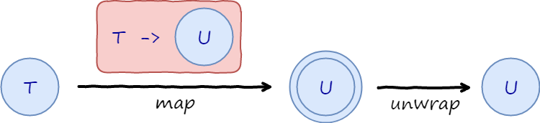
Workflow Pattern
class WorkflowThatReturns<T> {
WorkflowThatReturns<U> addStep(
Function<T, WorkflowThatReturns<U>> step);
}

Slide 38
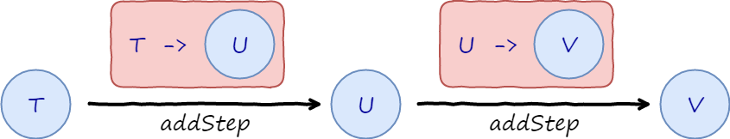
Workflow Pattern
WorkflowThatReturns<Phone> workflow(Speaker speaker) {
return order
.nextTalk() .addStep(x => x
.getConference() ).addStep(x => x
.getCity() );
}

Slide 39
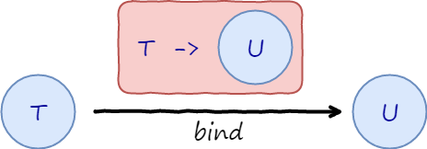
Monad
class Monad<T> {
Monad<U> bind(Function<T, Monad<U>> f);
}
// or alternatively
class Monad<T> {
Monad<U> apply(Function<T, U> f);
static Monad<U> unwrap(Monad<Monad<U>> nested);
}

Slide 40
Option Monad (a.k.a. Maybe)
class Optional<T> {
// ... constructors go here
Optional<U> flatMap(Function<? super T, Optional<U>> func) {
if (this.value.isPresent()) {
return func.apply(this.value.get());
}
else {
return Optional.empty();
}
}
}

Slide 41
Sequence Monad
static class Enumerable
{
public static IEnumerable<U> SelectMany(
this IEnumerable<T> values,
Func<T, IEnumerable<U>> func)
{
foreach (var item in values)
foreach (var subItem in func(item))
yield return subItem;
}
}

Slide 42
Future Monad (a.k.a. Task)
class CompletableFuture
{
CompletableFuture<U> thenCompose( Function<T, CompletableFuture<U>> func)
{
// Some black magic happens here,
// but it works!!!
}
}

Slide 43
WHAT IF WORKFLOW IS NOT SEQUENTIAL?

Slide 44
Problem: Need to capture scope
class Venue {
Task<City> getCity(Talk talk) { ... }
}
static Task<City> nextTalkCity(Speaker speaker) {
return
speaker
.nextTalk()
.ContinueWith(talk =>
talk.Result.getConference()
.ContinueWith(c => c.getCity(talk.Result)) .Unwrap()
).Unwrap();
}

Slide 45
Async-await
static async Task<City> nextTalkCity(Speaker speaker)
{
var talk = await speaker.nextTalk();
var conf = await talk.getConference();
var city = await conf.getCity(talk);
return city;
}

Slide 46
MONADS IN FUNCTIONAL LANGUAGES

Slide 47

Async in F#
let nextTalkCity (speaker: Speaker) = async {
let! talk = speaker.nextTalk()
let! conf = talk.getConference()
let! venue = conf.getCity(talk)
return city
}

Slide 48
Option Monad in F#
let nextTalkCity (speaker: Speaker) = option {
let! talk = speaker.nextTalk()
let! conf = talk.getConference()
let! venue = conf.getCity(talk)
return city
}

Slide 49
Actor in Akka.NET F#
let loop () = actor {
let! message = mailbox.Receive()
match message with
| Greet(name) -> printfn "Hello %s" name
| Hi -> printfn "Hello from F#!"
return! loop ()
}

Slide 50
Option Monad Implementation
type OptionBuilder =
member this.Return(value) =
Some value
member this.Bind(opt, func) =
match opt with
| Some value -> func value
| None -> None

Slide 51
WHAT IS A MONAD?

Slide 52
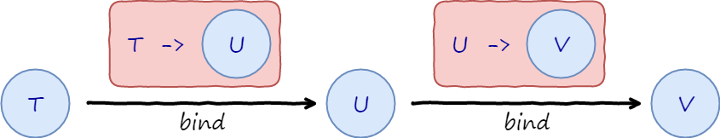
Monad is …
Pattern
Generic Container
Workflow Builder

Slide 53
John De Goes, who knows what Monads are
Monads are virtual machines for expressing sequential, dependent computation, where the instruction set of a VM is given by the structure of the monad's constructors

Slide 54
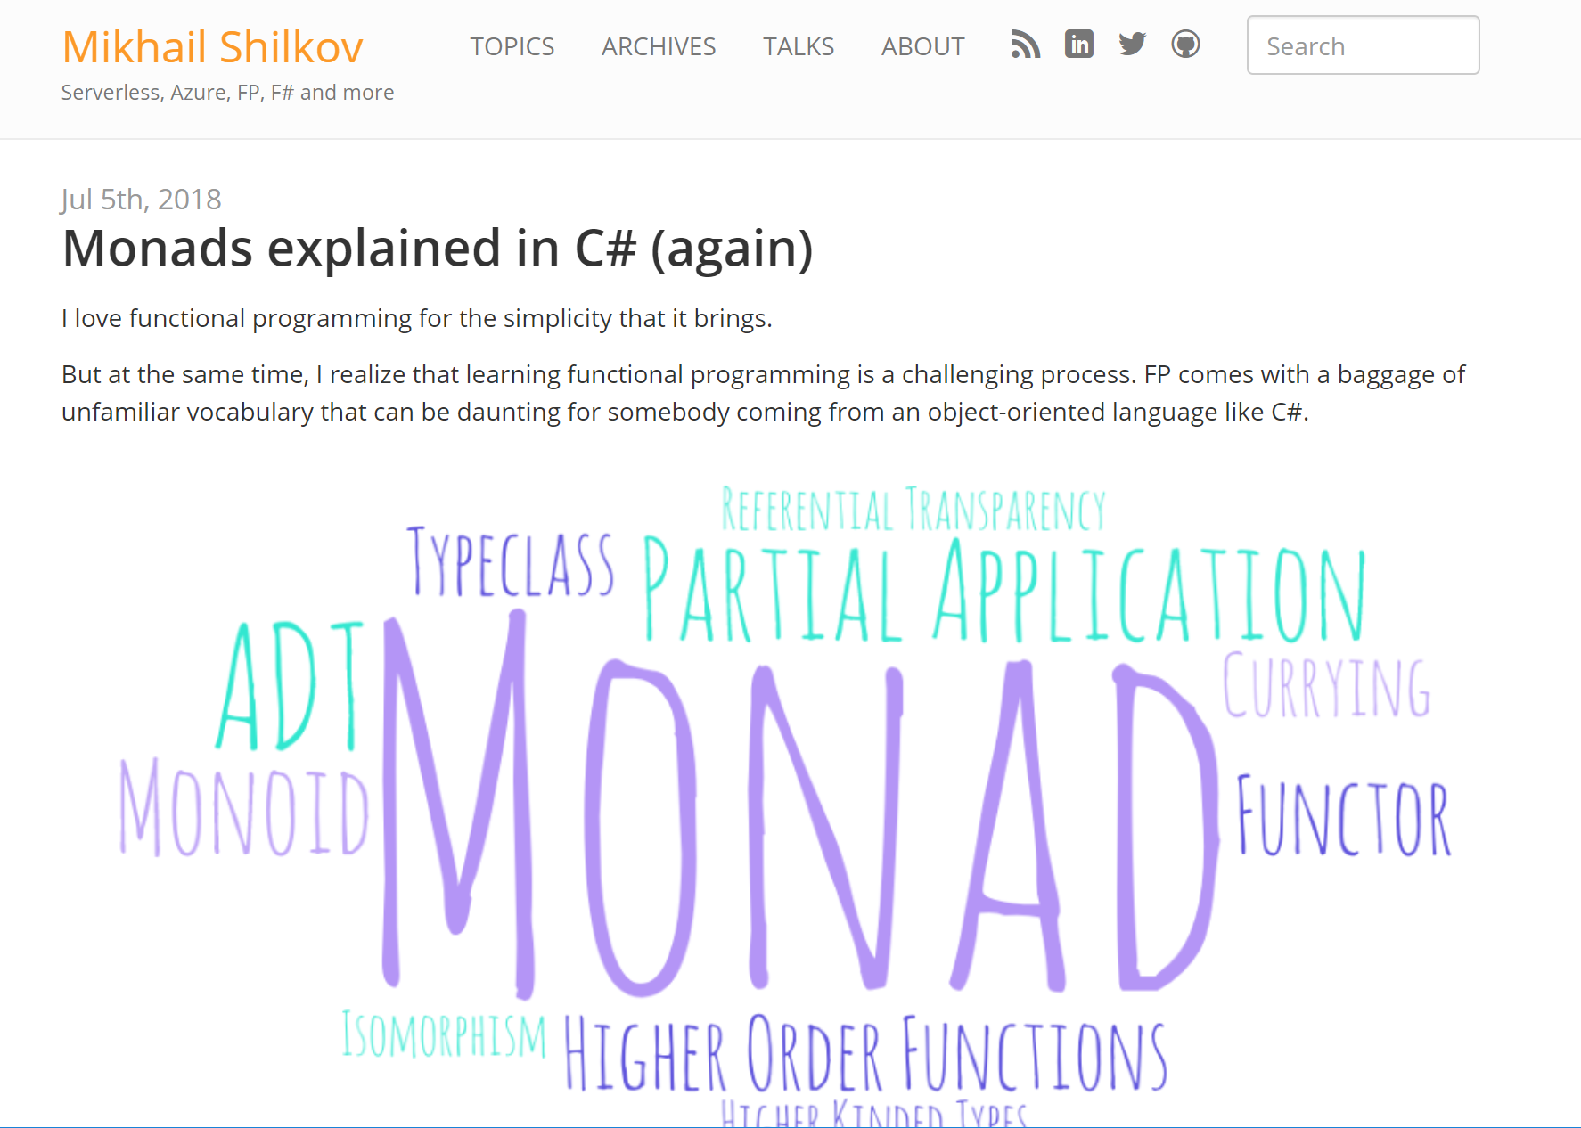
Monads explained in C#
https://mikhail.io/2018/07/monads-explained-in-csharp-again/

Slide 55
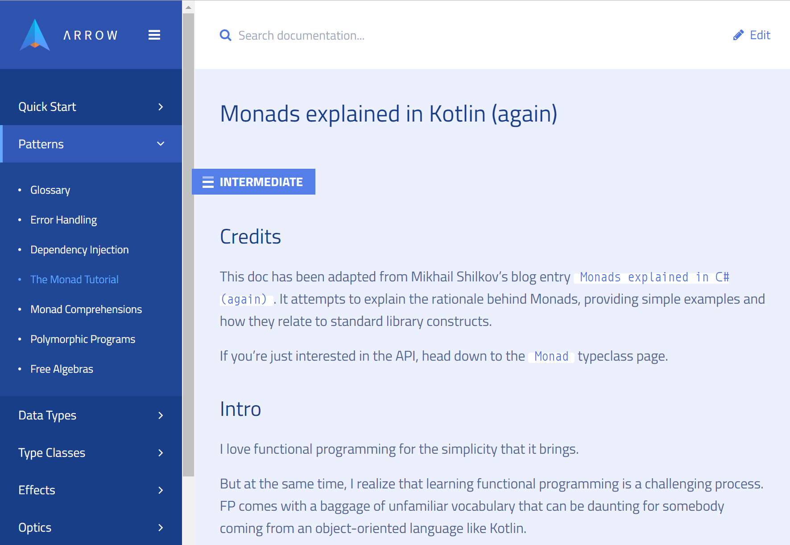
Monads explained in Kotlin
https://arrow-kt.io/docs/patterns/monads/

Slide 56
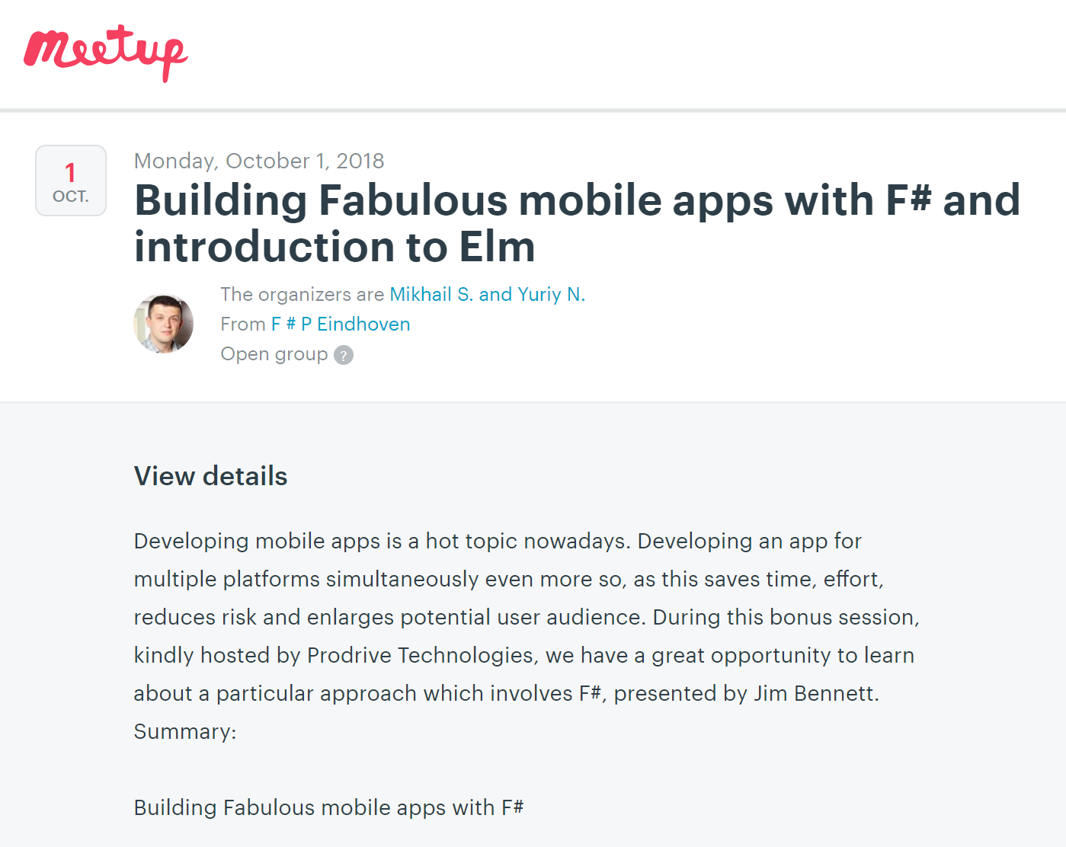
F#P Eindhoven Meetup
https://www.meetup.com/F-P-Eindhoven

Slide 57
@MikhailShilkov
https://mikhail.io

