Slide 1
ownCloud App for Android
María Asensio
David A. Velasco

Slide 2
ownCloud App for Android
Set up the project (in Android Studio)
Overview of project structure
Your first contribution

Slide 3
ownCloud App for Android
Set up the project (in Android Studio)
Overview of project structure
Your first contribution

Slide 4
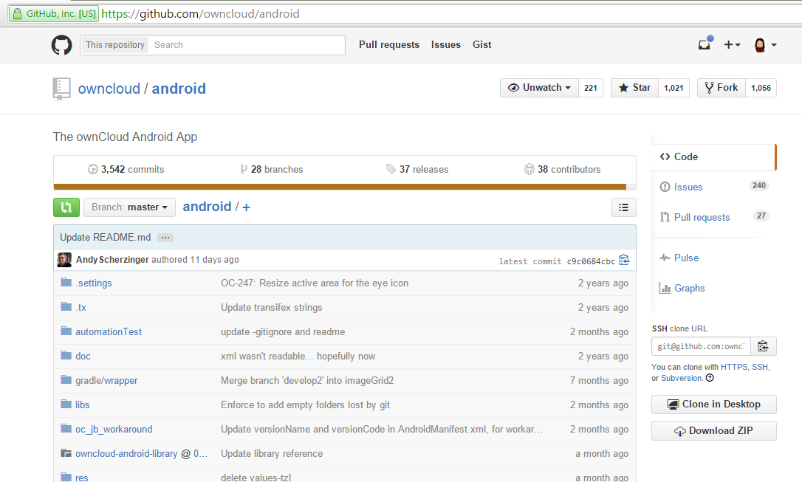

Set up the project
Create a fork of the project

Slide 5
Set up the project
Download android/master repository
  clone your new repo:
    git clone git@github.com:YOURGITHUBNAME/android.git
  Move to the project folder:
    cd android
  Checkout the remote branch 'master' in your own local branch:
    git checkout -b master remotes/origin/master

Slide 6
Set up the project
Download android/master repository
  Pull any changes from your remote branch 'master'
    git pull origin master
  Make official ownCloud repo known as upstream
    git remote add upstream git@github.com:owncloud/android.git
  Make sure to get the latest changes from official android/master branch
    git pull upstream master

Slide 7
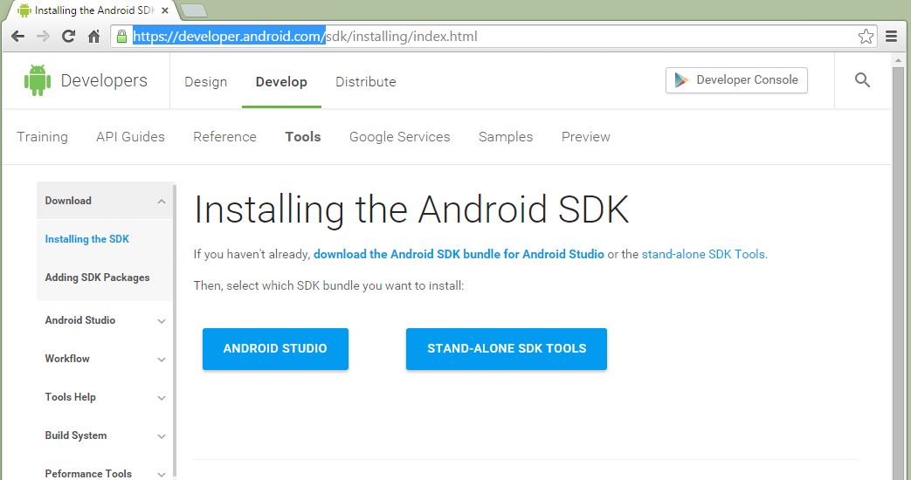
Set up the project
Install Android Studio

Slide 8

Set up the project
Complete the setup of project properties running:
  Windows:setup_env.bat gradle
  Mac OS/Linux: ./setup_env.sh gradle
Open Android Studio

Slide 9
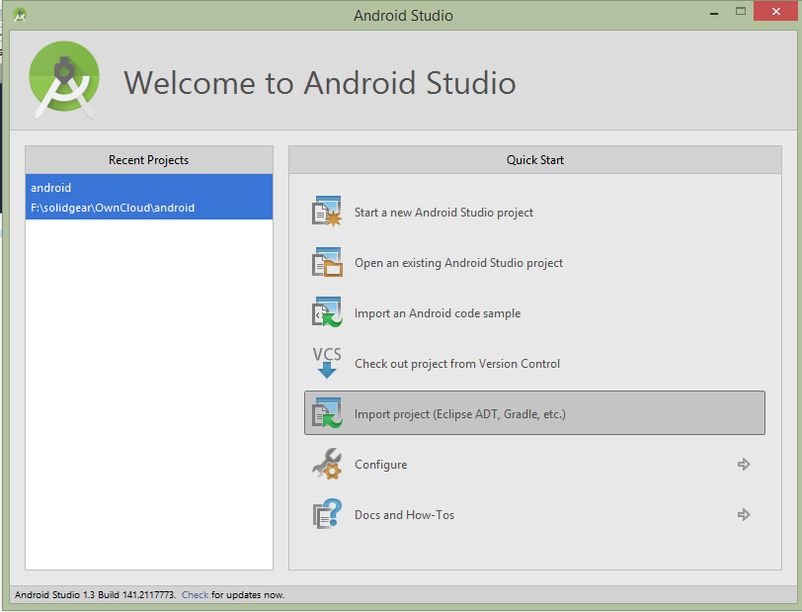
Setup the project
Import project

Slide 10
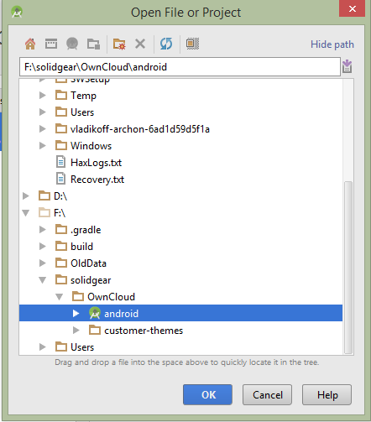
Set up the project
Select the project to import

Slide 11
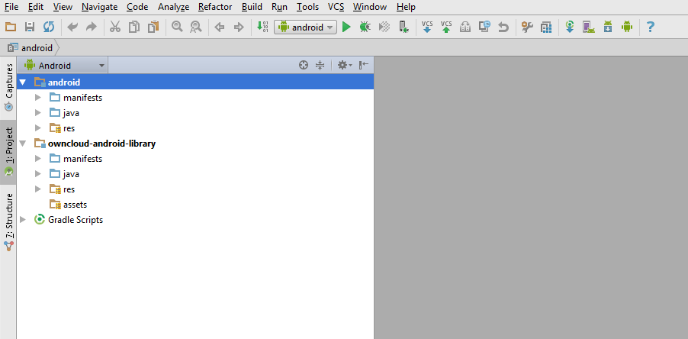
Set up the project
OwnCloud project is loaded in Android Studio

Slide 12
Interesting slides
Set up the project (in Android Studio)
Overview of project structure
Your first contribution

Slide 13
Overview of project structure
android app
android library
Notes:
The project contains two modules.
The first one corresponds to the app itself.
The second is the OC library for Android. This library is built to facilitate other apps access to files in OC servers.
We will be focused in the app module.

Slide 14
Overview of project structure - Android App
manifest & resources
code
  third_parties
    some utility classes from others
  com.owncloud.android
Notes:
Manifest & resources contain the usual stuff in Android projects.
In the code folder we can find two clearly separated paths.
One is com.owncloud.android, where all the original code of the app is kept.
In the third_parties folder there are some classes reused from other projects. We preferred to keep these classes in source code because we made some small modifications on them.

Slide 15
Overview of project structure - Android App
code
  com.owncloud.android
    authentication
    datamodel
    db
    files
    media
    notifications
Notes:
+ authentication/
AccountAuthenticator & friends
PassCodeManager
SsoWebViewClient
+ datamodel/
FileDataStorageManager
OCFile
ThumbnailsCacheManager
+ db/
DbHandler
ProviderMeta
+ files/
+ services/
FileDownloader, FileUploader & friends
BootupBroadcastReceiver
FileMenuFilter
FileOperationsHelper
InstantUploadBroadcastReceiver
+ media/
MediaControlView
MediaService
MediaServiceBinder
+ notifications/
NotificationBuilderWithProgressBar
NotificationDelayer

Slide 16
Overview of project structure - Android App
code
  com.owncloud.android
    operations
    providers
    services
    syncadapter
    utils
    widgets
Notes:
+ operations/
+ common/
SyncOperation
***Operation (16), OAuth2GetAccessToken
+ providers/
FileContentProvider
+ services/
+ observer/
FileObserverService
FolderObserver
OperationService
SyncFolderHandler
+ syncadapter/
AbstractOwnCloudSyncAdapter
FileSyncAdapter
FileSyncService
+ utils/
*Utils
RecursiveFileObserver
ErrorMessageAdapter
CopyTmpFileAsyncTask
OwnCloudSession <<< unused
+ widgets/
ActionEditText <<< unused

Slide 17
Overview of project structure - Android App
code
  com.owncloud.android
    ui
Notes:
+ ui/
+ activity/
*Activity (12),
+ adapter/
*Adapter (10), DiskLruImageCache
+ dialog/
*Dialog (8), *DialogFragment (7), SslWebView
+ fragment/
*Fragment (7)
+ preview/
FileDowloadFragment, PreviewImageFragment, PreviewMediaFragment
ImageViewCustom
PreviewImageActivity, PreviewVideoActivity
PreviewImagePagerAdapter
ActionItem <<<< unused CheckBoxPreferenceWithLongTitle
CustomPopup <<<< unused
ExtendedListView
NavigationDrawerItem
PreferenceWithLongSummary
QuickAction <<<< unused
RadioButtonPreference
SquareImageView
SquareLinearLayout
TextDrawable <<< unused so it seems

Slide 18
OCFile
OCFile
OwnCloudAccount
Notes:
The main class in our (data) model is OCFile. It represents a file in an ownClouad account. It's an abstraction gathering data both from the remote copy and from the local copy of the file.
In the app, files are shown as a single entity, not explicitly distinguishing between the local and the remote copies of the file. But some properties of interest are distinguished to the user (such as the 'down' state), and some others are needed to synchronize the contents of the file.
Folders are just instances of OCFile, returning 'true' to the method 'isFolder()'.

Slide 19
UI
FileActivity
FileFragment
OCFile
Notes:
Most of the Activities in our app extend FileActivity, that defines some basic methods and behaviours, common to any Activity that wants to show information or act upon an OCFile.
Typically, a FileActivtiy instance will hold an instance of a FileFragment, another abstraction that groups methods and behaviours common to Fragments that hold an OCFile. FIleFragments allow reusing different portions of the UI in different FileActivities, or in devices with different configurations (such as tablets in landscape orientation).

Slide 20
UI
FileActivity
AuthenticatorActivity
OCFile
OwnCloudAccount
Notes:
FileActivity validates the existence in the device of the account holding the OCFile(s) that handles every time it's moved to the front of the screen, and swaps to a different account if doesn't exist anymore. If no other account exits, it starts the LoginActivity to request the user to create the first again (such as on the first start of the app).

Slide 21
UI
OperationsService
FileActivity
FileDownloader
FileUploader
Notes:
Besides, FileActivity establishes connections with the main services that handle the sychronization of local and remote copies of the files, both to monitor the state of transfers and to request operations on the files.

Slide 22
UI
FileActivity
FileFragment
FileDisplayActivity
OCFileListFragment
OCFile
Notes:
There are different subclasses of FileActivity. The first of all, and the first started in the app is FileDisplayActivity. This class is specially complex because may hold different instances of FileFragment depending on the target OCFile that is shown in it, and the device configuration. The first FileFragment it holds is OCFileListFragment, namely, the list of files in a folder. This is automatically shown by FileDisplayActivity if the OCFile received in the starting Intent is a folder, or if OCFile is passed in the Intent, that defaults to showing the root folder of the current account. It's also shown in the left side of tablets in landscape orientation, even when the OCFile received in the Intent is not a folder (its parent folder is listed then).

Slide 23
UI
FileActivity
FileFragment
FileDisplayActivity
PreviewMediaFragment
OCFile
Notes:
FileDisplayActivity instances different FileFragments when receives an OCFile that is not a folder as a parameter.
For downloaded audio or video files, it shows a PreviewMediaFileFragment, that allows their playback.

Slide 24
UI
FileActivity
FileFragment
FileDisplayActivity
FileDetailFragment
OCFile
Notes:
For files being transferred or files of that cannot be previewed in the OC app, it shows a FileDetailFragment instance, that summarizes the data of the file, and shows a progress bar in the case of files in transference.

Slide 25
UI
FileActivity
FileFragment
FileDisplayActivity
OCFileListFragment
FileDetailFragment
OCFile
Notes:
These fragments are displayed using the full screen in smartphones or tablets in portrait mode, or in the right side of the screen in tablets on landscape.

Slide 26
UI
FileActivity
FragmentStatePagerAdapter
FileFragment
PreviewImageActivity
PreviewImageAdapter
FileDownloadFragment
OCFile
PreviewImageFragment
Notes:
Other important FileActivity is PreviewImageActivity. This is the image gallery Activity in our app. It holds a FragmentStatePagerAdapter, a component that allow swiping through an indefinitely long list of Fragments, that may be of two classes: FileDownloadFragment, that shows the progress of images being downloaded; and PreviewImageFragment, that displays an image file on screen.

Slide 27
UI
FileActivity
FileFragment
PreviewVideoActivity
PreviewMediaFragment
OCFile
Notes:
Other example of FileActivity is PreviewVideoActivity. This activity takes the control when the user taps on video in the PreviewMediaFragment shown by FileDisplayActivity, and continues the playback in full screen mode.

Slide 28
UI
FileActivity
UploadFileActivity
LocalFileListFragment
java.io.File
Notes:
Other important FileActivities are Uploader and UploadFilesActivity.
UploadFileActivity is shown when the user taps on the 'upload' icon in the action bar, and then selects 'Files' in the next dialog. It displays the list of files in the public storage of the device, and allows to browse through it. This is done in an instance of LocalFileListFragment, that is quite similar to OCFileListFragment, but handling java.io.Files instead of OCFiles.

Slide 29
UI
FileActivity
app
Uploader
java.io.File
Notes:
Uploader is the activity shown when other app sends a file to OC. It doesn't hold any fragment. It's a quite old activity, requiring a good refactoring, though it's also a FileActivity. It's the only FileActivity that doesn't swap to a different account if the default account doesn't exist anymore. Instead, it shows a list with all the current accounts to the user, and allows chosing one of them to share the file into. If no other account exists, then it behaves as any other FileActivity, starting the AuthenticatorActivity to enforce the creation of an account.

Slide 30
UI
ActionBarActivity
PreferenceActivity
Preferences
PassCodeActivity
AuthenticatorActivity
Notes:
Not all the Activities in the app extend FileActivity. There are some important exceptions, namely:
Preferences
This activity extends android.preference.PreferenceActivity and forms the Settings screen of our app.
PassCodeActivity
this is shown when the user wants to enable or disable a passcode protecting the access to the OC app, or when this passcode is enabled and requested. It has no interaction with OCFiles, so doesn't need to implement FileActivity.
authentication.AuthenticatorActivity
the only Activity of the app not in the .ui package. It show the login view when an account is created, modified or credentials are not valid anymore.

Slide 31
Services
CreateFolderOperation
RenameFileOperation
OperationsService
SynchronizeFileOperation
SynchronizeFolderOperation
Notes:
Most of the real stuff in the OC app is performed in Services. This allows that long operations of different types are queued in a simple way, and that are not interrumpted even though the user leaves the UI of the app.
Some of these services could (and will) be merged in a single service, so that the app is easier to understand and maintain. Besides, some operations are not performed in background services, but directly in background threads (out of any service) or in AsyncTasks.
service.OperationsService handles most of the operations performed on files & folders. It attends requests for creation, deletion and update of both files and folders, each of them resulting in the instantiation of objects of some of the subclasses of .operations.SyncOperation; namely, CreateFolderOperation, RenameFileOperation, RemoveFileOperation, etc... Generally this is the first place to think about when a change on a file is needed.

Slide 32
Services
FileDownloader
DownloadFileOperation
FileUploader
UploadFileOperation
SynchronizeFileOperation
Notes:
When a file or folder needs to be synchronized between the device and the server, usually a data transfer is needed in one or other direction. This is achieved requesting for downloads or uploads to FileDownloader and FileUploader, services that take care of queueing and running downlads and uploads respectively. However, downloads and uploads should not be requested generally from the UI components to thsese services. Instead, a request for a SynchronizeFileOperation or SynchronizeFolderOperation should be done to OperationsService.

Slide 33
Services
FileSyncService
FileSyncAdapter
SynchronizeFileOperation
Notes:
Another important service related to synchronization is FileSyncService and the delegate class that really implements its operations, FileSyncAdapter. These elements take care of performing a synchronization of all the files and folders in a given account at request of the system. These classes implement the API defined by the Android framework to allow synchronizations managed by Android, and its existence guarantees that the OC accounts appear in the 'Settings/Accounts' menu in the Android devices. By default, the automatic synchronization of OC accounts is disabled, but may be enabled in the 'Settings/Accounts' menu. Nowadays, this kind of synchronization does not sync all the data of the files in an account, but only the properties of the files, and the data of those files that are checked as favorites. This policy will evolve soon.
Digging in the code of SyncAdapter will show that, in the end, it trusts again in instances of SynchronizeFileOperation and SynchronizeFolderOperation to do the real work. These classes allow different kind of synchronizations, including or not the data of the files and folders they act upon.

Slide 34
Services
FileObserverService
FileObserver
OCFile
java.io.File
SynchronizeFileOperation
Notes:
Another service related to synchronization is observer.FileObserverService. This is responsible for monitoring the state of files marked as favorites, listening for updated made on them. This observation allows that changes on the favorite files made by external applications are detected as soon as possible, even though the OC app is not started.

Slide 35
Services
FileActivity
FileFragment
FileDisplayActivity
PreviewMediaFragment
MediaService
OCFile
Notes:
Last but no least, MediaService takes care of music playback. This allows that sound and music files played in the OC app keep playing if the app is left by the user.

Slide 36
Persistence
FileDataStorageManager
ContentResolver
ContentProvider
FileActivity
OCFile
FileContentProvider
OCService
Notes:
Persistence of the data handled by the OC app is distributed in different locations.
[19]
The properties of the files and folder known by the app are saved in a private database. This one is accessed through a content provider, the class provider.FileContentProvider. Though most of the changes on the database could be done without the need of a content provider, the integration with the synchronization framework requires its existence, since its the parameter passed to FileSyncAdapter to access the data of the app from a system process. (not exactly)
Generally, the app does not access directly to the methods of FileContentProvider, but uses instead FileDataStorageManager, that defines methods of a higher abstraction level to make easily common queries and updates on the database.
The data of the files locally synchronized are kept in the 'ownCloud' folder, in the public storage of the device. The location of each file may be accessed with the method OCFile.getStoragePath(), and is kept in the private database.

Slide 37
Persistence
ThumbnailsCacheManager
FileActivity
OCFile
Notes:
Another point of storage is ThumbnailsCacheManager, that keeps in a local LRU cache on disk the thumnails for images shown in the list(s) of files in the app (those got from the server, and those generated locally too).

Slide 38
Persistence
AccountUtils
AccountManager
FileActivity
OwnCloudAccount
OCService
Notes:
Finally, the information of the OC accounts is saved through the system AccountManager, that enforces its own security rules to get information.

Slide 39
Interesting slides
Set the project up (in Android Studio)
Overview of project structure
Your first contribution

Slide 40
Your first contribution
Sign the Contributor Agreement, before your changes can be accepted!
Load your local changes
  Commit your changes locally: git commit -a
  Push your changes to your GitHub repo: git push

Slide 41
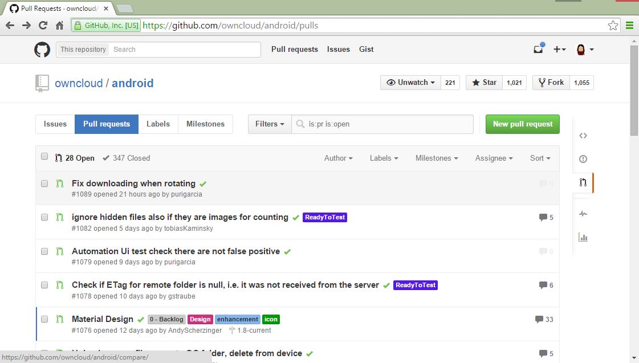
Your first contribution
Make a Pull Request
  Browse to https://github.com/YOURGITHUBNAME/android/pulls

Slide 42
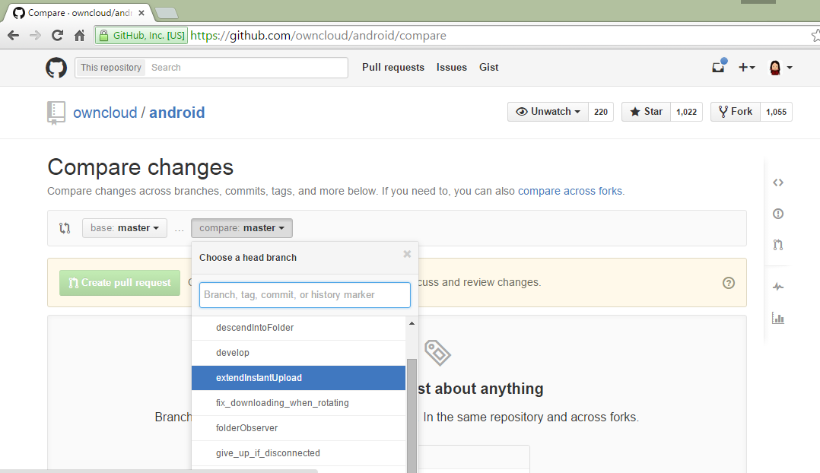
Your first contribution
Make a Pull Request
  Set base:master and set compare:branch_with_changes

Slide 43
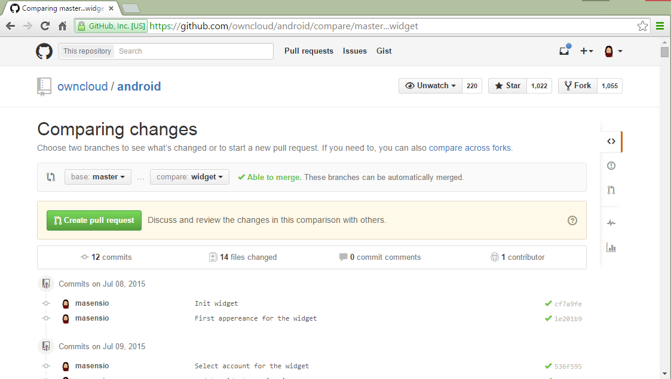
Your first contribution
Make a Pull Request

Slide 44
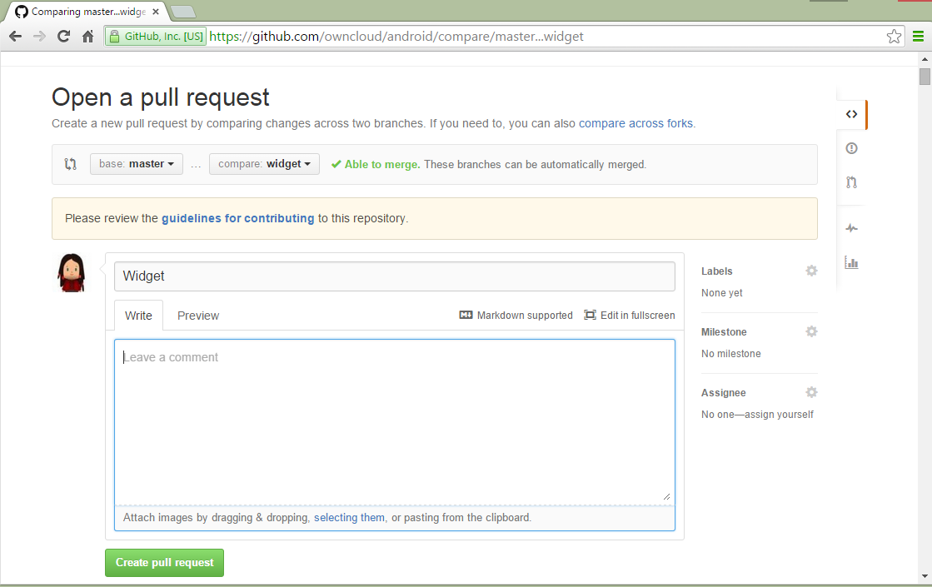

Your first contribution
Make a Pull Request

Slide 45
Next contributions
Create a new branch which is a clone of upstream/master.
  git fetch upstream
  git checkout -b my_new_master_branch upstream/master
If you want to rename that branch later
  git checkout -b my_new_master_branch_with_new_name
Push branch to server
  git push -u origin name_of_local_master_branch
Use GitHub to issue PR

Slide 46


Develop a Junior Job
Select a issue labeled as

Slide 47
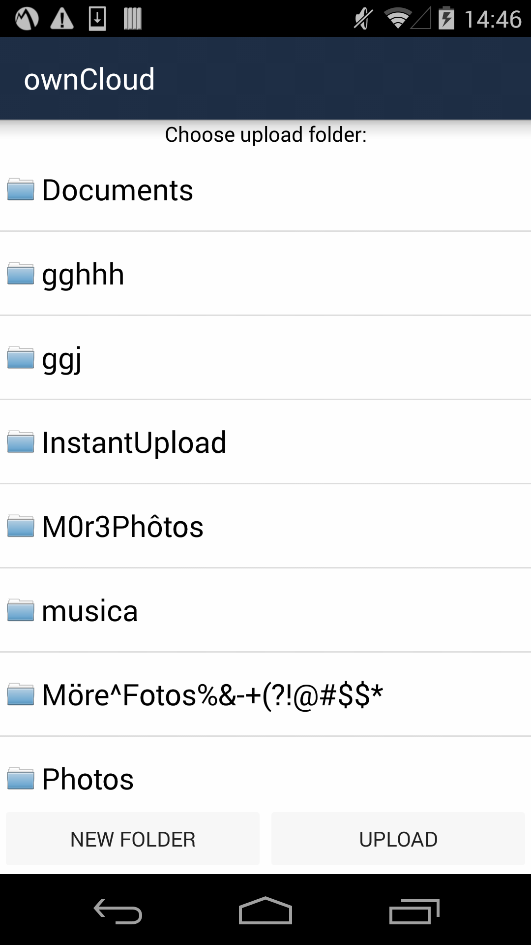
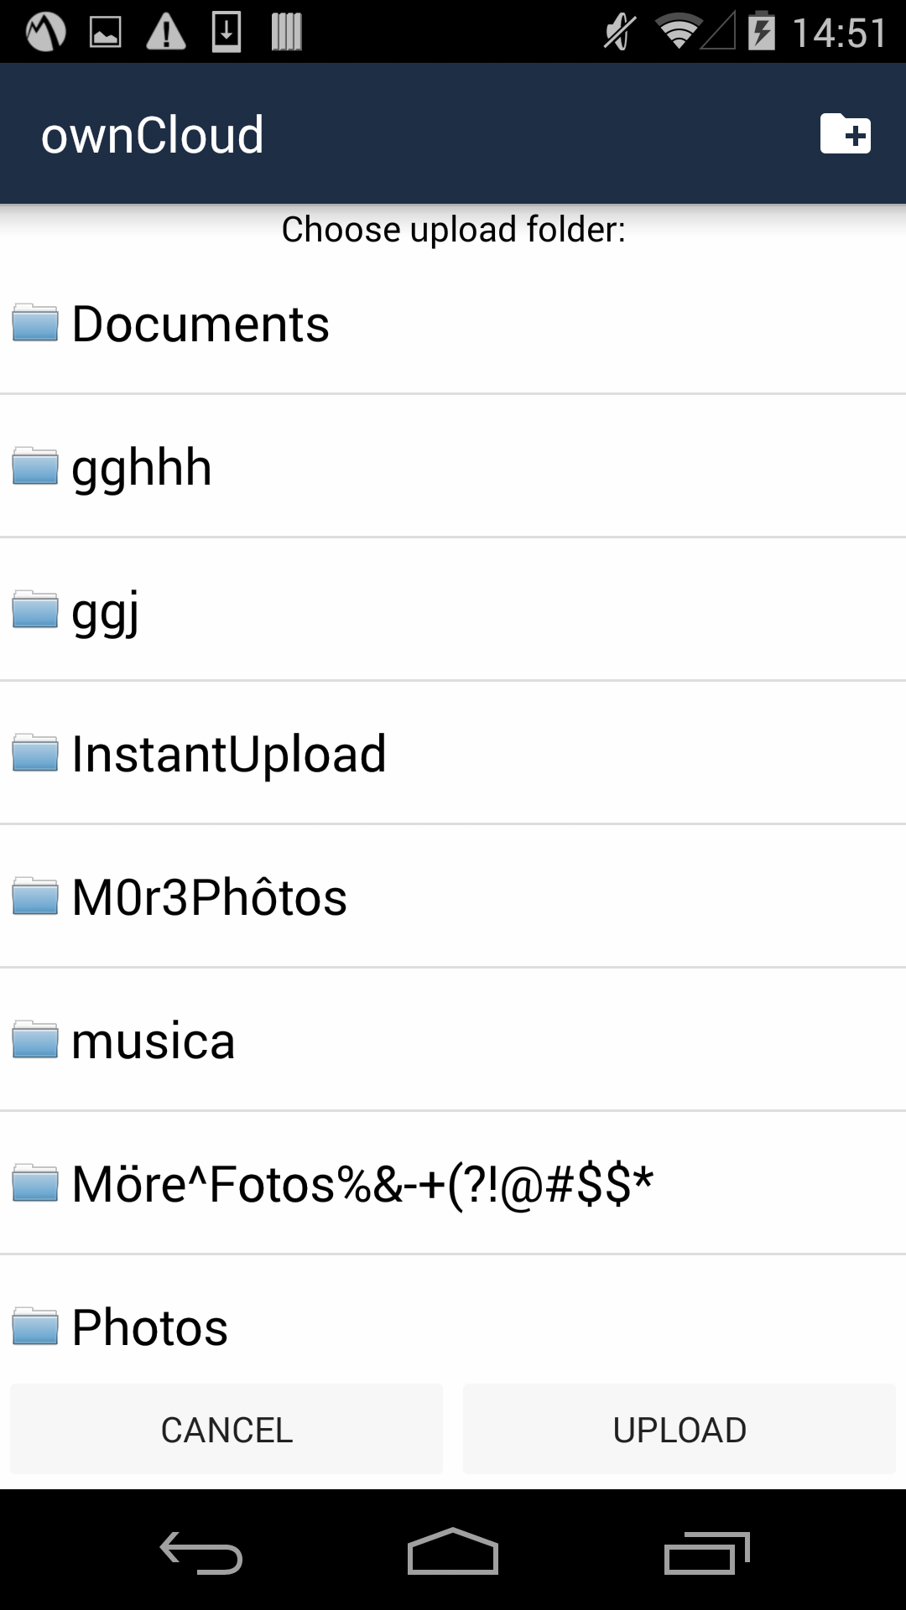
Develop a Junior Job
Example:

Slide 48
Develop a Junior Job
Solution in branch:
    create_folder_button_on_action_bar_for_uploader
Push the branch
Create the Pull Request

Slide 49
Thanks

