Slide 1

Nextcloud presentation

Slide 2
Agenda
What is Nextcloud
What can it do
Why you want it
How you get it

Slide 3
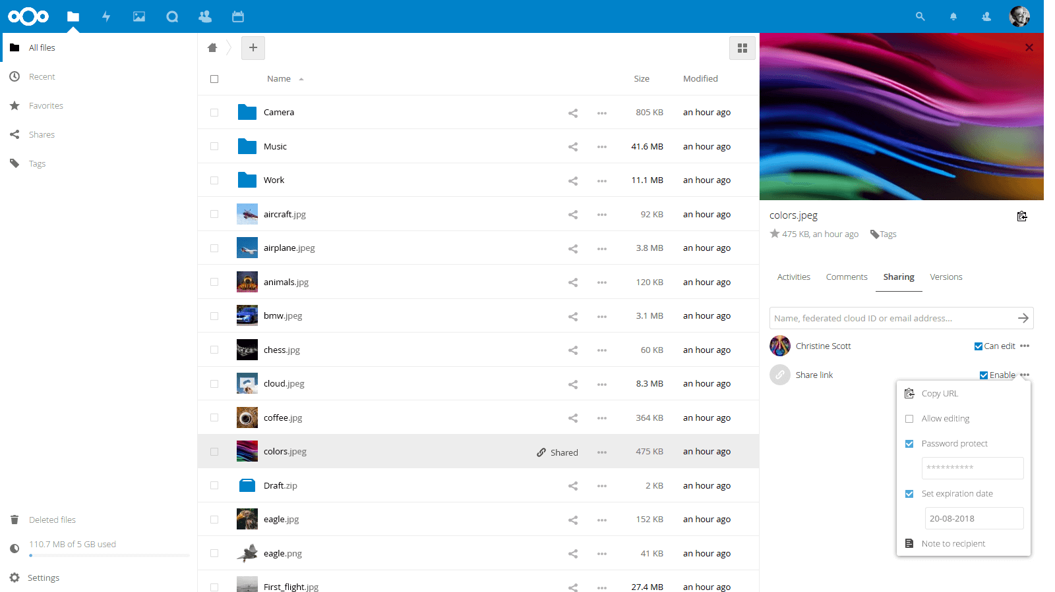
What is Nextcloud?
Secure data
Private clouds
Cross-cloud sharing
Audio & video chat

Slide 4









Features
Open Source
Easy to use
Communication
Document editing
Fine-grained control
Auditing, workflow
Configurable external storage
LDAP/ SAML
Developer APIs

Slide 5


A safe home for all your data
nextcloud.com
github.com/nextcloud
help.nextcloud.com

