Slide 1
Nextcloud presentation

Slide 2
Agenda
What is Nextcloud
What can it do
Why you want it
How you get it

Slide 3
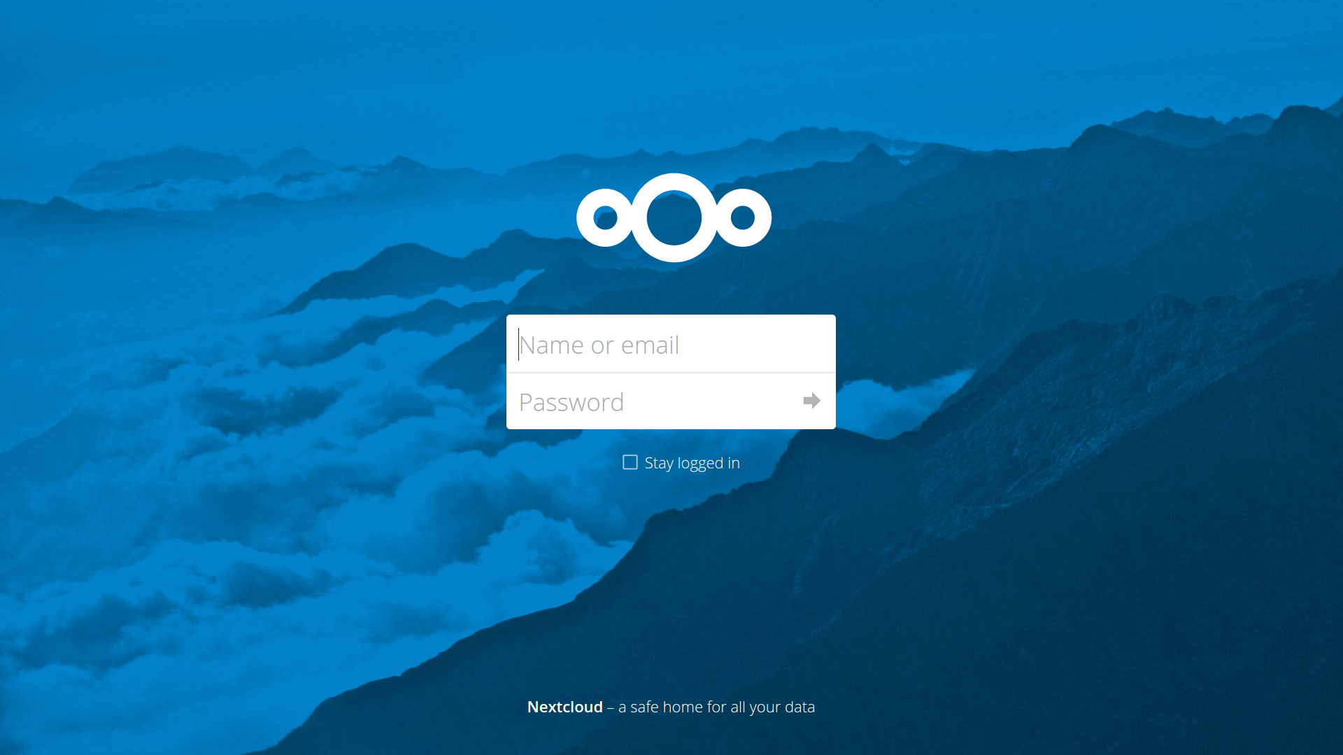
What is Nextcloud?
Secure data
Private clouds
Cross-cloud sharing
Audio & video chat

Slide 4









Features
Open Source
Easy to use
Communication
Document editing
Fine-grained control
Auditing, workflow
Configurable external storage
LDAP/ SAML
Developer APIs

Slide 5



A safe home for all your data
Nextcloud GmbH
Kronenstr. 22A
70173 Stuttgart
Germany
+49.711.896656-0
hello@nextcloud.com
nextcloud.com

