Slide 1
Learning Object Evaluation Tool (LOBE)

Slide 2
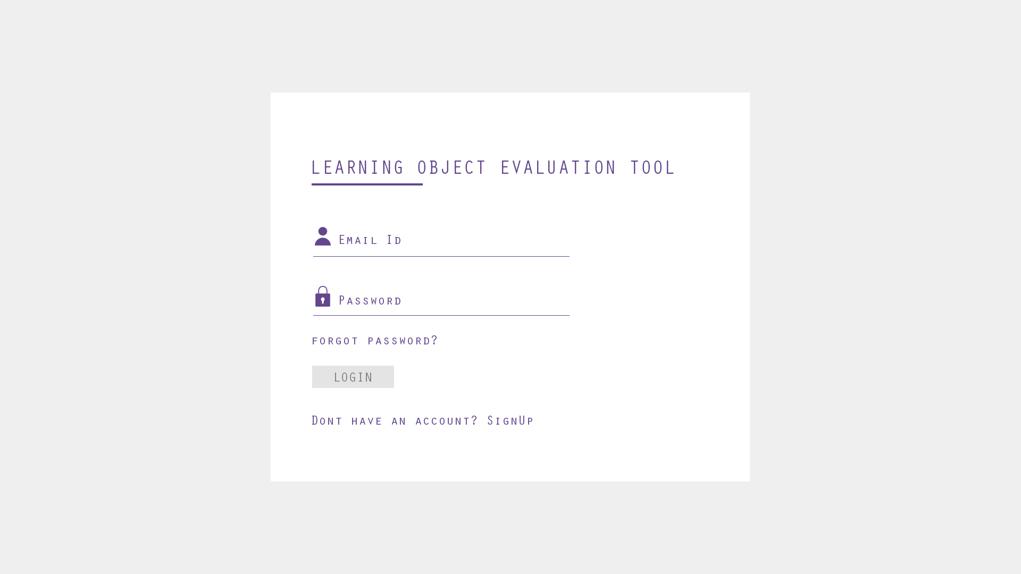
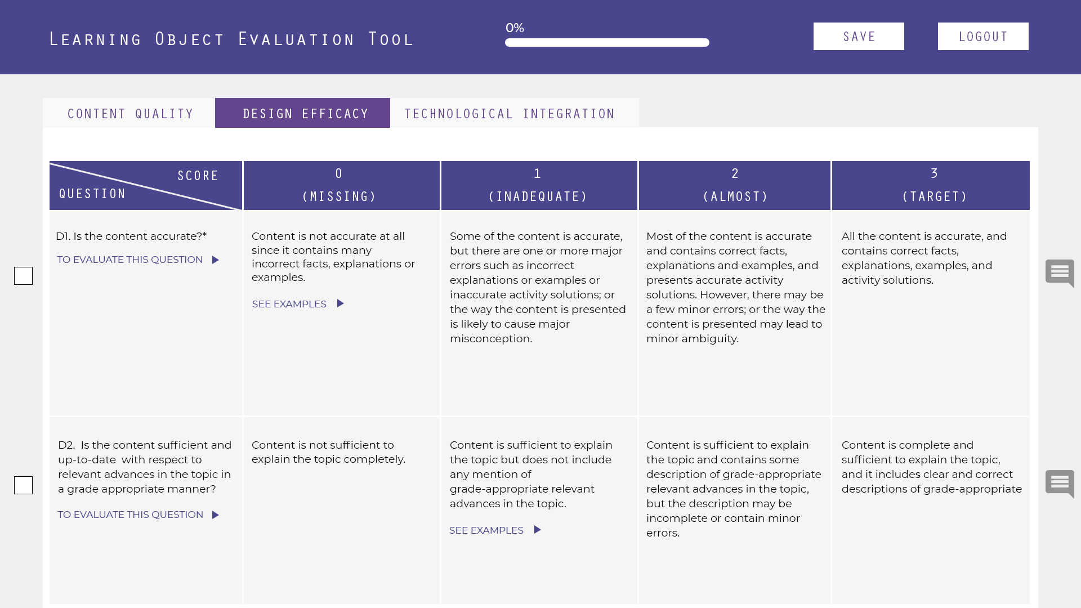
Overview

Slide 3
Open signup.html
User will login if they have an account.
If user doesn’t have an account, they will click on “Don’t have an account” link. See next slide for the page that will open up when this link is clicked.

Slide 4
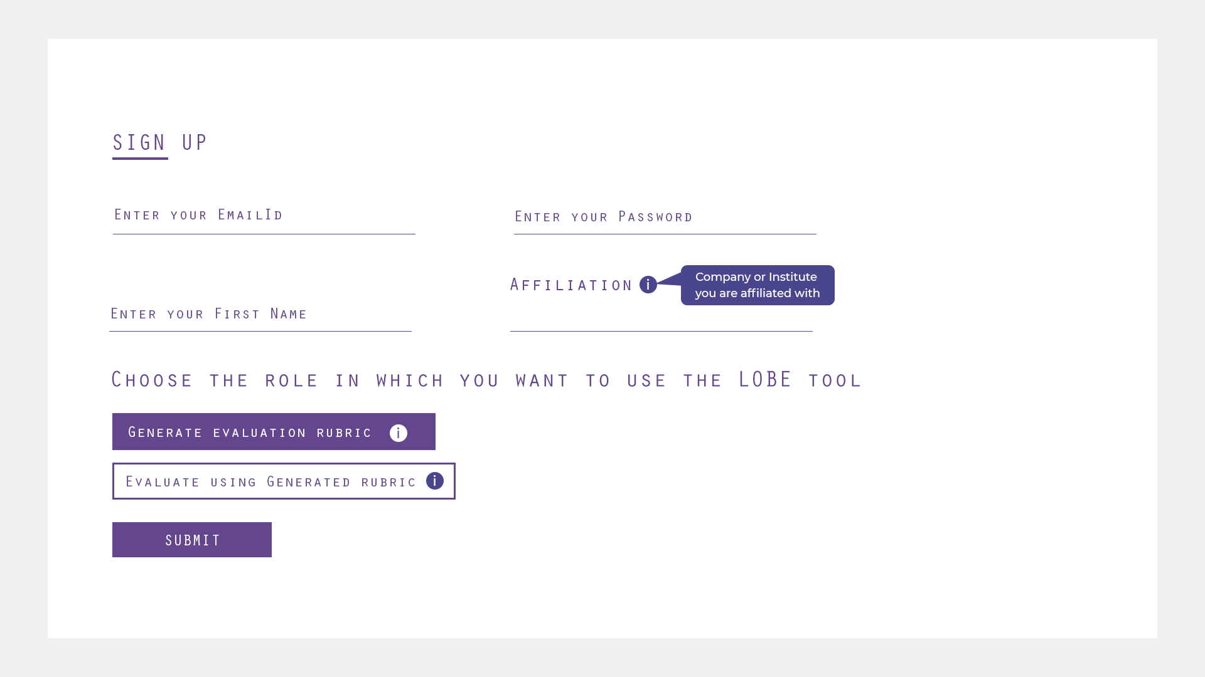
Open signup.html
Here user can create their account.
They will enter email-id, password, name, affiliation and choosing the role (which is acting as an radio button). Save all of these to the database.

Slide 5
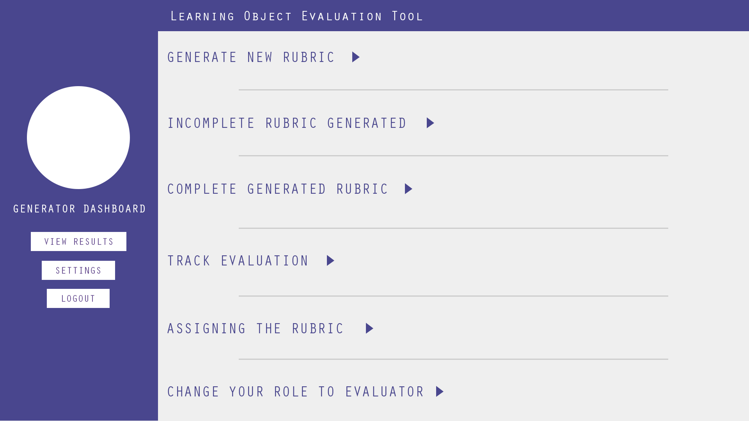
Open generator-dashboard.html
After selecting the role ‘Generate evaluation rubric’ (see slide-2), user will be redirected to this page generator-dashboard.html.
Here user will click on Generate New Rubric.

Slide 6
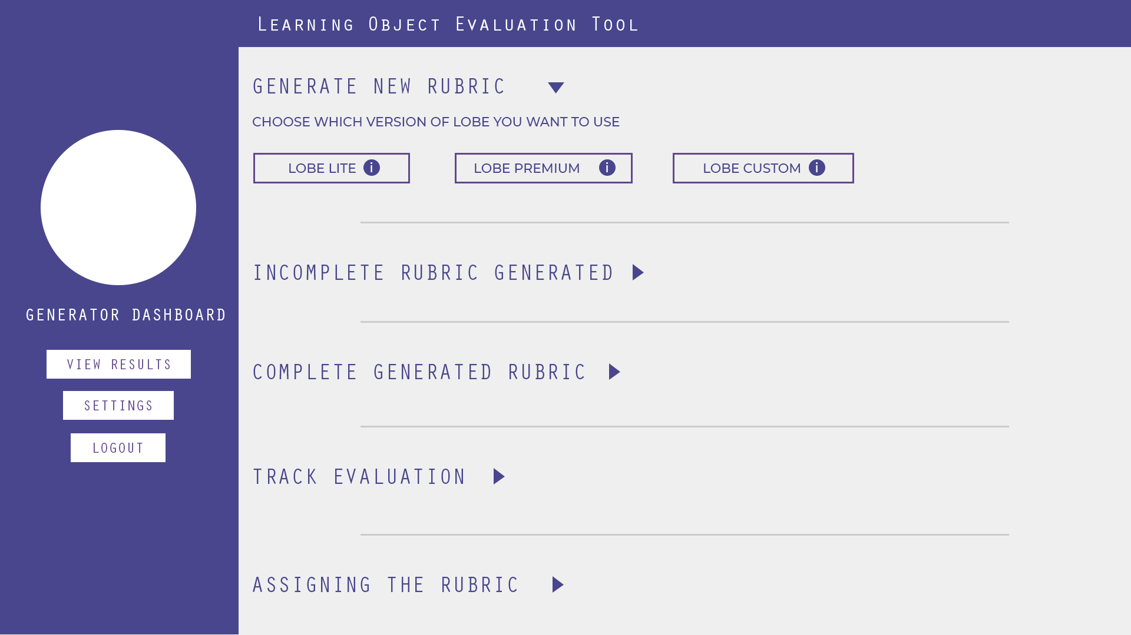
Now user will click on LOBE Custom radio button.

Slide 7
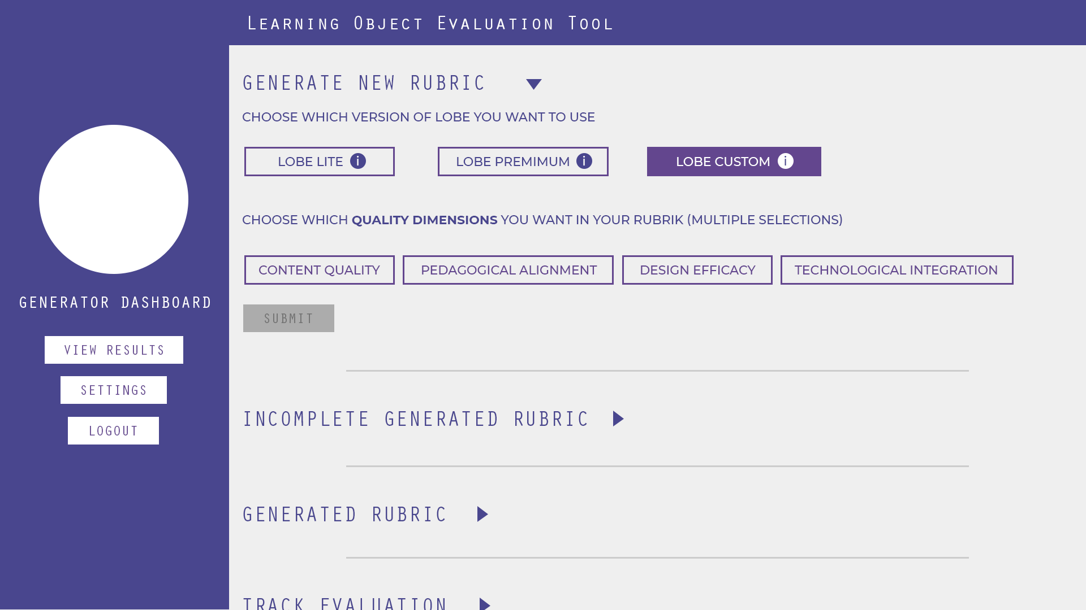
After clicking on LOBE Custom, 4 more options will appear. These options correspond to quality dimensions.
User can choose any 2 of them.

Slide 8
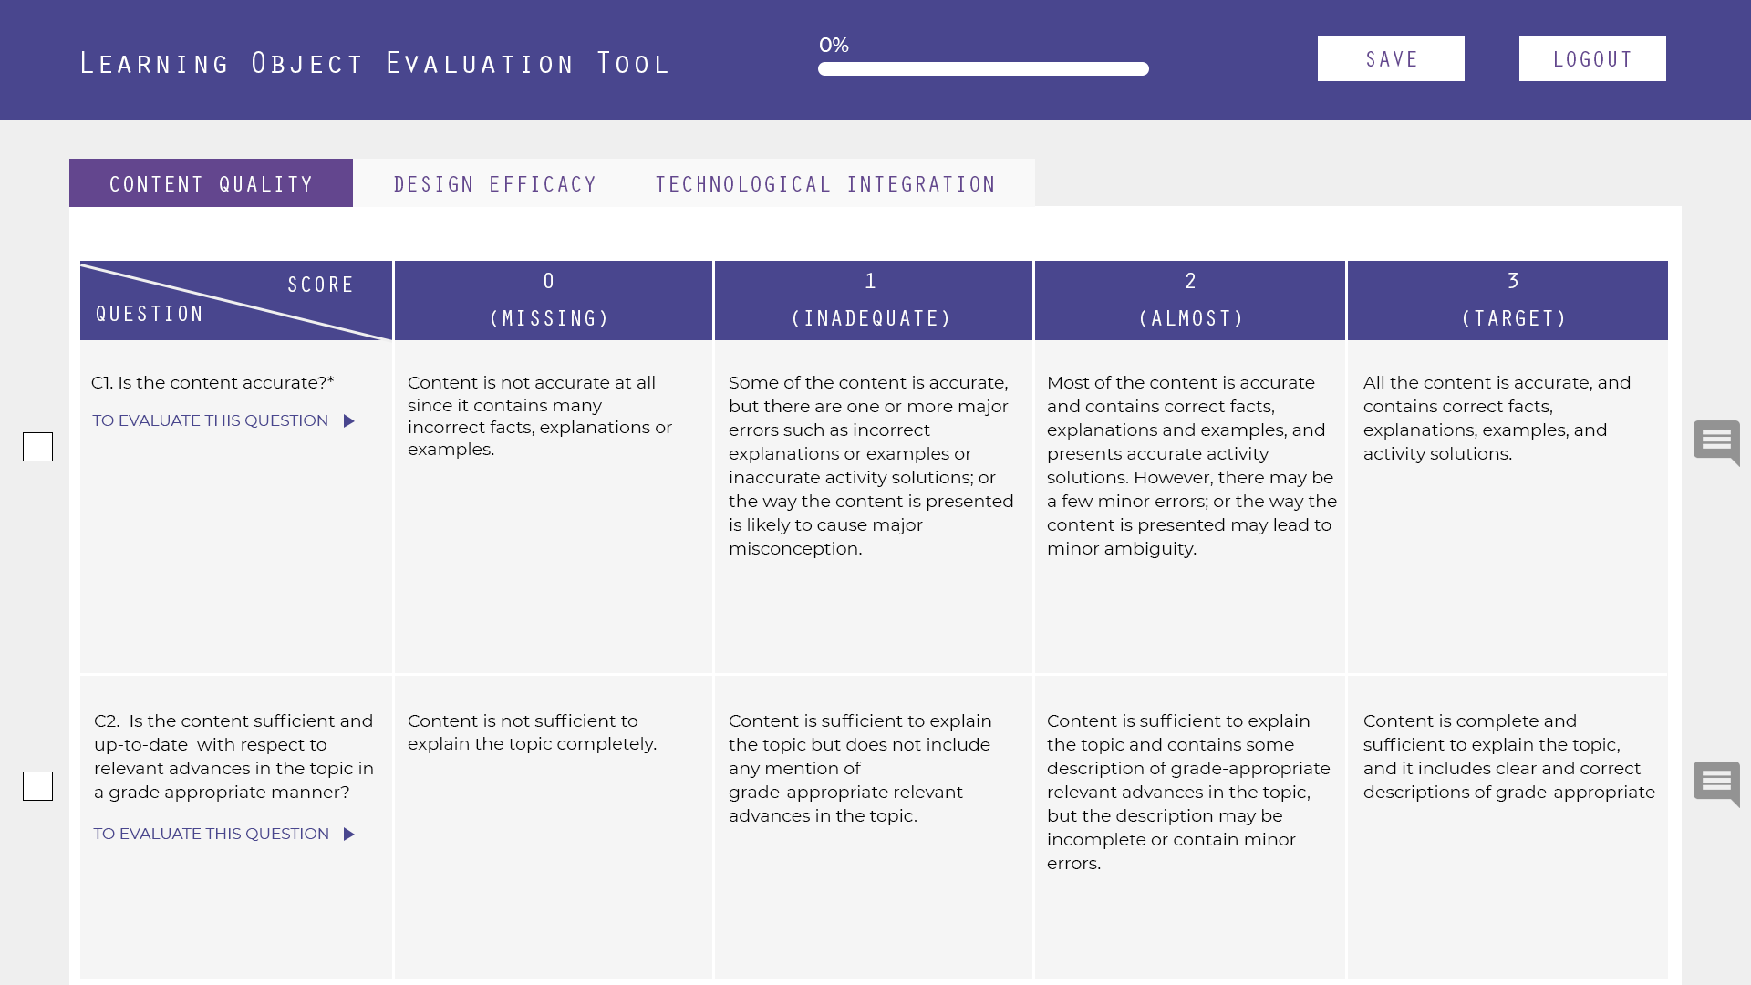
Tabs
This page is generator-questions.html.
Based on the selection user made in the quality dimensions radio button (slide - 3), the tabs should be shown above.
Fetch entire rubric i.e. the content within each cell from the database.
Only those questions will be saved which are checked and not the unchecked ones.

Slide 9
In each tab there will be 2 questions.
User can select any of them.

Slide 10
In the design efficacy tab, Question D1 will have static image, whereas question D2 will have image gallery. These image will popup by clicking on ‘See Examples’ link.
These images will also be fetched from database. Refer next 2 slides for these images

Slide 11
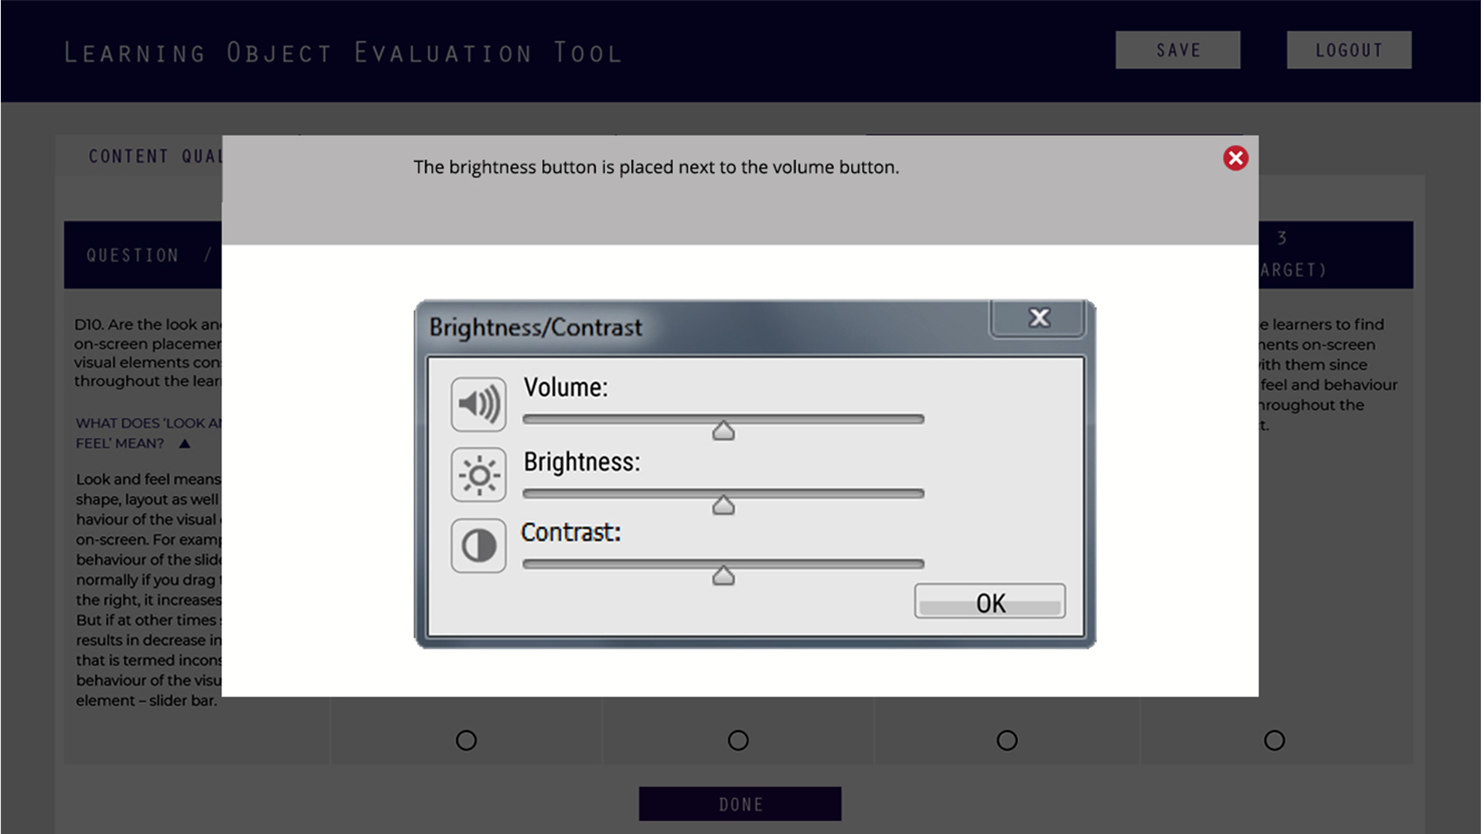
Qs. D1 question static image.

Slide 12
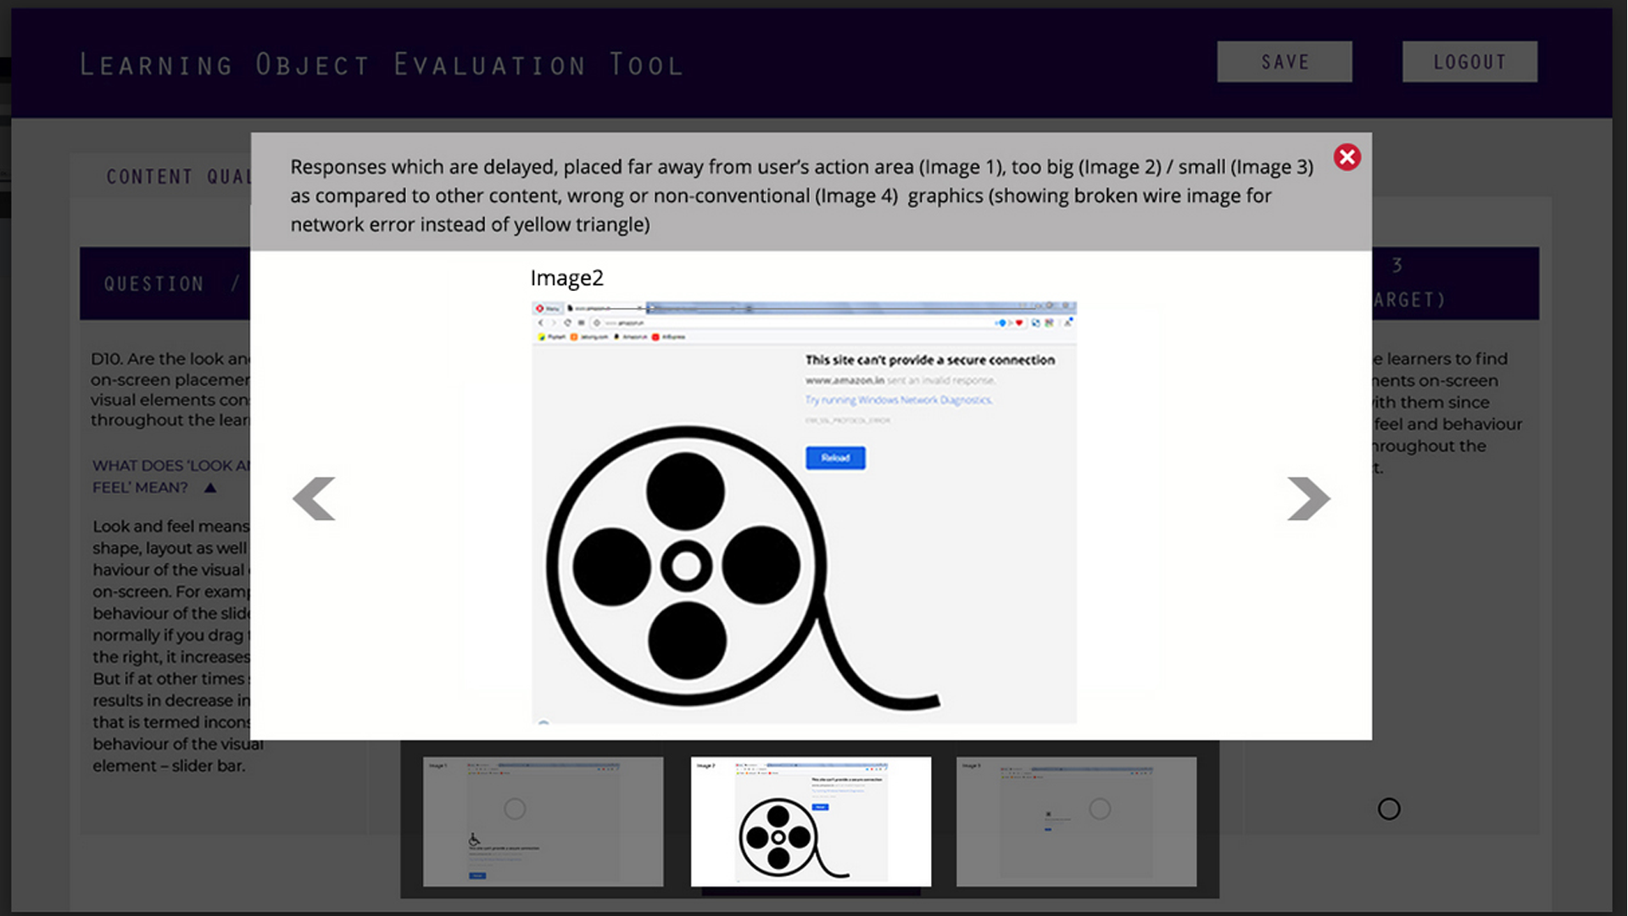
Qs. D2 images slideshow.

Slide 13
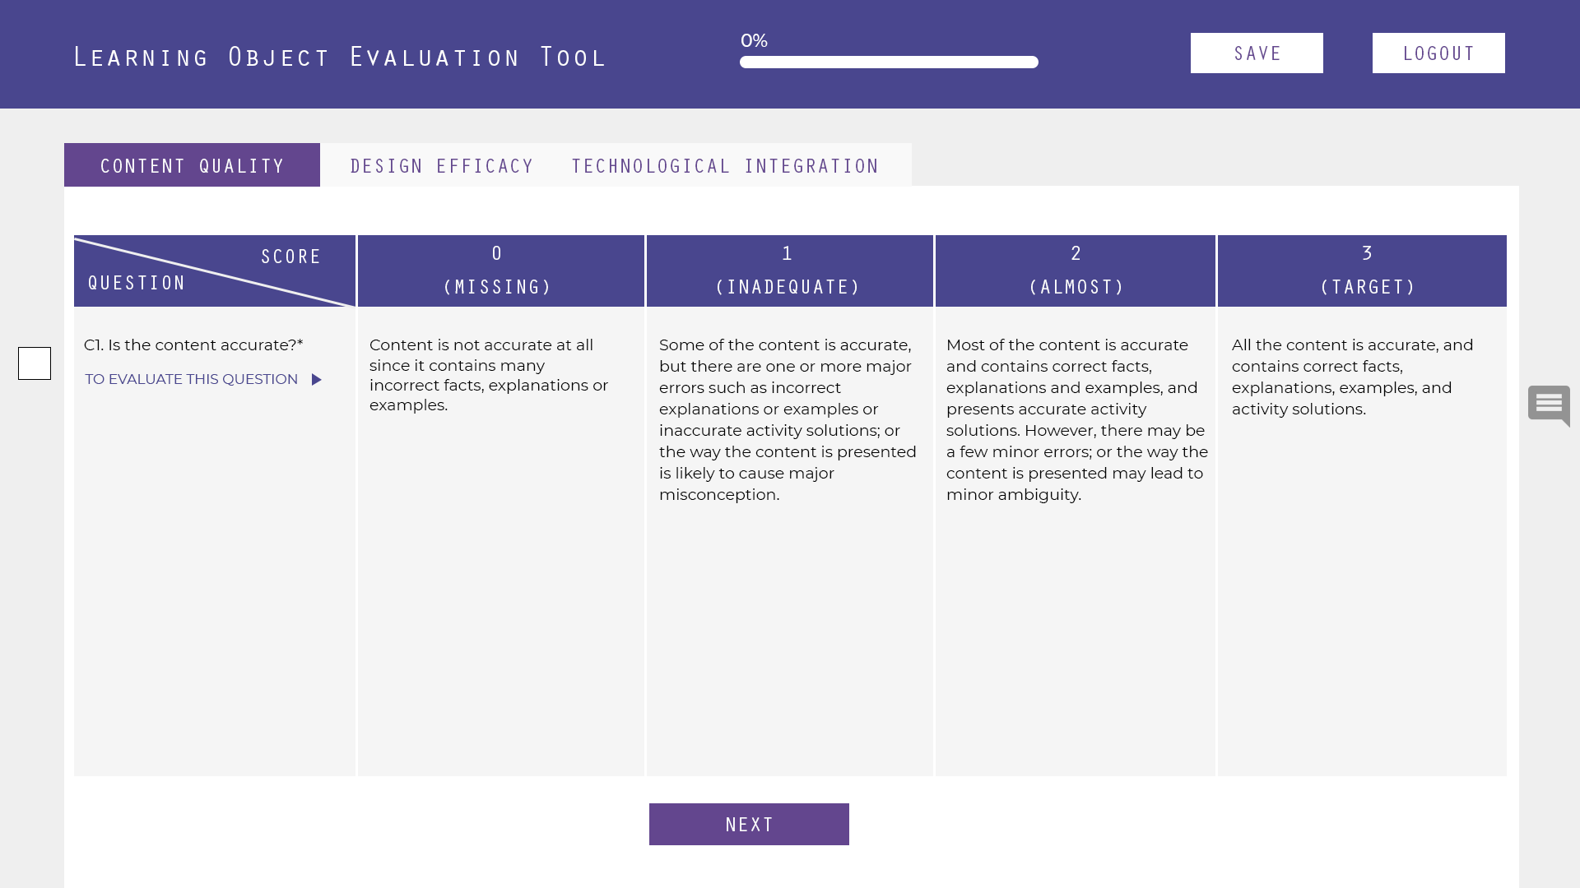
At the end of the each tab there will be a Next button.
When user clicks on it, he will go to the next tab.
At the top, there are 2 buttons - one is save and the other is logout.
User can save the work he has done and can logout. If he logs out without saving the work, there should be a popup asking them to save and then logout.

Slide 14
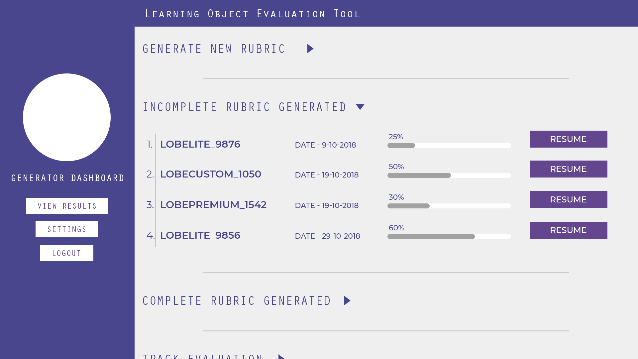
As explained in the slide -11, user can save and logout in middle of generating the rubric.
After logging back, he should be able to see the session where he left off, by clicking the INCOMPLETE RUBRIC GENERATED option in the dashboard.
Here he should be able to see - the rubric unique name, the date when he had last worked on the rubric and a Resume button.
By clicking on the Resume button, he should be redirected to that tab/question from where he had left in the previous session.

Slide 15
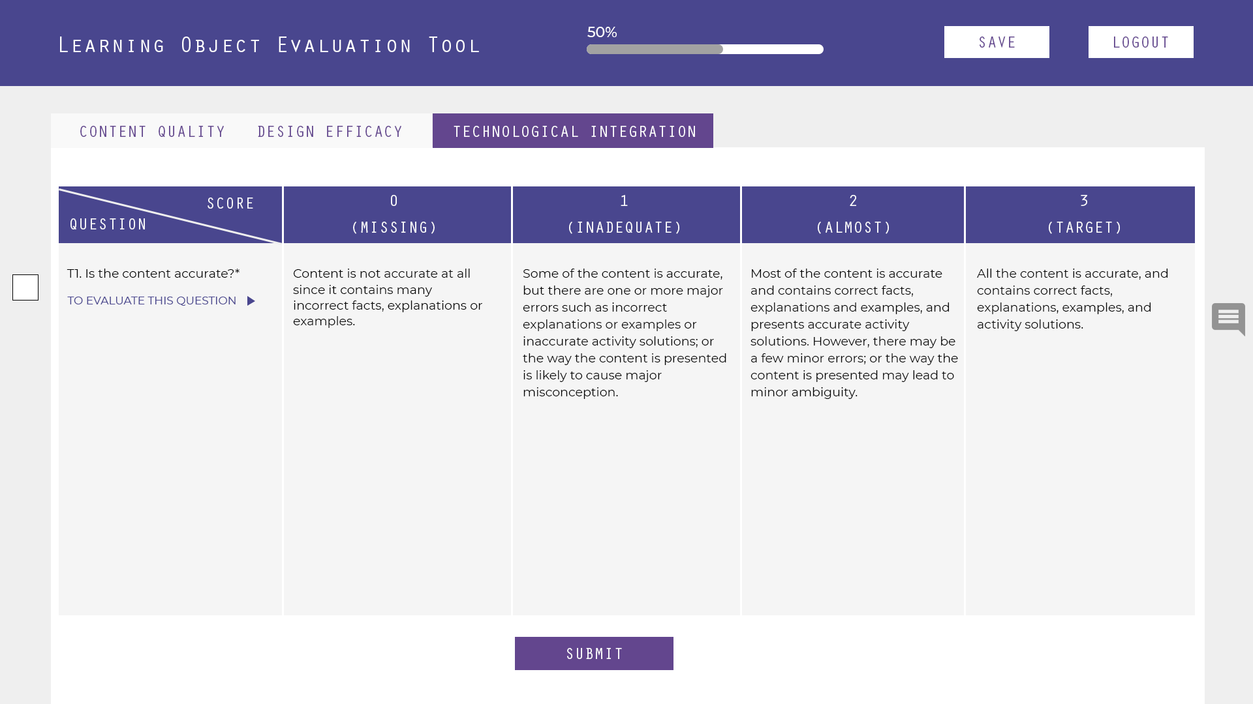
Refer to slide -5. Whichever is the last tab, there will be a Submit button at the bottom.
On clicking Submit button, the session will get stored in database with a unique name, for e.g – LOBECUSTOM_2468 (2468 is the unique id) and user will be redirected to dashboard (slide 1).
User can create at least 3-4 sessions like this and each one will have different unique name.
Each time the user logs in, he should be able to resume from where he had left off.

Slide 16
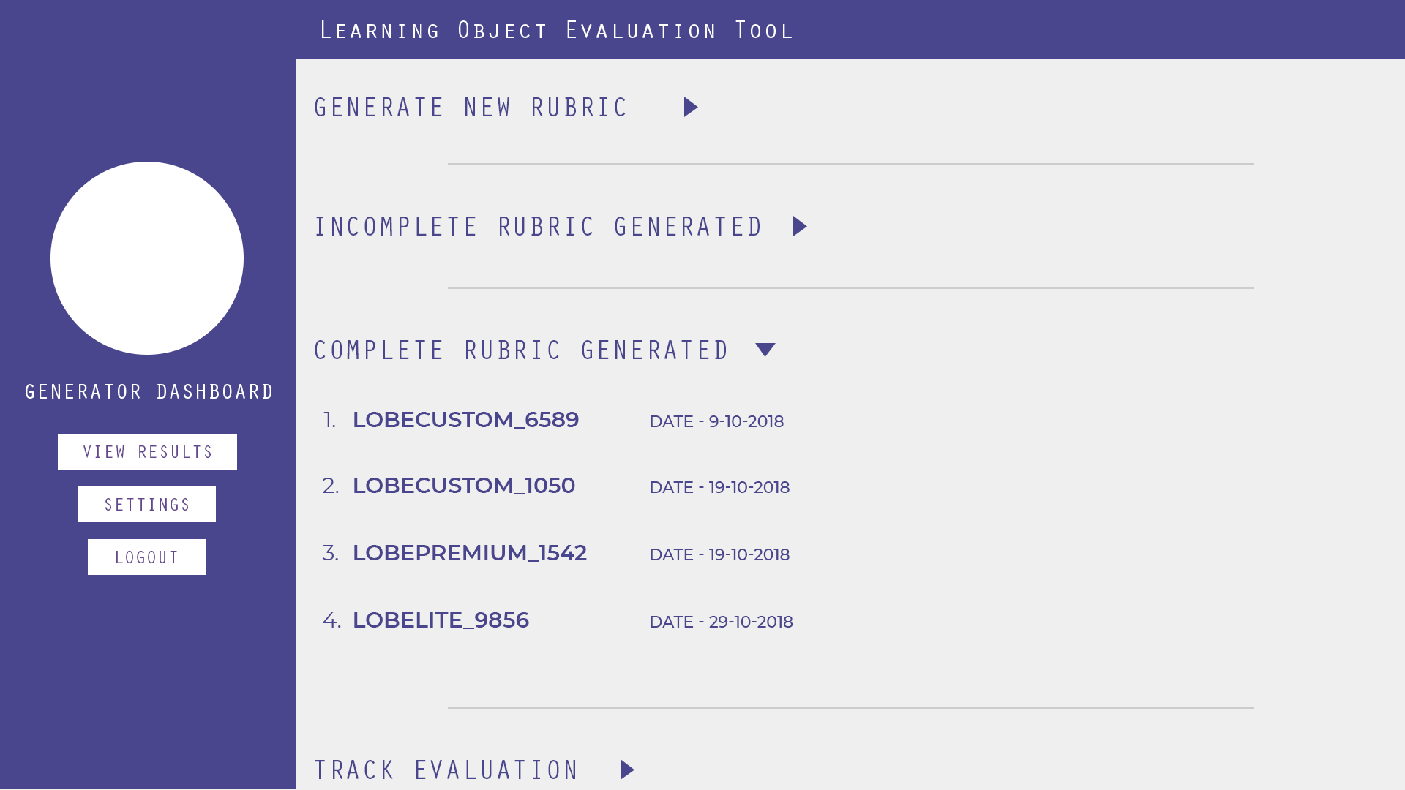
Once the entire rubric is completed by clicking on Submit button, the rubric will get stored in the database
That rubric with it’s unique name will be shown under COMPLETE RUBRIC GENERATED for eg- Rubric unique name (LOBECUSTOM_6589) with the date and when they have completed it.

