Slide 1

Nextensio Ingress Path – Davi Gupta 2019
ingressgateway
3
1
apiVersion: v1
kind: Service
metadata:
name: roku-com-in
namespace: blue
labels:
app: roku
spec:
ports:
- port: 80
name: roku-inside
selector:
app: roku
apiVersion: extensions/v1beta1
kind: Deployment
metadata:
name: roku
namespace: blue
spec:
replicas: 1
template:
metadata:
labels:
app: roku
version: v1
cluster: "ric"
role: minion
spec:
containers:
- name: minion
image: davigupta/minion:0.59
imagePullPolicy: IfNotPresent
ports:
- containerPort: 80
- containerPort: 8002
env:
- name: MY_NODE_NAME
valueFrom:
fieldRef:
fieldPath: spec.nodeName
- name: MY_POD_NAME
value: "roku-com"
- name: MY_POD_NAMESPACE
valueFrom:
fieldRef:
fieldPath: metadata.namespace
- name: MY_POD_IP
valueFrom:
fieldRef:
fieldPath: status.podIP
- name: MY_POD_CLUSTER
valueFrom:
fieldRef:
fieldPath: metadata.labels['cluster']
- name: MY_DNS
value: "10.100.209.238"
terminationGracePeriodSeconds: 60
imagePullSecrets:
- name: regcred
apiVersion: networking.istio.io/v1alpha3
kind: VirtualService
metadata:
name: roku-gw-svc
namespace: blue
spec:
hosts:
- "gateway.ric.nextensio.net"
exportTo: ["*"]
gateways:
- default/nextensio-ingressgateway
http:
- match:
- headers:
x-nextensio-for:
regex: .+\.kismis\.org
route:
- destination:
host:
roku-com-in
port:
number: 80
- match:
- headers:
x-nextensio-for:
prefix: "connector-1"
route:
- destination:
host:
roku-com-in
port:
number: 80
- match:
- headers:
x-nextensio-connect:
prefix: "connector-1"
route:
- destination:
host:
roku-com-out
port:
number: 8002
websocketUpgrade: true
apiVersion: networking.istio.io/v1alpha3
kind: DestinationRule
metadata:
name: roku-ingress
namespace: blue
spec:
host: roku-com-in
exportTo: ["."]
subsets:
- name: roku
apiVersion: v1
kind: Service
metadata:
name: roku-com-out
namespace: blue
labels:
app: roku
spec:
ports:
- port: 8002
name: roku-outside
selector:
app: roku
2
apiVersion: networking.istio.io/v1alpha3
kind: DestinationRule
metadata:
name: roku-egress
namespace: blue
spec:
host: roku-com-out
exportTo: ["."]
subsets:
- name: roku
4

Slide 2
Nextensio Egress Path – Davi Gupta 2019
Pod/Envoy [Mesh]
1
egressgateway
4
apiVersion: networking.istio.io/v1alpha3
kind: VirtualService
metadata:
name: direct-sjc-through-egress-mesh
namespace: blue
spec:
hosts:
- gateway.sjc.nextensio.net
exportTo: ["."]
gateways:
- mesh
http:
- match:
- gateways:
- mesh
port: 80
route:
- destination:
host: istio-egressgateway.istio-system.svc.cluster.local
subset: sjc
port:
number: 80
weight: 100
apiVersion: networking.istio.io/v1alpha3
kind: VirtualService
metadata:
name: direct-sjc-through-egress-gateway
spec:
hosts:
- gateway.sjc.nextensio.net
gateways:
- default/nextensio-egressgateway
http:
- match:
- port: 80
route:
- destination:
host: gateway.sjc.nextensio.net
port:
number: 443
weight: 100
7
apiVersion: networking.istio.io/v1alpha3
kind: ServiceEntry
metadata:
name: sjc
spec:
hosts:
- gateway.sjc.nextensio.net
ports:
- number: 80
name: http-port-sjc
protocol: HTTP
- number: 443
name: http-port-sjc-for-tls-origination
protocol: HTTP
resolution: DNS
2
5
apiVersion: networking.istio.io/v1alpha3
kind: DestinationRule
metadata:
name: egressgateway-for-sjc
namespace: blue
spec:
host: istio-egressgateway.istio-system.svc.cluster.local
exportTo: ["."]
trafficPolicy:
loadBalancer:
simple: ROUND_ROBIN
portLevelSettings:
- port:
number: 80
tls:
mode: DISABLE
subsets:
- name: sjc
trafficPolicy:
loadBalancer:
simple: ROUND_ROBIN
portLevelSettings:
- port:
number: 80
tls:
mode: DISABLE
6
3
apiVersion: networking.istio.io/v1alpha3
kind: DestinationRule
metadata:
name: sjc-ext
spec:
host: gateway.sjc.nextensio.net
trafficPolicy:
loadBalancer:
simple: ROUND_ROBIN
portLevelSettings:
- port:
number: 443
tls:
mode: MUTUAL
caCertificates: /etc/istio/sjc-credentials/cacert
clientCertificate: /etc/istio/sjc-credentials/cert
privateKey: /etc/istio/sjc-credentials/key
sni: gateway.sjc.nextensio.net

Slide 3

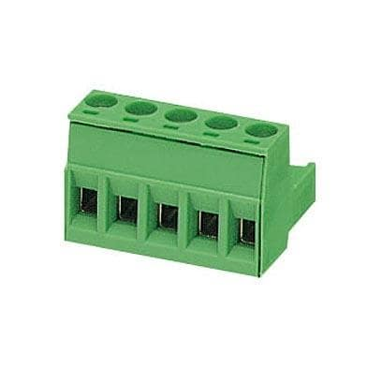



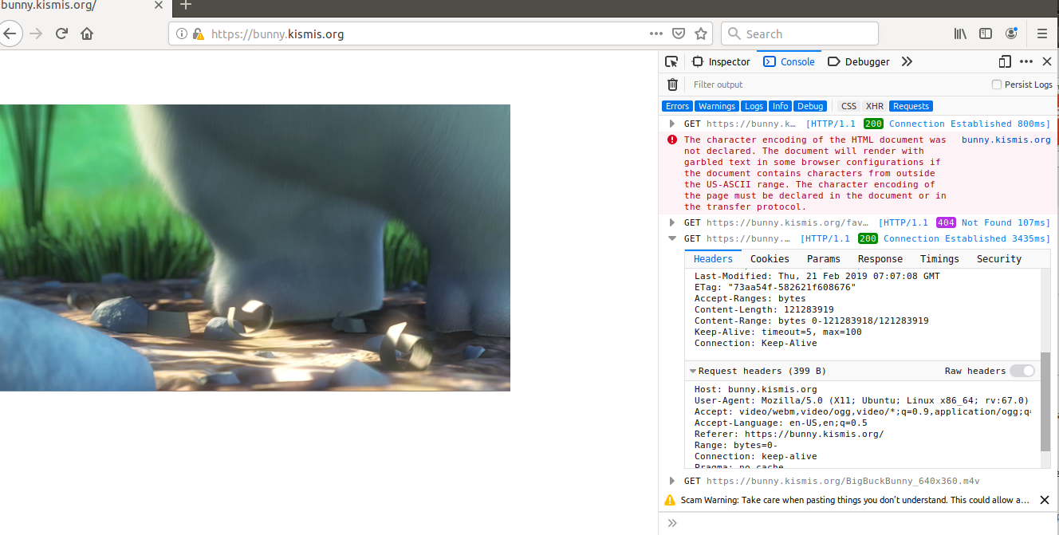

Multi Cluster Setup
internet
GCP
Internet GW
mTLS
tivo
https://bunny.kismis.org/dash.html
mTLS
IGW
EGW
mTLS
IGW
EGW
sony
mTLS
AWS
roku
*.kismis.org GW
SJC
RIC
https://bunny.kismis.org/hls.html

