Slide 1
NextGenVote
Visualizing Geneva’s Next Generation E-Voting System
| B.Sc. Computer Science - Final day Presentation
Graduates: Yanick Denzer, Kevin Häni
Supervisors: Prof. Dr. Rolf Haenni, Prof. Dr. Philipp Locher
Expert: Han van der Kleij, SBB

Slide 2
Content
Who we are
Goal
Demo
Project
Implementation details
Next steps
Notes:
https://www.ssl2buy.com/wiki/symmetric-vs-asymmetric-encryption-what-are-differences

Slide 3
E-Voting
Privacy is only one requirement
Anonymity
Authenticity
Eligibility
Verifiability
and more …

Slide 4
CHVote Protocol
ElGamal Encryption
k-out-of-n Oblivious Transfer by Chu and Tzeng
Multiplicative Homomorphic Encryption
Cryptographic Shuffles
Re-Encryption Mix-Nets
Pedersen Commitments
Non-Interactive Zero-Knowledge Proofs
Schnorr Signatures
Wikström’s Shuffle Proof
Lagrange Interpolating Polynomials
Shared Key Pairs
…

Slide 5
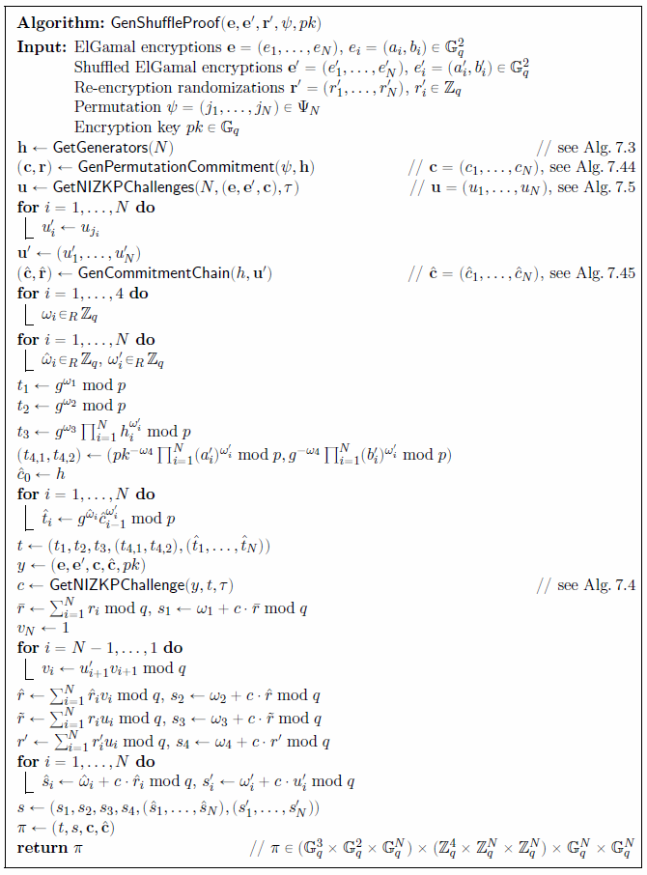
CHVote Protocol
Specified approx. 60 algorithms

Slide 6
Educational Problem
E-Voting is difficult to understand / explain
Our Task / Goal
Implementing a software that allows to visualize an e-voting system based on the CHVote specifications
Webbased application with real-Time updates (web sockets)
Separate views for every actor of the protocol

