Slide 1
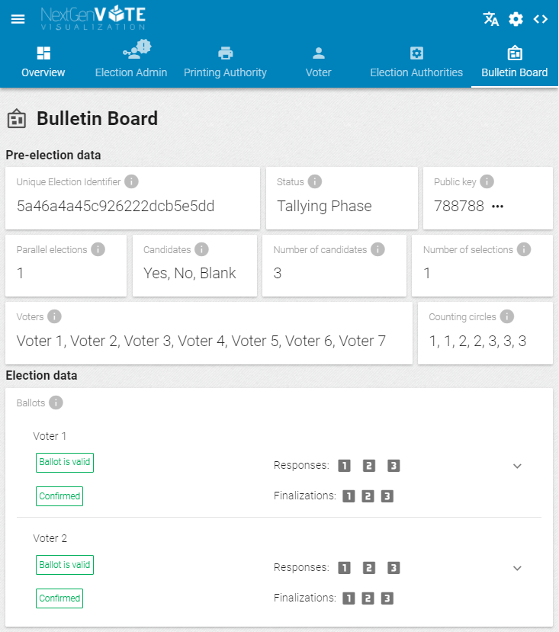
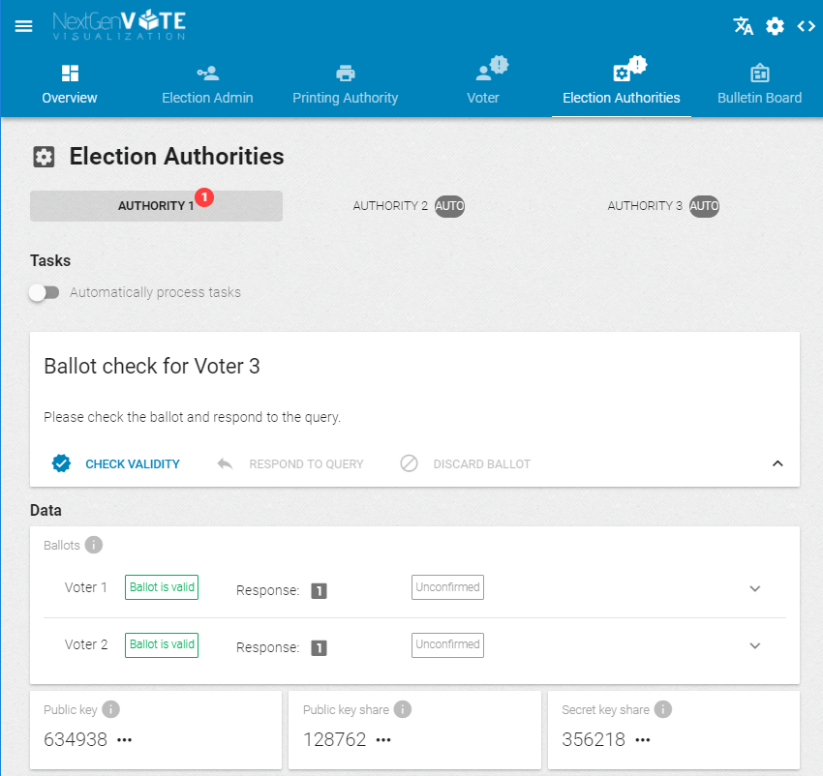
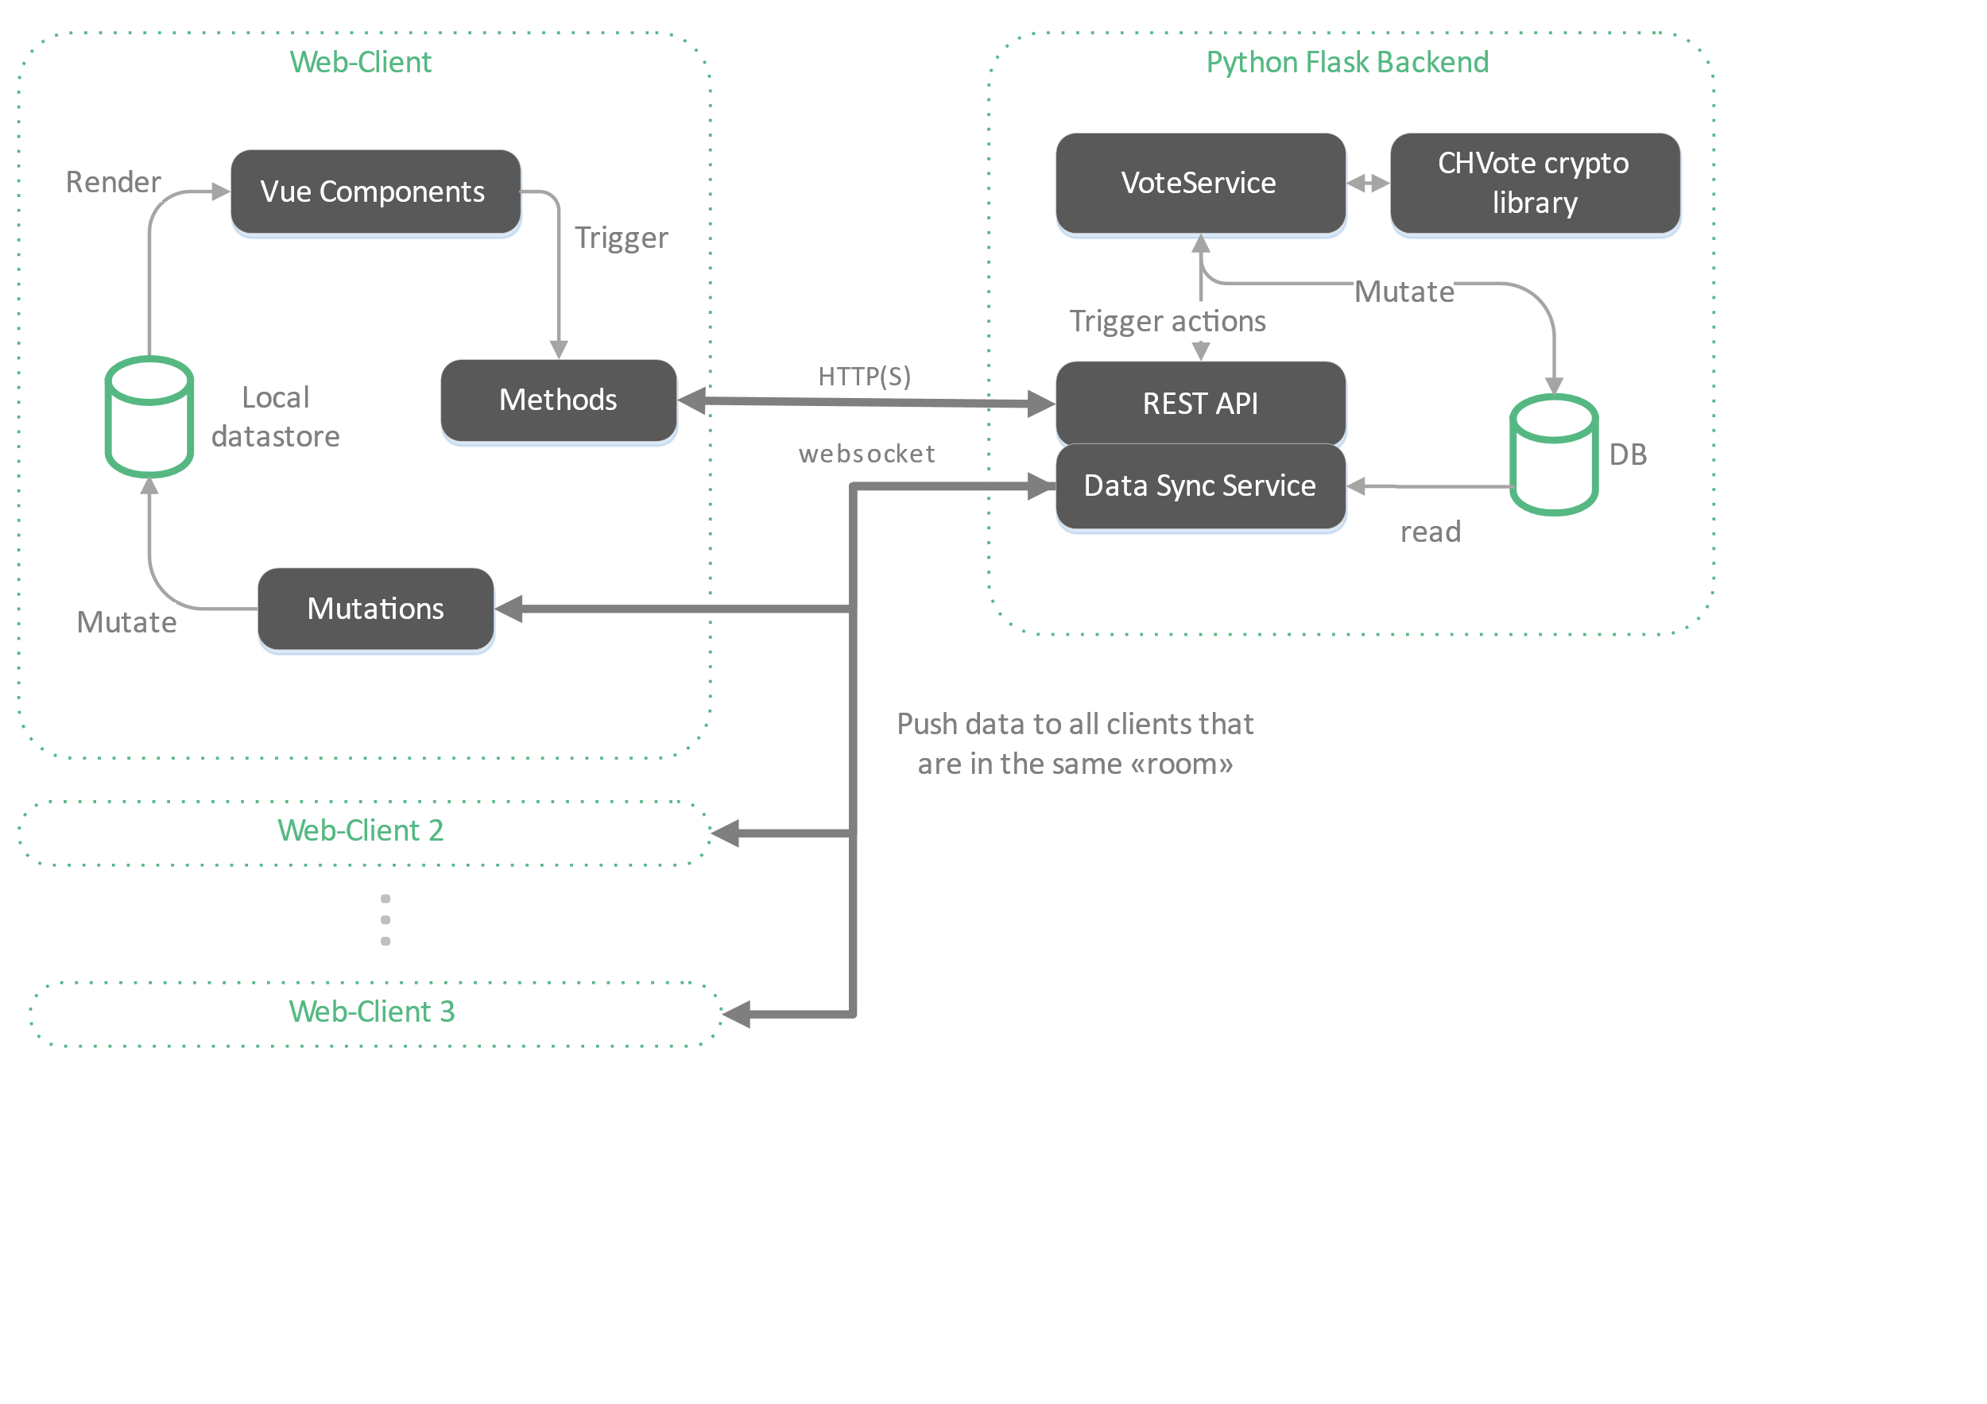
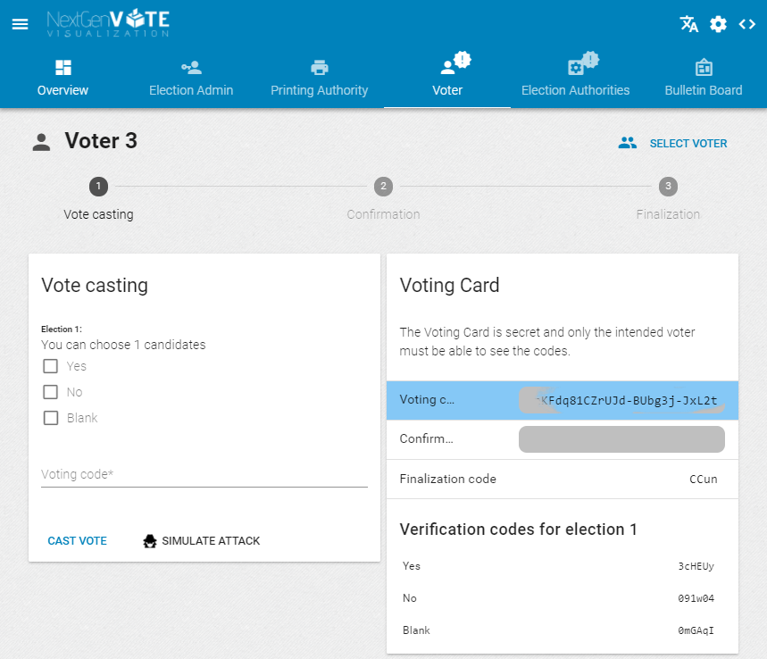
Context
Previous attempts to introduce e-voting platforms in Switzerland were limited to only small electorates as these platforms didn’t meet the many requirements set up by the Swiss government.
In 2017, the Research Institute for Security in the Information Society (RISIS) published their specifications for Geneva’s new e-voting system, CHVote, which had the potential of being accepted as a large-scale, nationwide e-voting platform.
However, one challenge that still remains is the educational problem: it is difficult to understand such a complex protocol without sufficient knowledge of cryptography. This might also result in mistrust towards e-voting.
Goals The goal of this project is to develop an application that addresses the difficulty to impart knowledge regarding e-voting. Through this project, users will be able to get a hands-on experience with an e-voting system. This would allow a better understanding of the next-generation e-voting protocol.
The system will also allow to display multiple perspectives of an election event on different screens, which requires real-time synchronization of data. Another goal is to enable the authors of the specification, our supervisors, to use our application to present and explain their protocol to an audience.
Design and Implementation
We first implemented approximately 75 algorithms that have been described in the specifications. In addition to this crypto-library, we also built a back-end that provides the voting functionality as an API. Both the library as well as the back-end are written in Python.
Our front-end that visualizes all the voting phases is a single-page application written in JavaScript using the VueJS framework. In order to achieve real-time updates, we have used web sockets (socket.io) to synchronize a client-side copy of the database whenever the data has been altered on the back-end.
Results
With our application, it is possible to conduct election events according to the protocol specifications not only from the perspective of a voter, but also all other participating actors such as the election administrator, printing, or election authority.
Our application combines modern technology and an intuitive design to allow users to gain a better understanding of the protocol and offering a preview of how the future of voting might possibly look like in Switzerland.
Visualizing Geneva's Next Generation E-Voting System
Graduates: | Kevin Häni Yannick Denzer
Professors: | Prof. Dr. Rolf Haenni Prof. Dr. Philipp Locher
Expert: | Han van der Kleij
Bachelor Thesis 2018 Degree Programme Computer Science

