Slide 1
Time Series Forecasting
UA DataLab

Slide 2
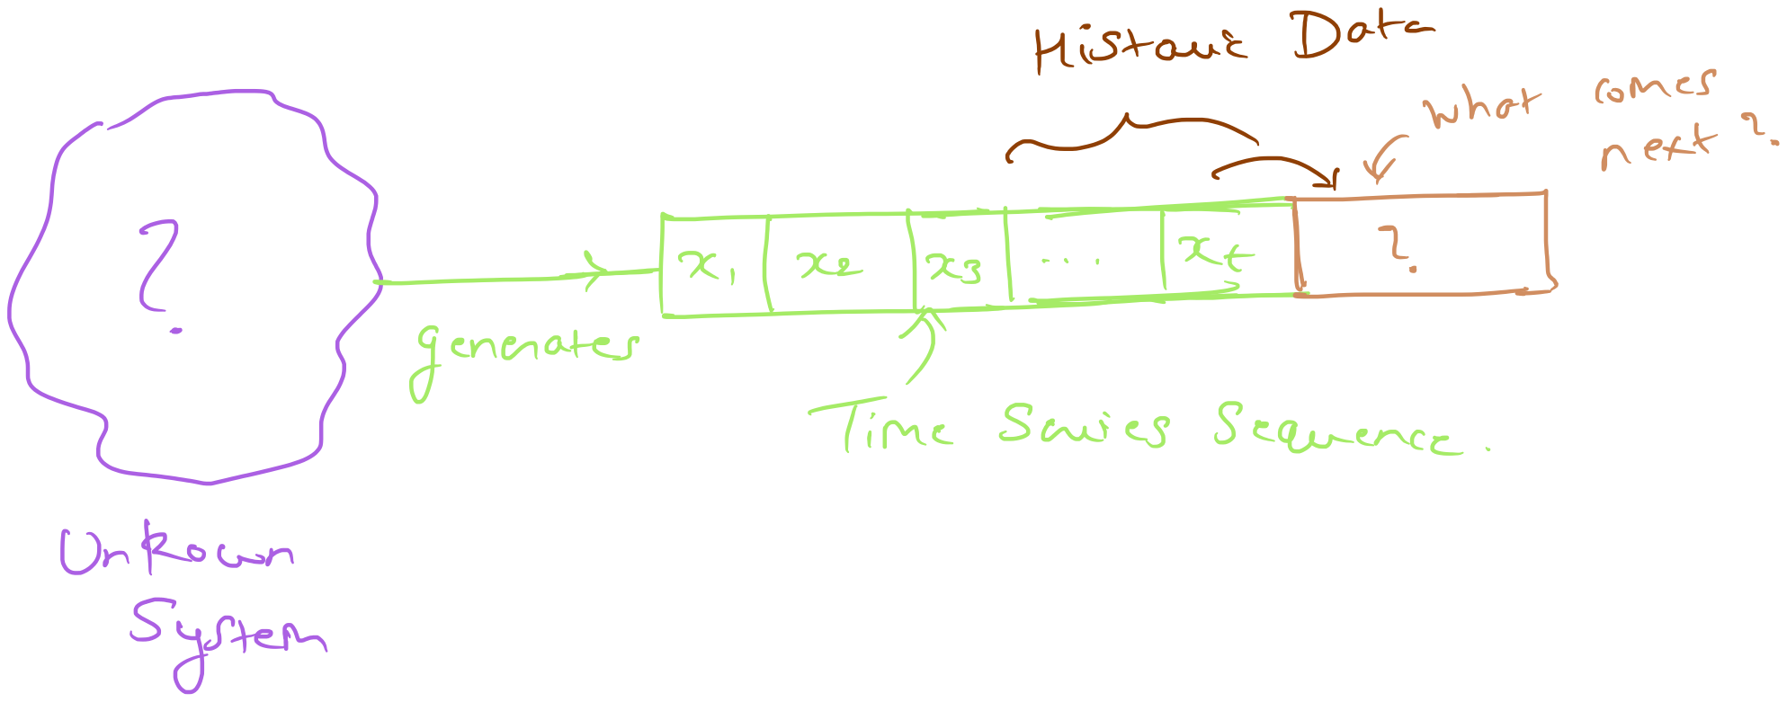
Problem Illustration
Given a sequence of data-points, we must predict what comes next.

Slide 3
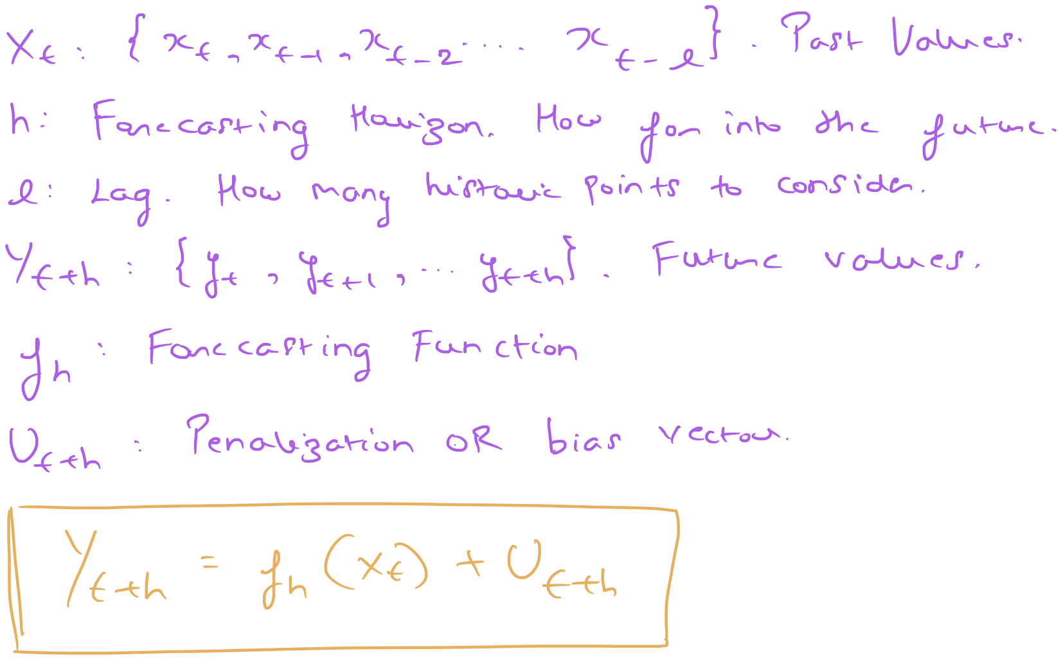
Problem Formalization

Slide 4
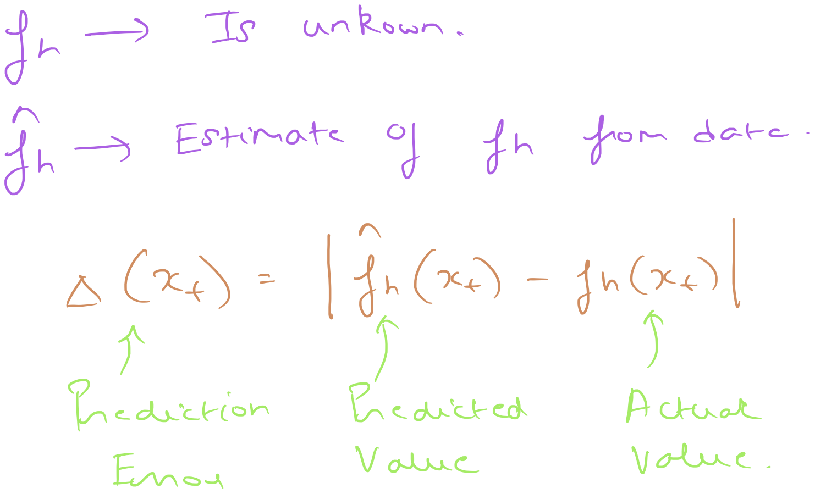
Formulation of prediction accuracy

Slide 5
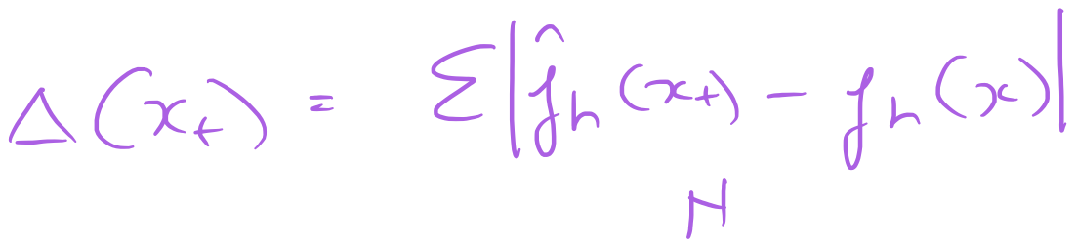
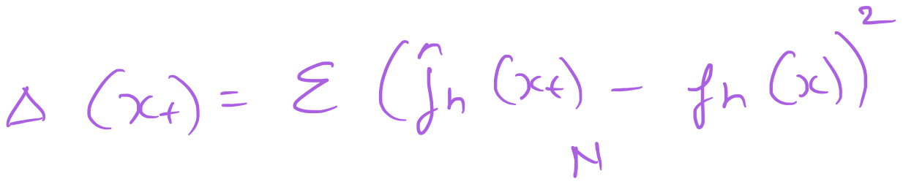
Common Errors – L1 and L2 norm
Mean Absolute Prediction Error (MAPE)
Mean Squared Prediction Error (MSPE)
L1
L2

Slide 6
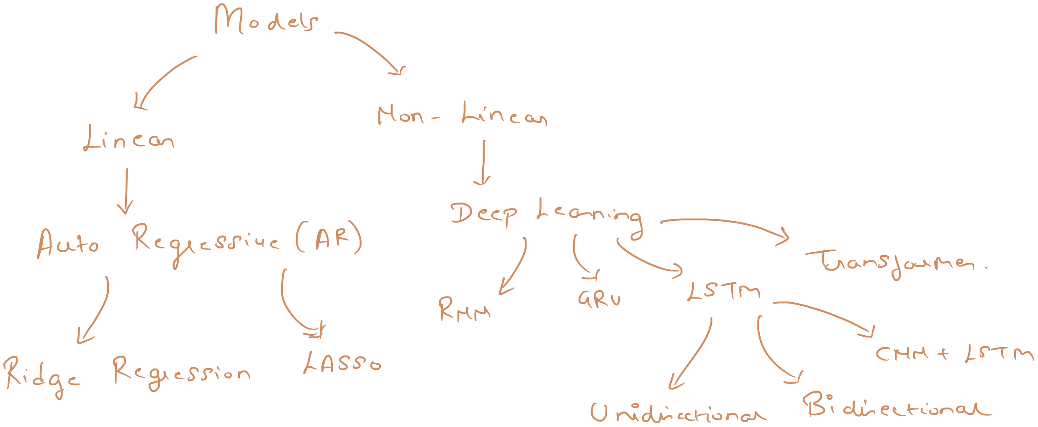
Forecasting options

Slide 7
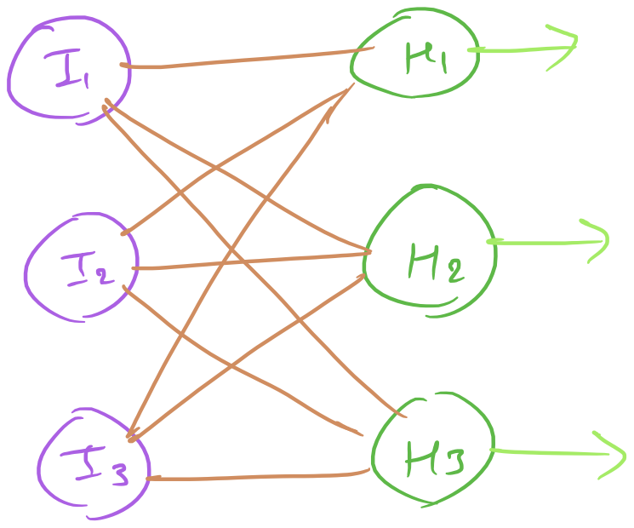
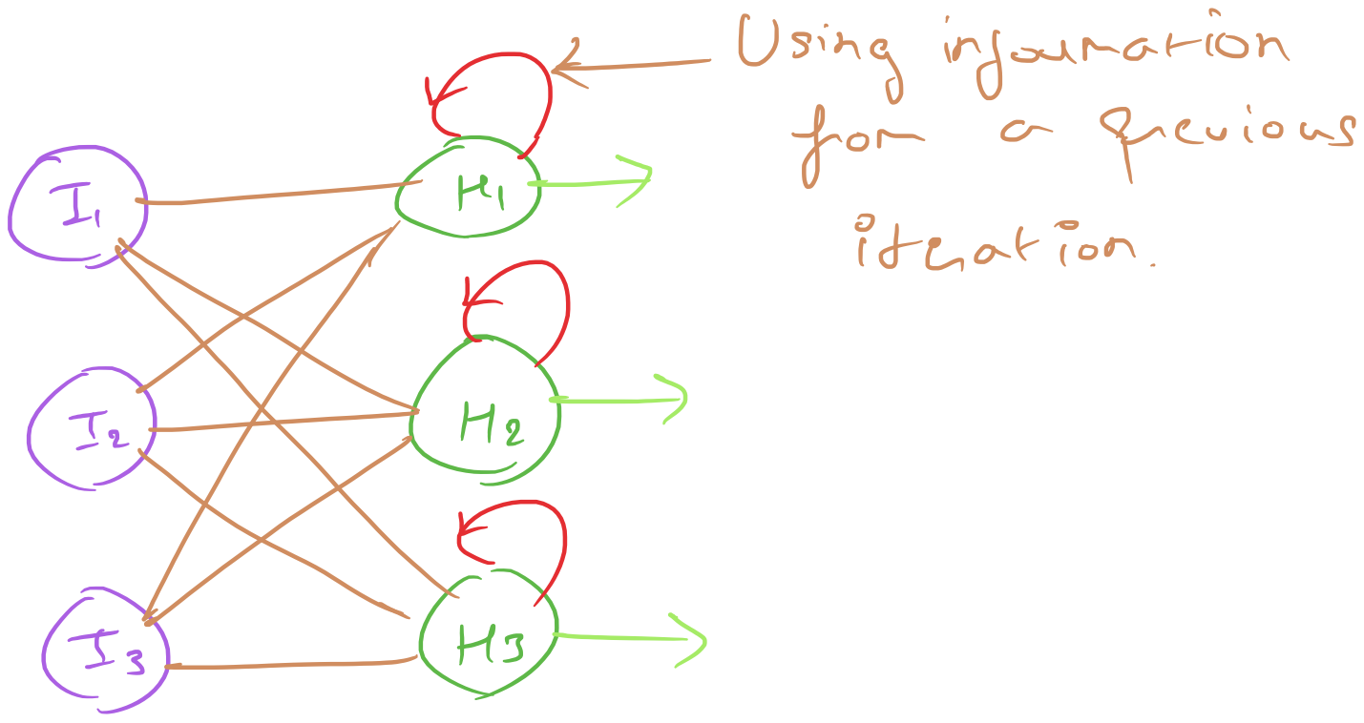
RNN – Recurrent Neural Networks
Feed forward neural networks
Recurrent neural networks

Slide 8
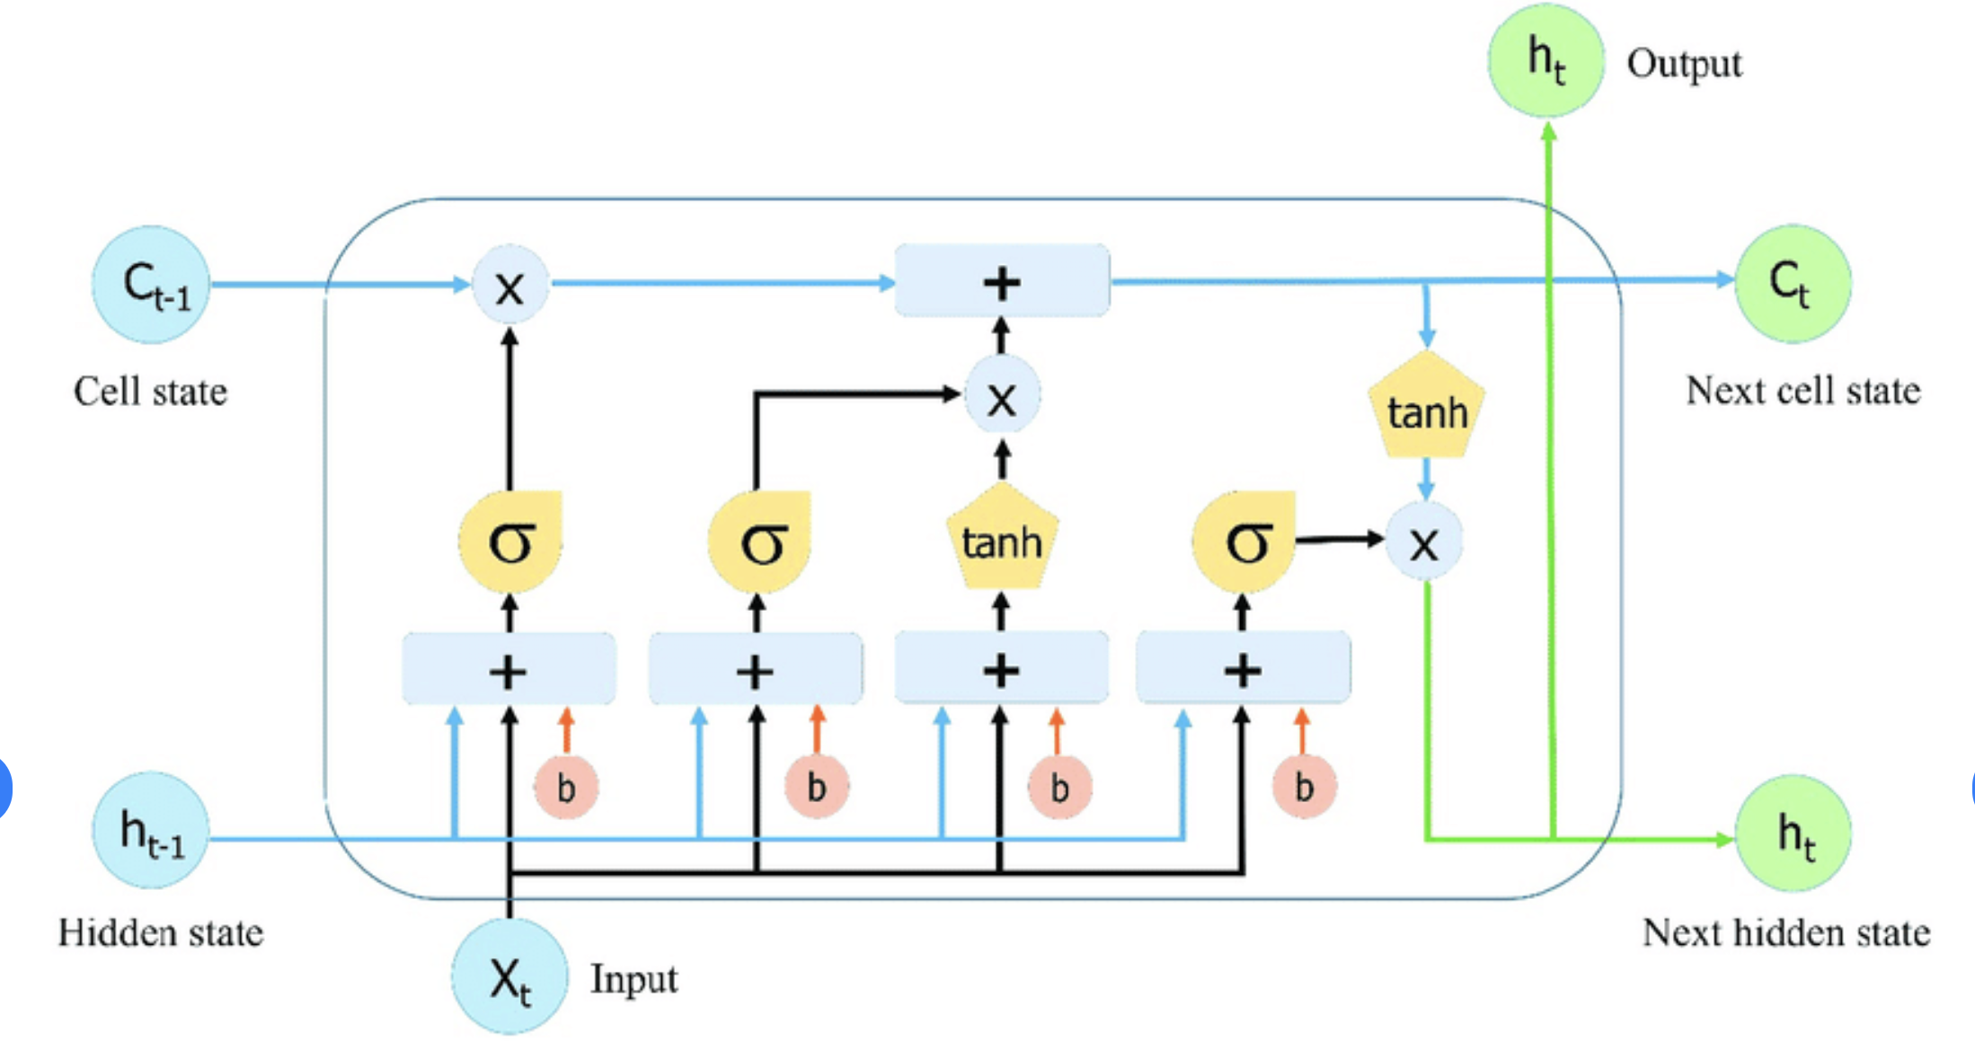
LSTM (Long-Short Term Memory)

Slide 9
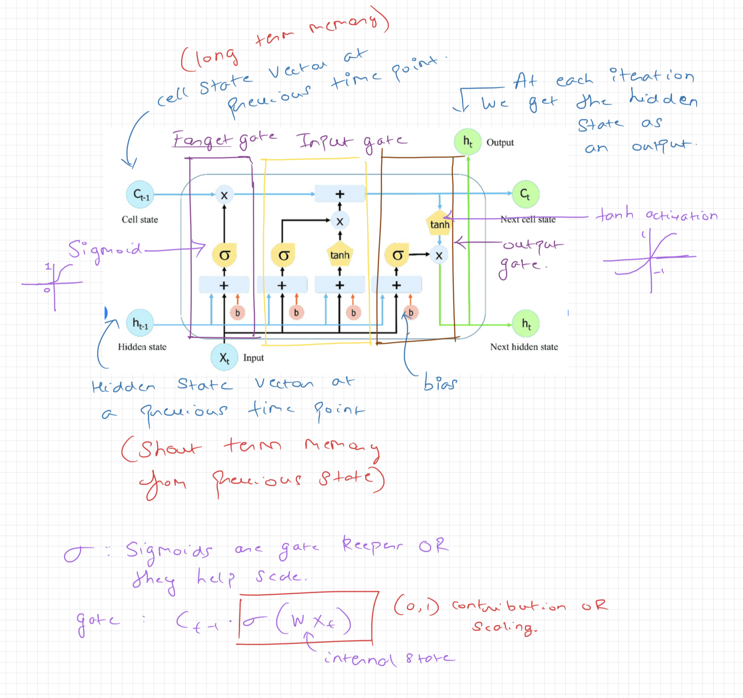
LSTM Annotated

Slide 10
Thank You
Check out the workshop page for notebooks and notes.
Contact me if you have any questions – shravanaras@arizona.edu

