Slide 2
Cases Summary
Direct SQL data statement
Select <direct select statement : multiple rows>
Update <update statement : searched>
Delete <delete statement : searched>
Insert <insert statement>

Slide 3
User Data

Slide 4

User data list
User1 (level = 0,...)
User2 (level = 2,...)

Slide 5
Policy Screenshot

Slide 6
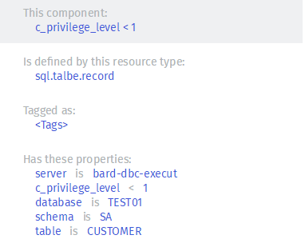
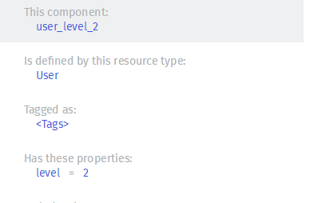
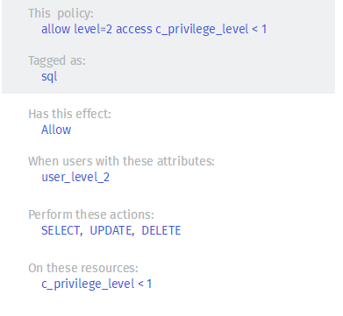
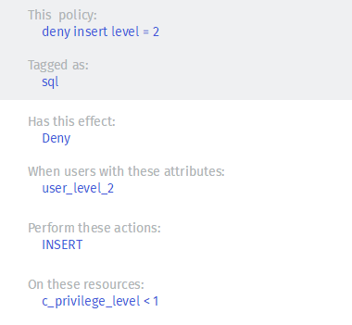
Policy
Resource Componet User Component Policy1 Policy2

Slide 7
Case 1:Filter on SELECT

Slide 8
Case 1:
Policy Description
Users with level 2 can only access(Select) records with c_privilege_level < 1 in the table of SA.CUSTOMER.
Use Case
User1 (level = 0) can access records without any limitation
in the table of SA.CUSTOMER, but User2 (level = 2) will be
Limited.

Slide 9
SQL enforcer solution on direct select statement
We analyze user’s SQL scripts semantically based on SQL 2003 standard. For < direct select statement >, our enforcer solution is add some predicate filter condition to user’s script based on policy.
INPUT SCRIPT : SELECT *
FROM SA.CUSTOMER;
User1’s ENFORCED SCRIPT : SELECT *
FROM SA.CUSTOMER;
User2’s ENFORCED SCRIPT : SELECT *
FROM SA.CUSTOMER
WHERE (SA.CUSTOMER.c_privilege_level<1);

Slide 10
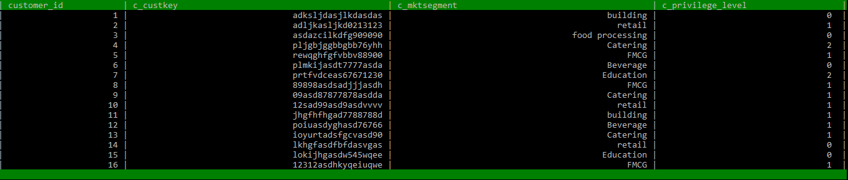
Result:
User1’s enforcement result:
User2’s enforcement result:

Slide 11
Case 2: Filter on UPDATE

Slide 12
Case 2: Filter on Update
Policy Description
Users with level 2 can only update records with c_privilege_level < 1 in the table of SA.CUSTOMER.
Use Case
User1 (level = 0) can update records without any limitation
in the table of SA.CUSTOMER, but User2 (level = 2) will be
Limited.

Slide 13
SQL enforcer solution on update statement
We analyze user’s SQL scripts semantically based on SQL 2003 standard. For < update statement >, our enforcer solution is add some predicate filter condition to user’s script based on policy.
INPUT SCRIPT : UPDATE SA.CUSTOMER
SET c_privilege_level = c_privilege_level - 1
WHERE c_mktsegment = ‘building’;
User1’s ENFORCED SCRIPT : UPDATE SA.CUSTOMER SET c_privilege_level = c_privilege_level - 1
WHERE c_mktsegment = ‘building’;
User2’s ENFORCED SCRIPT : UPDATE SA.CUSTOMER SET c_privilege_level = c_privilege_level - 1
WHERE (c_mktsegment = ‘building’)
AND (SA.CUSTOMER.c_privilege_level<1);

Slide 14
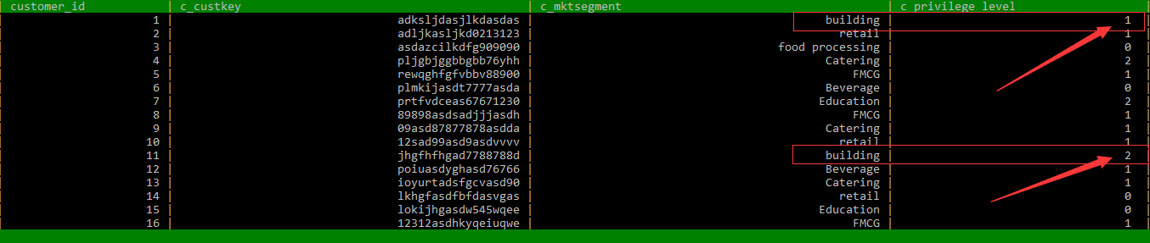
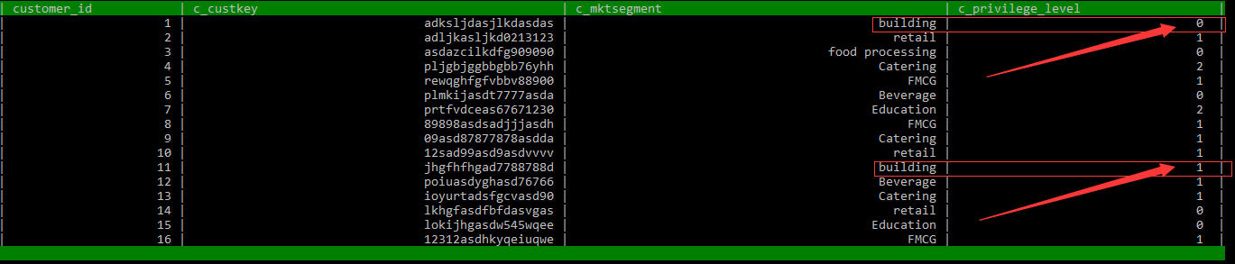
Result of User1
User1 view this table
====> (2 rows affected)

Slide 15
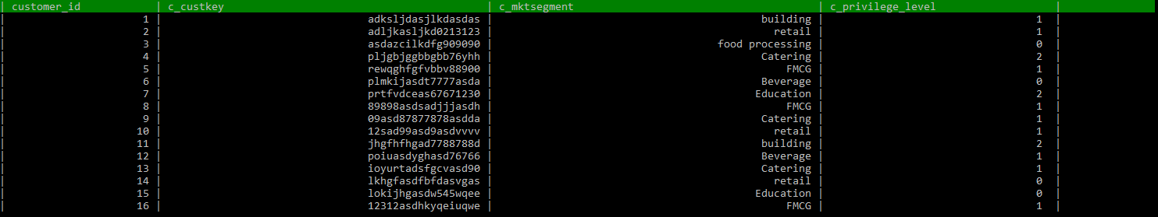
Result of User2
User2 view this table
====> (0 rows affected)
We use user1’s view to prove that no row is affected

Slide 16
Case 3: Filter on DELETE

Slide 17
Case 3: Filter on DELETE
Policy Description
Users with level 2 can only delete records with c_privilege_level < 1 in the table of SA.CUSTOMER.
Use Case
User1 (level = 0) can delete records without any limitation
in the table of SA.CUSTOMER, but User2 (level = 2) will be
Limited.

Slide 18
SQL enforcer solution on delete statement
We analyze user’s SQL scripts semantically based on SQL 2003 standard. For < delete statement >, our enforcer solution is add some predicate filter condition to user’s script based on policy.
INPUT SCRIPT : DELETE
FROM SA.CUSTOMER
WHERE c_mktsegment = ‘FMCG’;
User1’s ENFORCED SCRIPT : DELETE FROM SA.CUSTOMER
WHERE c_mktsegment = ‘FMCG’;
User2’s ENFORCED SCRIPT : DELETE FROM SA.CUSTOMER WHERE (c_mktsegment = ‘building’)
AND (SA.CUSTOMER.c_privilege_level<1);

Slide 19
Result of User2
User2 view this table
====> (0 rows affected)
We use user1’s view to prove that no row is affected

Slide 20
Case 4:Filter on INSERT

Slide 21
Case 4: block on insert
Policy Description
Users with level 2 can not insert records into the table of SA.CUSTOMER.
Use Case
User1 (level = 0) can insert records into the table of SA.CUSTOMER, but User2 (level = 2) will be
Blocked.

Slide 22
SQL enforcer solution on insert statement
We analyze user’s SQL scripts semantically based on SQL 2003 standard. For < insert statement >, our enforcer solution is cancel the execution of the entire script. At the same time, SQLExecDirect will return SQL_ERROR, SQLGetDiagRec will return a SQLSTATE 42000 (the user did not have permission to execute the SQL statement),
INPUT SCRIPT : INSERT
INTO SA.CUSTOMER
(c_custkey, c_mktsegment, c_privilege_level)
VALUES (‘1321eqweasdsa12312’, 'retail' , 0),
(‘12313798ada1321233’, 'retail' , 0);

Slide 23
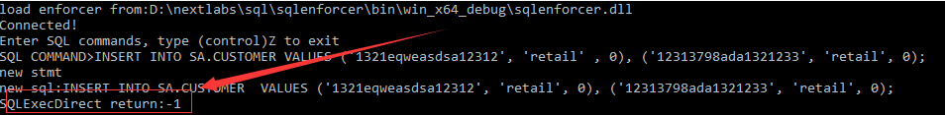
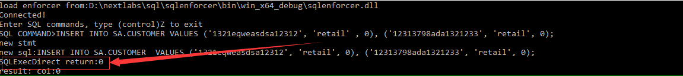
Result of User2
User2's result with SQL_ERROR(-1)
User1's result with SQL_SUCCESS(0)

Slide 24
Advanced Case

Slide 25
Multi-Table Select
INPUT SCRIPT : SELECT l_orderkey, Sum(l_extendedprice*(1-l_discount)) AS REVENUE,
o_orderdate, o_shippriority
FROM sa.customer, sa.orders, sa.lineitem
WHERE c_mktsegment = ‘Catering’ AND c_custkey = o_custkey
AND l_orderkey = o_orderkey AND o_orderdate < ‘1995-03-15’
AND l_shipdate > ‘1995-0315’
GROUP BY l_orderkey,
o_orderdate,
o_shippriority
ORDER BY revenue DESC,
o_orderdate;
COMMENT ： This is a common Multi-Table Query, this query get data from table LINEITEM and ORDERS. However, due to join with the protected table CUSTOMER, different user will have different result.

Slide 26
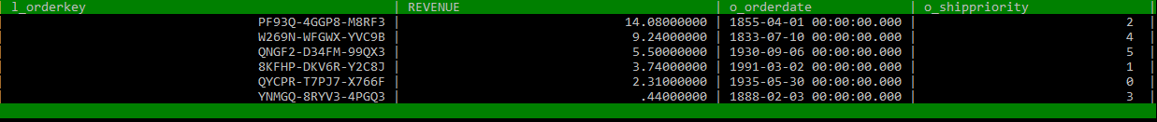
Result of Multi-Table Select
User2's result (empty result set due to the enforcer)
User1's result

Slide 27
Correlated-Subquery
INPUT SCRIPT : SELECT o_orderpriority, Count(*) AS ORDER_COUNT
FROM sa.orders
WHERE o_orderdate >= ‘1983-07-01’
AND o_orderdate < Dateadd(mm, 3, Cast(‘1993-07-01’ AS datetime))
AND EXISTS( SELECT *
FROM sa.customer
WHERE c_custkey = o_custkey)
GROUP BY o_orderpriority
ORDER BY o_orderpriority;
COMMENT ： This is a common query with correlated-subquery, this query get data from table ORDERS. However, due to the EXISTS predicate condition(the ORDERS record should have matching records in the protected table CUSTOMER), different user will have different result.

Slide 28
Result of Correlated-Subquery Case
User2's result (the ORDER COUNT(1) is less than user1’s result due to the enforcer)
User1's result

Slide 29
Problems and limitation
1. The added predicate filter condition based on policys is not checked. Policy with error will generate an illegal sql expression (e.g invalid column name, illegal operator use …) .
2. Block by enforcer just have a SQL_ERROR, error detail is not support
3. Currently, user attr info is stored in file as a xxx.ini
4. Our Enforcer solution is based on the semantic analysis of user’s script. Enforcer will do nothing if parser can not understand the script. This includes two aspects. First, some special syntax is not supported By Parser.Second, some necessary information need by enforcer does not exist in the parsing phase.

