Slide 1
Software for Digital Innovation (CIS4044-N)
Lecture 1
Module introduction & Introduction to Python

Slide 2
Today’s agenda
Module introduction
Jumping into coding
Get familiar with the module aims and learning outcomes.
Familiarise ourselves with how this module will be delivered.
Take a look at how the module will be assessed.
Define programming: what is it?
Introduce the Python programming language.
Begin simple Python programming using Python’s native development environment IDLE

Slide 3
Module introduction
Aims, outcomes and indicative content.

Slide 4

Module aims
This module aims to provide students with:
Introduce students to the theory and practice of programming for digital innovation.
Develop students critical understanding of the use of relevant libraries.
Develop students programming knowledge and skills in a professionally productive manner.

Slide 5
Learning outcomes
Personal and Transferable Skills Development
Apply high-level problem-solving skills in a formal structured environment to meet a specification.
Research, Knowledge and Cognitive Skills
Demonstrate a systematic and critical understanding of programming concepts to solving a given problem.
Ability to read, interpret, understand and describe existing code solutions and identify errors.
Critically examine and evaluate relevant software tools and their appropriateness and limitations in a particular scenario.
Select and apply appropriate software libraries and tools to real world applications, and critically evaluate their effectiveness in the given scenario.
Professional Skills, values and Behaviours
Critically evaluate the security and other risk implications related to the utilisation of software libraries and tools to real world applications in the context of AI, Data Science or FinTech.

Slide 6
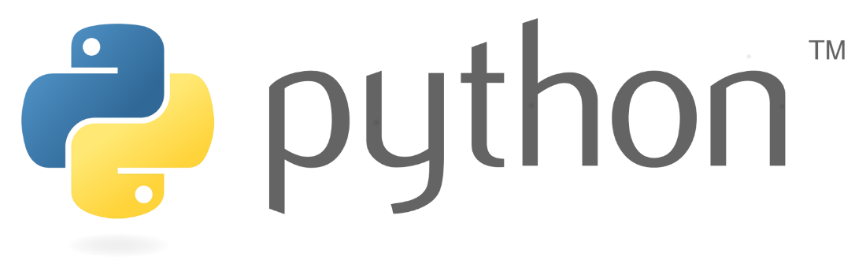
Indicative content
This module will examine the following topics:
Python basics
Python Data Structures
Python Programming Fundamentals
Working with Data in Python
Software Testing
Risk analysis and mitigation
Using Python libraries and software tools in CS, DS, AI or FinTech applications

Slide 7
Two component assessment
Component 1 [20%] - Programming fundamentals test (lab-based)
Blackboard-based test on the fundamentals of programming
Week beginning 10th November (teaching week 8)
Assessment Criteria
Ability to demonstrate how the fundamentals of programming are applied in to solve problems,
Read, understand and describe concisely what existing code does,
Identify errors/bugs and recommend fixes.

Slide 8
Two component assessment
Component 2 [80%] - Application Development
You will develop an application to perform some basic Data Processing and Visualisation
Historical weather data
Hand-in date: 6th January 2026 via Blackboard
Assessment criteria
Ability to produce a solution to the problem scenario described
Quality of the code comments and the clarity of the presented material.
Quality, relevance and use of research materials.
Quality of the code and algorithms presented.
Use of suitable libraries to facilitate development of the solution.
Work within the requirements given.
Demonstrate a robust approach to testing.
Security consideration and risk evaluation

Slide 9
Scheduled time
Lectures
Introduce you to programming concepts through practical demonstrations
Tutorial Activities
Review exercises
Solve programming problems using the concepts introduced in the lectures.
As you progress, the problems will increase in complexity.
Provide an opportunity to work on the assessment later in the semester.
Receive regular feedback from your tutors and each other to reflect upon and take forward to future activities.

Slide 10
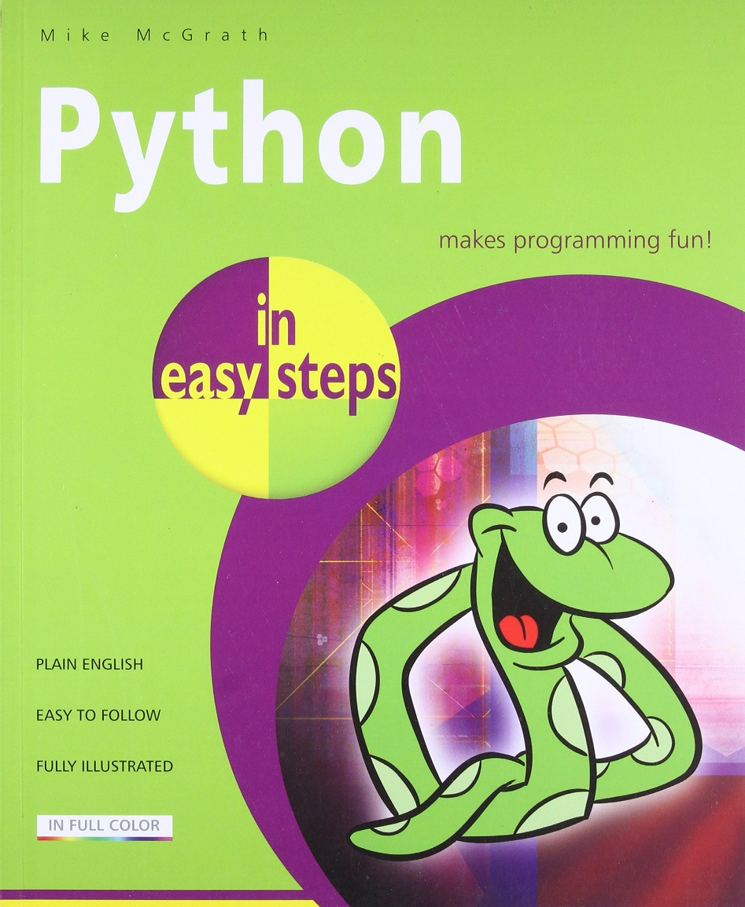
Recommended reading
We recommend “Python in easy steps” to accompany you through this module. The University library has it, and it’s also available to buy from Amazon etc. for under £10.
Work through it to keep your skills sharp. Keep it on your desk as a reference. Refer to it as and when you need it!

Slide 11
Beginning programming
What’s a program?

Slide 12
So, what’s a program? (part 1.)
Conceptually, a program is a simple thing - a sequence of instructions (called statements) in a programming language.
These can be:
Operators (like +, -) and operands
Expressions
Assignments
Keywords
x = 10
y = 20
z = x + y
print(z)

Slide 13
So, what’s a program? (part 2.)
We need to be very precise when we write programs because…

Slide 14
So, what’s a program? (part 3.)
…computers don’t think! They don’t truly understand the program you write, only how to run it! They have no notion of context; they will do as you tell them – nothing more and nothing less.

Slide 15
So, what’s a program? (part 4.)
We call the grammar of a program its syntax.
We call the meaning of program its semantics.
For example, in mathematics, 5(2) has different syntax to 5×2, but the same semantics⁠⁠: 5 multiplied by 2!
x = 10
y = 20
z = x + y
print(z)

Slide 16
A generic program (part 1.)
Input
Keyboard
Mouse
Processing
Software
Output
Screen
Network
Printer
Hardware

Slide 17
A generic program (part 2.)
Input
Keyboard
Mouse
Processing
Software
Output
Screen
Network
Printer
Hardware
This is what we are interested in!

Slide 18
Programs are just instruction lists
Remember this program on the right from before?
It’s a sequential list of instructions.
It says:
Put the value ‘10’ in ‘x’
Put the value ‘20’ in ‘y’
Add ‘x’ to ‘y’ and put it in ‘z’
Give ‘z’ as program output
x = 10
y = 20
z = x + y
print(z)

Slide 19
Programs are just equations!
Don’t get worried, this will become clear!
All a program does is take input from the user, change (or, more technically, transform) the data and give it as output.
On the right, there’s a mathematical equation specifically a function definition (not a Python one, we’ll get to that later!).
See how it works? Depending on what we give as x, we get a different answer!
Here, x is the input, f is the program, and the right-hand side is the output.
f(x) = x × 2
f(2) = 4
f(10) = ?

Slide 20
Here’s the Python equivalent
Mathematical equation
Python implementation
f(x) = x × 2
x = input()
ans = x * 2
print(ans)

Slide 21
Getting started with Python!
Python: Who, What, Where and Why?

Slide 22
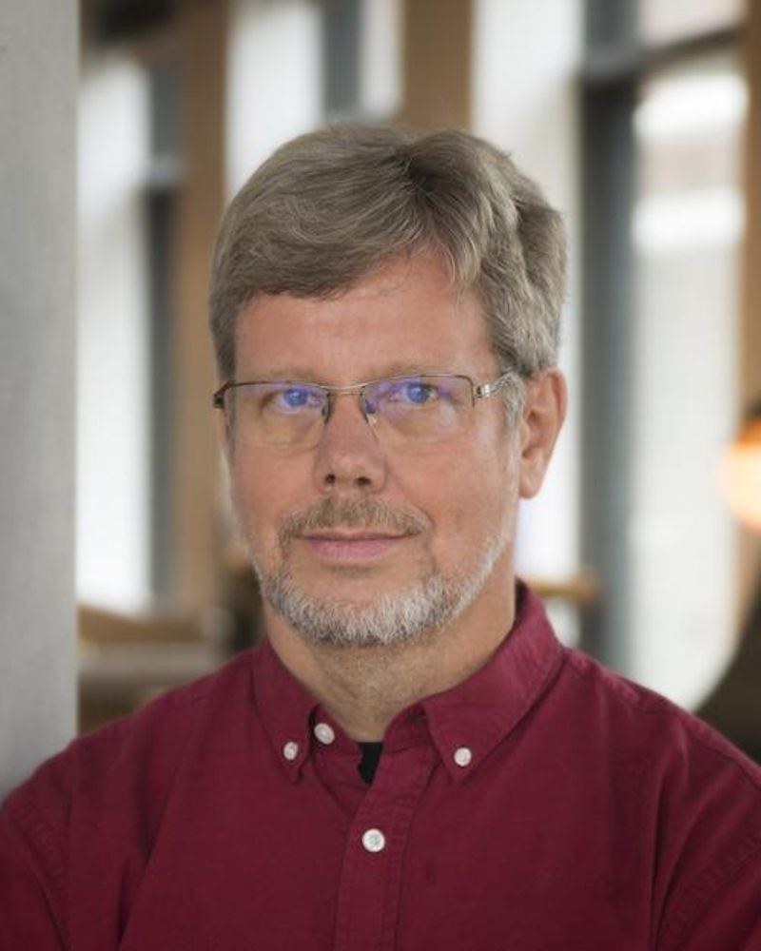
Python: Origins (part 1.)
Python is a programming language that was invented by Dutch programmer Guido van Rossum in 1990. It’s named after the Monty Python comedy group!
It’s free, powerful, expressive, readable, approachable and cross-platform (it’ll run on Mac, Linux, Windows, and even microcontrollers).
It has a massive following, and mountains of support is available online and in person!
We’ll be learning Python 3 on this module, which is a different language to Python 2.

Slide 23
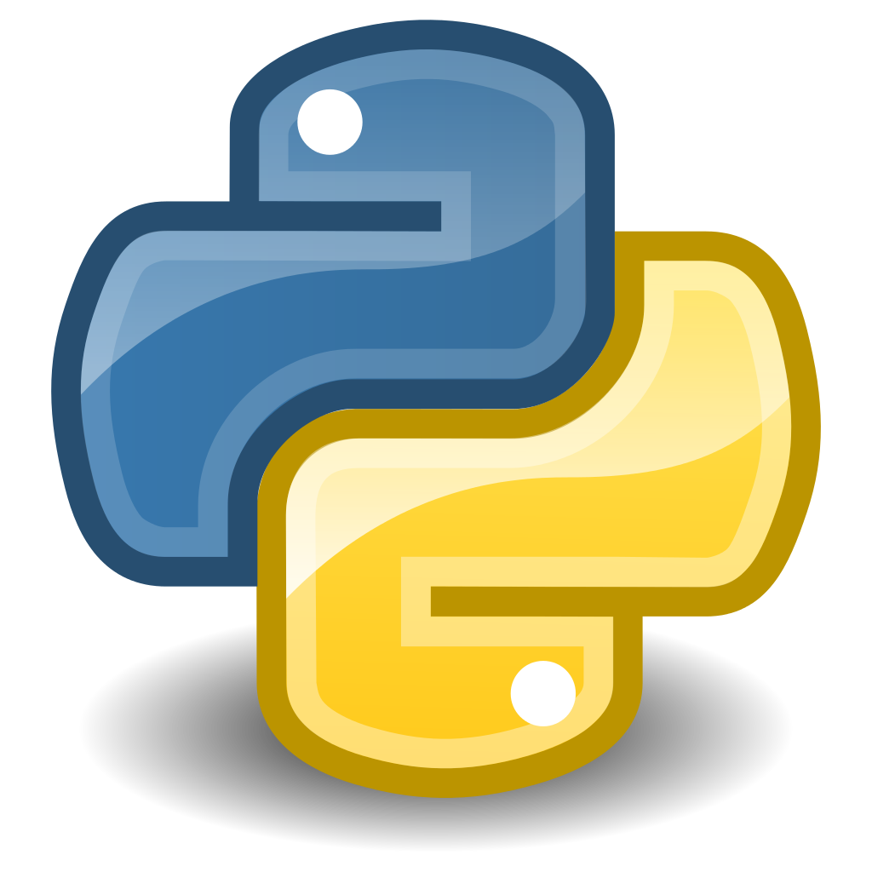
Python: Origins (part 2.)
Python is typically an interpreted language.
This means that additional software is required to run Python programs, which are written in plain text.
That’s right, all you need to write Python code is Notepad! Or any IDE
To run Python programs however, you’ll need the Python interpreter, available here: https://www.python.org/downloads/

Slide 24

Why Python? (Part 1)
It has a relatively simple language syntax that is easier to learn that some other languages.
Is widely used in many areas of computing:
Data Analysis & Data Science .
Networks, Cyber-security, Digital Forensics.
Task automation.
“Glue” language.
Scientific and Research computation.
Games & 3D animation.
Web development.
Has good job prospects.

Slide 25
Why Python? (Part 2.)
Comes with “batteries included”.
A rich and versatile standard library which is immediately available, without making the user download separate packages. This gives the Python language a head start in many projects.
Many additional packages available that are easy to install using PIP.
Is an expressive and readable language (let’s take a look at another Java comparison).

Slide 26
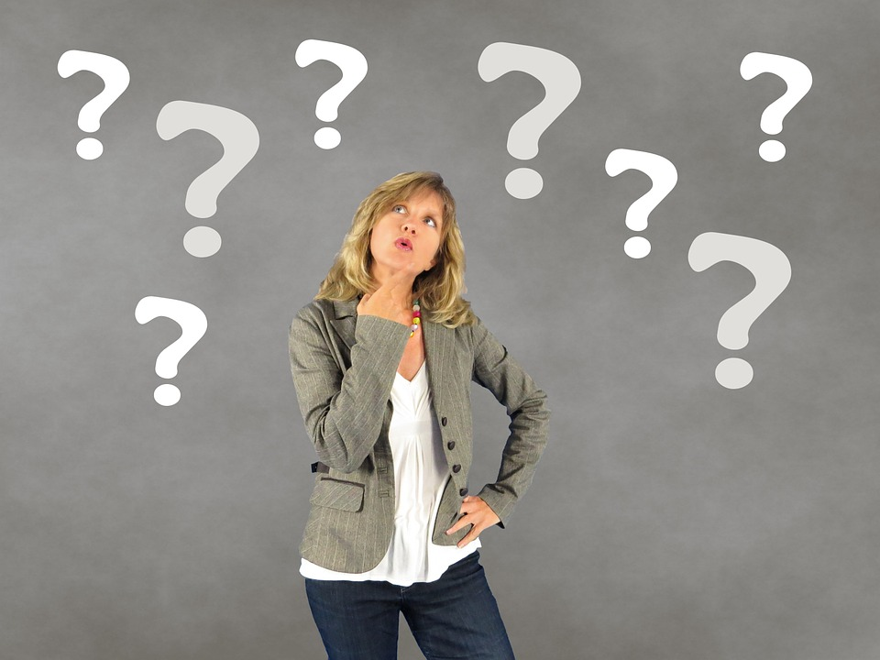
Any drawbacks?
Python can be slower than compiled languages (i.e. C++) that are converted to raw machine code before they are run.
Due to its interpreted nature, Python does not check variable types at compile time (more on this later).
You can’t really compile Python programs (i.e. turn them into .exe files to run anywhere).

Slide 27
Hello World!
The first program most programmers implement when dealing with a new language.

Slide 28
Java Vs. Python (Part 1)
Java: Traditional Object-Oriented Language
Python: Designed for Expressiveness
public class HelloWorld
{
public static void main(String[] args)
{
System.out.println("Hello World");
}
}
print("Hello World")

Slide 29
Java Vs. Python (part 2.)
Swap the values of two variables around…
// Java
int temp = var1;
var1 = var2;
var2 = temp;
# Python
var2, var1 = var1, var2
var1
2
1
var2
temp
3

Slide 30
A quick demo
We’re going to write our first program(s) together now.
Notes:
We’ll write a quick program to create a few variables where one is given result of adding the other 2.

Slide 31
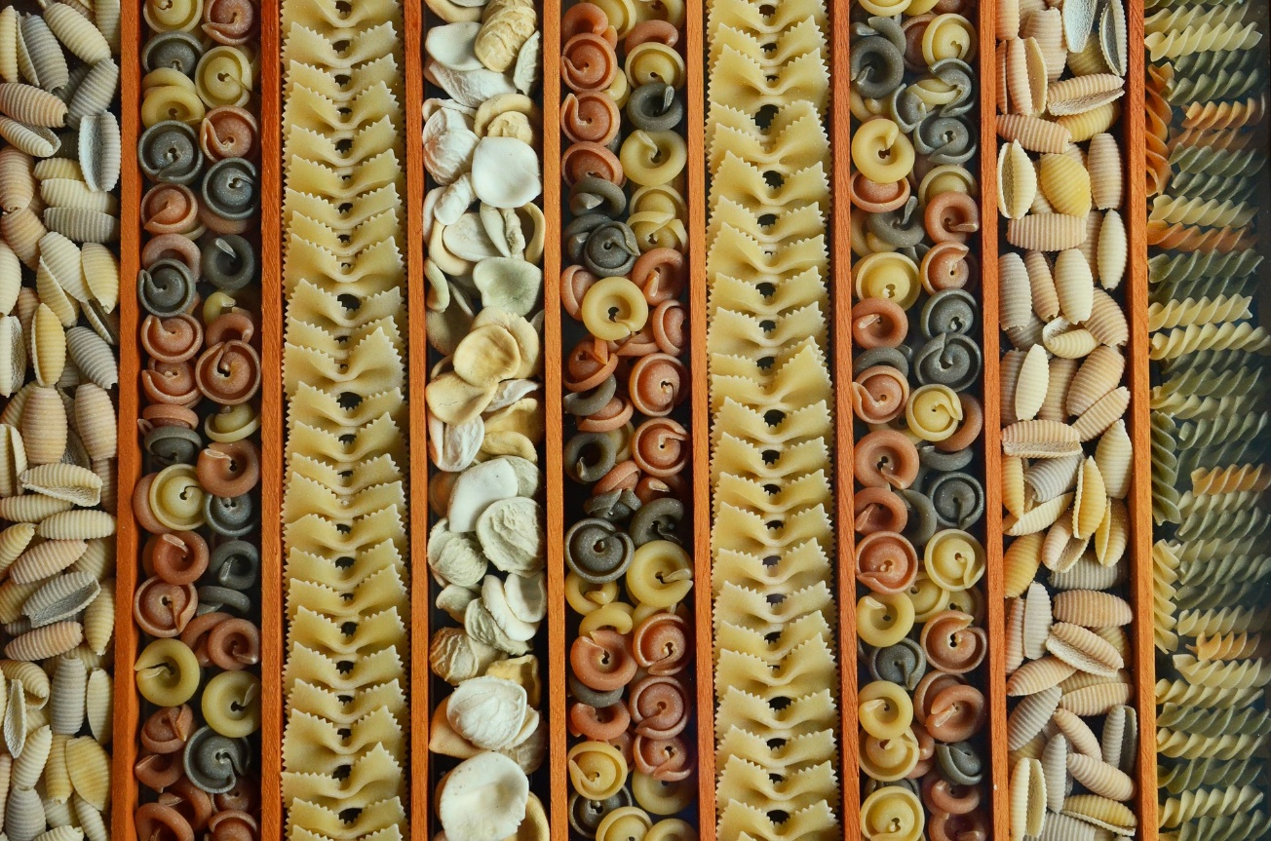
Types: What are they? (part 1.)
Type is a concept in programming that relates to the kind of data the computer has stored.
For example, adding 1 and 2 together we get 3, but what about trying to add the number 1 to the word "bananas".
We can’t do it, of course! This is known as a type error – trying to make incompatible data types do something they can’t.

Slide 32
Types: What are they? (part 2.)
Scalar (single) types in Python include:
Integers (whole numbers)
Floating point numbers (decimals)
Boolean values (true/false, yes/no)
None (represents nothing or null)
Strings, sequences of letters like “hello” are non-scalar or composite. What does this mean?
Notes:
Scalar types: In programming, scalar types are those that contain a single value. However, the definition isn’t a strict as mathematics.
Strings: You may well find that the programming community at large can’t agree whether strings are scalar or not. Some languages consider strings are primitive types but to also call them scalar seems a bit of a stretch given the arbitrary order that characters can appear in a string.
Modern Python advocates the use of “Type Hinting”, we’ll not make extensive use of it throughout this module.

Slide 33
What’s a “variable”? (part 1.)
A variable is like a box that can be used to store a value of some type.
We give variables names, called identifiers in order to work with them easily.
In Python, these names can only contain letters, numbers and underscores (_), and cannot start with a number.
x = 10
x123 = 8
x123! = False
123x = "Hello!"
X_123 = 23.53
Notes:
I would complicate the Python parser if variables were allowed to start with digits. Moreover, it could confusing to other programmers reading the code.

Slide 34
What’s a “variable”? (part 2.)
Some words have special meaning in Python which means we can’t use them as variables.
Some of them on the right. A complete list can be found here: https://www.programiz.com/python-programming/keyword-list
Some so-called reserved words in Python include:
import
class
def
True
False
if
continue

Slide 35
The print() function
The print() function will write some text to the screen.
The print() function can take multiple arguments (small pieces of data we provide) separated by a comma.
The comma introduces a space in the output separating the printed content of adjacent arguments.
# Set some variables
result = 42
x = 6
y = 7
# Use print to output to screen
print()
print("Result is: ", result)
print(x, "*", y, "=", (x * y))

Slide 36
The input() function
The input() function will get a value from the user.
The input() function should normally be given with a prompt to observe good user interface practice (single argument only)
The prompt can be a literal (as indicated) or a string variable.
The input() function would normally include a variable name assignment to record whatever was entered in response.
input()
input("Please enter something: ")
name = input("And your name is?")
The input statement returns a character string type!

Slide 37
Casting
Casting is the process of converting a value of one type to another.
For example, if we read two numbers from the user as strings, we cannot add them together until we turn them into integers! To cast to values of a different type, we use functions including:
float(x) - converts x to a float
int(x) - converts x to an integer
str(x) - converts x to a string
x = input("Enter x: ")
y = input("Enter y: ")
print(x * y) # This won't work!
print(int(x) * int(y)) # This will
# Notice the use of casting here

Slide 38
Operators
Operators are functions that work on operands.
Examples, with operands x as 8 and y as 3 are shown on the right.
These are called binary operators. Binary just means ‘2’, and because these operators take 2 operands, they get their name.
This has nothing to do with the concept of binary numbers (i.e. 1s and 0s)!
Operation | Python | Example
Addition, subtraction | + or - | x + y = 11
Multiplication | * | x * y = 24
Division | / | x / y = 2.67
Exponentiation (Power) | ** | x ** y = 256
Integer division | // | x // y = 2

Slide 39
Live demo: Bar bill
Write a program that will provide a total when ordering items from the SU bar.

Slide 40
High-level steps – pseudocode
Define the costs of the available bar
Initialise the total bar bill to 0
Ask the user for how many beverages they want
Ask the user for how many food items they want
Update the total bar bill, ie: number of drinks x cost + number of food item * cost
Display the final cost to the user

Slide 41
Finally, Conform to the Style Guide!
Code must be written in a way that makes it easy to read!
To help us with this, programmers often employ style guides to make sure that our code conforms to certain standards.
Python’s most popular style guide is called PEP 8 and you can look at it here: https://www.python.org/dev/peps/pep-0008/
When we write code on this course, we want to conform to this as closely as we can.
Why is it important to write readable code?

Slide 42
Questions

