Slide 1
Autonomous Grid Navigation
An AI Solution using Reinforcement Learning and Search
CIS4049-N · Artificial Intelligence Foundations
CUI JIANGKUN
Student No: F5743005
A warehouse delivery robot, solved two ways — and compared.
Notes:
Hello. This is my AI Foundations solution: Autonomous Grid Navigation. I take one real-world problem — a warehouse delivery robot finding its way to a drop-off — and I solve it with two different families of AI technique from the module, reinforcement learning and classical search, and then I critically compare them. Let me show you.

Slide 2
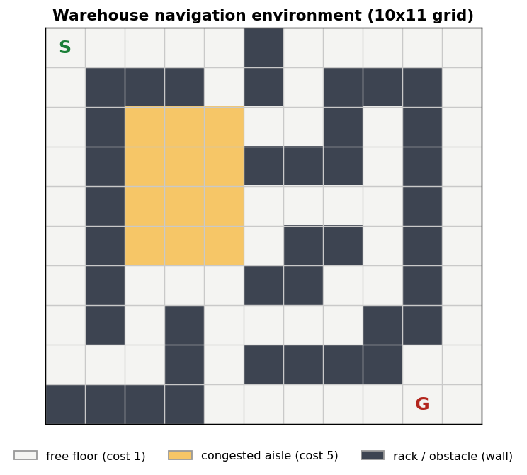
THE PROBLEM
A delivery robot that plans, not just moves
Start → Goal The robot must travel from its charging depot (S) to a drop-off point (G).
Obstacles & congestion Storage racks block cells; congested aisles are 5× slower to cross.
Cheapest, not shortest The route with the fewest steps runs through the slow aisles — we want lowest cost.
Why it is AI Choosing an action sequence through a state space is a classic AI problem.
Notes:
The task is a warehouse floor laid out as a grid. The robot starts at S and must reach the goal G. Some cells are storage racks it cannot pass; the yellow cells are congested aisles that cost five times as much to cross. Crucially, the cheapest route is not the one with the fewest steps — and finding good action sequences like this is a classic AI search problem.

Slide 3
APPROACH
One task, two AI paradigms
Q
Reinforcement Learning
S
Classical Search
No map — learns from experience
Tabular Q-learning, ε-greedy
Trial and error over rewards
Module Weeks 5–6
Has a map — plans directly
BFS, Uniform-Cost / Dijkstra, A*
Systematic state-space search
Module Weeks 7–9
Then compared: the Week 8 “Search vs Reinforcement Learning” question.
Notes:
Rather than pick one method, I solve the same task two ways. On the left, reinforcement learning: the robot is given no map and learns a policy by trial and error using tabular Q-learning. On the right, classical search: given a map, it plans the route directly with breadth-first search, uniform-cost search, and A-star. Comparing them is exactly the Week 8 Search-versus-RL question.

Slide 4
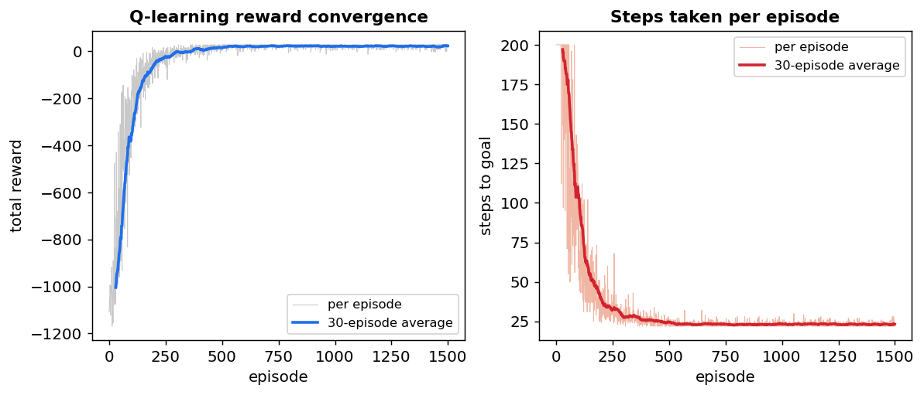
REINFORCEMENT LEARNING
Learning to navigate from reward alone
ε-greedy Explores random actions early, exploits the best later — ε annealed 1.0 → 0.05.
TD update Q(s,a) ← Q(s,a) + α[r + γ·maxQ(s′,a′) − Q(s,a)].
Reward shaping −cost per move, +50 at the goal, −10 for hitting a rack.
Converges ~1,500 episodes: reward climbs, steps fall from 200 to ~22.
The learning curve — the signature of a converged policy.
Notes:
Here is how the learning works. The agent picks actions ε-greedily — exploring early, exploiting later — and after every move it applies the Q-learning temporal-difference update shown here. Rewards are shaped: a small penalty per move, a big bonus at the goal. Over about fifteen hundred episodes it converges — reward climbs and the steps-per-episode collapse from two hundred to about twenty-two. That flattening is the signature of a learned, stable policy.

Slide 5
CLASSICAL SEARCH
Three ways to plan the route
1
BFS
2
UCS / Dijkstra
3
A*
Optimal in steps
Optimal in cost
Optimal + efficient
FIFO queue, expands shallowest first — ignores terrain cost.
Priority queue by path cost g(n) — routes around congestion.
Adds an admissible Manhattan heuristic f = g + h — far fewer nodes.
Admissible heuristic (never overestimates) → A* keeps optimality while expanding roughly half the nodes of UCS.
Notes:
On the search side I implemented three algorithms that share one structure and differ only in how the frontier is ordered. Breadth-first search uses a simple queue — it is optimal in the number of steps but ignores cost. Uniform-cost search, which is Dijkstra, orders by path cost and is optimal in cost. A-star adds an admissible Manhattan heuristic, staying optimal while expanding far fewer nodes.

Slide 6
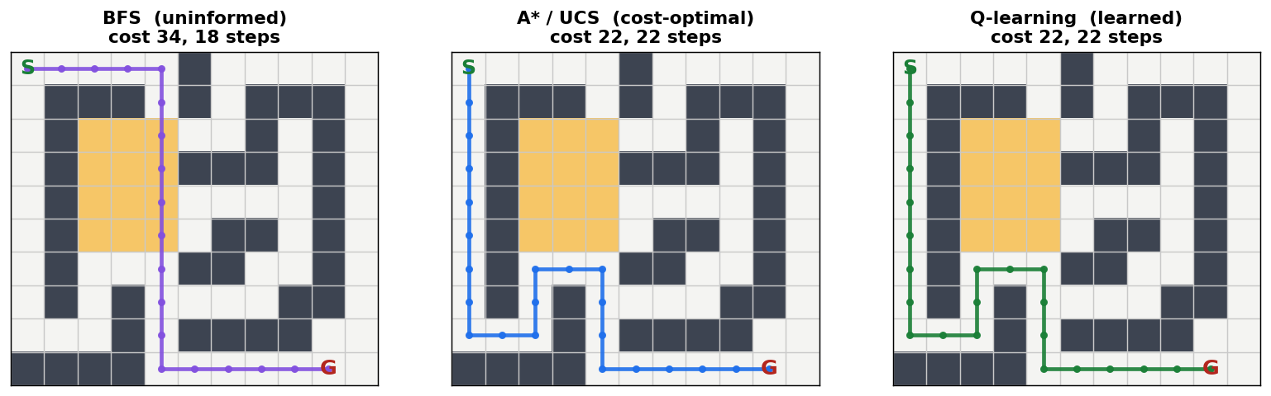
RESULTS
Same optimum, found two ways
cost 34
cost 22
cost 22
BFS — fewest steps (18) but drives through the congestion
A* / UCS — cost-optimal; A* expands 33 nodes vs 59
Q-learning — the same optimal route, learned with no map
Notes:
And here is the payoff. The three panels show the route each paradigm chose. Breadth-first search takes the fewest steps but plunges through the congested band for a cost of thirty-four. A-star and uniform-cost both find the cost-optimal route of twenty-two, with A-star expanding only thirty-three nodes against fifty-nine. And Q-learning — with no map at all — independently learns that same optimal route. All of this is checked automatically in the notebook.

Slide 7
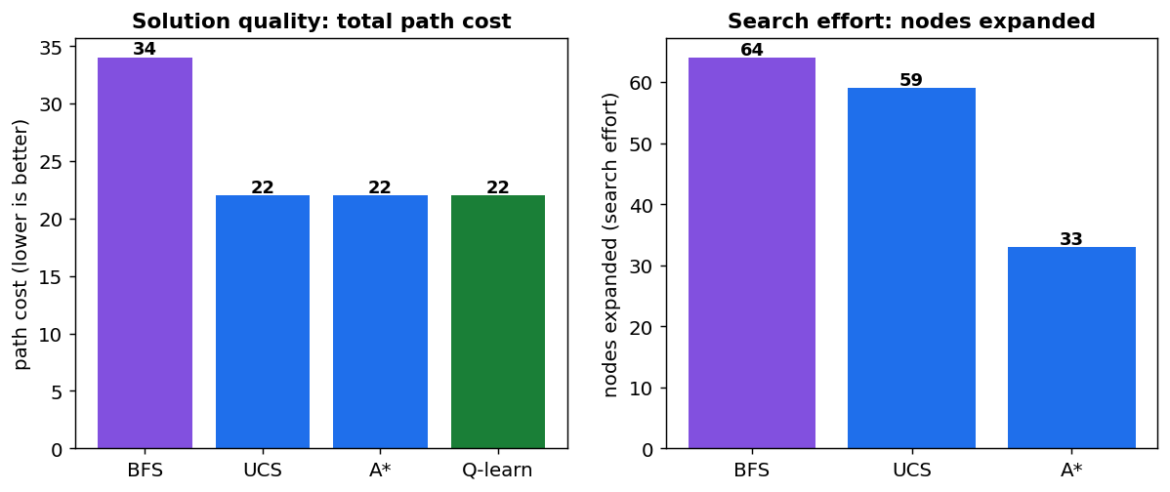
CRITICAL COMPARISON
Search vs Reinforcement Learning
The verdict
Plan with search when the world is known; learn with RL when it is not.
A* halves the search effort with a good heuristic.
RL needs no model — ideal for unknown, changing floors.
But RL pays in sample cost and gives empirical, not guaranteed, optimality.
Notes:
So what is the trade-off? Search is exact and fast — but only because it is handed a perfect map, and a good heuristic like A-star's roughly halves the work. Reinforcement learning needs no map, which makes it the right tool for unknown or changing environments — but it pays in sample cost, and its optimality here is empirical rather than guaranteed. The verdict: plan with search when the world is known, and learn with RL when you must discover it.

Slide 8
RISKS, LIMITATIONS & TAKEAWAYS
What it would take to deploy this
Commercial
Professional
Limitations → Future
Sim-to-real gap on hardware
Scalability — curse of dimensionality
Fleet-level, not per-robot, objectives
Safety-critical certification
Learned policy harder to audit than a plan
Workforce & accountability
Deterministic, tabular today
→ stochastic + SARSA
→ Deep Q-Networks, hybrid planner
CUI JIANGKUN · F5743005
CIS4049-N Artificial Intelligence Foundations — thank you.
Notes:
Finally, deploying this responsibly means facing real issues. Commercially: the sim-to-real gap, scalability from the curse of dimensionality, and optimising for the whole fleet, not one robot. Professionally: safety certification, the fact that a learned policy is harder to audit than an explicit plan, and workforce impact. And its limitations point to the future — stochastic dynamics, SARSA, deep Q-networks, and a hybrid that plans with search but adapts with learning. Thank you for watching.

