Slide 1
BluePeak HR
MERN Stack Employee Management System
Project overview and functionality presentation
Student
Guide
Deployment
Bhanu Sharma
Enrollment: O24MCA112292
MCA Full Stack Development
Alok Srivastva
Academic Year: 2024-2026
Chandigarh University
Live on Render
https://bluepeak-hr.onrender.com
MongoDB Atlas database

Slide 2
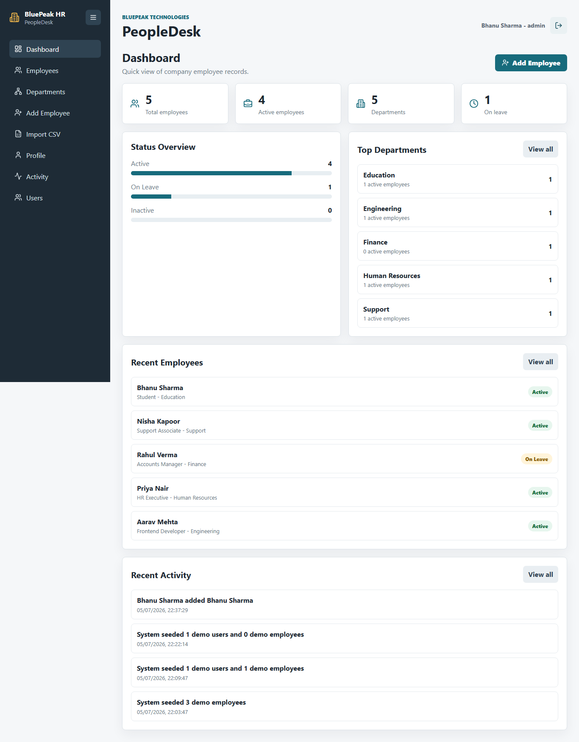
Project Overview
MERN Stack Employee Management System
Purpose
BluePeak HR is a web application that helps an organization store, search, secure, and maintain employee records through a browser-based interface.
Centralized employee records
JWT-based authentication
Admin, department head, and user roles
Employee CRUD, search, filters, CSV import/export
Activity log and dashboard summaries
Bhanu Sharma | O24MCA112292 | MCA Full Stack Development
https://bluepeak-hr.onrender.com

Slide 3
Objectives And Scope
MERN Stack Employee Management System
Database
Backend APIs
Frontend
Design MongoDB schemas for users, employees, activity logs, and app settings.
Develop RESTful APIs with Express for authentication, employees, users, activity, and imports.
Create a React interface with separate pages and clear workplace-style navigation.
Security
Testing
Deployment
Use JWT, password hashing, route protection, and role-based access control.
Verify workflows using build checks, API checks, and Playwright browser testing.
Deploy the working MERN application on Render with MongoDB Atlas.
Bhanu Sharma | O24MCA112292 | MCA Full Stack Development
https://bluepeak-hr.onrender.com

Slide 4
System Architecture
MERN Stack Employee Management System
React Frontend
Express Backend
MongoDB Atlas
Render
Pages, components, services, AuthContext
>
Routes, controllers, middleware, validation
>
Users, employees, activity logs, app settings
>
Builds React and runs the Node.js service
The React app sends API requests to Express. Express validates requests, checks permissions, reads/writes MongoDB data, and serves the built frontend in production.
Bhanu Sharma | O24MCA112292 | MCA Full Stack Development
https://bluepeak-hr.onrender.com

Slide 5
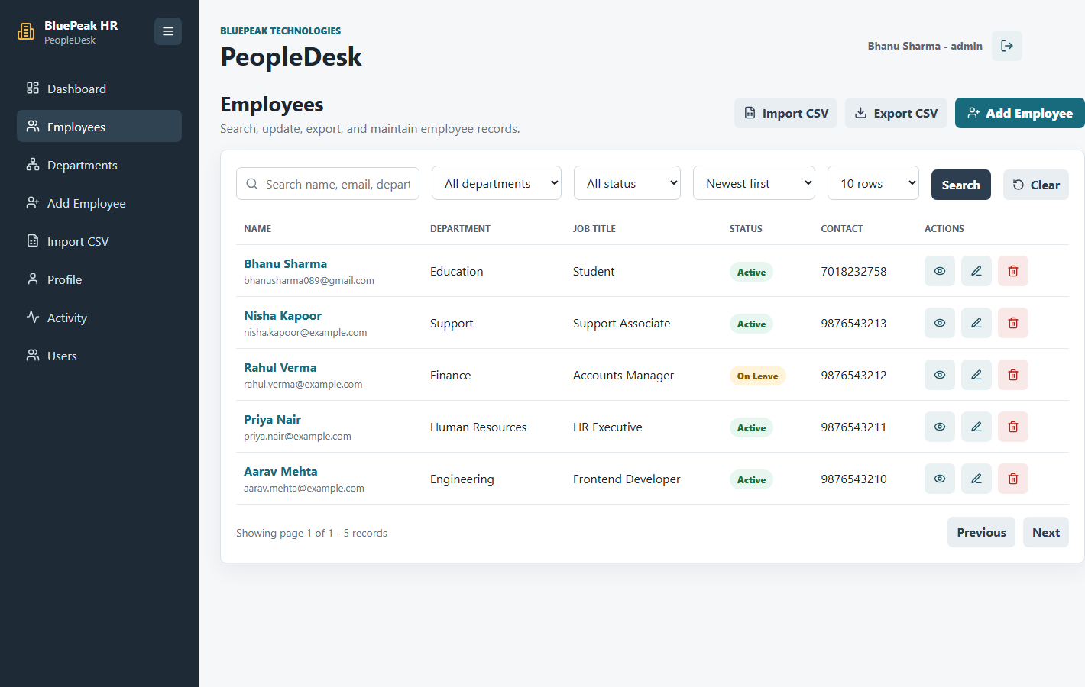
Main Functionality
MERN Stack Employee Management System
Secure login, registration, and profile management
Employee create, read, update, and delete operations
Search by name, email, department, and job title
Department, status, sorting, and row-count filters
CSV import with validation and CSV export
Activity history for employee and account changes
Bhanu Sharma | O24MCA112292 | MCA Full Stack Development
https://bluepeak-hr.onrender.com

Slide 6
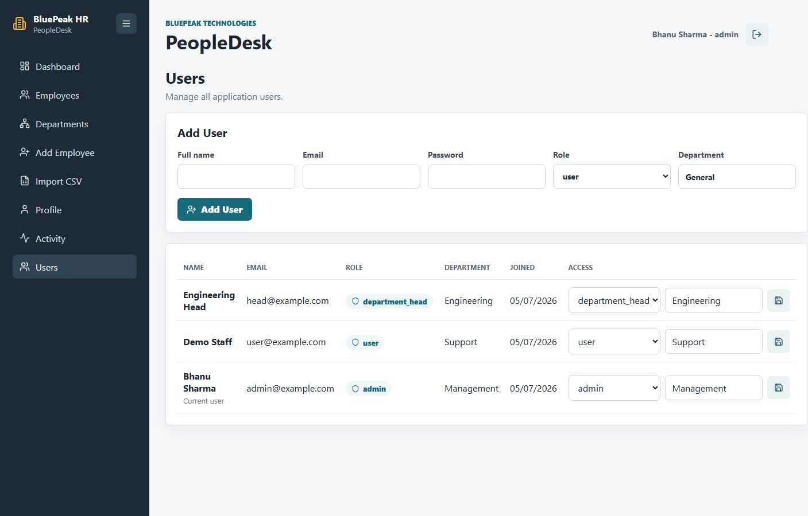
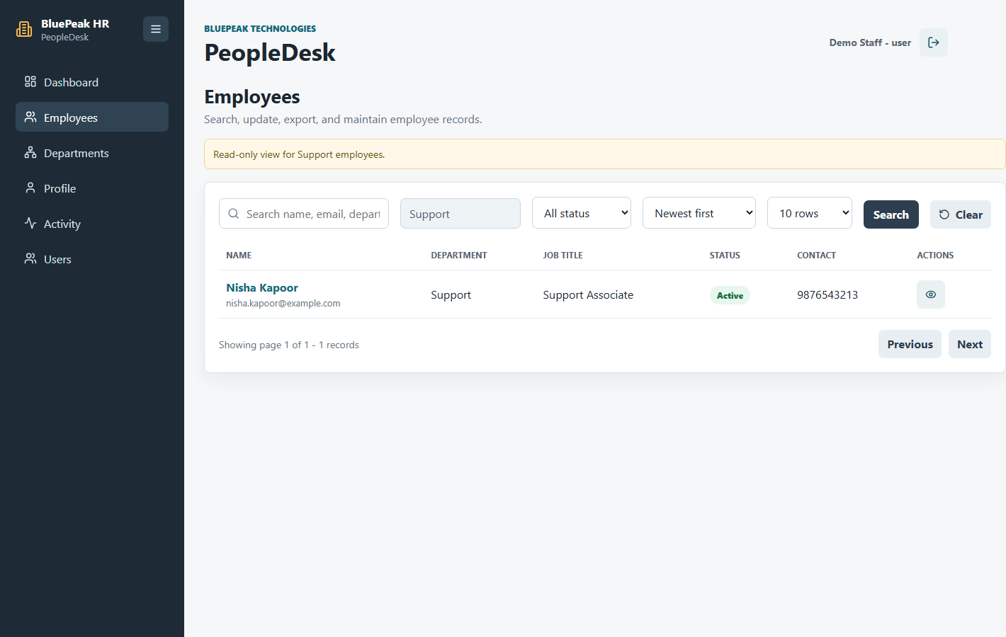
Role-Based Access Control
MERN Stack Employee Management System
Admin
Department Head
User
Can view and manage all employees and users. Can create users in any department and update roles.
Can manage employees and add normal users only inside their own department.
Can view employee and user information related to their department in read-only mode.
Bhanu Sharma | O24MCA112292 | MCA Full Stack Development
https://bluepeak-hr.onrender.com

Slide 7
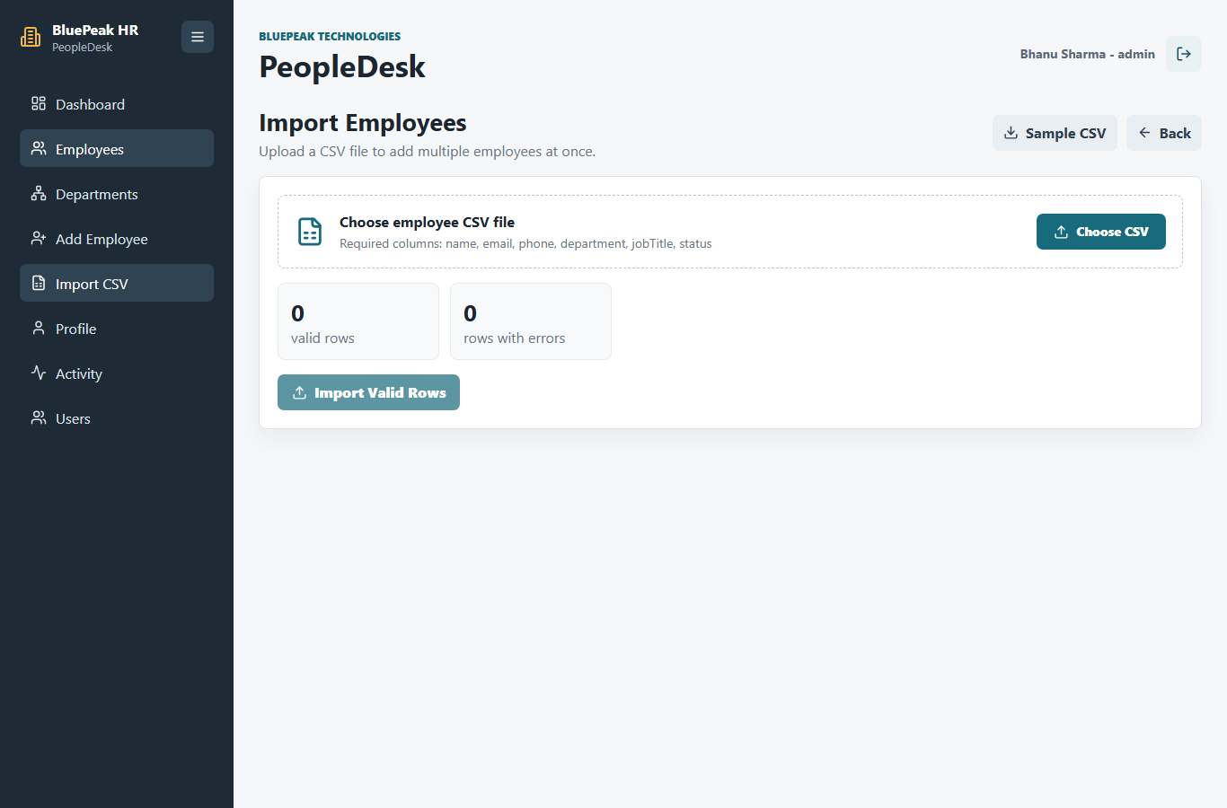
CSV Import And Validation
MERN Stack Employee Management System
Bulk employee upload using CSV files
Checks required columns before import
Validates email, phone, department, job title, and status
Shows row-level validation errors
Department heads can import only their own department
Bhanu Sharma | O24MCA112292 | MCA Full Stack Development
https://bluepeak-hr.onrender.com

Slide 8
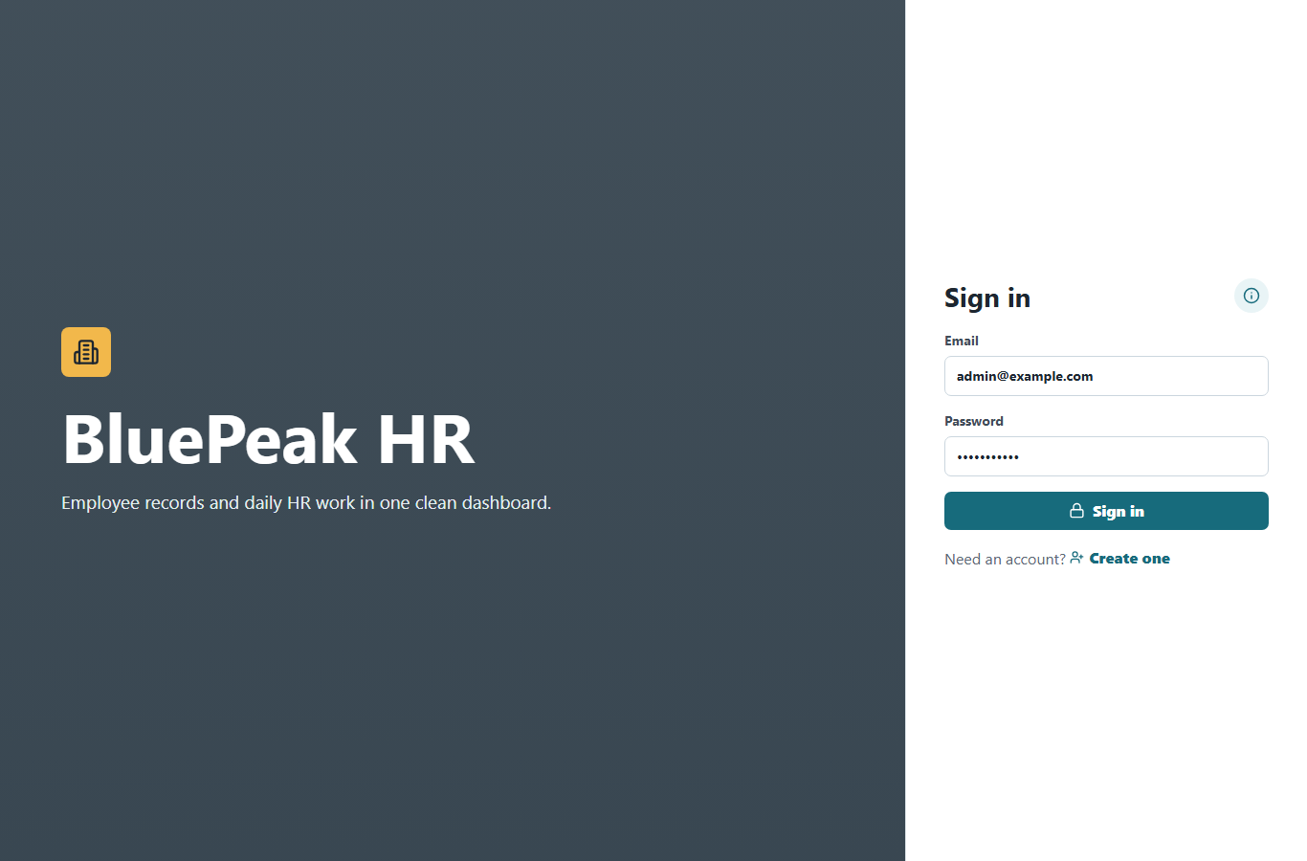
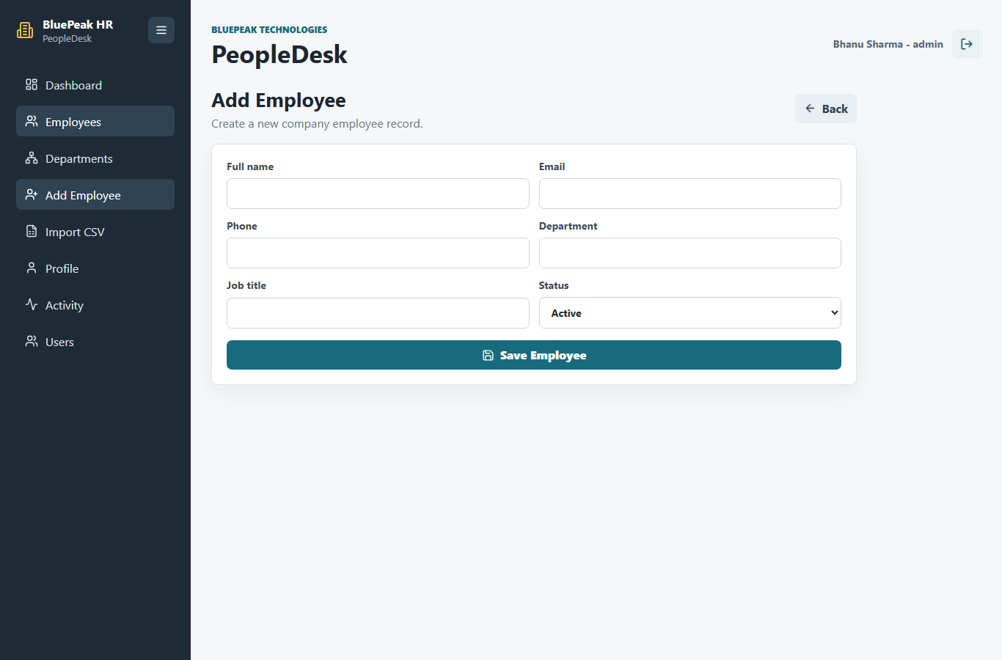
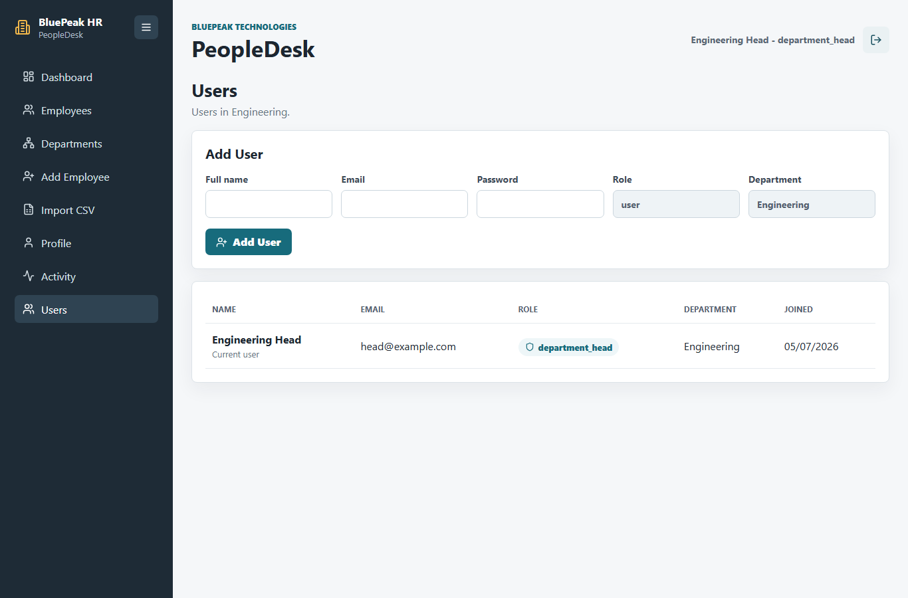
Important Screens
MERN Stack Employee Management System
Login
Add Employee
Department Head
Demo accounts for admin, department head, and staff user.
Separate page for creating new records.
User creation locked to the head department.
Bhanu Sharma | O24MCA112292 | MCA Full Stack Development
https://bluepeak-hr.onrender.com

Slide 9
Testing And Verification
MERN Stack Employee Management System
Frontend production build completed
Backend JavaScript syntax checks completed
Playwright smoke test covers login and employee workflows
Permission checks verify user and department-head restrictions
Render health endpoint verified after deployment
Useful Commands
npm run build --prefix client
npm run test:e2e
node scripts/capture-ui-screenshots.js
node scripts/record-admin-tour.js
Health URL
https://bluepeak-hr.onrender.com/api/health
Bhanu Sharma | O24MCA112292 | MCA Full Stack Development
https://bluepeak-hr.onrender.com

Slide 10
Deployment
MERN Stack Employee Management System
Platform
Database
Repository
Render Web Service
MongoDB Atlas
GitHub: nextlvlpro/mern-employe-app
Render installs server and client dependencies
Vite builds React production files
Express serves API routes under /api
Express serves React build for browser routes
Startup seed creates safe demo data once
Live Application
https://bluepeak-hr.onrender.com
Demo Login
admin@example.com
password123
Bhanu Sharma | O24MCA112292 | MCA Full Stack Development
https://bluepeak-hr.onrender.com

Slide 11
Conclusion And Future Scope
MERN Stack Employee Management System
Project fulfills the MERN stack employee management requirements
Application supports secure authentication and role-based workflows
System is deployed and ready for project demonstration
Documentation includes PDFs, screenshots, and tour video
Attendance management
Payroll or salary module
Password reset through email
Advanced reports and charts
Profile image upload
Thank You
Bhanu Sharma | O24MCA112292 | MCA Full Stack Development
https://bluepeak-hr.onrender.com

