Slide 1


Recommendation platform
Backend Recommendation Engine
Update/create recommendations
Collaborative Filtering / Support Vector Machine
feedback loop
update recommendations
Sparsity Reducer
Fill-up the hole in the matrix users/answers
Users feed back
On quality of recommendation
Users’s answers / History
feedbacks
on recommendation
Interactive Recommendation Engine
Manage the question/selection and
user answers, Real-time, adaptative
and affinities toward products
answers questions
update global
question’s ranking
Dynamic & Real Time
Heuristic based on most discriminating questions & Expectation-Maximization
recommends products
user’s profile & context
Compiler
Knowledge Base
Recommendations
recommendation’s weight
Product Catalog
meta-model: hierarchy of features
Organized in a hierarchy of categories
1
*
*
*
Quizz
*
Choices
*
*
1
1
*
1
Questions
Content Generator
Product clustering on features values
*
typed: trade-off, features, polling, …
attached to a product’s category
Product Rating
rating by features

Slide 2
Knowledge Base
Category : a hierarchy of Features F₁, F₂ … F_{m} to describe common properties to a sub set of products
  Ex: category: telephone
  Ex: features: brand, has_gps, number_pixel
  product as a whole is a feature
Each Product: P₁, P₂ … P_{n} is described by a set of typed FeatureValues : FV_{Pi/Fj} (boolean, enumerated, numeric, etc…)
  Ex: nokia95/number_pixel == 5mpx
Each FeatureValue can be rated (opinion) by Users or inferred from all values of the feature. FeatureRating: FR_{Pi/Fj/Uk} -1.00 .. +1.00
  Ex: nokia95/has_gps==yes rating=-1.00 (it sucks)
  Relative rating (feature ! Is better than feature 2 on p1/p2)
Combined and weighted rating
Questions and Choices: Q₁ (C₁₁, C₁₂,…,C_{1m}), … Q_{n} (C_{n1}, C_{n2},…,C_{nm})
  are exclusive/multiple
  authored or generated by Content’s Generator
Recommendations (Pattern): R₁ (C_{ij}, [Pw₁ … Pw_{k} ]) , … R_{n} Pw=Product + weight (-1.00 … +1.00)
  is an association between a choice and a product
  are computed from question’s semantic and use the FeatureValues and FeatureRatings to compute the Pw
  are generated by the compiler
  weights are updated using an available Collaborative filtering algorithm using user’s context, profile, answers, guessed answers and feed-back on recommendations

Slide 3
Interactive Recommendation Engine Algorithm - overview
Start Quiz
Select a question Q_{i} not answered by the User_{k} maximizing
Popularity (Question_{i})
*
(1 - ConfidenceGuess(Question_{i}/User_{k}))
*
Ranking Factor(Question_{i} / User_{k})
*
Manual priority(Question_{i})
sequencing
questions
answers question
Detect Recommendation pattern and update Products Affinities / User_{k}
Building
recommendations

Slide 4
Interactive Recommendation Engine / Algorithm - sequencing questions -
Popularity Pop(Q_{i}) [0.0 … 1.0]
  Measure how a question splits the user population
  Pop(Qi) ==Interest(Q_{i}) * confidence(Q_{i}) * discrimination(Q_{i})
  Interest == 1.0 - Counter(nb_answers_no_opinion / nb_answers_total) for a given time frame
  confidence(Qi) == 1.0 - 1.0 / (nb_answers_total + 1) for a given time frame
  Discrimination function for Binary Question
    Discrimination(Qi) == 1 - ( abs((nb_answers_yes / (nb_answers_yes + nb_answers_no))- 0.5) * 2 for a given time frame
  similar discrimination functions are defined on questions ontology for multi-choices, numeric,…
  Explain better
ConfidenceGuess CG(Question_{i} / User_{k} ) [0.0 … 1.0]
  Computed by the Sparsity Reducer using user’s history and machine learning
  CG(Q_{i} / U_{k} ) == Average(CG(Q_{i} / C_{j} / U_{k} ))
  CG(Q_{i} / C_{j} / U_{k} ) ==
    +1.0 if the system has a full confidence that a given User will answer C_{j} to Q_{i} ,
    0.0 otherwise.
  defines cluster of Questions and Users
Ranking Factor RF(Q_{i} / U_{k} ) [0.0 … 1.0]
    +1.0 if User U_{k} answering to Question Q_{i} would help sorting out products. Based on the number of recommendations available for each choice of this Question and the current ranking of products
    0.0 otherwise.
    Weighted by sponsored products
Manual priority(Question_{i}) [0.0 … 1.0].

Slide 5
Interactive Recommendation Engine / Algorithm - building recommendations -
Products Affinities / User_{k} AF(P_{i} / U_{k}) [-1.0 … 1.0]
  Define a distance between a Product and a User
  Initially set to zero for all products (a finite set) when the quiz starts for a new user
after the User U_{k} answered Choice(s) C_{j} to Question Q_{i}
  Look up (using a pattern matching approach) all Recommendation(s) for this Choice(s). R₁(C_{ij}, [Pw₁ … Pw_{k} ]) , … R_{n )}
  For each product compute Discriminator(P_{i} / U_{k}) [-1.0 … 1.0] = Average(Pw₁ … Pw_{k} )
  Update Product Affinities
    AF(P_{i} / U_{k}) = Average(Discriminator(P_{i} / U_{k}))
    Sort the products by their updated affinities

Slide 6
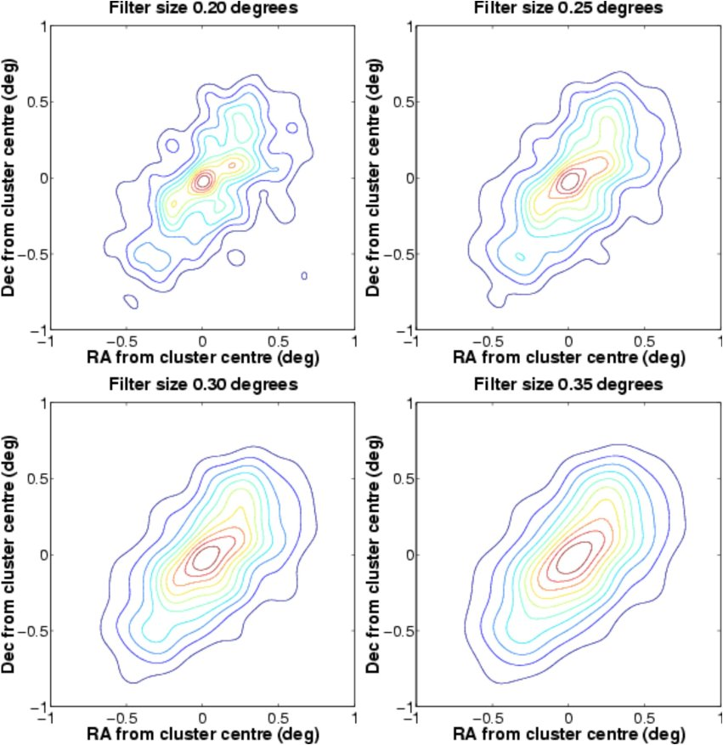
Matrix Sparsity reducer
Gaussian mixture models
Expectation-Maximization

Slide 7
Backend recommendation engine

