Slide 1

Meta ADS
WEEKLY PERFORMANCE REPORT
PRESENTED TO
Account Name
08/21/2026
🟢 Weekly Performance Score: 82/100 — Excellent
Monthly Ad Budget: $1,093 of $4,000 used (27%) — 10 days remaining

Slide 2







YOUR WEEKLY PERFORMANCE REPORT
Website_Leads (Campaign)
DATE RANGE
AD SPEND
COST PER QUOTE REQUEST SUBMITTED
$137
$7.61
August 14 - August 20 Ad Frequency: 1.4x avg
CAMPAIGN SUMMARY
REACH
CTR (ALL)
This campaign generated 18 quote requests at A$7.61 cost per request, spending A$137 to reach 4,730 people across 6,875 impressions. The campaign achieved a 1.86% click-through rate at A$2.20 cost per click, demonstrating solid audience interest in your offering this week.
4,730
1.86%
IMPRESSIONS
LINK CLICKS
6,875
68
KEY INSIGHTS & UPDATES
This week our campaign - website leads spent A$137 reaching 4,730 people with a 1.86% CTR. With 18 QUOTE REQUEST SUBMITTED recorded, the campaign shows strong traction at A$7.61 per result. To maximise results, budget will shift toward top-performing ads while underperformers are paused, with fresh creatives and refined targeting planned for the coming week.
QUOTE REQUEST SUBMITTED
COST PER LINK CLICK
18
$2.20

Slide 3
YOUR WEEKLY PERFORMANCE REPORT
Lead Campaign_ InstantForms (ad set)
DATE RANGE
AD SPEND
COST PER LEAD
$716
$8.95
August 14 - August 20 Ad Frequency: 1.3x avg
CAMPAIGN SUMMARY
REACH
CTR (ALL)
This ad set generated 80 leads at $8.95 cost per lead, spending $716 to reach 7,407 people across 9,784 impressions. The ad set achieved a 1.71% click-through rate at $6.35 cost per click, indicating solid audience interest in the lead form.
7,407
1.71%
IMPRESSIONS
LINK CLICKS
9,784
352
KEY INSIGHTS & UPDATES
This week the ad set spent $716 reaching 7,407 people with a 1.71% CTR. With 80 META FORM LEADS recorded, the campaign shows developing traction at $8.95 per result. To maximise results, budget will shift toward top-performing ads while underperformers are paused, with fresh creatives and refined targeting planned for the coming week.
META FORM LEADS
LANDING PAGE VIEWS
80
105

Slide 4
YOUR WEEKLY PERFORMANCE REPORT
Purchase Campaign | CBO | Conversion (Campaign)
DATE RANGE
AD SPEND
COST PER PURCHASE
$223
$14.87
August 14 - August 20 Ad Frequency: 1.8x avg
CAMPAIGN SUMMARY
REACH
CTR (ALL)
This campaign generated 15 purchase at $14.87 cost per purchase, spending $223 to reach 3,628 people across 6,687 impressions. The campaign achieved a 2.11% click-through rate at $1.25 cost per click, indicating solid audience interest in your offering this week.
3,628
2.11%
IMPRESSIONS
LINK CLICKS
6,687
64
KEY INSIGHTS & UPDATES
Your Purchase Campaign generated solid reach of 3,628 people with a 2.11% click-through rate, indicating strong audience interest in your messaging. However, 15 purchases at $14.87 cost per acquisition suggests the campaign needs further optimization to improve conversion efficiency.
PURCHASES
LANDING PAGE VIEWS
15
89

Slide 5
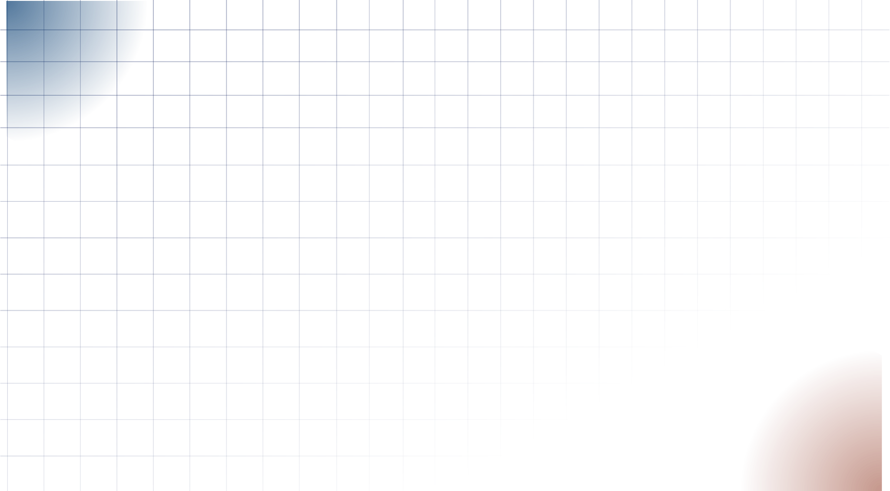
August Campaign Performance: August 1 - August 20, 2026
Total Month to Date Spend: A$1,076 · 3 Active Campaigns
Website_Leads Campaign
Lead Campaign_Instant Forms Campaign
Purchase Campaign | CBO | Conversion Campaign
$137
$716
$223
AD SPEND
AD SPEND
AD SPEND
18
80
15
QUOTE REQUEST SUBMITTED
META FORM LEADS
PURCHASES
$7.61
$8.95
$14.87
COST PER QUOTE REQUEST SUBMITTED
COST PER META FORM LEADS
COST PER PURCHASES

Slide 6
MONTHLY CAMPAIGN PERFORMANCE OVERVIEW
Month | Ad Spend | Reach | Impressions | CTR (All) | CPC (All) | META FORM LEADS | COST PER LEAD | WEB LEADS | COST PER WEB LEAD | PURCHASE | COST PER PURCHASE
July 1 - 31 | $582 | 118,555 | 326,044 | 0.07% | $2.60 | 33 | $17.63 | 0 | N/A | 0 | N/A
Aug 1 - 20 | $1,846 | 37,578 | 51,102 | 1.88% | $1.92 | 80 | $8.95 | 18 | $7.61 | 15 | $14.87

Slide 7









METRIC ABBREVIATION GUIDE
REACH
LINK CLICKS
QUOTE REQUEST SUBMITTED
The total number of unique users who saw your ad.
The actual number of clicks on links within the ad, leading to your chosen destination
QUOTE REQUEST SUBMITTED
IMPRESSIONS
COST PER QUOTE REQUEST
COST PER LINK CLICK
The total number of times your ad was displayed on users' screens.
COST PER QUOTE REQUEST SUBMITTED
Average cost for each link click
AD FREQUENCY
CPC (COST PER CLICK)
LEARNING PHASE
The average number of times each person in your reach saw your ad.
The average cost you paid for each click on your ad.
The period during which Facebook's algorithm is learning the best ways to achieve your campaign objective.
CTR (CLICK-THROUGH RATE)
CPM (COST PER MILLE)
CONVERSIONS
The percentage of people who saw your ad and performed a click on it.
The cost you paid for a thousand impressions of your ad.
The number of users who have completed a desired action.

