Slide 1
Tusky image

Slide 2
设计目的
Requirements:
To launch an NFT or a coin, a accessible distributed storage is needed for long-term preservation of images.
To launch a distributed storage avatar.
What problem does this system solve?
Wholesale distributed storage capabilities from Tusky, then retail them to users in need of image storage.

Slide 3
Roles
User
create profile
recharge (optional)
upload/view images
Admin
withdraw the balance

Slide 4
User: create profile
create profile
initial balance : 0.1 SUI
recharge
minimum charge: 0.1 SUI

Slide 5
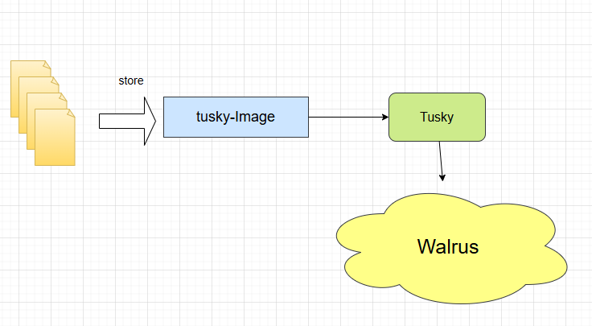
tusky image upload

Slide 6
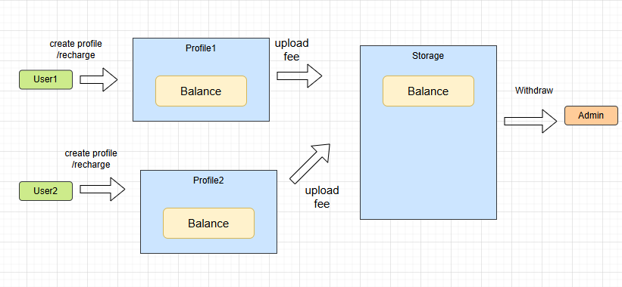
tusky image balance changes

Slide 7


User: upload image
upload image
view image

Slide 8
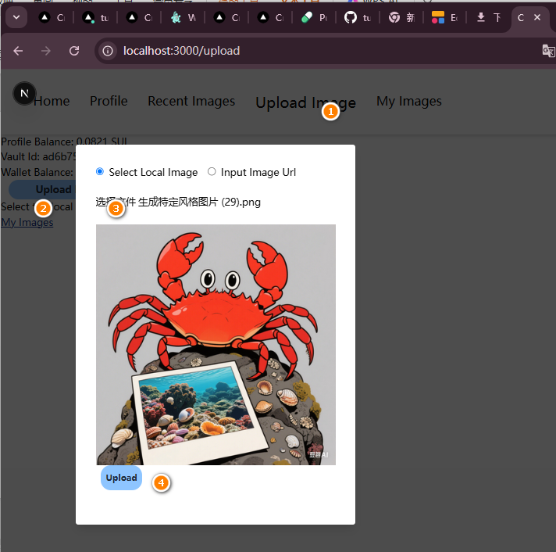
Upload Image

Slide 9
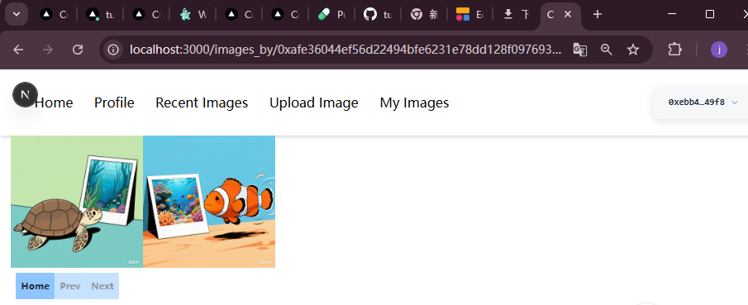
User： my image

Slide 10
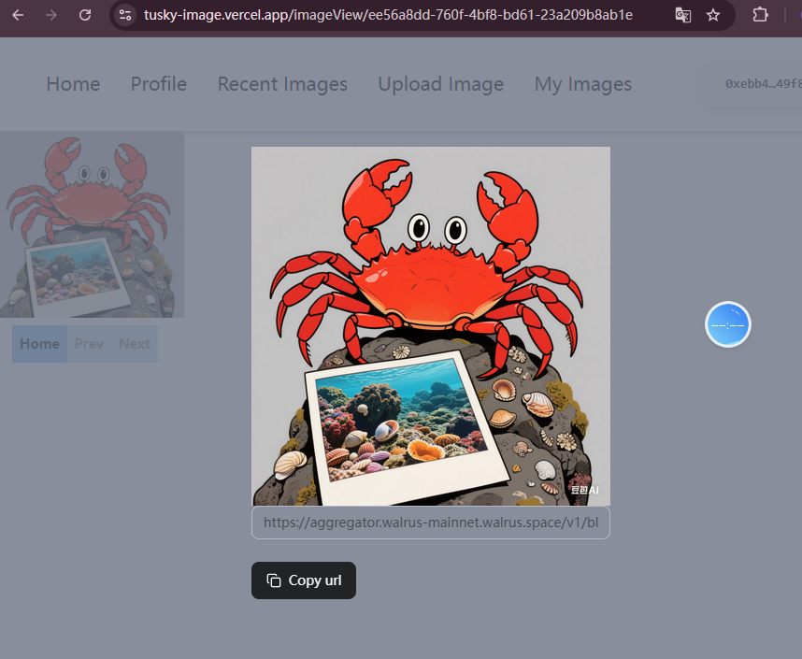
image url

Slide 11
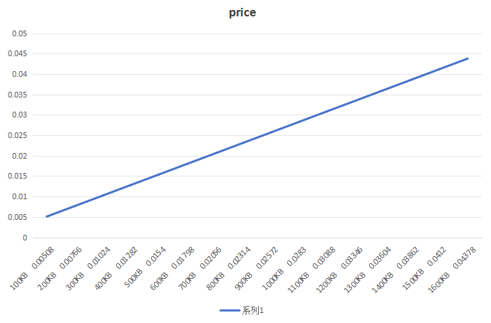
upload image fee
price:

Slide 12
admin
withdraw
withdraw the balance of storage

