Slide 1
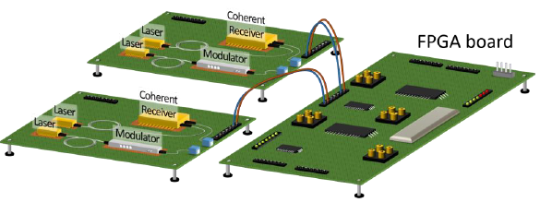
Sliceable-BVT white box demonstrator
Tx and Rx modules / reconfigurable optical layer parameter
Narrow linewidth laser / central wavelength {within C-band FlexGrid 12.5 GHz grid}, number of optical flows, number of optical carriers per flow
Dual polarization transmitter with driving electronics / modulation format {DP-mQAM, Digital subcarrier multiplexing, probabilistic shaping}, number of digital subcarriers, Baud rate
Polarization diversity receiver / Dual pol signals will always be considered
Transceiver board
RF circuitry hosting the electrical interfaces of the transmitter and receiver
NBLF is responsible for the development of the Linecard type demonstrator
Tx and Rx modules, Transceiver board and FPGA development for SDN control
Kick-off meeting, Athens 15-16 Jan 2018
1

Slide 2
Sliceable-BVT Model
SBVT is the main container consisting of:
An ID (unique)
An Array of Optical Flows
module: sliceable-bvt
+--rw sbvt
+--rw sbvt-id uint16
+--rw slice-ability-support boolean
+--rw optical-flows* [of-id]
+--rw of-id uint32
+--rw optical-flow-carriers* [ofc-id]
+--rw ofc-id uint32
+--rw frequency-info
| +--rw base-central-frequency frequency-ghz-type
| +--rw base-central-frequency-granularity frequency-ghz-type
| +--rw central-frequency-slot-granularity frequency-ghz-type
| +--rw n int16
| +--rw m int16
+--rw subcarrier-modules* [subcarrier-id]
+--rw subcarrier-id uint32
+--rw direction direction-type
+--rw baud-rate baud-rate-type
+--rw modulation modulation-type
+--rw central-frequency frequency-ghz-type
Optical flow:
ID (unique)
Array of Optical Carriers
Optical Carrier:
ID (unique)
Frequency Info:
Flex-Grid (ITU-T G.694.1)
Base-central-frequency: 193100 GHz
Central-frequency-granularty: 6.25 GHz
Slot Granularity: 12.5 GHz
n: to fix the nominal central frequency
m: to fix the carrier width
Array of Subcarriers
Subcarrier:
ID (unique)
Direction (TX, RX)
Other: Baud-rate, modulation format and central frequency

Slide 3
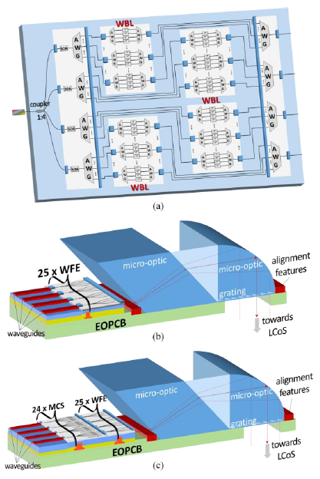
ROADM white box demonstrators
High speed 1x4 WSS
Reconfigurable optical parameters: Input port, output port(s), spectrum slot in multiples of 12.5 GHz, center frequency of port
1x24 WSS
Reconfigurable optical parameters: Input port, output port(s), spectrum slot in multiples of 12.5 GHz, center frequency of port
8x24 Transponder Aggregator (TPA)
Reconfigurable optical parameters: output port(s) (ADD/DROP), spectrum slot in multiples of 12.5 GHz, center frequency of port
ICCS/NTUA is responsible for developing the FPGA boards that will control the WSS components i.e. wavelength blockers and multicast switches
Kick-off meeting, Athens 15-16 Jan 2018
1

Slide 4
ROADM Model (road to): WSS
module: wss
+--rw wss
+--rw wss-id uint32
+--rw wss-direction direction-type
+--rw wss-number-of-ports uint32
+--rw wss-speed boolean
+--rw wss-ports* [port-id]
+--rw port-id uint32
+--rw port-direction direction-type
+--rw port-frequency-info
+--rw base-central-frequency frequency-ghz-type
+--rw base-central-frequency-granularity frequency-ghz-type
+--rw central-frequency-slot-granularity frequency-ghz-type
+--rw n int16
+--rw m int16
1xN
WSS
N Ports
In case of 1x4 WSS, Output direction (4x1), we will have:
5 Ports:
4 Input Ports: direction towards the wss
1 Output Port: direction outwards the wss

Slide 5
ROADM Model (road to): TPA
module: tpa
+--rw tpa
+--rw tpa-id uint32
+--rw tpa-direction tpa-direction-type
+--rw tpa-number-of-inports uint32
+--rw tpa-number-of-outports uint32
+--rw tpa-ports* [port-id]
+--rw port-id uint32
+--rw port-direction tpa-port-direction-type
+--rw port-frequency-info
+--rw base-central-frequency frequency-ghz-type
+--rw base-central-frequency-granularity frequency-ghz-type
+--rw central-frequency-slot-granularity frequency-ghz-type
+--rw n int16
+--rw m int16
MxN
TPA
M Ports
N Ports
In case of 8x24 WSS, Drop, we will have:
32 Ports:
8 Input Ports: direction towards the tpa
24 Output Ports: direction outwards the tpa, towards transponders

Slide 6
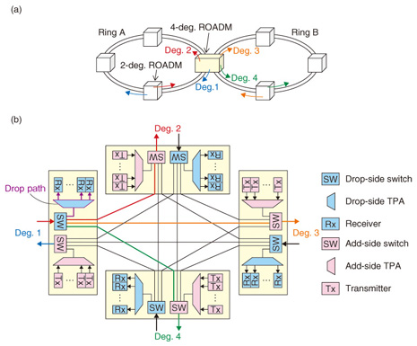
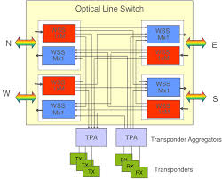
ROADM Model (road to): reference models
(A)
(B)

Slide 7
ROADM Model: “A” Solution
module: roamd
+--rw roadm
+--rw roadm-id? string
+--rw directions* [direction-id]
+--rw direction-id uint32
+--rw direction-switches* [wss-id]
+--rw direction-tpas* [tpa-id]
In “A” solution, TPAs are part of each ROADM grade.
A ROADM is modeled as a set of Directions/Degrees
Each Direction/degree includes a list of WSS and a List of TPAs
(A)

Slide 8
ROADM Model: “A” Solution
module: roamd
+--rw roadm
+--rw roadm-id? string
+--rw directions* [direction-id]
| +--rw direction-id uint32
| +--rw direction-switches* [wss-id]
+--rw tpas* [tpa-id]
In “A” solution, TPAs are NOT part of ROADM grades.
A ROADM is modeled as a set of Directions/Degrees and a set of TPAs
Each Direction/degree includes a list of WSS
(B)

Slide 9
Open issues
Presented models include only the configuration part:
Status and Notification are still missing
Also the internal wiring between components
To complete the ROAD Model it is possible to use OpenROADM (http://www.openroadm.org) as reference:
Telecom Italia is part of OpenaROADM consortium
Kick-off meeting, Athens 15-16 Jan 2018
1

