Slide 1
QAMeleon system & component simulations – ICCS/NTUA

Slide 2
Ongoing transmission simulations for WP2
Transmission Scenarios for all-purpose metro-regional network
Use of VPI Transmission Maker software
Single carrier transmission
Modulation Formats: Nyquist Shaped QPSK / 16-QAM / 64-QAM, Digital Subcarrier Multiplexing (DSM)
Bitrates: 32, 64, 128 Gbaud
Amplification: EDFAs in each transmission span (80 km)
Performance parameters under validation: BER vs Transmission Reach, BER vs OSNR
Comparative study between different modulation formats and bitrates
Examine the effect of cascaded filtering elements at each node (80 km)
Preliminary results will be presented at our plenary meeting in Berlin
Simulation testbed will be updated to support WDM transmission at least of 4 channels
Simulation testbed will be further updated with component models provided by VPI

Slide 3
Ongoing transmission simulations for WP2
Transmission Scenarios for DCI networks
Use of VPI Transmission Maker software
Single carrier transmission
Modulation Formats: Nyquist Shaped QPSK / 16-QAM / 64-QAM, Digital Subcarrier Multiplexing (DSM)
Bitrates: 32, 64, 128 Gbaud
Target Link Length: up to 100 km
Amplification: No EDFAs (amplifier-less transmission)
Performance parameters under validation: BER vs Transmission Reach, BER vs optical power
Comparative study between different modulation formats and bitrates
Preliminary results will be presented at our plenary meeting in Berlin
Simulation testbed will be updated to support WDM transmission at least of 4 channels
Simulation testbed will be further updated with component models provided by VPI

Slide 4
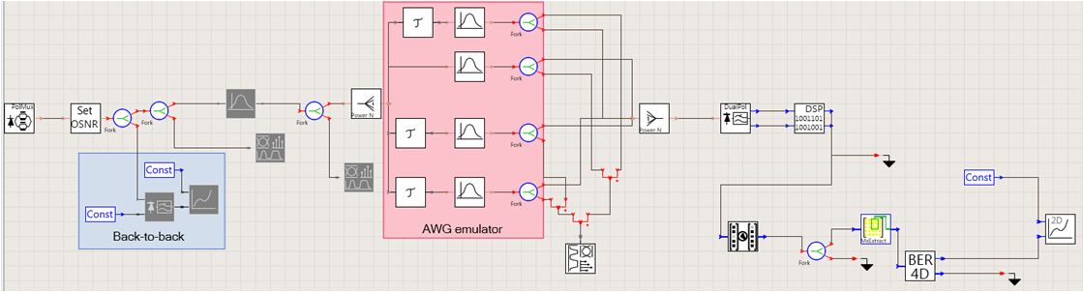
Ongoing system simulations for WP2 (Wavelength Blocker)
Emulate the performance of fast Wavelength Blocker elements (WBL) with AWGs
Phase 1: Use of VPI Transmission Maker to validate the proof of principle scenario of splitting and combining multiple spectral slices of 12.5 GHz by employing multiple filtering elements in parallel.
Modulation Formats: single carrier QPSK / 16-QAM / 64-QAM
Bitrates: 32, 64, 128 Gbaud
Performance parameters under validation: BER vs different delay values on each 12.5 GHz spectral slice, BER vs different optical loss values on each 12.5 GHz spectral slice
Use DSP for equalizing the combined data signal
Preliminary results will not consider the effect of SOAs
Preliminary results will be presented at the plenary meeting at Berlin
Updated simulation testbed will consider also Nyquist shaped constellations

Slide 5
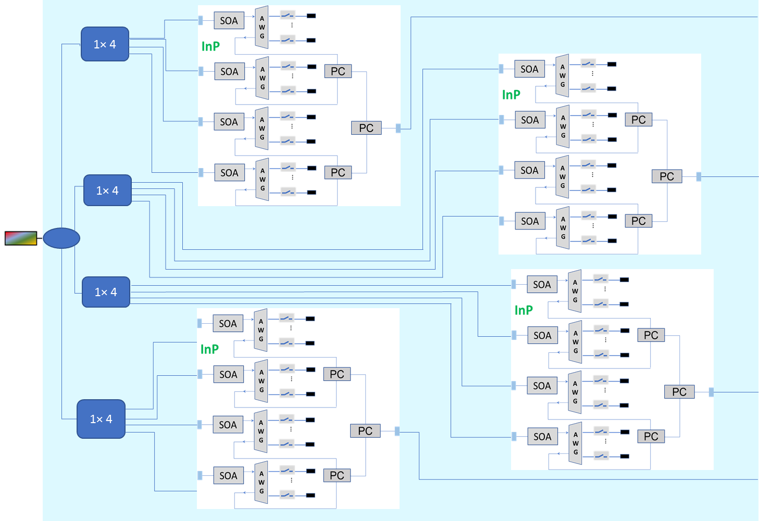
Component simulations for WP2 (Wavelength Blocker)
Phase 2 (after Berlin meeting): Use of VPI Component Maker to validate the actual architecture of a WBL developed in QAMeleon
Use SMART photonics PDK (waveguides, AWGs, SOAs)
SOAs will be included in the simulation setup
Updated simulation testbed will include polarization insensitive SOAs and AWGs when they become available from SMART photonics & VPI
Updated simulation testbed will include the 1x4 optical interleaver component in order to emulate the performance of an 1x4 WSS

Slide 6
Reconfigurable parameters for QAMeleon Tx/Rx and ROADM
QAMeleon Tx considered a two Dual Pol IQ MZMs prototype
Reconfigurable parameters (bold type are considered a vector):
{Number of optical flows, number of carriers per optical flow, wavelength(s), modulation format, baud rate}
wavelength: wavelength of optical carrier 1*, wavelength of optical carrier 2*
* The parameter wavelength will be used to tune also the wavelength of the LO laser at the Rx
modulation format: QAM order, number of digital subcarriers, pre-compensation/pulse shaping(tbd)
QAMeleon 1x4 fast WSS, 1x24 multi-port WSS and 8x24 TPA
Reconfigurable parameters (bold type are considered a vector): {Input port, output port}
Input port and Output port may be considered as vectors defined by: center frequency, bandwidth (in multiples of 12.5 GHz)
Reconfigurable parameters to be checked by FG3 partners and especially NXW in order to be compatible with their Yang model under development

