Slide 1
Progress on Task 2.3 – NXW

Slide 2


Task 2.3 - Objectives
Task 2.3 Design and specification of SDN interfaces (M06-M21) NXW, TIM, ICCS/NTUA, NBLF
Users, Applications, …
SDN Controller interfaces and device abstract information model:
North-bound interface:
Technology Indipendent
Virtual Network Slicing support
South-bound interface
Well-knonw protocol SDN (e.g. NETCONF )
Configuration and control (and monitoring) of optical devices.
Optical devices (S-BVT, ROADMs) abstraction
Yang models
North-bound Interface (NBI)
South-bound Interface (SBI)
Device Agent
Device Agent
Device Agent

Slide 3

Task 2.3 – On the interfaces
Users, Applications, …
Controller NBI:
Based on TransportAPI (TAPI)
Proposed by Open Networking Foundation (ONF)
Enables programmatic control of network both in a technology-indipent and in a technology-specific fashion
SDN Controller
Controller SBI (Controller-Agents):
Should offer functionalities for Configuration, Control, and Monitoring of the optical devices
Configuration:
Add/Remove/Update
Control
Modification (optimization) of optical parameters (e.g. Modulation Format)
Monitoring
Active: Controller periodically retrieves the status of the devices
Passive: Controller receives advertisements from the agents
NETCONF provides all required functionalities
SDN Controller
SDN Agent(s)

Slide 4
Task 2.3 – On the interfaces (Preliminary Work)
Preliminary work has been focused (and will be focused, in the first stage) on the abstraction (modeling) of the optical devices
NETCONF (RFC6241, RFC6242, …) offers all functionality required to handle a network device
YANG (RFC6020) is a data modeling language for NETCONF:
Models configuration and state data
Models Remote Procedure Calls (RPCs)
Models Notifcations
RFC6244 ”An Architecture for Network Management Using NETCONF and YANG” defines their interaction
SDN Controller
Base NETCONF Configuration/Control/Monitoring mechanisms
are shaped by the models
Model-driven
Controller-Agent Interface
SDN Agent(s)

Slide 5
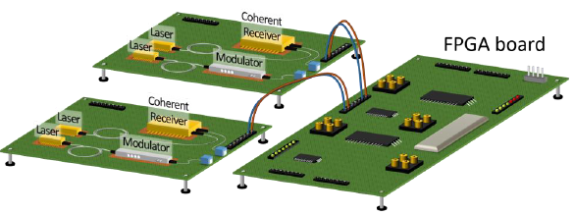
Task 2.3 – Towards a Sliceable-BTV model
Tx and Rx modules / reconfigurable optical layer parameter
Narrow linewidth laser / central wavelength {within C-band FlexGrid 12.5 GHz grid}, number of optical flows, number of optical carriers per flow
Dual polarization transmitter with driving electronics / modulation format {DP-mQAM, Digital subcarrier multiplexing, probabilistic shaping}, number of digital subcarriers, Baud rate
Polarization diversity receiver / Dual pol signals will always be considered
Presented at 12 Apr FG3 Conference Call

Slide 6
Task 2.3 - Sliceable-BVT Model - Draft
SBVT is the main container consisting of:
An ID (unique)
An Array of Tranceivers
module: sliceable-bvt_v2
+--rw sbvt
+--rw sbvt-id uint16
+--rw slice-ability-support boolean
+--rw tranceivers* [tranceiver-id]
+--rw tranceiver-id uint32
+--rw optical-flows* [of-id]
+--rw of-id uint32
+--rw optical-flow-carriers* [ofc-id]
+--rw ofc-id uint32
+--rw frequency-info
| +--rw base-central-frequency frequency-ghz-type
| +--rw base-central-frequency-granularity frequency-ghz-type
| +--rw central-frequency-slot-granularity frequency-ghz-type
| +--rw n int16
| +--rw m int16
+--rw subcarrier-modules* [subcarrier-id]
+--rw subcarrier-id uint32
+--rw direction direction-type
+--rw baud-rate baud-rate-type
+--rw modulation modulation-type
+--rw central-frequency frequency-ghz-type
Tranceivers:
ID (unique)
Array of Optical Flows
Optical flow:
ID (unique)
Array of Optical Carriers
Optical Carrier:
ID (unique)
Frequency Info:
Flex-Grid (ITU-T G.694.1)
Base-central-frequency: 193100 GHz
Central-frequency-granularity: 6.25 GHz
Slot Granularity: 12.5 GHz
n: to fix the nominal central frequency
m: to fix the carrier width
Array of Subcarriers
Subcarrier:
ID (unique)
Direction (TX, RX)
Other: Baud-rate, modulation format and central frequency
Plenary meeting, Berlin 22-23 May 2018

Slide 7
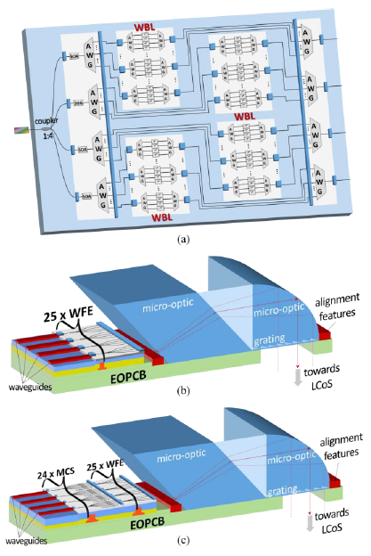
Task 2.3 – Towards a ROADM model
High speed 1x4 WSS
Reconfigurable optical parameters: Input port, output port(s), spectrum slot in multiples of 12.5 GHz, center frequency of port
1x24 WSS
Reconfigurable optical parameters: Input port, output port(s), spectrum slot in multiples of 12.5 GHz, center frequency of port
8x24 Transponder Aggregator (TPA)
Reconfigurable optical parameters: output port(s) (ADD/DROP), spectrum slot in multiples of 12.5 GHz, center frequency of port
Presented at 12 Apr FG3 Conference Call
Plenary meeting, Berlin 22-23 May 2018
7

Slide 8
Task 2.3 - ROADM Model (road to): WSS - draft
module: wss
+--rw wss
+--rw wss-id uint32
+--rw wss-direction direction-type
+--rw wss-number-of-ports uint32
+--rw wss-speed boolean
+--rw wss-ports* [port-id]
+--rw port-id uint32
+--rw port-direction direction-type
+--rw port-center-frequency frequency-ghz-type
+--rw port-frequency-slots uint16
1xN
WSS
N Ports
In case of 1x4 WSS, Output direction (4x1), we will have:
5 Ports:
4 Input Ports: direction towards the wss
1 Output Port: direction outwards the wss
Plenary meeting, Berlin 22-23 May 2018

Slide 9
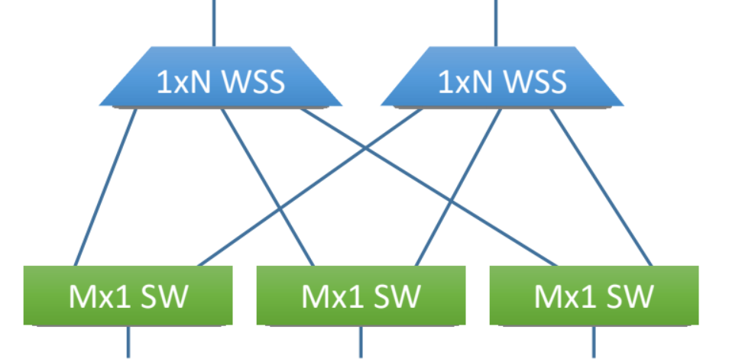
Task 2.3 - ROADM Model (road to): TPA - draft
M Ports
module: tpa
+--rw tpa
+--rw tpa-id uint32
+--rw tpa-direction tpa-direction-type
+--rw tpa-number-of-inports uint32
+--rw tpa-number-of-outports uint32
+--rw tpa-ports* [port-id]
+--rw port-id uint32
+--rw port-direction tpa-port-direction-type
+--rw port-center-frequency frequency-ghz-type
+--rw port-frequency-slots uint16
N Ports
In case of 8x24 TPA, Drop, we will have:
32 Ports:
8 Input Ports: direction towards the tpa
24 Output Ports: direction outwards the tpa, towards transponders

Slide 10
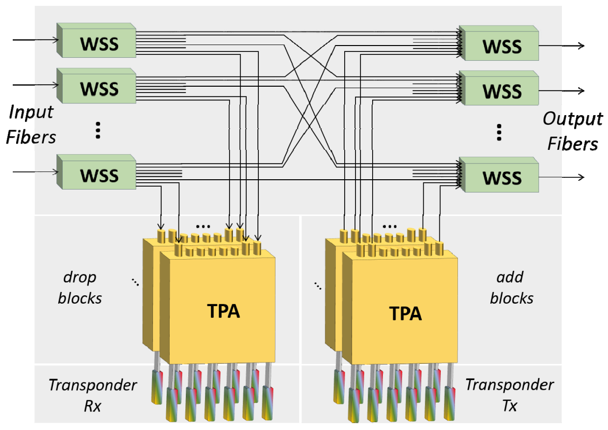
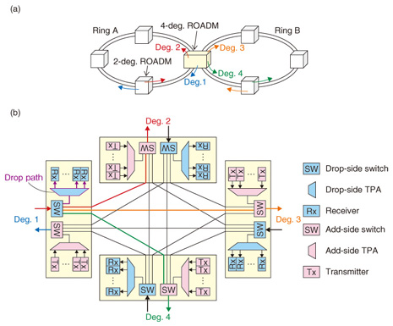
Task 2.3 - ROADM Model (road to): reference models
QAMeleon ROAD proposal
Example of 4-degrees ROADM
Plenary meeting, Berlin 22-23 May 2018

Slide 11
ROADM Model: a possible solution
module: roadm
+--rw roadm
+--rw roadm-id? string
+--rw directions* [direction-id]
+--rw direction-id uint32
+--rw direction-switches* [wss-id]
+--rw direction-tpas* [tpa-id]
TPAs are part of each ROADM degree.
A ROADM is modeled as a set of Directions/Degrees
Each Direction/degree includes a list of WSS and a List of TPAs
(A)

Slide 12
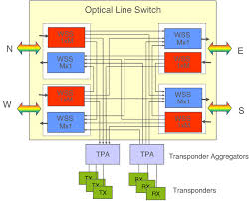
Task 2.3 - ROADM Model: Alternative Solution
module: roadm
+--rw roadm
+--rw roadm-id? string
+--rw directions* [direction-id]
| +--rw direction-id uint32
| +--rw direction-switches* [wss-id]
+--rw tpas* [tpa-id]
TPAs are NOT part of ROADM degree.
A ROADM is modeled as a set of Directions/Degrees and a set of TPAs
Each Direction/degree includes a list of WSS
(B)
Plenary meeting, Berlin 22-23 May 2018

Slide 13
Task 2.3 - ROADM Model: components wiring and lightpaths
In a network of N devices:
Is it a scalable approach?
Is a single instance of SDN controller enough to handle such complexity?
Discussion is still in progress
Possible solutions:
More models per device with different levels of abstraction
Controller hiearchy
e.g. one controller for a small set of devices and one which handles the network domain
Physical connection between ROADM components:
Needed to know what resources Optical HW offers in terms of available path for the light
Lightpaths:
Connections in use
Potential risk: the proposed centralized architecture may need to evolve in a «hierarchical» architecture.
→ More complexity for a scalable deployment (not an issue for demos)
Plenary meeting, Berlin 22-23 May 2018

Slide 14
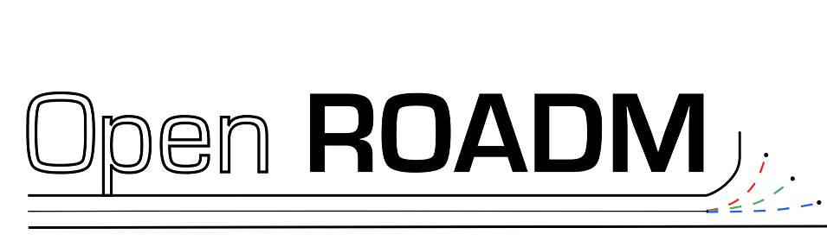
Task 2.3 – On ROADM modeling: OpenROADM MSA
From OpenROADM web site (http://www.openroadm.org) :
“The Open ROADM Multi-Source Agreement (MSA) defines interoperability specifications for Reconfigurable Optical Add/Drop Multiplexers (ROADM). Included are the ROADM switch as well as transponders and pluggable optics. Specifications consist of both Optical interoperability as well as YANG data models”
OpenROADM defined a set of usefull yang models can be reused in QAMeleon
Telecom Italia is a memeber of the agreement
Plenary meeting, Berlin 22-23 May 2018
14

Slide 15
Task 2.3 – On D2.2: ToC Proposal – SDN section
As T2.3 will start at [M6], D2.2 (due at M8) will cover only 2 of the 15 months of the task.
Proposed SDN Section ToC (both SBVT and ROADM):
State of the art for SBVT and ROADM modelling and control - NXW, NTUA, TIM
Existing projects (ORCHESTRA, NEPHELE for agent) - NXW, NTUA, TIM
Paper references - NXW, NTUA
Effort on modelling: Standard, Consortium, etc (IETF, OpenROADM, ...) - NXW
SDN-based architecture for controlling SBVT and ROADMs - NXW
Disaggregated modelling approach
General components and reference points
SDN controller + SDN agent
Abstract messages
Controller SBI
Short discussion on protocol alternatives, motivation for NETCONF – NXW
Interaction with proprietary devices with embedded controllers - TIM
YANG models draft - NXW
Interface between SDN-Agent and hw (via FPGA) – NTUA/NXW
Initial implementation design (i/f, NETCONF modules, etc.) - NXW
Probably this deliverable is too early for implementation and integration issues. This needs further discussions in WP7.
Plenary meeting, Berlin 22-23 May 2018
15

Slide 16
Task 2.3 – Progress, risks & plans for next 6 months
Plans:
Close interaction with FG3 partners (expecially NTUA and TIM) both offline and telcos to:
Definition and practical solution for Agent-FPGA communication interface
Definition of interface between agent and TIM Roadm solution
Periodically check of progresses on models (SDN functionalities, parameter correctness, etc)
Proposed models include only the configuration part
Status and Notification are still missing
Progress:
Expected to have a quite stable model for both S-BVT and ROADM
Preliminary skeleton of the agent(s)
Plenary meeting, Berlin 22-23 May 2018
16

