Slide 1
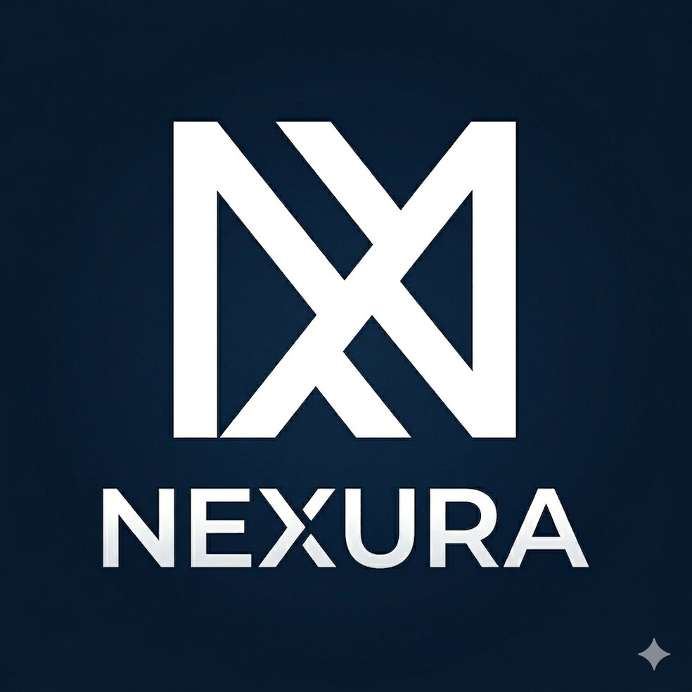


Quality marketing tools for independent pubs —
completely free while we build it together.

Slide 2
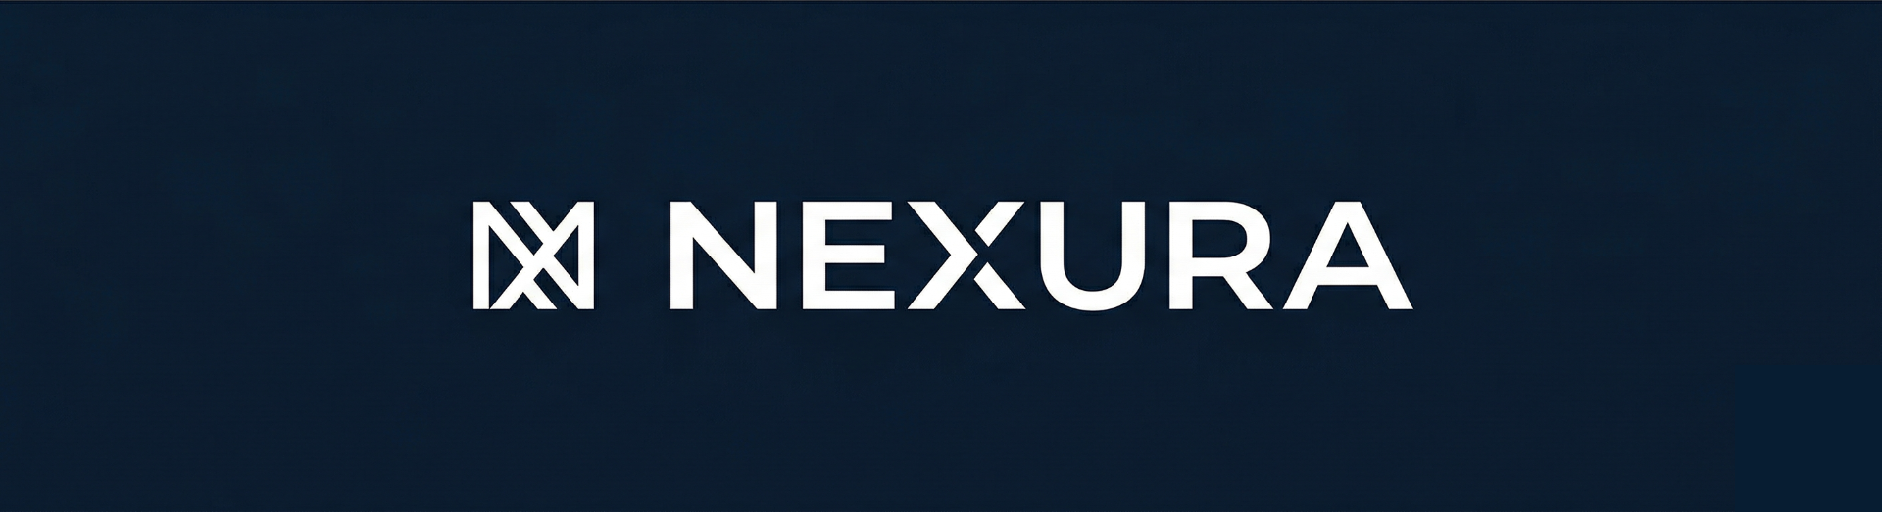
01
Built by people who
believe in your pub.
Our mission
We're Hudson and Sam — business students in London with a shared passion for independent hospitality.
Give independents access to the same marketing tools bigger brands take for granted.

Slide 3
02
Reaching more
people online.
60%
of consumers discover new venues through social media.
Your pub already has the atmosphere — social media helps share it with people who haven't found you yet.
We handle the online side so you can focus on what you do best.

Slide 4
03
54.8M
The digital shift
is well underway.
UK social media users
Pubs with a consistent online presence naturally reach more of their local community.
1h 37m
Daily time on social platforms

Slide 5
You send
"Quiz night Thursday, £2 off craft beers, starts at 7"
04
Just send a text.
We handle the rest.
NEXURA works through WhatsApp — no new apps, no dashboards.
We deliver
Professional post on Instagram & Facebook — caption, hashtags, the right image. Live within minutes.

Slide 6
Social Media Manager
05
£500 – £2,000
On us, for now.
per month
During our pilot, NEXURA is completely free.
Content & Strategy
£1,200 – £4,000
per month
NEXURA Pilot
£0

Slide 7
01
What you get
06
A full month of NEXURA, free. No contracts, no payment details. We handle the setup.
Try it for a month.
Completely free.
02
What we'd love
Your honest feedback. What's working, what could be better — it shapes what we build.
We're refining NEXURA with real businesses, and we'd love your input.
03
A thank you
Pilot members lock in legacy pricing forever. You helped build it — that should count.

Slide 8
Let's get started.
Text us on WhatsApp — we'll have you posting within 24 hours.
Hudson & Sam London

