Slide 1

SMART INDIA HACKATHON 2026
MailTrace
Explainable email threat detection with origin and campaign forensics
Upload a saved email. See the evidence behind its risk and likely infrastructure.
PROBLEM STATEMENT ID
SIH26106
PROBLEM STATEMENT TITLE
AI-Powered Email Threat Detection, GeoLocation and Forensic Intelligence Platform
THEME
Blockchain & Cybersecurity
PS CATEGORY
Software
TEAM ID
[ENTER PORTAL TEAM ID]
TEAM NAME
[ENTER REGISTERED TEAM NAME]

Slide 2
From one suspicious message to a connected case file.
MailTrace combines detection, origin context and campaign correlation in one analyst workflow.
PROPOSED SOLUTION
01
02
03
04
CAPTURE
EXTRACT
EXPLAIN
CONNECT
.eml bytes stay local; hash exact evidence.
Headers, links, MIME parts and Received chain.
Auth evidence, score and citeable reasons.
Shared Reply-To, domain or hop IP becomes a campaign lead.
INNOVATION PROOF
CAMPAIGN CORRELATION / TWO CASES, ONE EXPLAINABLE RELATIONSHIP
07 / CLOUD HOPS
08 / CAMPAIGN TWIN
mail-secure.net
SHARED
mail-secure.net
Reply-To + hop + domain
Reply-To + 18.184.10.20 / AWS
Reply-To + 18.184.10.20 / AWS
Correlation creates a campaign candidate — never an identity or exact-location claim.

Slide 3
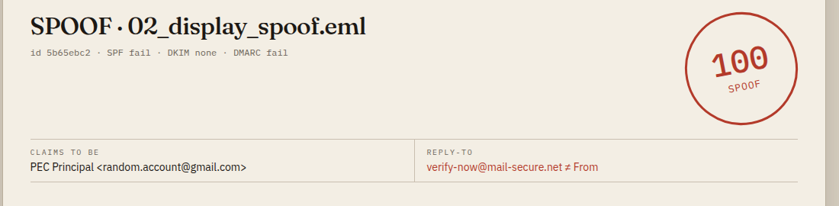
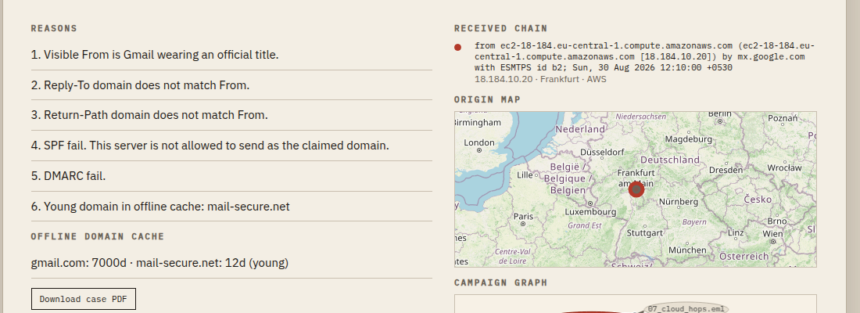
Evidence pipeline: small, explainable modules.
The working prototype is deterministic first; NLP is one supporting signal, not the whole product.
METHODOLOGY
01
02
03
04
05
.EML
MIME
AUTH
ORIGIN
OUTPUT
raw bytes + SHA-256
headers, body, URLs
SPF / DKIM / DMARC
hops + hosting intel
score + map + graph + PDF
IMPLEMENTED PROTOTYPE
REAL LOCALHOST PROOF
FastAPI + Python email parser + SQLite case store
NetworkX campaign graph + Leaflet hop map
ReportLab forensic PDF with exact-file SHA-256
Offline demo intelligence keeps laptop runs reproducible
Captured from the local case screen: score, reasons, hop map and evidence footer.

Slide 4
Feasible now; harden the edges as adoption grows.
The first version runs on a laptop and avoids fragile live dependencies. The production path is modular.
FEASIBILITY
NOW / IDEA-ROUND PROTOTYPE
NEXT / PRODUCTION HARDENING
Saved .eml upload; no mailbox credentials
Live DNS and cryptographic auth verification
Eight crafted cases for spoof, phish, BEC and campaign paths
Maintained GeoIP/ASN data and private deployment
Offline demo geo/domain cache for reproducible runs
Access control, PII masking and retention policies
Local case store, graph, map and forensic PDF
Larger labelled corpus, calibration and analyst feedback
RISKS AND MITIGATIONS
RISK
MITIGATION
Headers may be forged
Show confidence; preserve raw evidence; never call a lead proof.
IP geo is not a person
Report hosting city/ISP only; explicitly reject GPS attribution.
Email is sensitive
Local-first workflow; no Gmail ingest; future masking and retention controls.

Slide 5
Impact: turn a vague warning into an actionable case.
MailTrace helps people explain what happened, preserve evidence and decide what to do next.
ANALYST DIFFERENCE
FILTER
MAILTRACE CASE FILE
spam / not spam
SPF fail · Reply-To mismatch · earliest hop
A label leaves the next question unanswered.
Frankfurt / AWS · related case 08 · SHA-256
TARGET USERS AND VALUE
IT / helpdesk
Triage a suspicious message with reasons they can cite.
SOC / incident response
Preserve original evidence and connect related messages.
Universities / SMEs
Run locally without handing an inbox to a third party.
PILOT MEASURES / NO INVENTED NUMBERS
time-to-triage · evidence completeness · linked-campaign discovery · analyst agreement

Slide 6
Research basis and implementation references.
The prototype maps directly to SIH26106 while keeping attribution and privacy claims bounded.
PROBLEM + STANDARDS
BUILD REFERENCES
SIH26106
Official PS: NLP/ML detection, header forensics, IP geo, domain intelligence, graph correlation and forensic reporting.
Python email
MIME parsing; attachments named and hashed, never executed.
RFC 5322
NetworkX + Leaflet
Relationship graph and hop map for analyst inspection.
Internet Message Format: structured headers, message IDs and Received fields.
RFC 7208 / 6376 / 7489
ReportLab + SHA-256
Portable case PDF and integrity fingerprint of the exact uploaded bytes.
SPF, DKIM and DMARC concepts used for authentication evidence and alignment.
SCOPE AND SAFETY
Local crafted .eml files only; no Gmail/Outlook ingest and no real phishing messages.
Geo output is hosting infrastructure with confidence, never the exact location of a person.
Evidence hash is an integrity fingerprint, not a public blockchain or cryptocurrency ledger.
Source links: sih.gov.in/sih2026PS · rfc-editor.org · docs.python.org · networkx.org · leafletjs.com

