Slide 1
DMETL
Term Project : Team Nexus

Slide 2
Using "tXMLMap" to read XML
Objective:
The objective was to read a XML file and convert it to a flat file(Excel file)
It Shows how we can convert XML record saved in a file into a format that is readable by "tXMLMap" and how can we read and process the data in XML record.

Slide 3
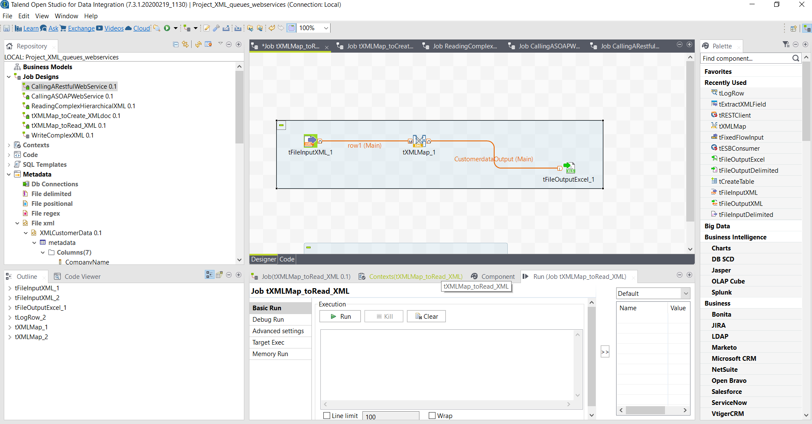

Slide 4
Using tXMLMap component to create XML Document
Objective:
The objective was to read from a flat file and convert it to a XML document for output file.
- Reading from a flat file and converting it to a XML document for output file.

Slide 5
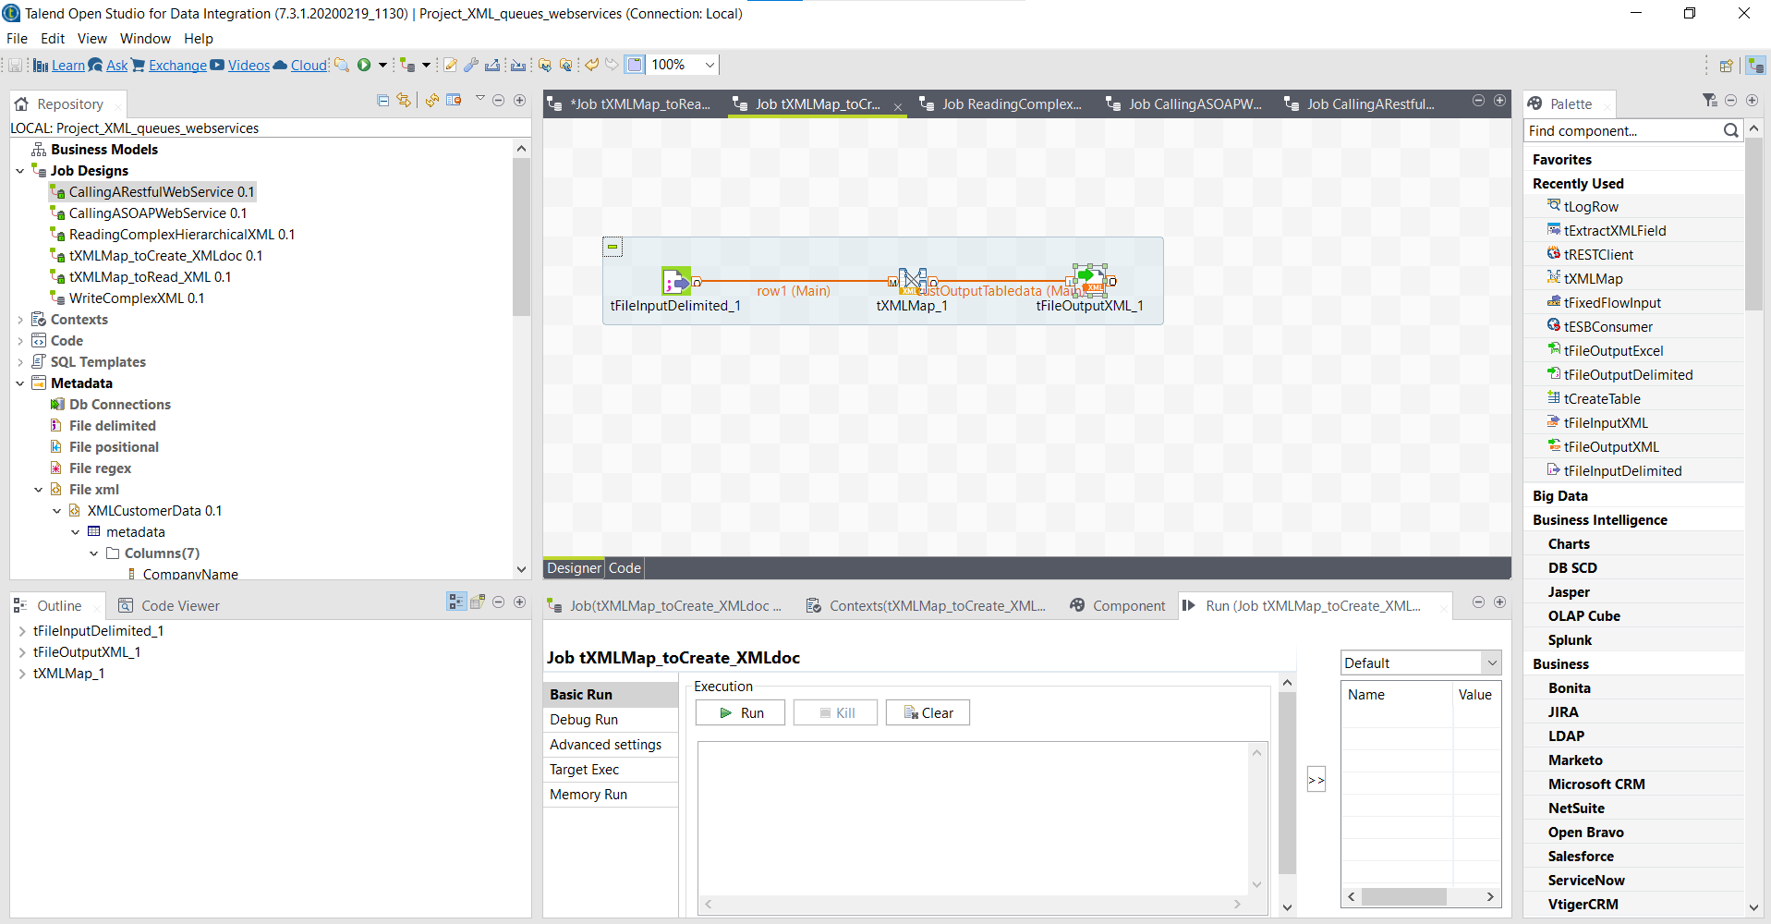

Slide 6
Reading Complex Hierarchical XML
Objective:
The objective was to read XML document and convert it to a flat file.
- It shows how can we deconstruct a more complex XML record into individual sets of data while ensuring that the hierarchical relationships between the data are not lost.

Slide 7
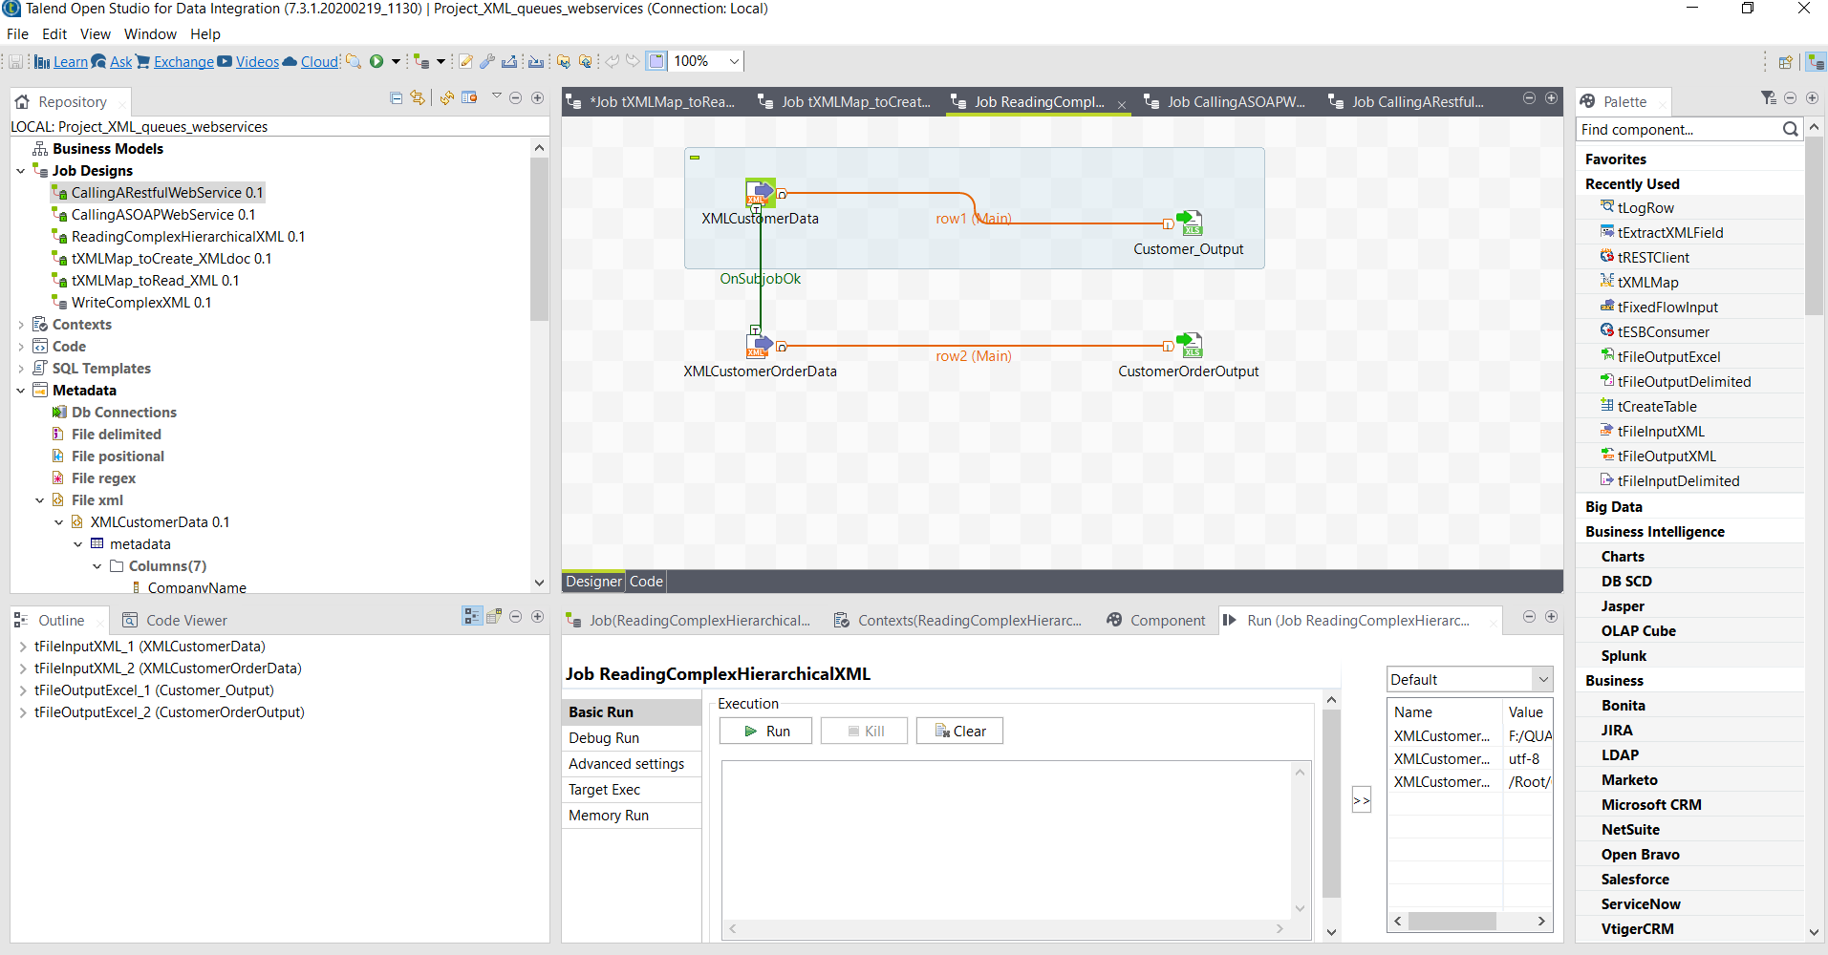

Slide 8
Thank you

