Slide 1

Optimizing mine maintenance.

Slide 2


Team
Cam Ramsay William Hoang
Developer Developer
isitpizza.com @sweetiewill
Simon Ramsay Lindsey Taylor
Developer Miner
ramsay.xyz

Slide 3
“Unscheduled can cost up to two times the cost of scheduled maintenance.”
Source: Truck WO.xlsx

Slide 4
Reduce costs
Optimize spares inventory
Consistent database structure
Easily collect meaningful field data
Fix small issues before they become big ones
Track the right KPIs and visualize
Reduce unwarranted downtime

Slide 5
Web App
Create issue
Do work
Order arrives
Dashboard
API
Issue from image
Issue from user input
Database
Issue queue
Inventory
Orders
Mobile App

Slide 6


Slide 7
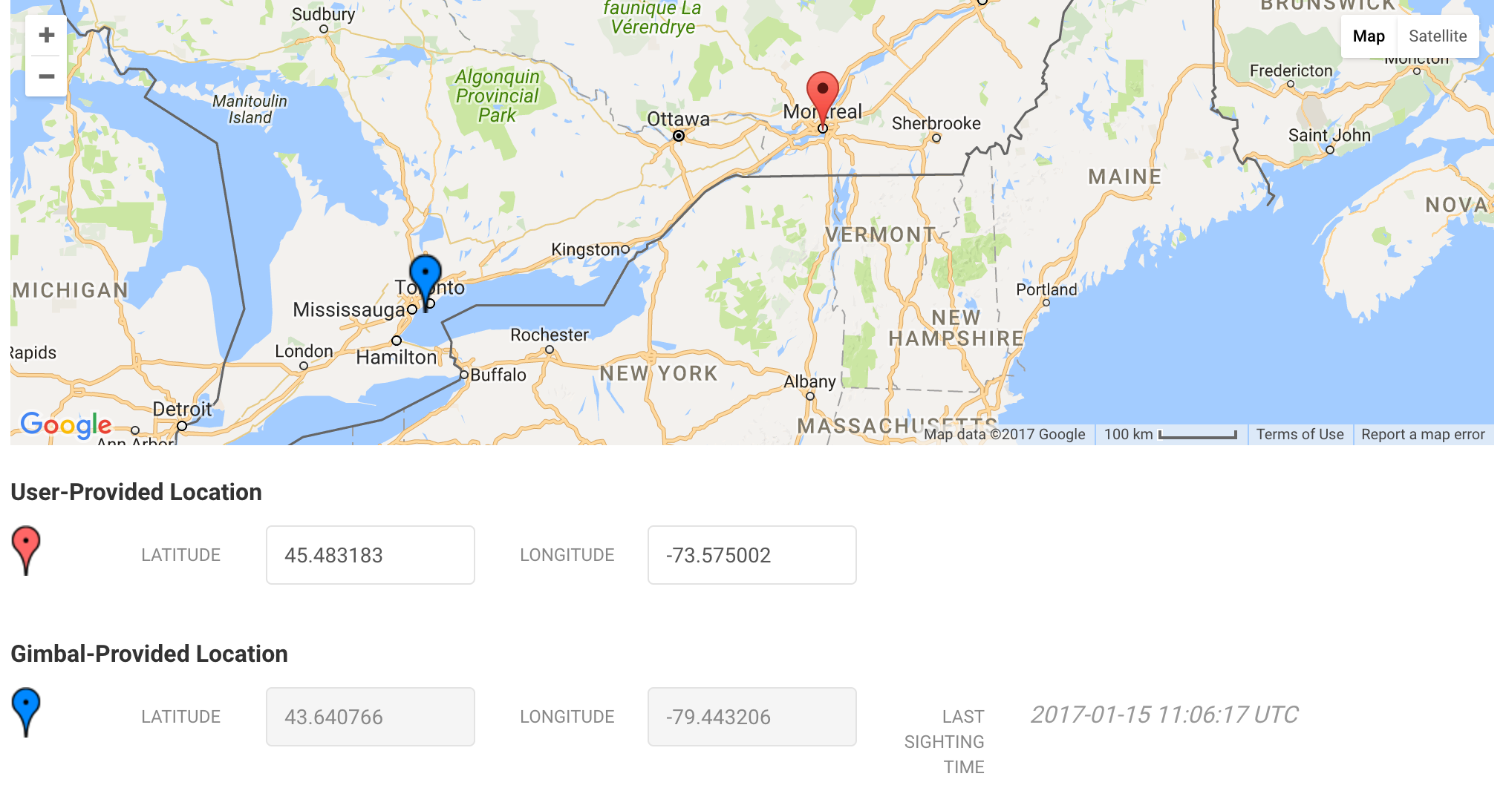

Slide 8
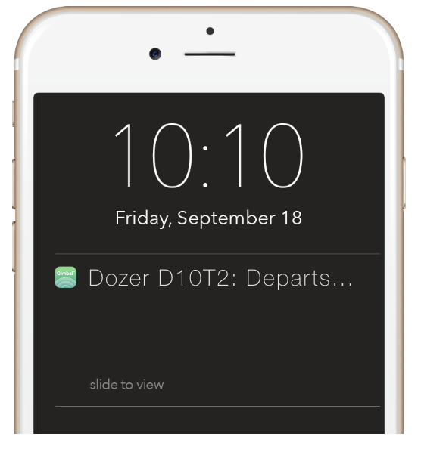
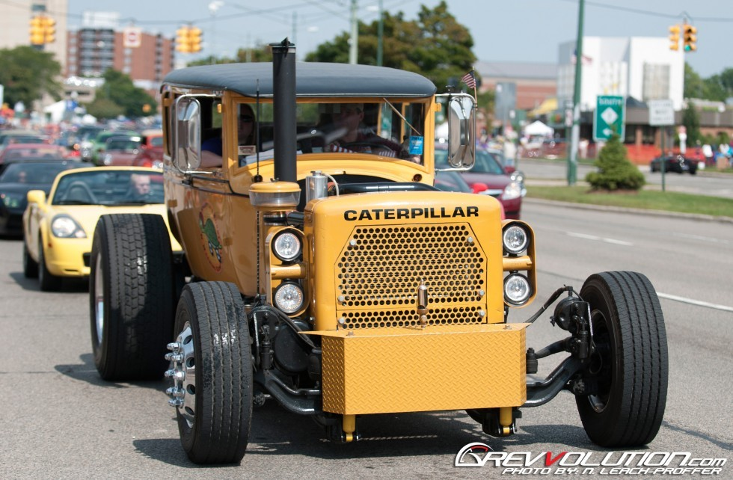

Slide 9
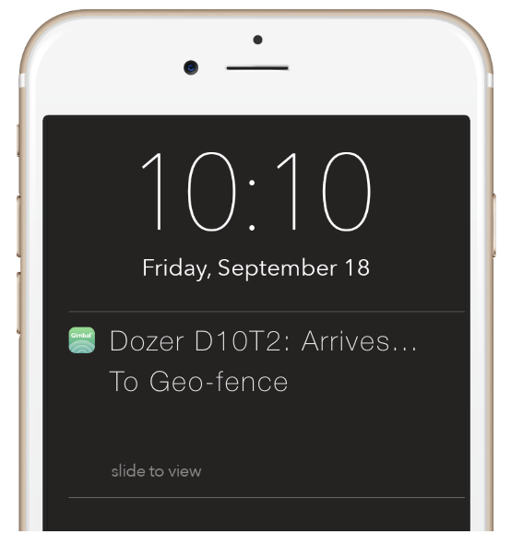
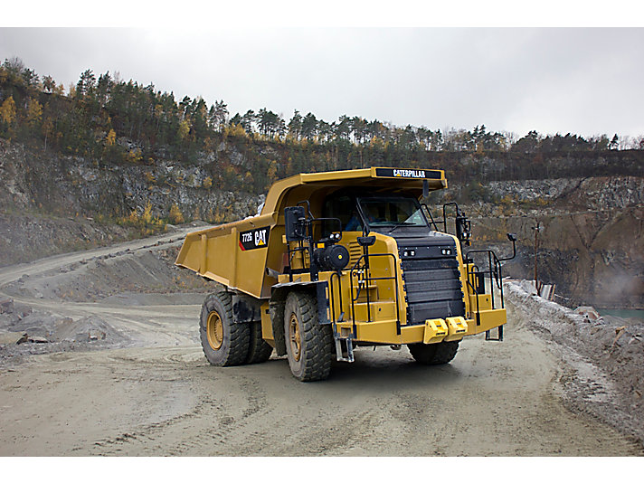

Slide 10


Slide 11
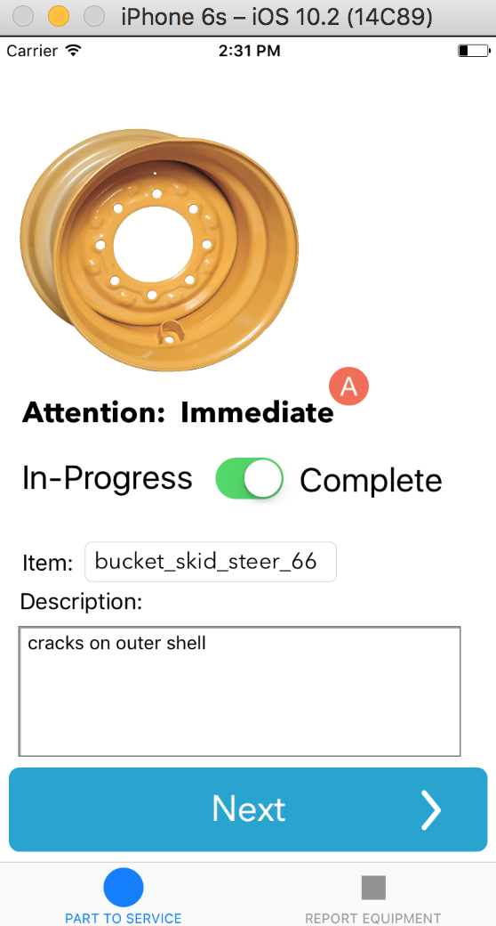

Slide 14


Slide 17
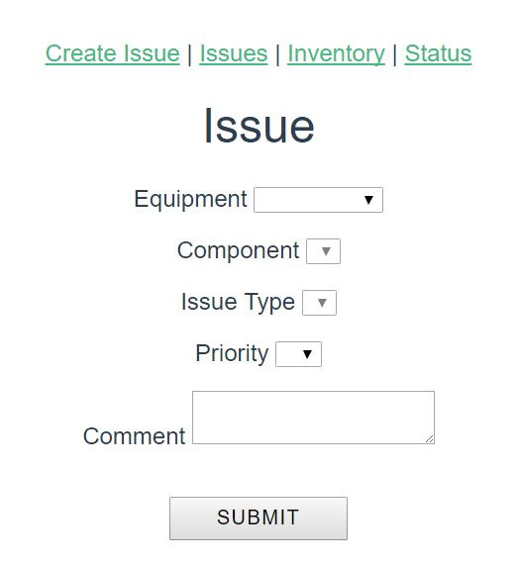

Slide 18
What’s Next…
Design
Prepopulate issue form
Computer vision from image
GPS location tracking
Create issue from sensor data
User login (SSO)
Assign resources (labour, budget)
Integrate into existing systems

Slide 19







@snapfixio

Slide 20
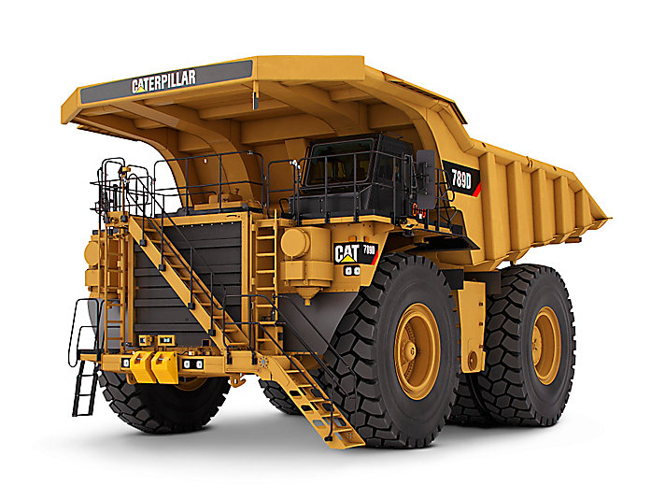
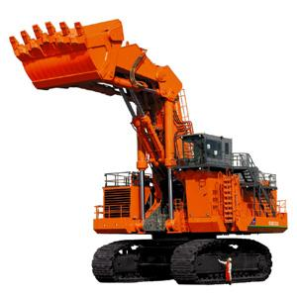
Item | Haul Truck | Shovel / Excavator
Reference | 2016 data in Truck WO.xlsx 4 trucks | 2016 data in Shovel WO.xlsx 2 shovels
Priority component | Electrical system Air conditioning system Engine Brake system Tire system | Implement bucket Cooler hydraulic Frame
Estimated cost | $700 / hour of equipment downtime ~40 k / tire | $226 /minute of equipment downtime
Analysis | 20% more time to actually complete job than estimated on average Actual planned : unplanned = 30:70 Spare tires kept in inventory | 195% more time estimated to complete job than actual on average Actual planned : unplanned = 50:50

