Slide 1
Understanding the Snooper‘s Charter
Theresa May‘s effort to abolish privacy
Hendrik Obelöer, 30.12.2016, 33C3

Slide 2
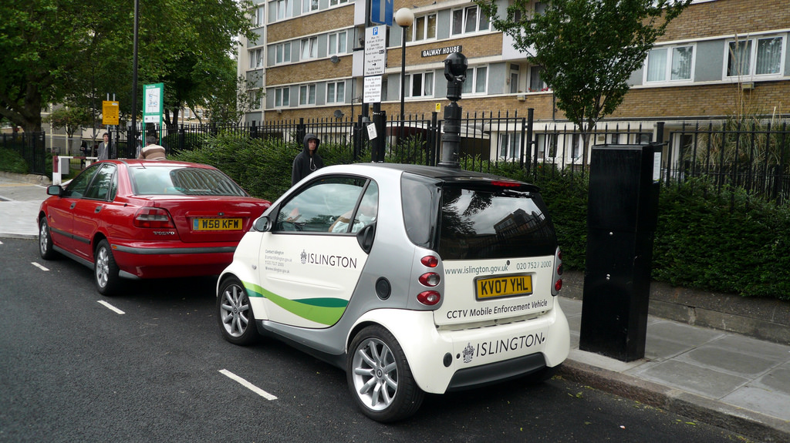
Picture: CC BY-SA 2.0 via flickr/Cory Doctorow

Slide 3
Overview
The Investigatory Powers Act explained
Why should we be concerned?
How can a democracy pass such a law?
How we could fight against it!

Slide 4
The Investigatory Powers Act explained
Why should we be concerned?
How can a democracy pass such a law?
How we could fight against it!

Slide 5

“A new bill that provides some of the strongest protections and safeguards anywhere in the democratic world. And an approach that sets new standards for openness, transparency and oversight.“
Picture: CC BY 2.0 via flickr/DFID

Slide 6
Hacking
The Investigatory Powers Act explained
Regional and national Police, GCHQ, MI5, and MI6
Individual and bulk warrants
in the interests of national security,
for the purpose of preventing or detecting serious crime, or
in the interests of the economic well-being of the United Kingdom so far as those interests are also relevant to the interests of national security
100 (5): (a) any conduct which it is necessary to undertake in order to do what is expressly authorised or required by the warrant, including conduct for securing the obtaining of communications, equipment data or other information

Slide 7
Interception of communication
The Investigatory Powers Act explained
Regulation similar to hacking warrants
Reinforced powers regardless of previous wrongdoings
Some limits on bulk warrants

Slide 8
Encryption
The Investigatory Powers Act explained
Legislatures listened to the concerns: strong legal protection and support for encryption
Businesses can be asked to help circumvent encryption
Manufacturers might need to inform the government of future changes

Slide 9
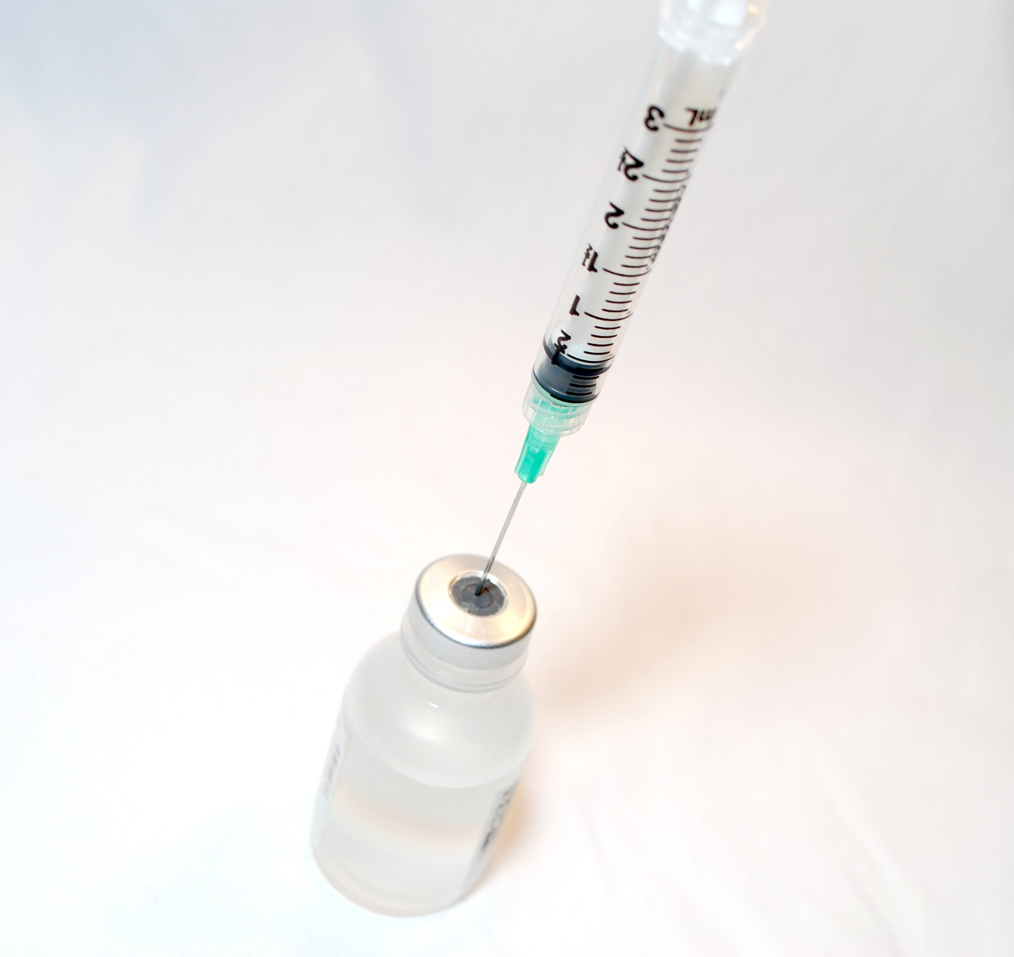
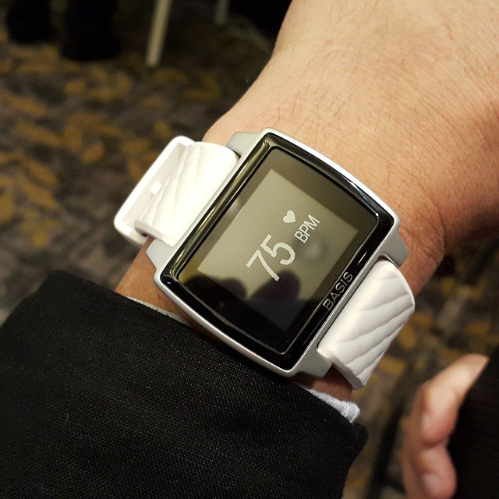
Access to Data Sets
The Investigatory Powers Act explained
Available to secret services
Access and analyse public and private data sets
e.g. medical data, data from fitness trackers
Picture: CC BY 2.0 via flickr/NIAID
Picture: CC BY 2.0 via flickr/Vernon Chan

Slide 10
„Internet Connection Records“
The Investigatory Powers Act explained
Data retention on steroids
Internet Connection Providers need to save:
  The domain you visit
  When
  From which device
  Where
  Further metadata
Messenger services can be asked to do the same
Relevant departments:
Metropolitan Police Service
City of London Police
Police forces maintained under section 2 of the Police Act 1996
Police Service of Scotland
Police Service of Northern Ireland
British Transport Police
Ministry of Defence Police
Royal Navy Police
Royal Military Police
Royal Air Force Police
Security Service
Secret Intelligence Service
GCHQ
Ministry of Defence
Department of Health
Home Office
Ministry of Justice
National Crime Agency
HM Revenue & Customs
Department for Transport
Department for Work and Pensions
NHS trusts and foundation trusts in England that provide ambulance services
Common Services Agency for the Scottish Health Service
Competition and Markets Authority
Criminal Cases Review Commission
Department for Communities in Northern Ireland
Department for the Economy in Northern Ireland
Department of Justice in Northern Ireland
Financial Conduct Authority
Fire and rescue authorities under the Fire and Rescue Services Act 2004
Food Standards Agency
Food Standards Scotland
Gambling Commission
Gangmasters and Labour Abuse Authority
Health and Safety Executive
Independent Police Complaints Commissioner
Information Commissioner
NHS Business Services Authority
Northern Ireland Ambulance Service Health and Social Care Trust
Northern Ireland Fire and Rescue Service Board
Northern Ireland Health and Social Care Regional Business Services Organisation
Office of Communications
Office of the Police Ombudsman for Northern Ireland
Police Investigations and Review Commissioner
Scottish Ambulance Service Board
Scottish Criminal Cases Review Commission
Serious Fraud Office
Welsh Ambulance Services National Health Service Trust
Department of Health
Food Standards Agency
Gambling Commission
Northern Ireland Ambulance Service Health and Social Care Trust

Slide 11
Supervision
The Investigatory Powers Act explained
Investigatory Powers Commission
  Unifies the work of previous bodies
A commissioner needs to give his or her approval for most warrants
Appointed by the Prime Minister
Likely to be unable to exercise powerful scrutiny

Slide 12
Improvements
The Investigatory Powers Act explained
codifies most of the surveillance measures
unifying legislature and control mechanisms
Accessing data without a warrant is now a criminal offence

Slide 13
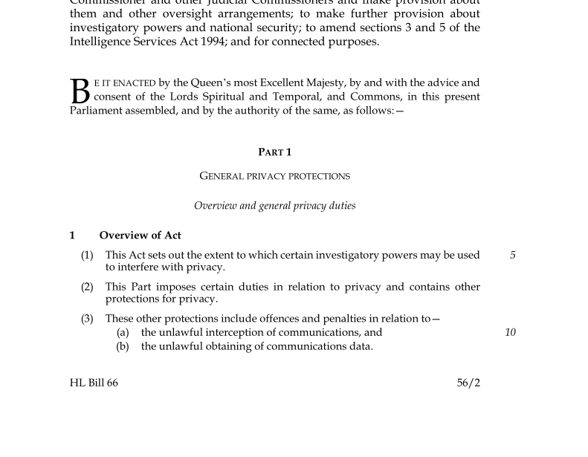

Slide 14
The Investigatory Powers Act explained
Why should we be concerned?
How can a democracy pass such a law?
How we could fight against it!

Slide 15
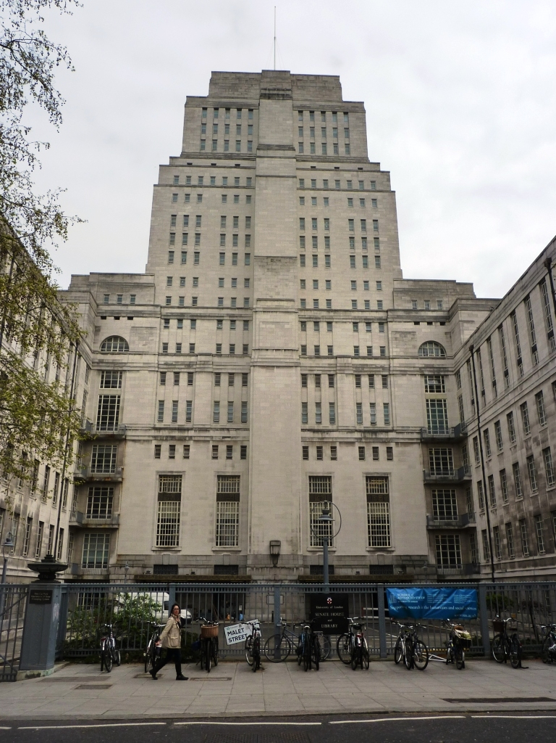
Implications
Why should we be concerned?
The unnoticeable surveillance state
Does not pretend to be a measure against the threat of terrorism
Snowden realisation: we cannot trust the agencies
Picture: CC BY-NC 2.0 via flickr/xpgomes6

Slide 16
International comparison
Why should we be concerned?
Part of larger trend
In scope and size unmatched by other democratic countries
Delegitimises the West’s criticisms of other regimes

Slide 17
“A new bill that provides some of the strongest protections and safeguards anywhere in the democratic world. And an approach that sets new standards for openness, transparency and oversight.“

Slide 18
“A new bill that provides some of the strongest protections and safeguards anywhere in the democratic world. And an approach that sets new standards for openness, transparency and oversight.“

Slide 19
establishes
the most intrusive surveillance measures
“A new bill that provides some of the strongest protections and safeguards anywhere in the democratic world. And an approach that sets new standards for openness, transparency and oversight.“
attacks the principles of

Slide 20
The Investigatory Powers Act explained
Why should we be concerned?
How can a democracy pass such a law?
How we could fight against it!

Slide 21
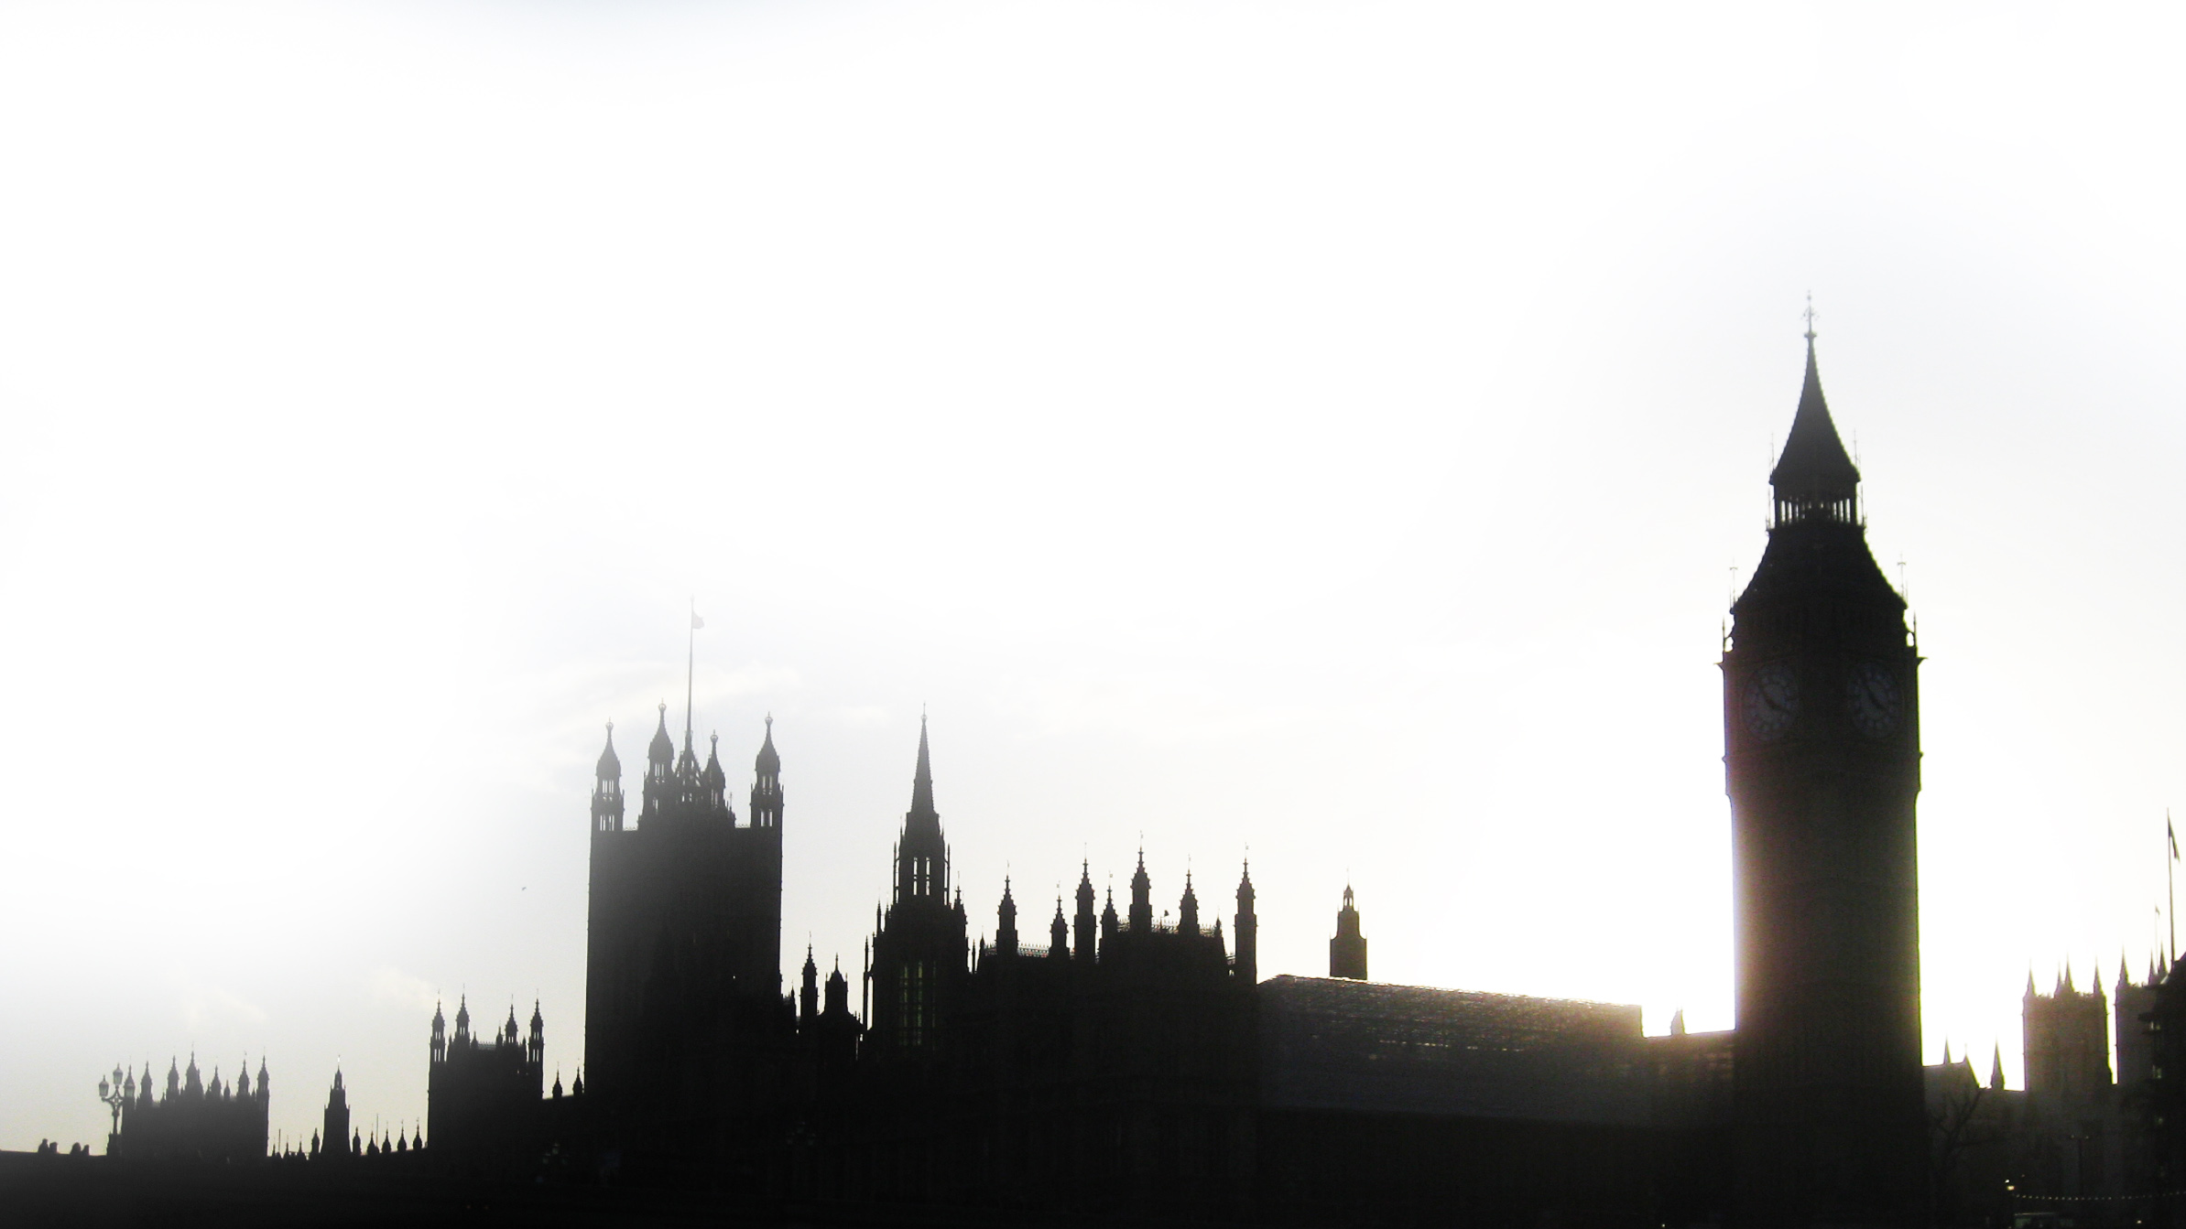
How does the British democracy work?
How can a democracy pass such a law?
Parliament = Sovereign + House of Lords + House of Commons
Common law and custom law
First-past-the-post electoral system
Very powerful „parliament“ (House of Commons) controlled by the Conservative Party
Picture: CC BY 2.0 via flickr/Matt Brown

Slide 22
Why was the law passed in Parliament?
How can a democracy pass such a law?
Overhaul of legal architecture was needed
Previous bill was blocked by coalition partner
Total failure of the Labour party in opposition – seemingly distracted by own power fights
House of Lords introduced only minor improvements

Slide 23
Why was the law really passed?
How can a democracy pass such a law?
Political culture is based on trust
  Long tradition of thinking „If you‘ve done nothing wrong, you‘ve nothing to hide.“
Political system puts the focus on other topics
Attention dominated by Brexit referendum and the US election
  Public outcry too little too late

Slide 24
The Investigatory Powers Act explained
Why should we be concerned?
How can a democracy pass such a law?
How we could fight against it!

Slide 25
The fight back I – Works for me
How we could fight against it!
Use VPNs
Prepare against hacking
Use encrpytion where possible
Etc.

Slide 26
The fight back II – Works for all
How we could fight against it!
Go to the Courts → the ECJ works!
Vicious circle: a lack of security can almost always be explained by a lack of access
How do we view government intrinsically? As a possible threat or a diligent actor?
Make our systems more representative
Work on our attention and not be blinded by other events

Slide 27
Understanding the Snooper‘s Charter
Theresa May‘s effort to abolish privacy
Thank you!
Hendrik Obelöer, 30.12.2016, 33C3

