Slide 1






Saving the World with (Vegan) Science
Benjamin Rupert
Benjamin.lee.rupert@gmail.com

Slide 2




The Future is Vegan?
Authentic video from the future

Slide 3
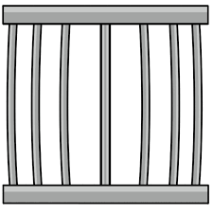

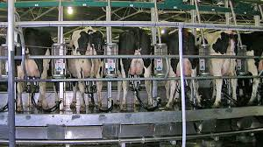
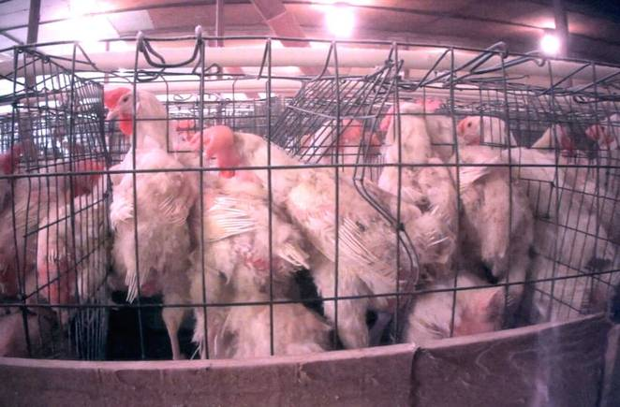
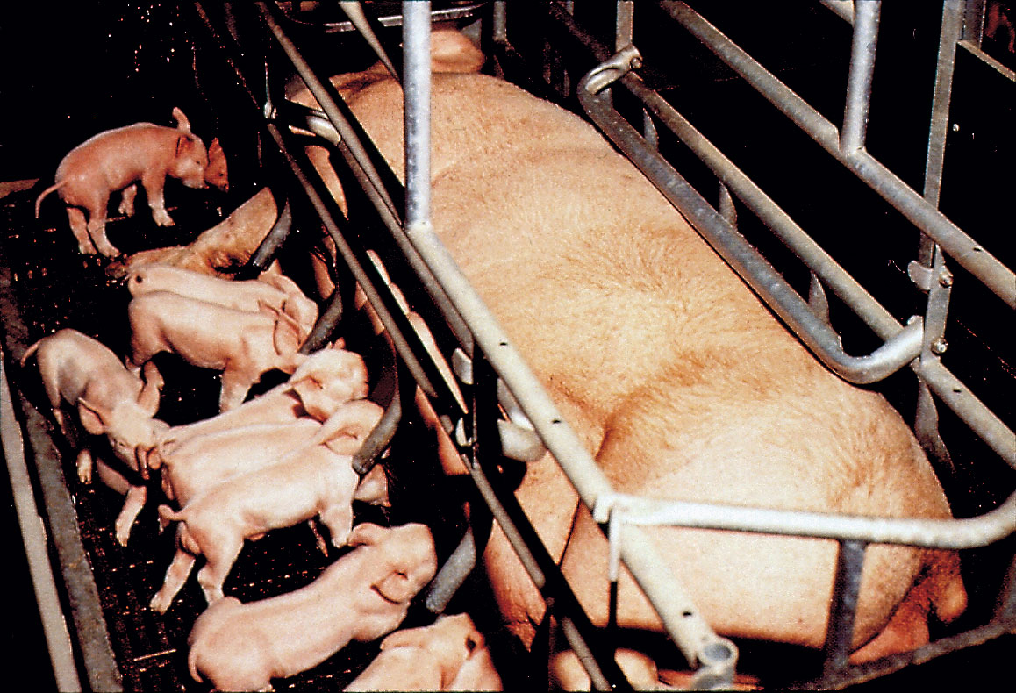
Why Would We Even?
If you don’t care about animal suffering, do you care about environmental disaster?

Slide 4



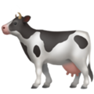
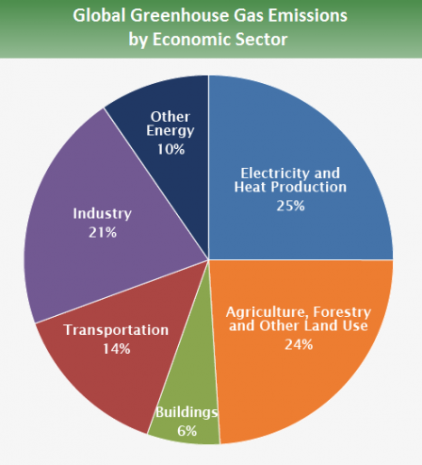
Some Numbers
A few facts
56% of the water used in the US goes to growing feed for animals. [1]
Animal agriculture is responsible for 18% of all greenhouse gas emissions, more than all transportation combined. [2]
Livestock uses 1/3 of the earth's ice-free land. [3]
[1] Jacobson, Michael F. “More and Cleaner Water.”
[2] Fao.org. Spotlight: Livestock impacts on the environment.
[3] FAO. "Livestock a major threat to environment"

Slide 5
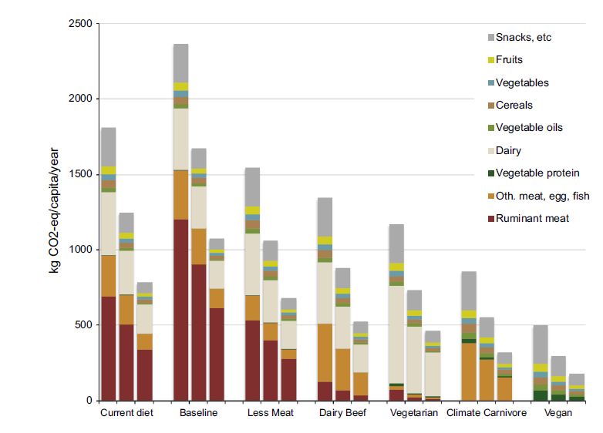
GHG Impact of Diet
Food Policy (2016) 59: 152-164

Slide 6
More Numbers
“A global transition to a low meat diet as recommended for health reasons would reduce the mitigation costs to achieve a 450 ppm CO2-eq. stabilization target about 50% in 2050 compared to the reference case.” [1]
“The US agricultural system alone could feed 1 billion additional people by shifting animal feed calories to direct human consumption.” [2]
“Agricultural production and GHG mitigation goals cannot be reached simultaneously, even if optimistic technological advances are attained. However, healthier human diets would allow sufficient decreases in agricultural production to meet GHG mitigation goals.” [3]
[1] Netherlands Environmental Assessment Agency
Climate Change (2009) 95: 83-102
[2] Redefining agricultural yields: from tonnes to people nourished per hectare
Environ. Res. Lett. (2013) 8: 034015
[3] USDA
Front. Ecol. Environ. (2012) 10(10): 571-579

Slide 7

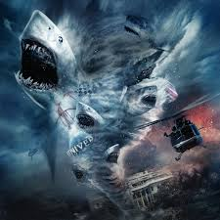


Something Ridiculous
Sharknado: A Tornado Filled with Sharks, which somehow terrorizes people

Slide 8


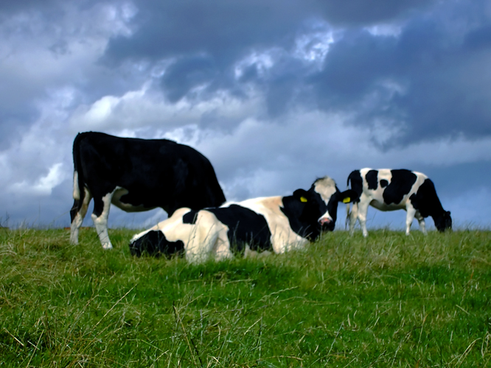
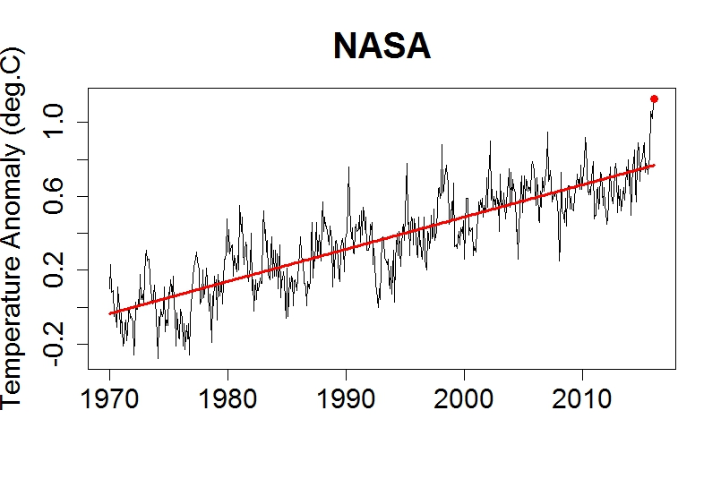
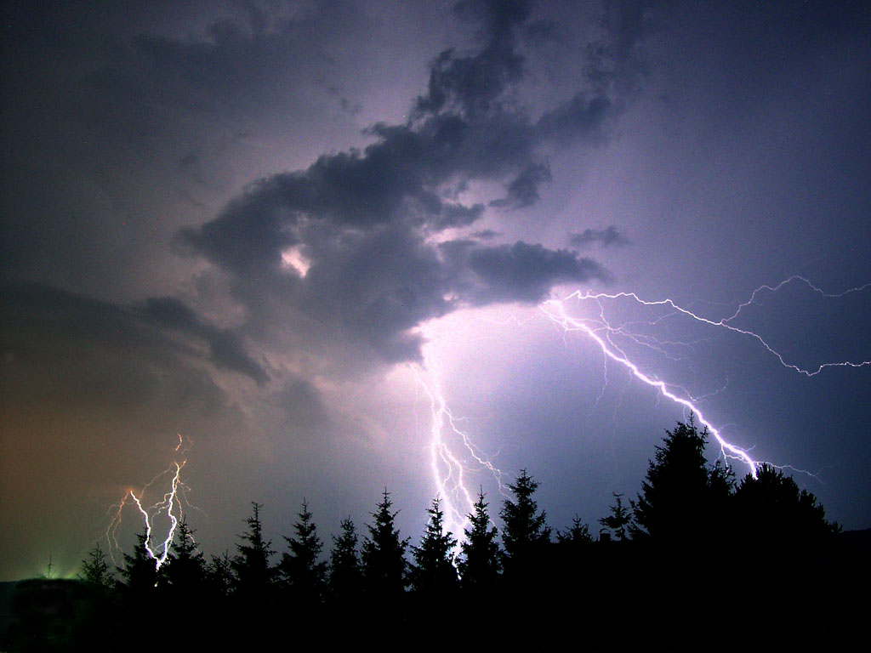
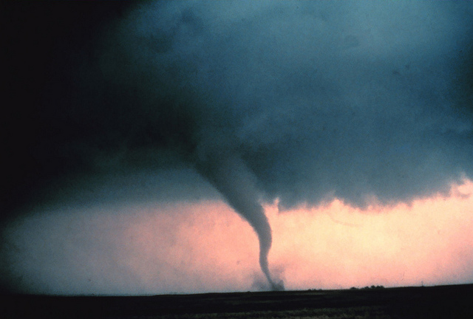
A More Realistic Danger

Slide 9

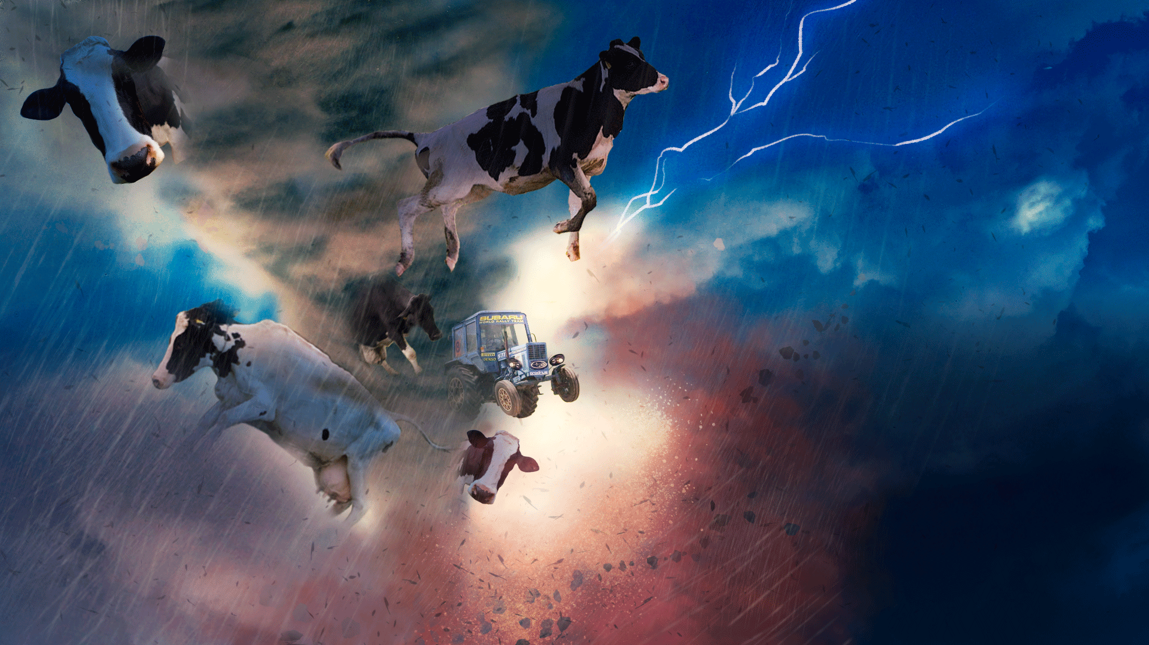
Fear The Cows

Slide 10

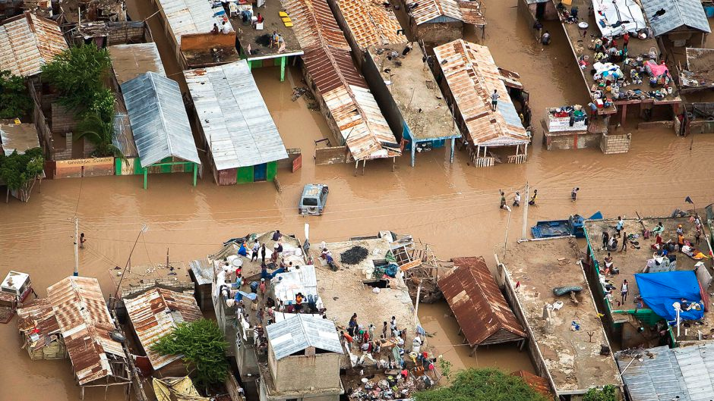


Not So Funny
According to the IPCC 2013 report:
50 percent of the world's population live in regions at risk of coastal flooding and erosion
2007-2014 an average of 22.4 million people/year have already been displaced by climate change
  Rates expected to increase dramatically
2.2 billion people depend on water from Himalaya-Hindu Kush mountain ranges
  Melting glaciers = permanent extreme drought

Slide 11




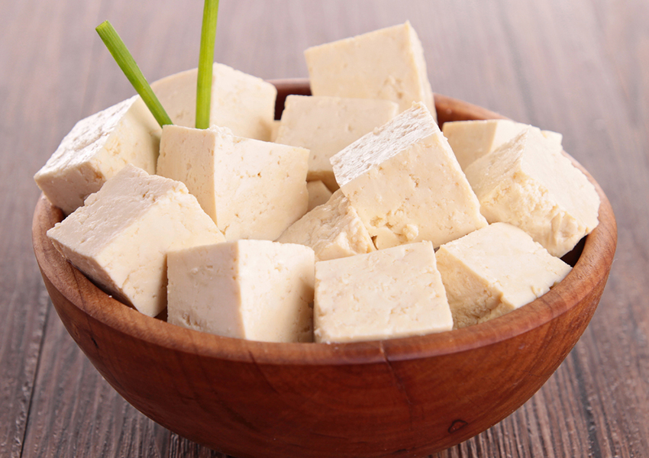
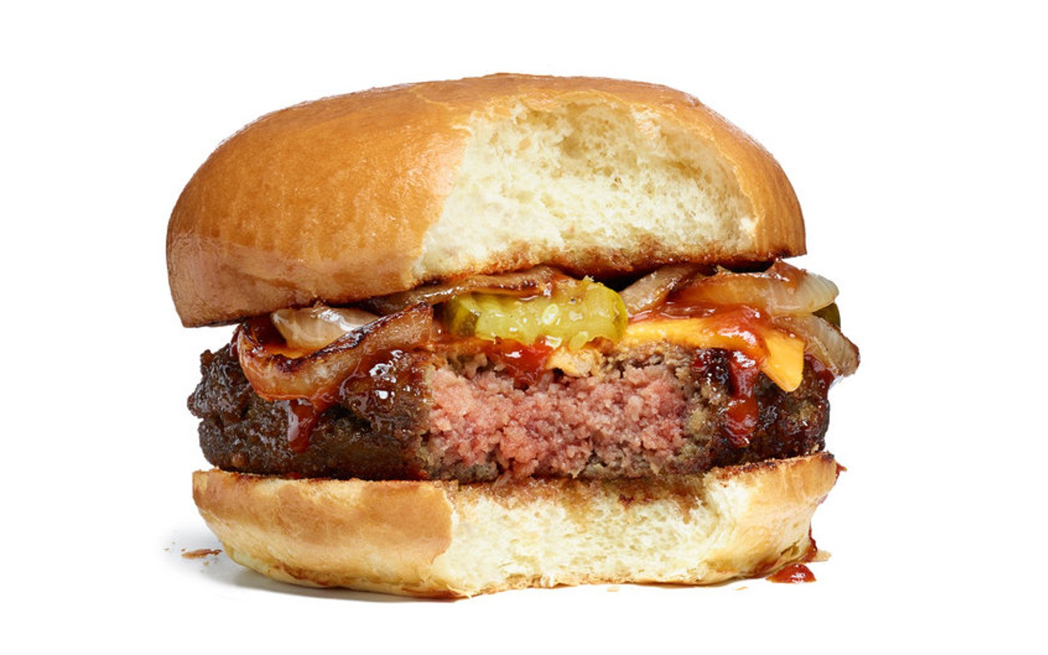
Condemned to Tofu?
Animal agriculture isn't sustainable, so what do we do?
1. Ignor the rest of this talk and go vegan now.
Vegan food is excellent as is.
2. If you won't do that, there is still hope...
There is a new generation of vegan food being developed now which aims to exactly or very closely replicate animal products

Slide 12
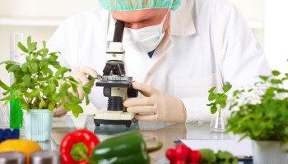
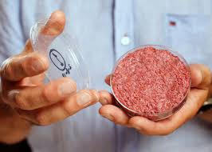
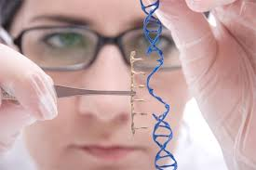
Various Efforts
Food science engineering better vegan food
  Discipline has been around for a long time
  Many companies exploring new plant proteins and fibers
In-vitro meat (AKA clean meat)
  grow actual animal cells, but not whole animals, to produce animal products
Genetic Engineering
  Produce important proteins and other components, identical to animal versions, in non-animal organisms.

Slide 13
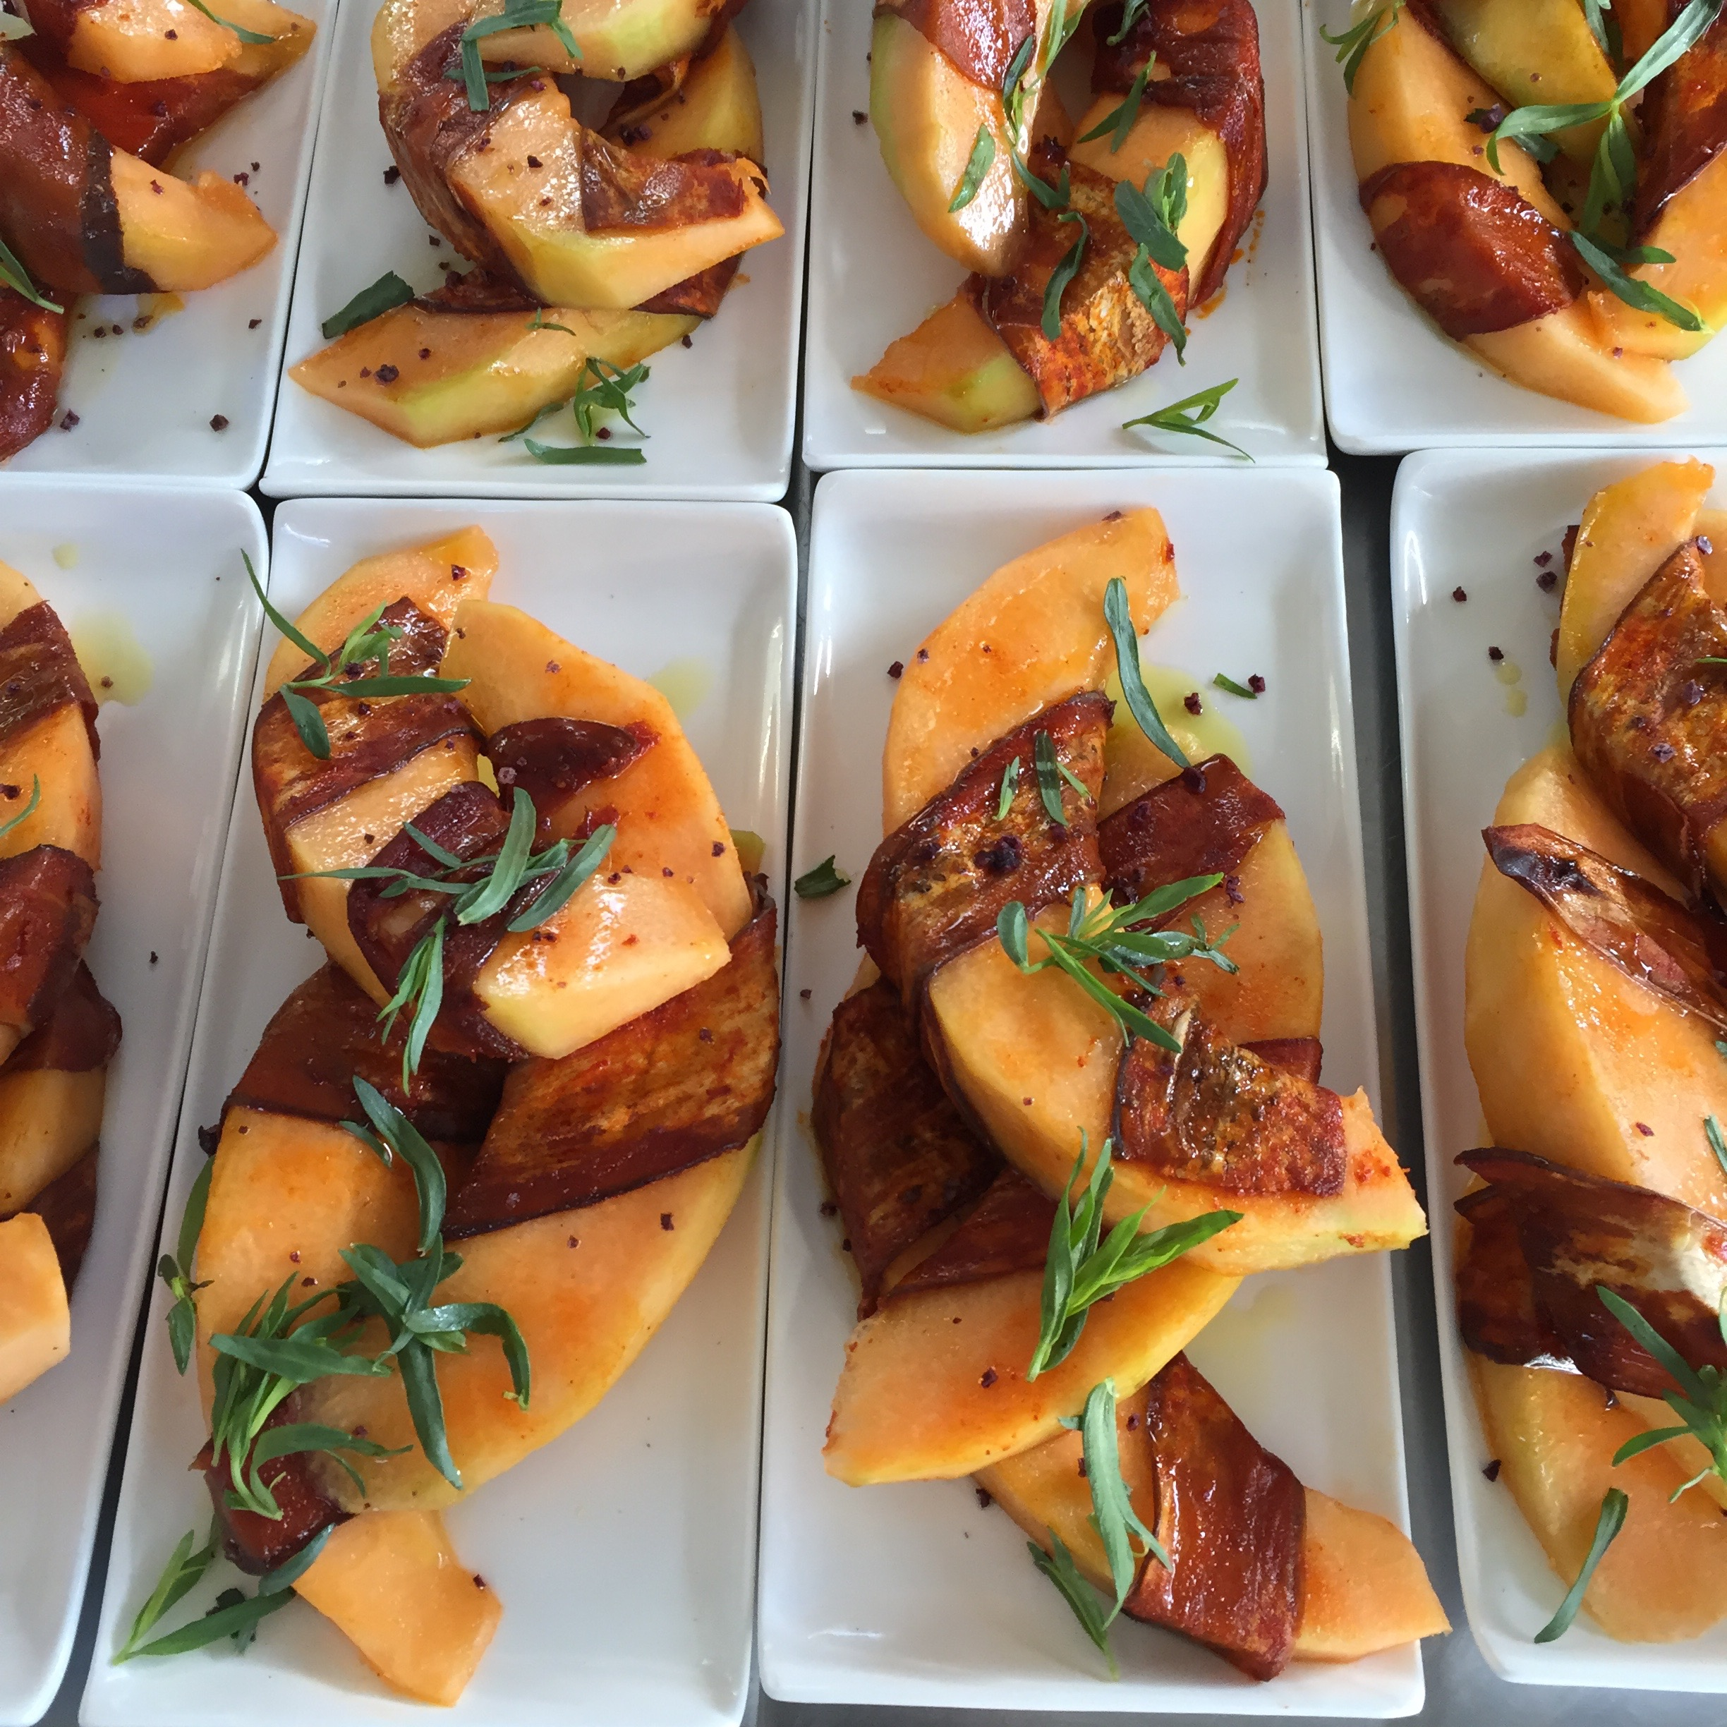
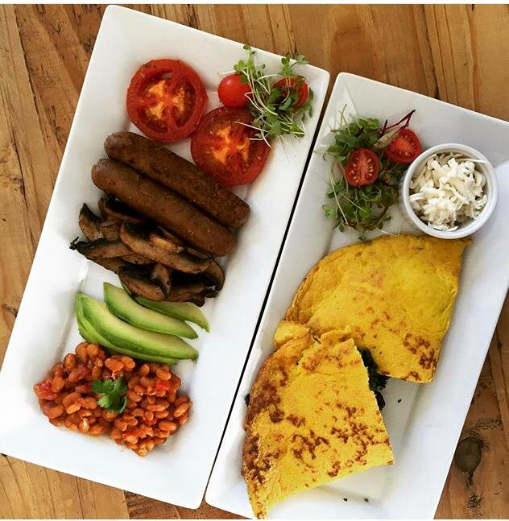
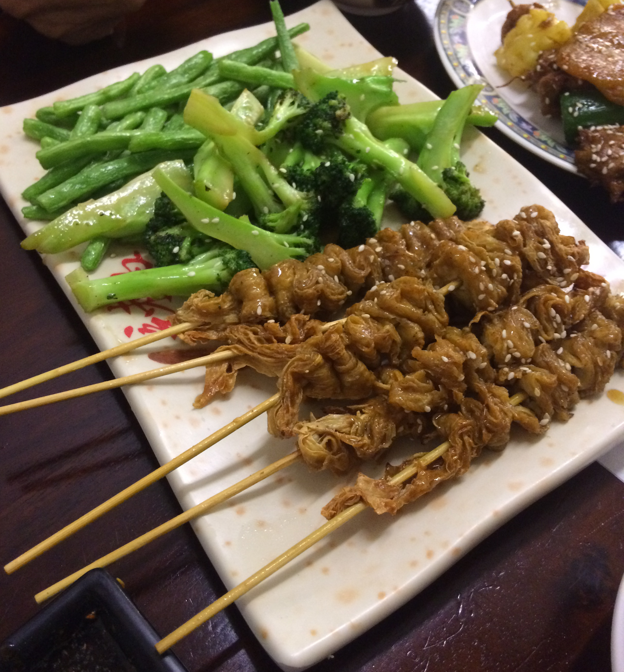
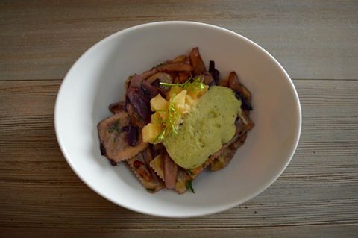
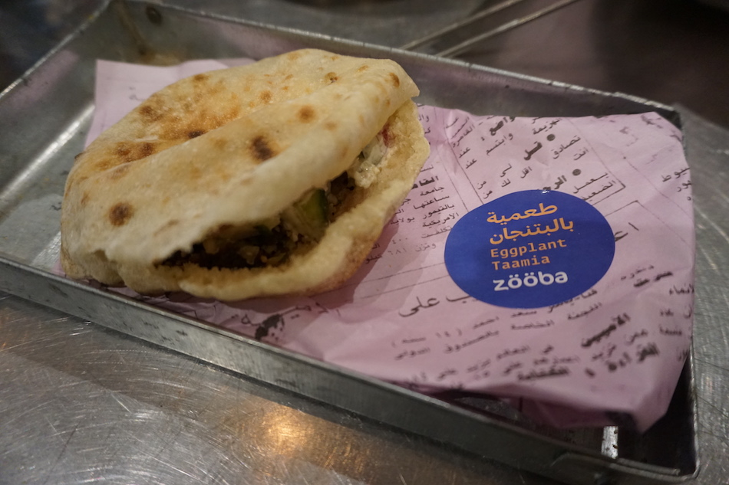
Vegan Food is Already Great
S+M Vegan
L.A., USA
Conscious 108
Johannesburg, South Africa
Taiwan
KOPPS
Berlin
Zooba
Cairo, Egypt

Slide 14


Food Science and Technology
“Food science is the study of physical, biological and chemical makeup of food; and the concepts underlying food processing.
Food technology is the application of food science to the selection, preservation, processing, packaging, distribution, and use of safe food.”
-from the Institute of Food Technologies (www.ift.org)
In the context of making vegan replacements of animal sourced foods:
Food science is taking an engineering approach to the behavior of plant proteins, starches, etc. to reproduce the textures and flavors of the animal products.

Slide 15

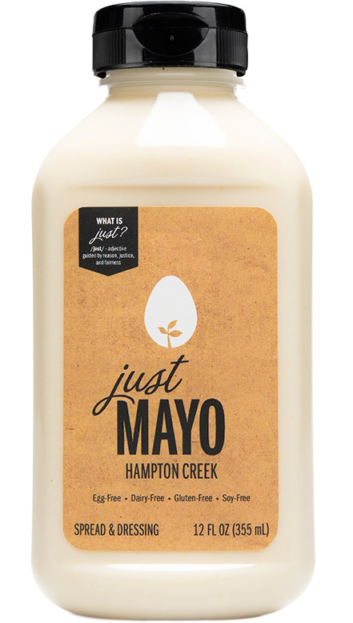
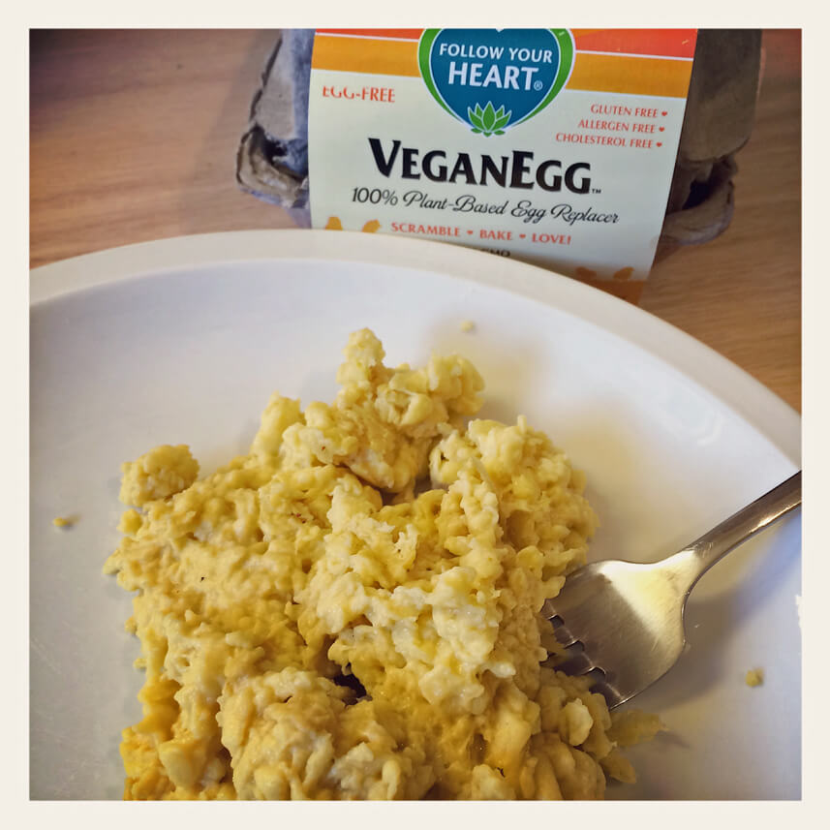
Engineered Eggs
Hampton Creek Foods
“We've only explored about 8% of the world's plant proteins as potential meat alternatives. Remaking meat is one sector of the food industry that is ripe for innovation and growth." -Bill Gates
Replacing egg products with plant proteins
No animal cell cultures or genetic engineering
Exploring materials properties of a huge number of plant proteins
Formulate products using engineering approach with this expanded basis set
Follow Your Heart
Realistic scrambled egg product
Made from proteins isolated from algae
“Vegan Eggs are so good that I could not tell that they were NOT real eggs. My wife made them for me without me knowing. Mean trick but good test of Vegan Egg.”
-Amazon.com review I used because it best made my point.
Remember to say this is real science and engineering, even though focused on other things

Slide 16

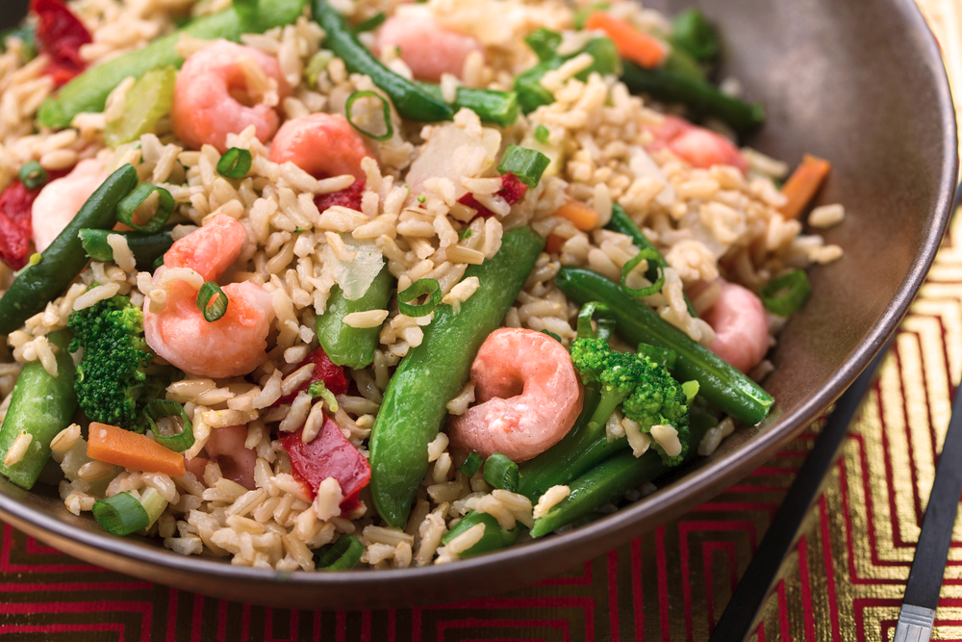
Replacement Seafood
New Wave Foods
First product is shrimp
Uses modern food science
  No genetic engineering or cell culture
Vice calls it “insanely realistic”
Gets around allergy problems
Gets around problems with kosher laws
  L’Chaim Sushi, a kosher sushi company in SF uses it
No child slavery, which is common with real shrimp

Slide 17
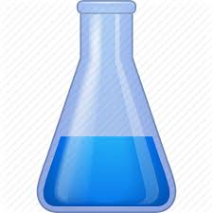
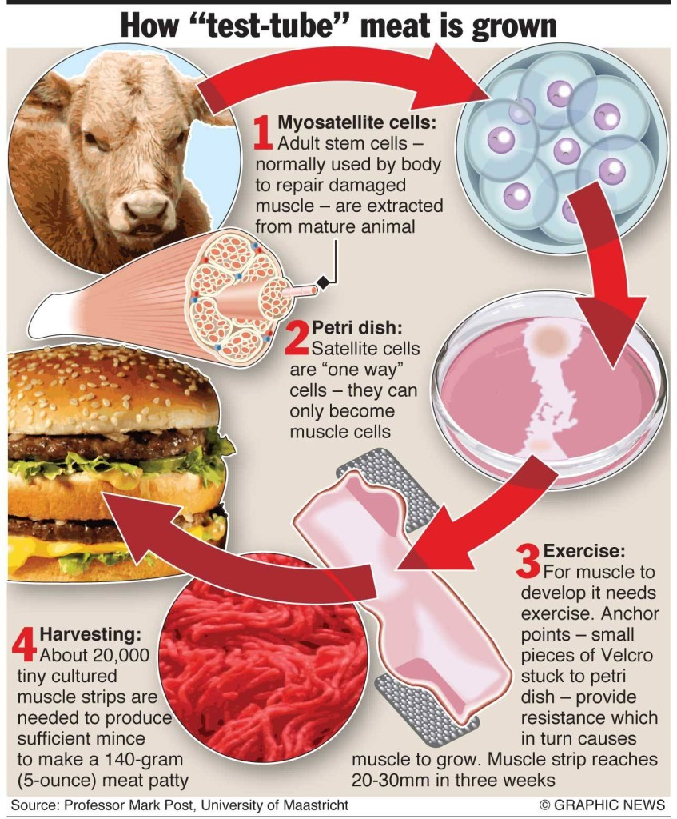
Clean (AKA In-Vitro) Meat
Will be actual meat, but lower impact and no animals harmed
Meat isn't just muscle cells
  Fat needed
  Growth of fat and muscle cells together?
First cultured hamburger took several years and $325,000 to complete
Requires fetal bovine serum
“In-vitro meat has the unique market position of being disgusting to both meat eaters and vegans” Michael Eisen
UC Berkeley/Impossible Foods

Slide 18

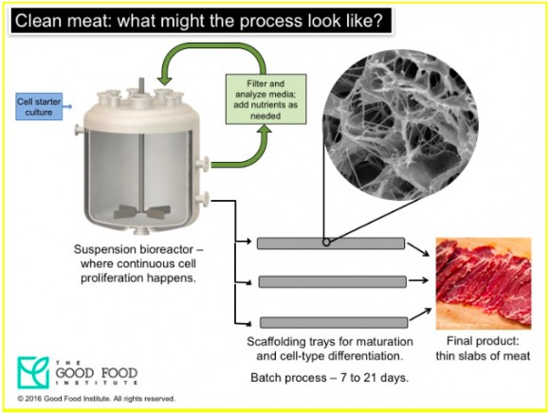
Clean (AKA In-Vitro) Meat
Bioreactors are being designed now
Will be similar to brewing beer
Fetal bovine serum replacements exist but need to scale (?)
Much lower chance of contamination from slaughter, mad cow, etc.
Can eventually engineer for an even better product
If question is properly framed, people say they will eat it

Slide 19

A Real Example
Memphis Meats
Reviews say that it tastes like a meatball
  Solved problem of growing muscle and fat together?
Price $18,000/lbs as of Feb.
Claim 90% less GHG emissions
But, Mark Posts burger down to $11/patty
  Claims to have also found a substitute for bovine fetal serum

Slide 20
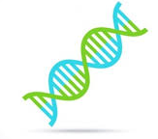


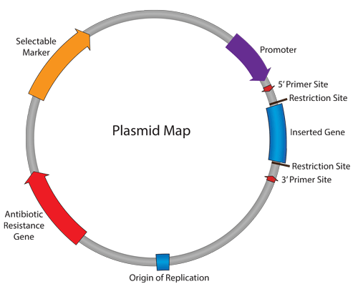
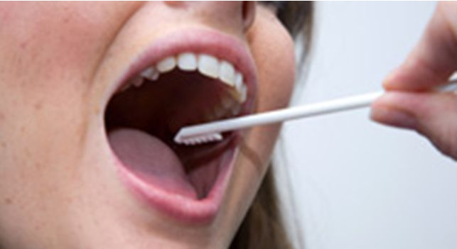
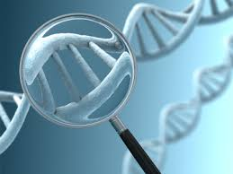
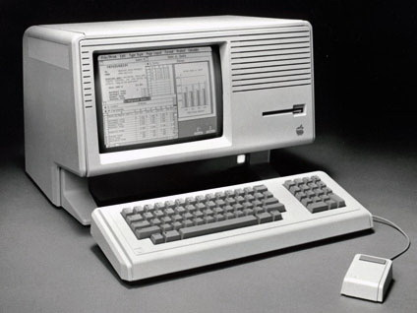
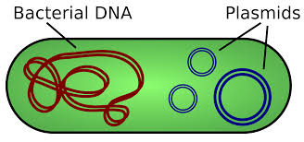
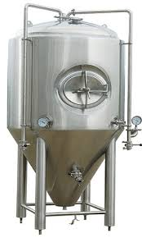
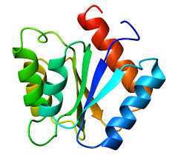
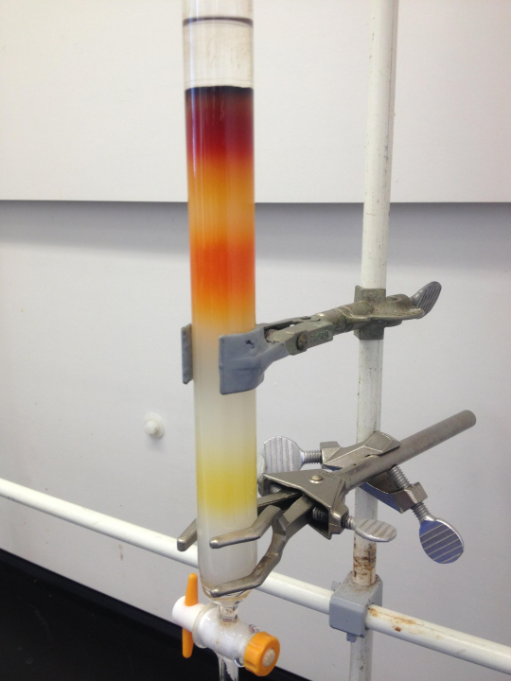
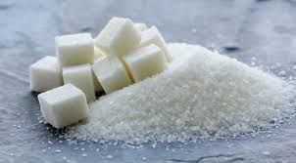
Genetic Engineering
Genetic Engineering: Altering the DNA of an organism
Transgenic: Transferring DNA from one organism to another
Profit!

Slide 21
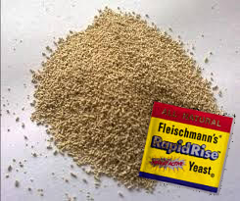
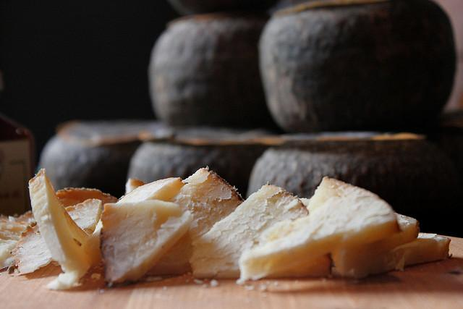
Real Vegan Cheese
We are engineering baker’s yeast to produce casein, which is the milk protein which is responsible for the unique properties of cheese. This will allow us to make cheese which is identical to animal derived cheese but which is vegan.

Slide 22
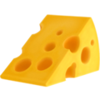
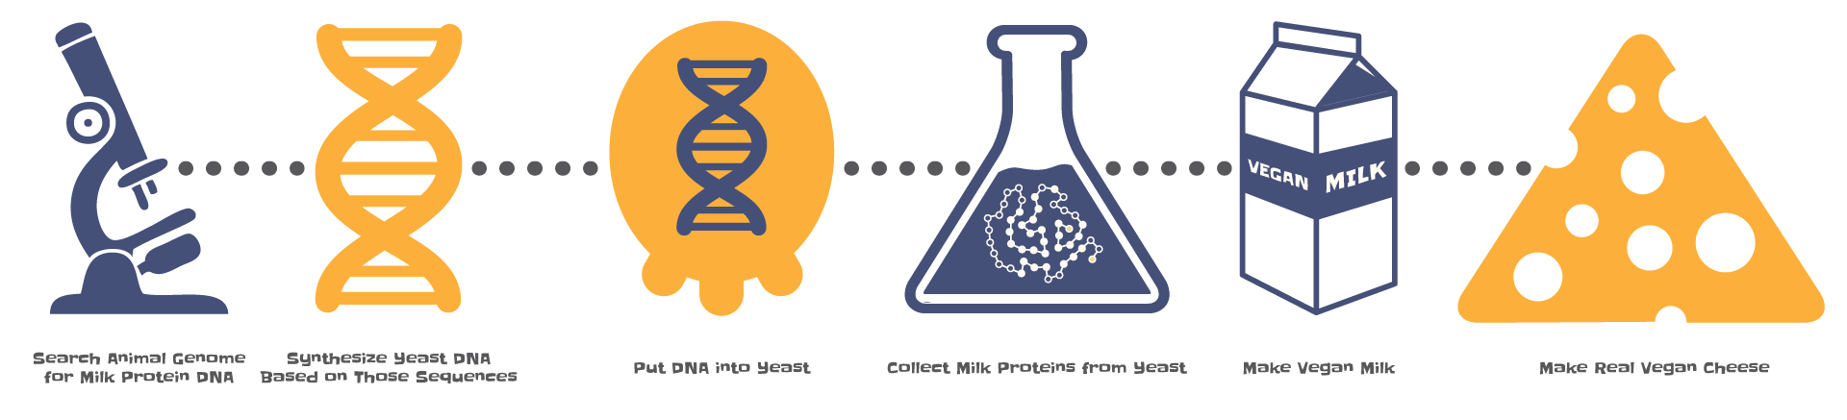
Real Vegan Cheese
Search for genes of interest in genome
We can make cheese from *any* sequenced mammal!
Synthesize DNA
No animals involved!
Insert casein genes into yeast
Using strawberry DNA as carrier
Express & Purify casein proteins
Secreted into supernatant
Make vegan “milk”
Casein micelles + sugars + fats
Make Cheese!

Slide 23

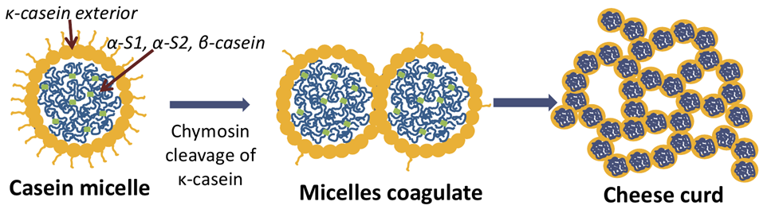
Real Vegan Cheese
Casein is a complex of four proteins
Inside casein micelle is hydrophobic and wants to separate from water
Calcium clusters and protein bound phosphate groups hold together proteins inside structure
The end of the k-casein on the surface of the micelle is hydrophilic
The k-casein hydrophilic end is coated in sugars (although functional w/o sugar)
The sugars and phosphate groups are added to the proteins by enzymes after the proteins are expressed

Slide 24

Real Vegan Cheese
Previously had designed and synthesized plasmids for bovine and human casein proteins
  Believe we had expression of some proteins but had problems verifying
  Bovine kappa casein appeared to be toxic to yeast
Redesigned plasmids
  Tag to verify production (histadine tag)
  Inducible promoters (switches to turn on and off production)
Want to try a different yeast, pichia pastoris, which may have better yields
We have started from isolated casein (from cow’s milk) and reconstitutad a milk with vegan fat and sugar and used this to make cheese
Progress is slow as a volunteer project
  Seeking funds to hire people part or full time (will keep open source)
For more on Real Vegan Cheese:
media.ccc.de/v/camp2015-6702-real_vegan_cheese

Slide 25
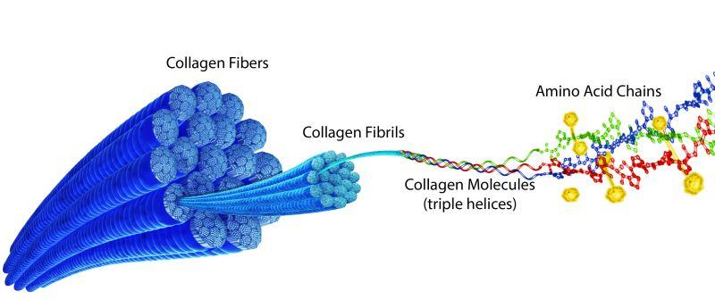
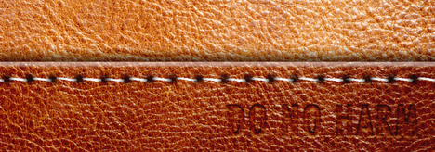
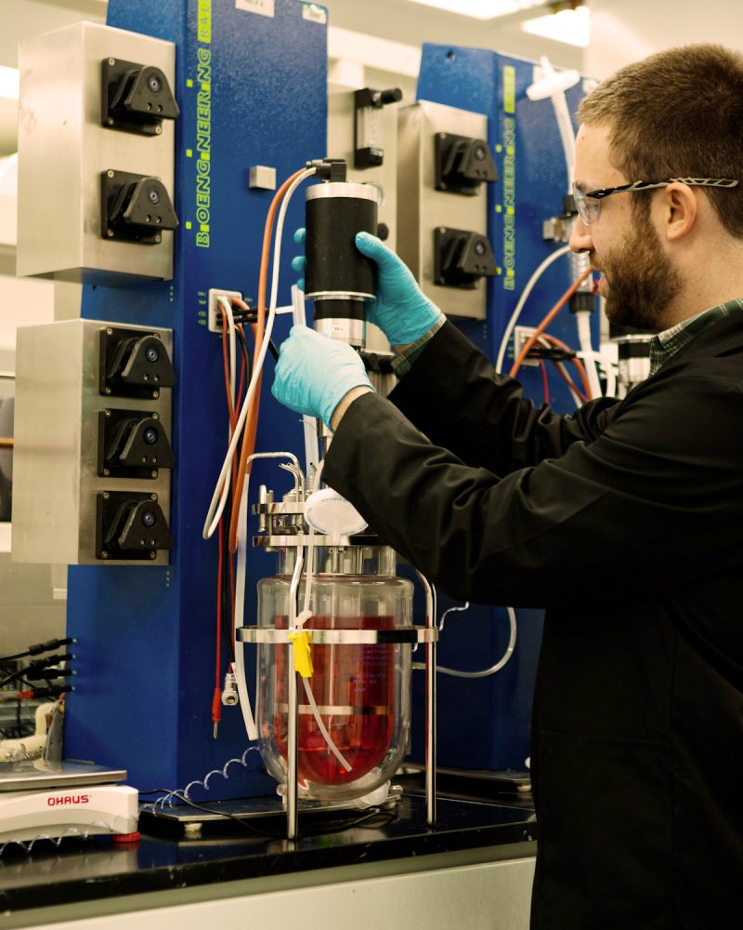
Not Just Food
Modern Meadow
Producing leather in yeast
Leather is tanned animal skin
Skin is mostly made of the protein collagen
Can optimize collagen structure to make leather better than the animal version
Another company, Bolt Threads, is doing the same thing with spider silk
Likely easier than farming spiders

Slide 26
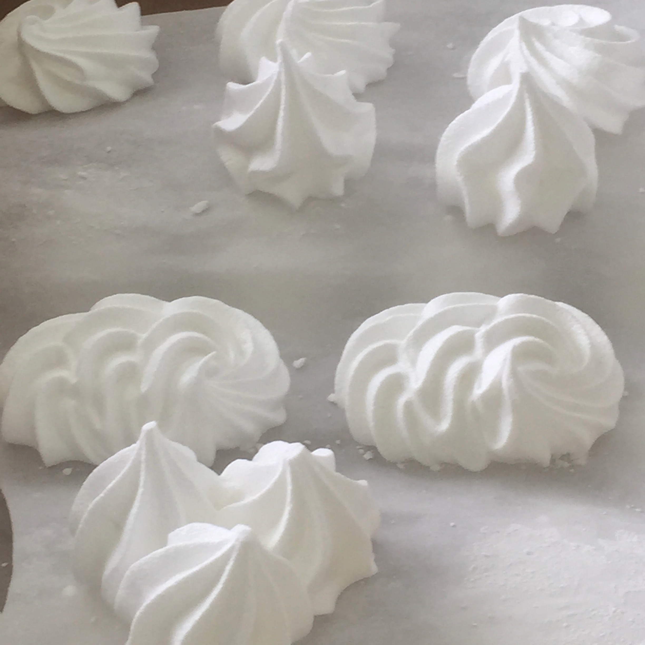
Egg Whites
Clara Foods
Egg whites (albumin) made in yeast
More secure supply chain
  Avian flu wiped out large portion of US egg laying hens in 2015
  80% price increase in eggs Jan.-Jun. 2015
Less disease risk
  No salmonella
  Concentrated bird farms and pig farms are breeding grounds for many of the most deadly human flu strains
“Our baking and binding applications team uses a proprietary protein functionality matrix to deliver improved volume, foaming, texture, and tensile strength for all your product needs” - From Clara website

Slide 27


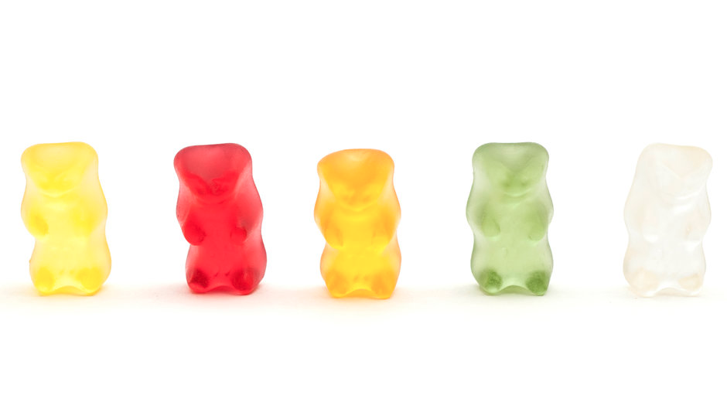

Gelatin
Gelator
Producing gelatin in yeast
Usually made from animal bones and skin
Gelatin is used in many foods
  Jell-O, marsh mellows and pill capsules are some of the most recognizable
  Additive in many thousands of other food products
Mastodon gummy bears

Slide 28










Wherefore Meat Flavor?
What do we need for (cooked) meat flavor?
Protein!
Fat!
And...
Heme containing proteins have a distinct flavor (blood), but also serve another role
Nutty
Sweet
Bitter
Burnt
Malt
Caramel
Nutty
Cereal
Meaty
sweet
Protein + Heme + heat
Buttery
Burnt, Sweet
Sweet, Almond

Slide 29




A Veggie Burger that Bleeds
Impossible Foods
Wheat Protein
Engineered Yeast
(not in final product)
Coconut Fat
Traditional Meat
Substitute
(Seitan)
Heme Protein
“Plant Blood”

Slide 30


A Veggie Burger that Bleeds
Impossible Foods
The Fake-Meat Burger So Realistic It Fooled My Entire Family
-Bon Appétit

Slide 31

Is Capitalism the Answer?
No
Wait, what’s the question again?
Capitalism is great at producing new technology and solutions to problems (provided that money can be made).
Currently we have enough food but people still starve
Currently we could all go vegan and live very healthy lives with lower environmental impact
We need the combination of new products which lower the barrier to leading lower impact lives, but also social change

Slide 32
Thank You

