Slide 1
AGRICULTURAL SUPPLY CHAIN INTELLIGENCE PLATFORM
MandiFlow
Turning fragmented mandi, price, weather and logistics data into one live decision layer for India's agricultural markets.
Hackathon Track: Agriculture & Rural Development
Team: Pattern Seekers
LIVE PIPELINE • 25,750 RECORDS • 57 MANDIS

Slide 2




THE PROBLEM
India's mandi ecosystem runs on fragmented, delayed signals
Farmers, traders and policymakers each see a slice of the picture — never the whole supply chain at once.
Price Volatility, No Warning
Fragmented, Siloed Data
Modal prices swing sharply against MSP floors, with crash rates topping 50% for crops like cotton — and no early signal for traders or farmers.
Arrival volumes, price discovery, weather and logistics data live in disconnected government and private systems.
Logistics Blind Spots
No Unified, Real-Time View
Mandi-to-warehouse transit runs 27+ hours on average, with no visibility into which corridors are chronically slow.
There is no single live dashboard connecting catchment districts, trading mandis and warehouses for fast decisions.
2

Slide 3




OUR SOLUTION
MandiFlow: one live pipeline, four decision layers
A unified agricultural supply-chain intelligence platform that fuses arrivals, price discovery, weather and logistics into a single real-time workspace — with an AI layer on top for plain-language answers.
Unify
Reveal
Optimize
Converse
25,750 records across 57 mandis, 18 districts & 6 warehouses in one live feed.
Modal price vs. MSP parity, crash-rate risk and market spread, crop by crop.
Transit-time and corridor analytics flag warehouses breaching the 24h threshold.
A built-in NL assistant answers market questions instantly, no dashboards to hunt through.
3

Slide 4






PLATFORM AT A GLANCE
Seven connected workspaces, one dataset
25,750
57
18
7
6
RECORDS IN LIVE PIPELINE
ACTIVE TRADING MANDIS
CATCHMENT DISTRICTS
ANALYTICS WORKSPACES
LOGISTICS WAREHOUSES
Overview
Mandi Analysis
Crop & Price
Transport
Weather Impact
Data Quality
AI Analytics
Executive KPIs across arrivals, price & transit
Trading-hub benchmarking & geographic ranking
MSP parity, price-crash risk & market spread
Fleet dispatch efficiency & corridor bottlenecks
Rainfall, temperature & inflow correlation
Automated validation across every dataset
Natural-language market query engine
4

Slide 5
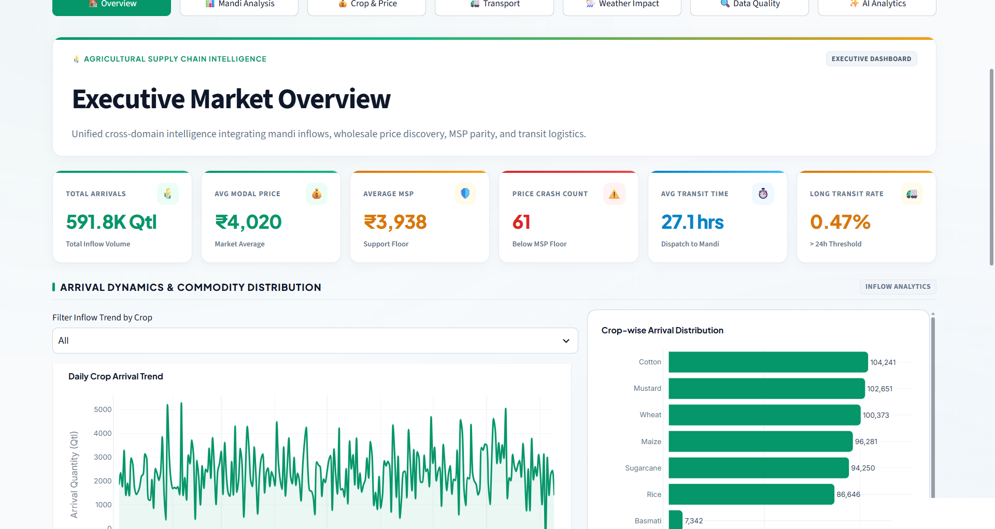
FEATURE WALKTHROUGH — OVERVIEW
Executive Market Overview
A single-screen briefing that fuses mandi inflows, wholesale price discovery, MSP parity and transit logistics for decision-makers.
591.8K Qtl
TOTAL INFLOW VOLUME TRACKED
₹4,020
AVERAGE MODAL MARKET PRICE
27.1 hrs
AVERAGE TRANSIT, DISPATCH TO MANDI
WHY IT MATTERS
Cotton, mustard and wheat dominate inflow — over 300K quintals combined — making them the highest-leverage crops for price and logistics interventions.
5

Slide 6
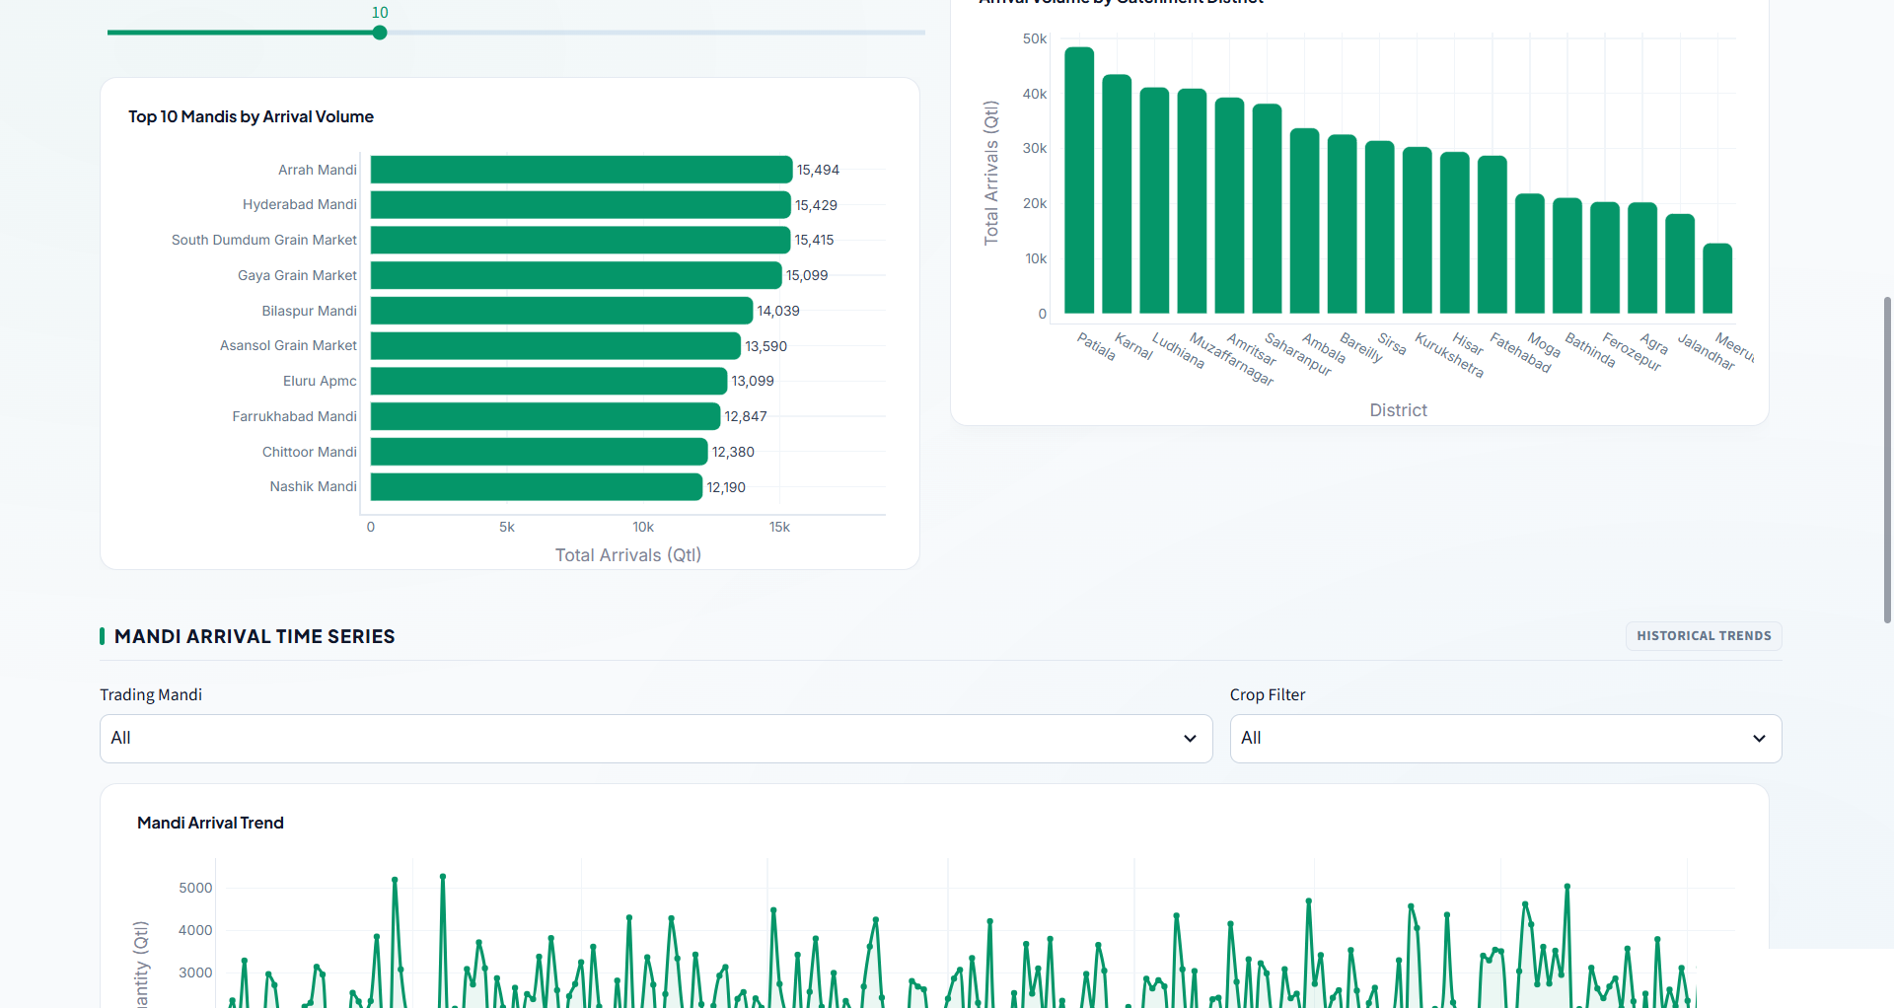
FEATURE WALKTHROUGH — MANDI ANALYSIS
Mandi Activity & Geographic Benchmarking
Ranks trading hubs by arrival volume and benchmarks catchment districts to reveal where supply concentration actually sits.
57
ACTIVE REPORTING MANDIS
Arrah Mandi
TOP-VOLUME MANDI — 15,494 QTL
Patiala
DOMINANT CATCHMENT DISTRICT
WHY IT MATTERS
The top 10 mandis alone account for a disproportionate share of arrivals — prioritizing them first gives the fastest path to market stabilization.
6

Slide 7
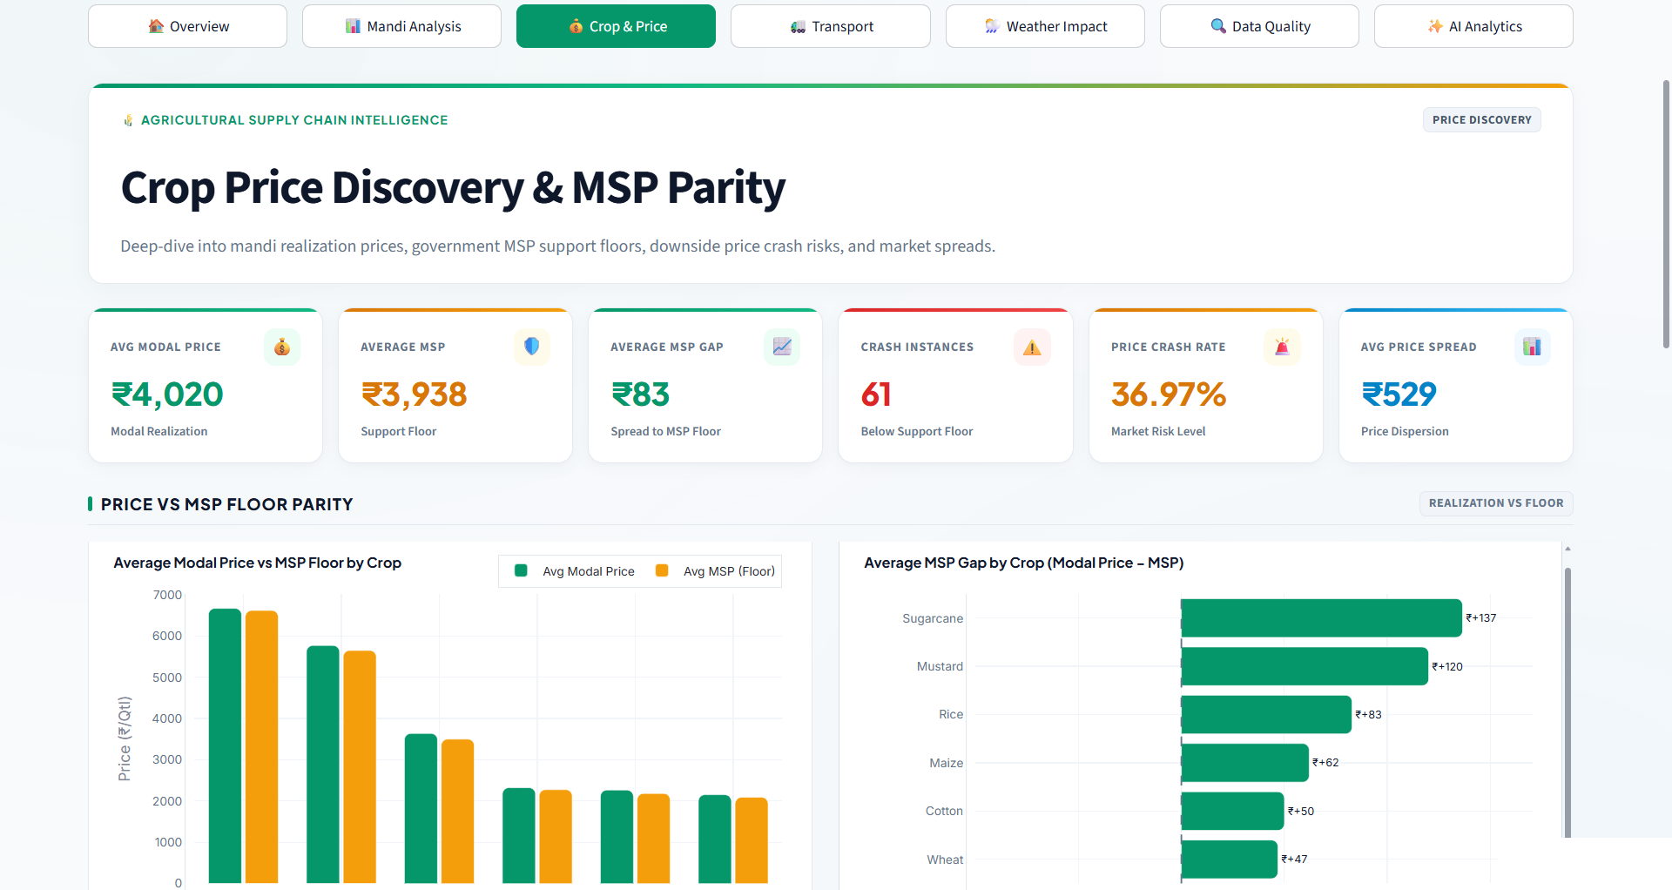
FEATURE WALKTHROUGH — CROP & PRICE
Crop Price Discovery & MSP Parity
Deep-dives into mandi realization prices against government MSP floors, exposing where farmers are trading below their support price.
₹83
AVERAGE GAP TO MSP FLOOR
61
RECORDED PRICE-CRASH INSTANCES
36.97%
OVERALL MARKET RISK LEVEL
WHY IT MATTERS
Sugarcane and mustard show the widest MSP gaps (₹+137 / ₹+120) — clear targets for procurement or price-support policy focus.
7

Slide 8
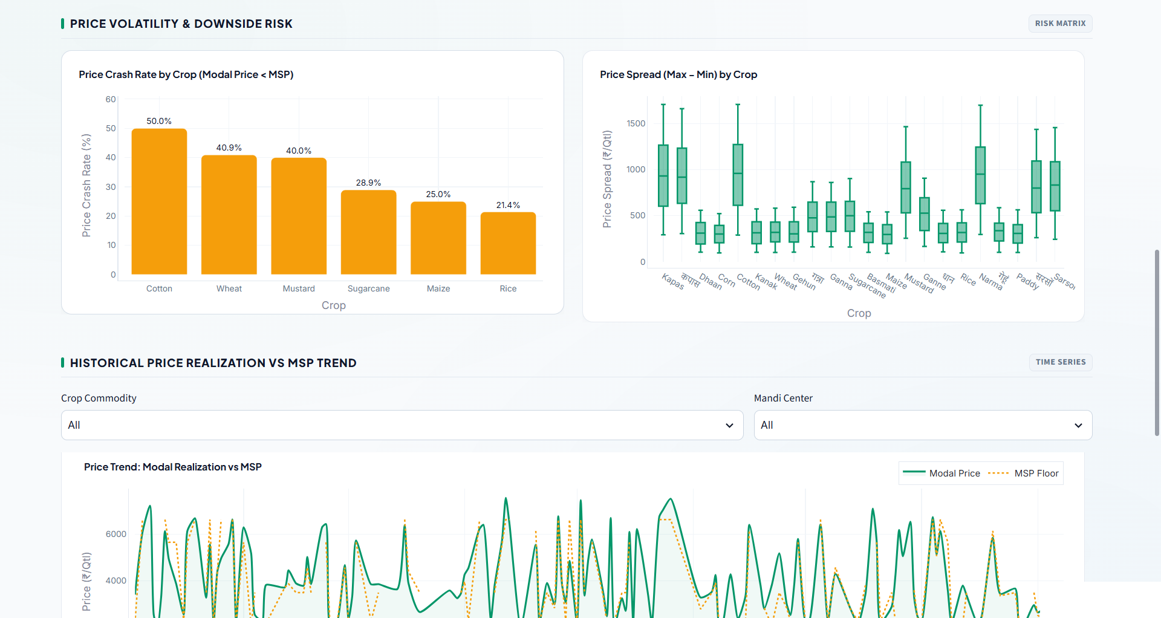
FEATURE WALKTHROUGH — CROP & PRICE
Price Volatility & Downside Risk
Ranks crops by how often modal price falls below MSP, and how wide the price spread runs — turning raw variance into an actionable risk matrix.
50.0%
COTTON — HIGHEST PRICE-CRASH RATE
40.9%
WHEAT PRICE-CRASH RATE
21.4%
RICE — MOST PRICE-STABLE CROP
WHY IT MATTERS
Cotton and wheat need the closest monitoring; rice's stability makes it a useful benchmark for what a well-supported market looks like.
8

Slide 9
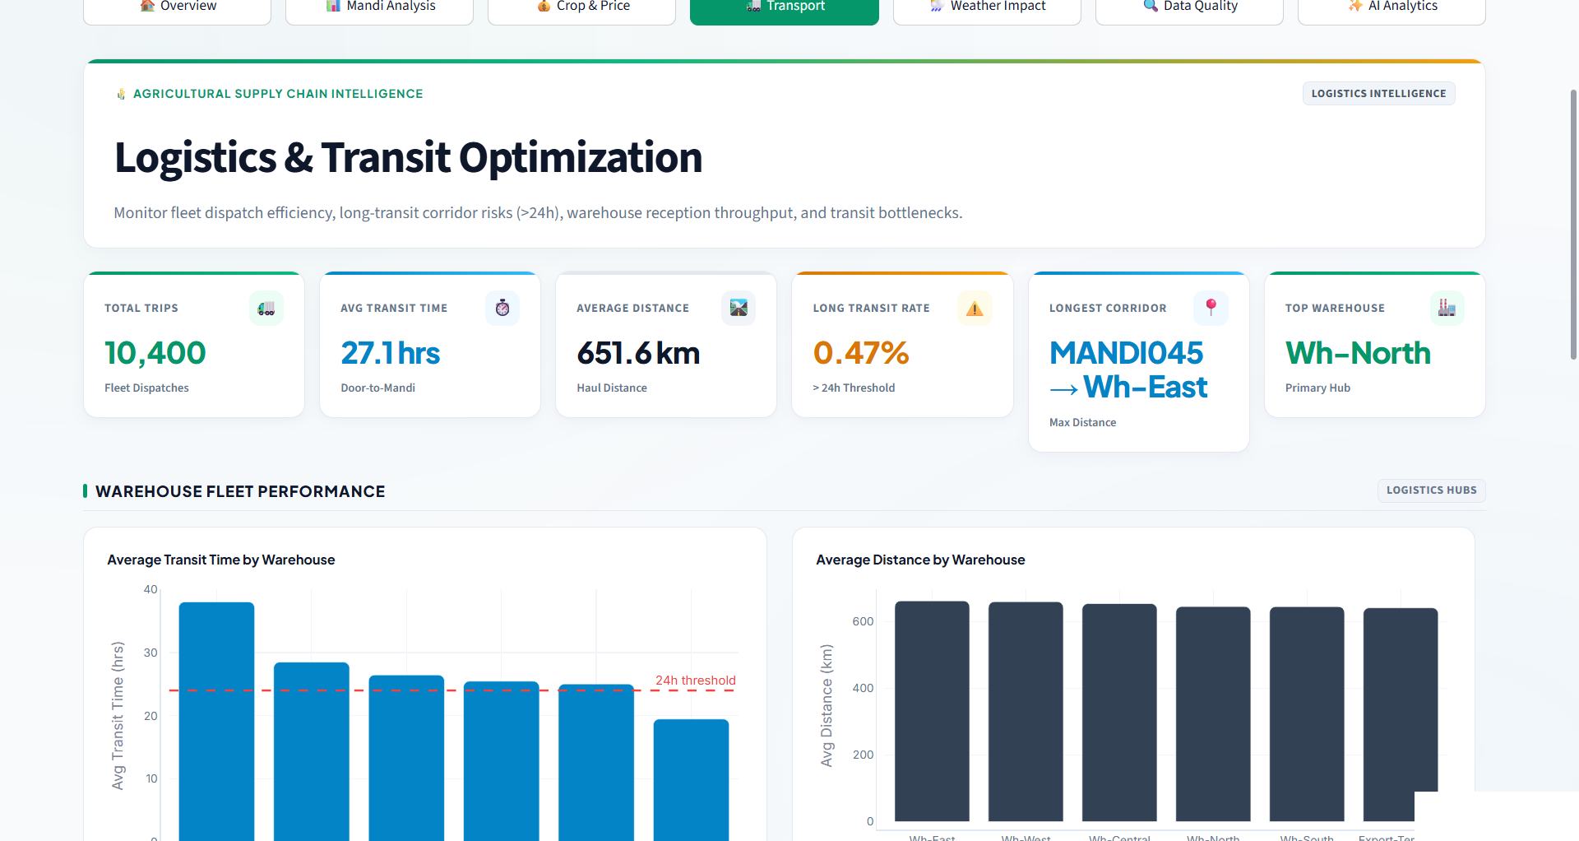
FEATURE WALKTHROUGH — TRANSPORT
Logistics & Transit Optimization
Tracks fleet dispatch efficiency, haul distance and corridor-level transit risk across every mandi-to-warehouse route.
10,400
FLEET DISPATCHES TRACKED
651.6 km
AVERAGE HAUL DISTANCE
Wh-North
TOP-PERFORMING WAREHOUSE HUB
WHY IT MATTERS
The MANDI045 → Wh-East corridor is the longest route in the network — a strong first candidate for a new intermediate warehouse.
9

Slide 10
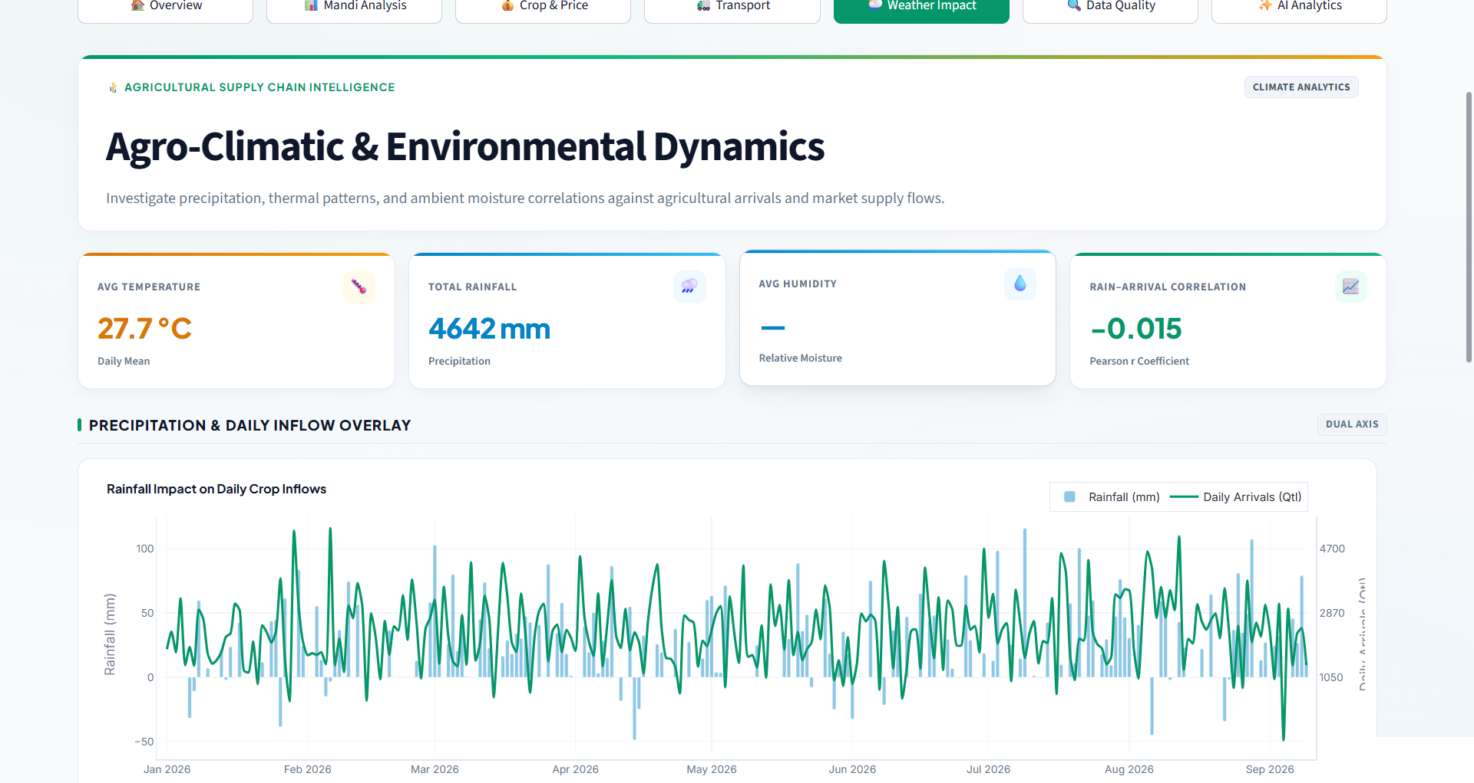
FEATURE WALKTHROUGH — WEATHER IMPACT
Agro-Climatic & Environmental Dynamics
Correlates rainfall, temperature and humidity against daily arrivals to separate genuine climate risk from routine market noise.
4,642 mm
TOTAL RAINFALL OBSERVED
27.7 °C
DAILY MEAN TEMPERATURE
−0.015
RAINFALL-TO-ARRIVAL CORRELATION (R)
WHY IT MATTERS
The near-zero correlation confirms arrivals are driven mainly by market and logistics factors, not short-term weather — a key input for forecasting models.
10

Slide 11
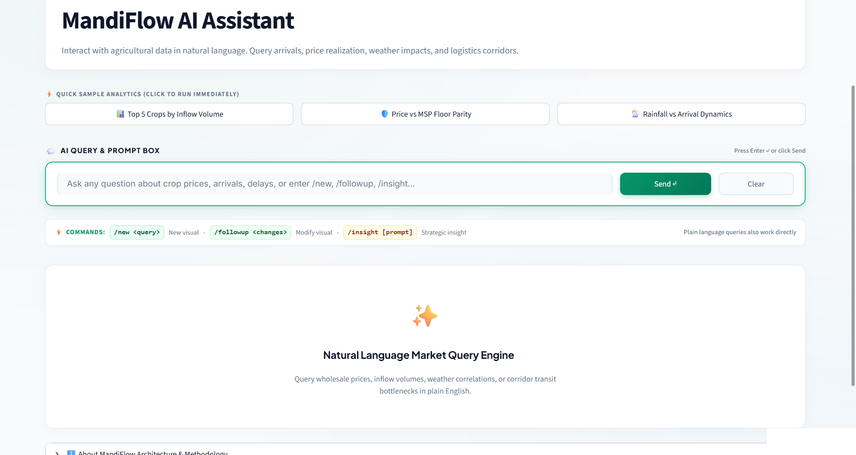


FEATURE WALKTHROUGH — AI ANALYTICS
Ask MandiFlow anything, in plain English
A built-in natural-language query engine lets any stakeholder — officer, trader or analyst — pull the exact cut of data they need without touching a filter.
“Top 5 crops by inflow volume”
“Price vs MSP floor parity”
“Rainfall vs arrival dynamics”
/new · /followup · /insight
Slash commands generate new visuals, refine them, or surface a strategic insight — no re-querying needed.
11

Slide 12
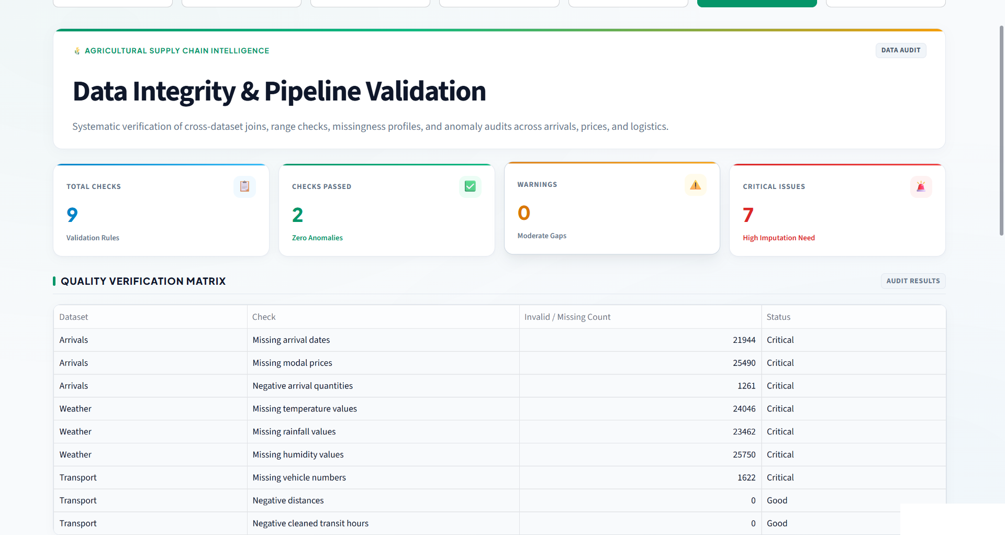
FEATURE WALKTHROUGH — DATA QUALITY
Data Integrity & Pipeline Validation
Every dataset is automatically checked for missing values, invalid ranges and cross-dataset join integrity before it reaches a dashboard.
9
AUTOMATED VALIDATION RULES
0
ANOMALIES IN TRANSPORT DATA
7
FIELDS FLAGGED FOR IMPUTATION
WHY IT MATTERS
Radical transparency: MandiFlow surfaces its own data gaps rather than hiding them — arrival dates and modal prices are the top imputation priorities.
12

Slide 13







HOW IT'S BUILT — IMPACT & ROADMAP
Lightweight stack, real-world impact
TECH STACK
ROADMAP
Python
Pandas
What ships next
Data pipeline & analytics engine
Cleaning, joins & aggregation
Predictive Alerts
Forecast MSP-crash risk 7–14 days ahead using historical price patterns.
Plotly
Streamlit
Interactive charting layer
Live, filterable web dashboard
Mobile & SMS Push
IMPACT & SCALE
Push farmer-facing price and weather alerts to low-bandwidth channels.
Farmers get MSP-parity visibility to time sales, not just guess.
State-Level Rollout
Extend the 18-district pilot to a full multi-state mandi network.
Logistics teams flag slow corridors before they become losses.
Farmer-Facing App
Officers get a governed, validated single source of truth.
A simplified, vernacular front-end on top of the same live pipeline.
13

Slide 14
Thank You
MandiFlow — one live pipeline for every mandi decision.
Live demo: mandiflow-agricultural-supply-chain-analytics.streamlit.app
Team: Pattern Seekers

