Slide 1
Introduction
Overview of the Alumni Management System:
- Purpose: Connects alumni to their institution and peers.
- Features: Events, job opportunities, networking, and more.
- Scalable, secure, and user-focused platform.

Slide 2
Project Objectives
• Enhance alumni relationships.
• Streamline event and data management.
• Provide centralized career opportunities.
• Build a secure and scalable platform.

Slide 3
Core Features
• User registration and login with verification.
• Profile management with career updates.
• Event browsing, RSVP, and participation.
• Job postings and search capabilities.
• Admin control for user and event management.

Slide 4
Methodology: Agile Approach
• Incremental and iterative development.
• Sprints to deliver prioritized features.
• Regular user feedback integration.
• Continuous testing for quality assurance.

Slide 5
Feasibility Study
1. Technical Feasibility:
- Tools: Django, PostgreSQL, JavaScript.
- Hosting: AWS, Heroku.
2. Economic Feasibility:
- Budget: ~$120-$170.
3. Operational Feasibility:
- Benefits for stakeholders.
4. Schedule Feasibility:
- Project divided into 6 sprints.

Slide 6
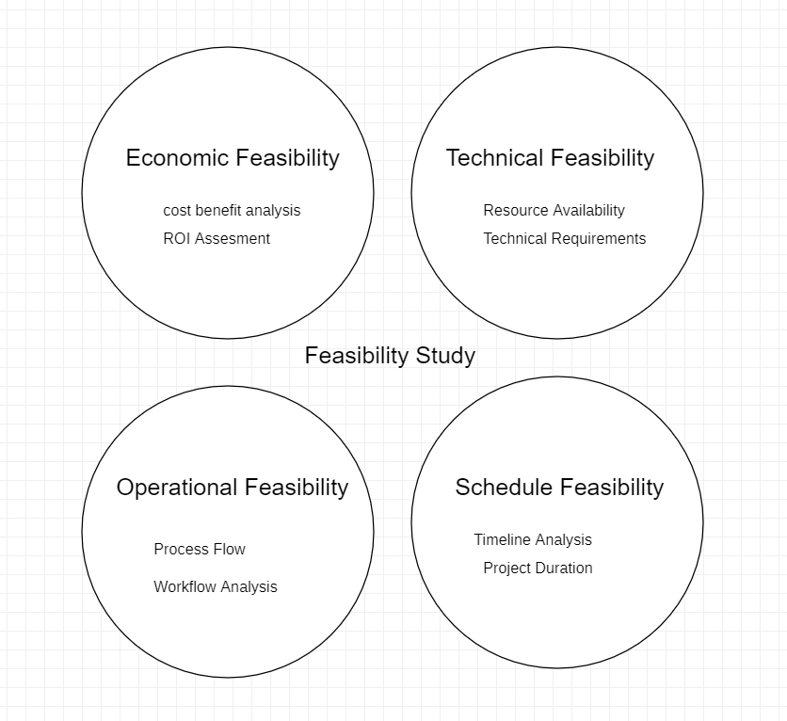

Slide 7
Technical Feasibility
Tools and Infrastructure:
- Django: Scalable backend.
- PostgreSQL: Secure database.
- Responsive frontend: HTML, CSS, JavaScript.
Security:
- HTTPS, role-based access control, encryption.

Slide 8
Economic Feasibility
Low-cost development:
- Open-source tools: Django, PostgreSQL.
- Hosting options: Free or minimal cost plans.
- Miscellaneous costs: $50.
Estimated Budget: ~$120-$170.

Slide 9
Operational Feasibility
Advantages for Alumni:
- Networking, career access, and event participation.
Advantages for Administrators:
- Streamlined workflows and centralized management.

Slide 10
System Design Overview
1. Registration: Document verification.
2. Profile Management: Update details.
3. Event Management: Browse, RSVP, and manage events.
4. Job Management: Post and browse opportunities.
5. Admin Controls: Approvals and data management.

Slide 11
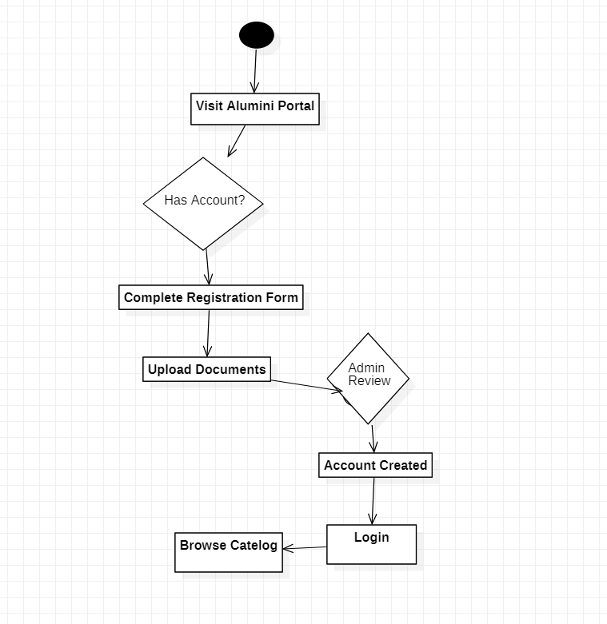

Slide 12
Activity Diagram: Registration
• New users register by providing details.
• Admin verifies and approves registration.
• Existing users log in to access the platform.

Slide 13
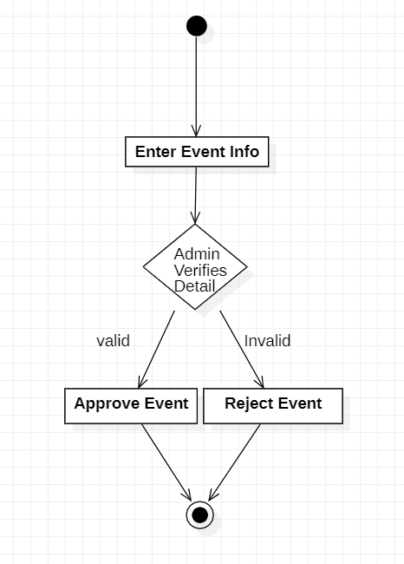

Slide 14
Activity Diagram: Event Management
• Browse upcoming events.
• RSVP for free or paid events.
• Track registration history.

Slide 15
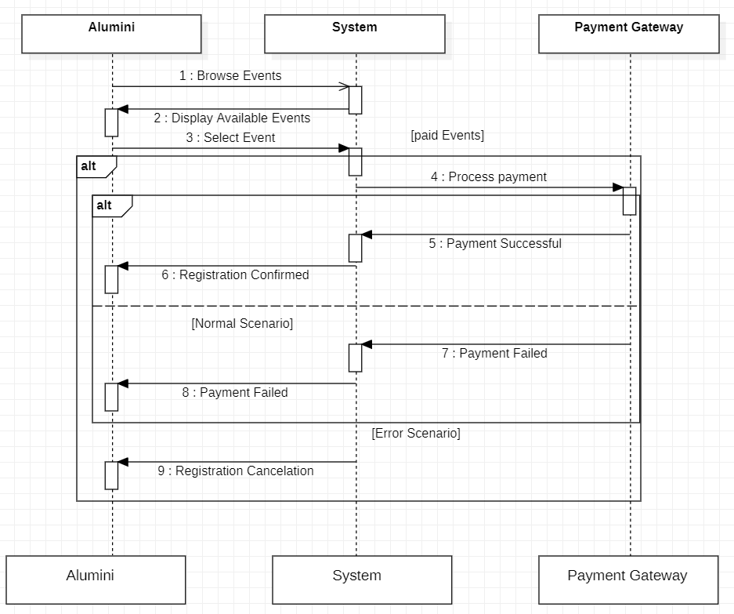

Slide 16
Use Case Diagram
Actors:
- Alumni: Register, update profile, participate in events.
- Admin: Approve users, manage events, and monitor data.
Use Cases:
- Registration and Login
- Event and Job Management.

Slide 17
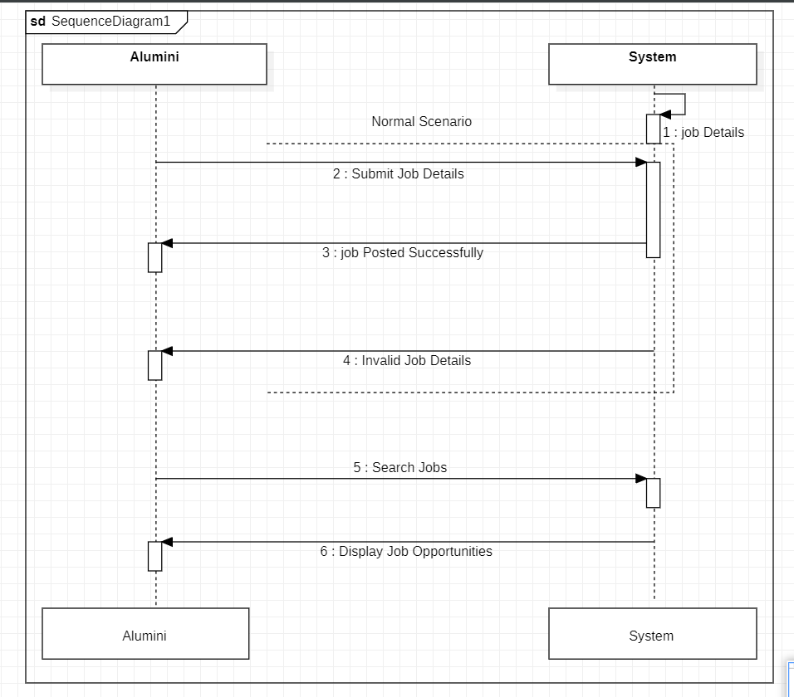

Slide 18
System Sequence Diagram: Registration
1. Alumni submits details.
2. Admin approves/rejects registration.
3. Alumni accesses the dashboard post-login.

Slide 19
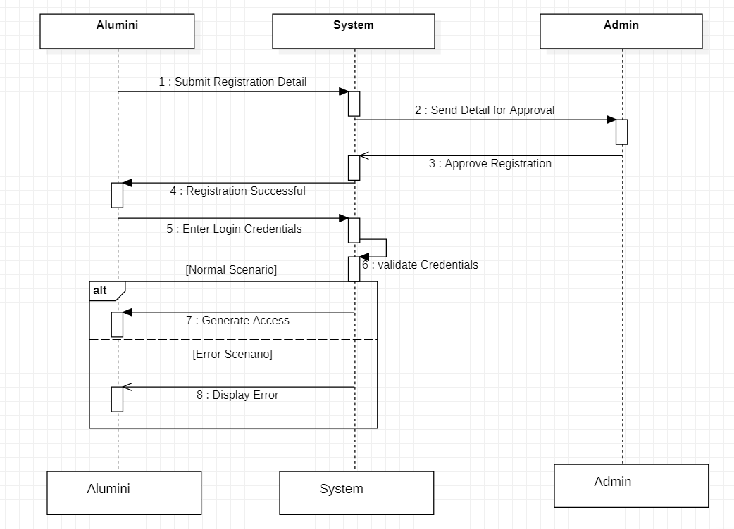

Slide 20
Domain Class Diagram
Key Classes:
- User: Alumni and Admin roles.
- Event: Details and registrations.
- Profile: User-specific data.
- Job Posting: Opportunities shared by alumni or admins.

Slide 21
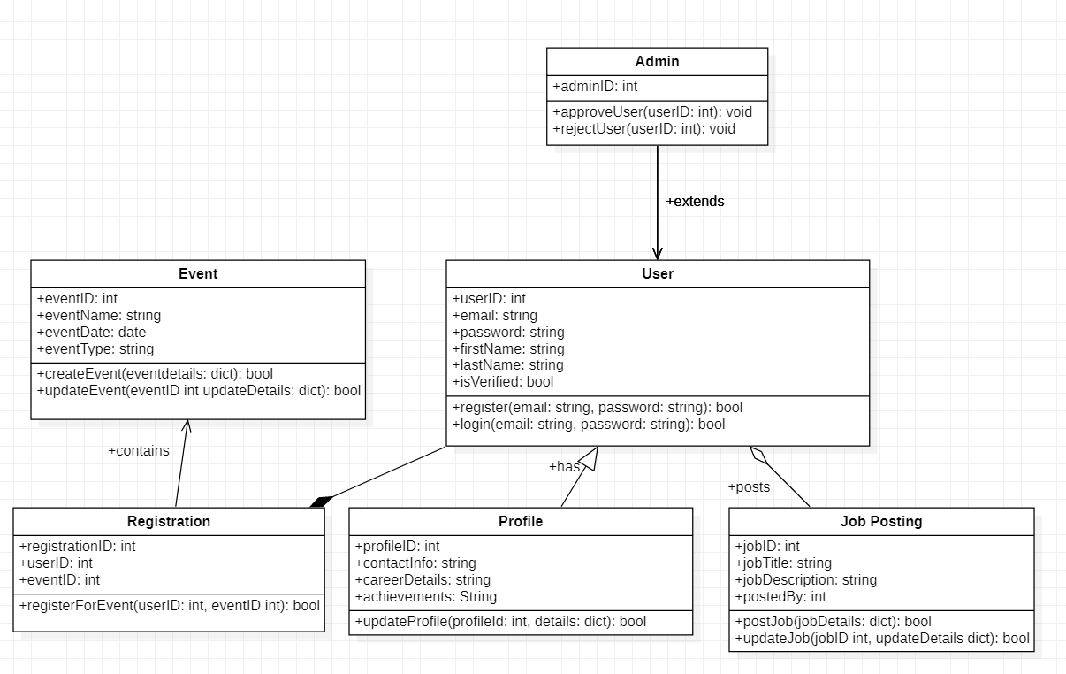

Slide 22
High-Level Architecture
Model-View-Controller (MVC):
- Model: Manages business logic and data.
- View: Handles presentation and UI.
- Controller: Coordinates user inputs and system actions.

Slide 23
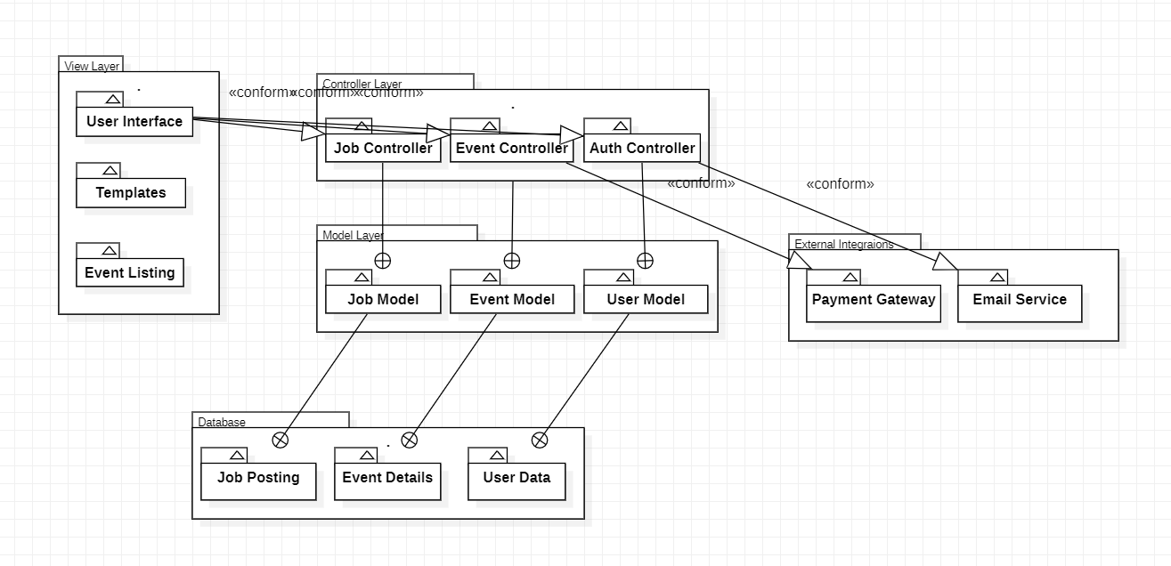

Slide 24
Security Features
1. HTTPS for secure communication.
2. Role-based access control.
3. Encrypted sensitive data (e.g., passwords).

Slide 25
Sprint Plan
1. Sprint 1: User registration and login.
2. Sprint 2: Alumni directory and search.
3. Sprint 3: Event notifications and participation.
4. Sprint 4: Job postings and opportunities.
5. Sprint 5: Feedback integration and testing.
6. Sprint 6: Deployment and documentation.

Slide 26
Benefits for Alumni
• Peer-to-peer networking opportunities.
• Access to job opportunities and events.
• Personalized profiles to showcase achievements.

Slide 27
Benefits for Administrators
• Centralized alumni and event management.
• Automation of repetitive workflows.
• Enhanced alumni engagement strategies.

Slide 28
Future Enhancements
1. Mobile application development.
2. Advanced analytics for user engagement.
3. Chat and messaging features.
4. AI-based recommendations for events and jobs.

Slide 29
Conclusion
The Alumni Management System:
- Connects alumni to institutions and peers.
- Provides secure, scalable, and user-friendly solutions.
- Strengthens alumni relationships and institutional reputation.

Slide 30
Questions and Feedback
Thank you for your attention!
Please share any questions or suggestions.

