Slide 1
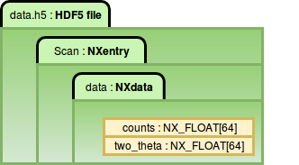
NeXus scientific data format:
Introduction and applications
erhtjhtyhy
Pete R. Jemian, group leader
www.nexusformat.org
Beamline Controls & Data Acquisition Group
Advanced Photon Source, USA
Könnecke et al., J Appl Cryst 48.1 (2015) 301–305, 10.1107/S1600576714027575
2017-08-25
This work was supported in part by the U.S. Department of Energy, Office of Science, under Contract No. DE-AC-02-06CH11357.

Slide 2

A few things to know about NeXus
Uses HDF5 as file format: https://www.hdfgroup.org
NeXus is a common data format for neutron, x-ray, and muon science.
HDF5 is a hierarchical format:
  components: groups, datasets, attributes, links
NeXus
  Defines the layout of information in an HDF5 file
  Uses the HDF5 group structure to organize data
  Provides a dictionary of common terms
  NeXus application definitions can further define
  terms and layout specific to a scientific community
  for the exchange of data
Basic NeXus structure
NeXus HDF5 data file
NXentry
NXdata
# datasets
NXinstrument # optional
# raw data structures
NXsample # optional
# sample metadata
# other metadata
J. Appl. Cryst. (2015). 48, 301-305
https://doi.org/10.1107/S1600576714027575

Slide 3
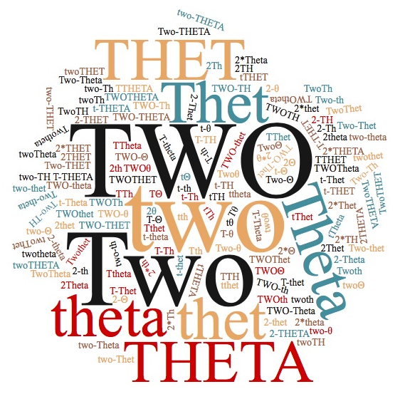
Overview
Introduction to NeXus
  Components
  Design Principles
  Data Storage Objects
  Programs that read / write NeXus files
Examples
NeXus International Advisory Committee (NIAC)
Communications
How many variations of this common term?

Slide 4
Introduction
NeXus is an effort by an international group of scientists
common data exchange format for neutron, X-ray, and muon experiments
built on top of the scientific data format HDF5 (hdfgroup.org)
Purposes
  raw data : any relevant data associated with a scientific instrument or beamline
  processed data : structures for exchange of data between applications

Slide 5
The Components of NeXus
Design Principles
  group, field, attribute, link
Data Storage Objects
  base classes, application definitions, and contributed definitions
Subroutines
  NAPI, Python (and other) examples
Scientific Community
  you

Slide 6
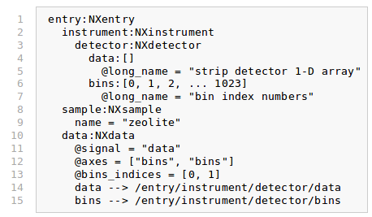
NeXus Design Principles
Group
Field
Attribute
Link

Slide 7
NeXus Data Storage Objects
written in NeXus Definition Language (NXDL)
base classes
  A set of components that are used to construct a data file
  Defines the set of terms that might be used in an instance of that class
application definitions
  Specifies a data structure for a given domain, such as small-angle scattering
  Defines the minimum set of terms that must be used
contributed definitions
  Propositions from the community for base classes or application definitions
  Other NXDL files for long-term archival by NeXus
  Considered as either in incubation or a special case not for general use

Slide 8
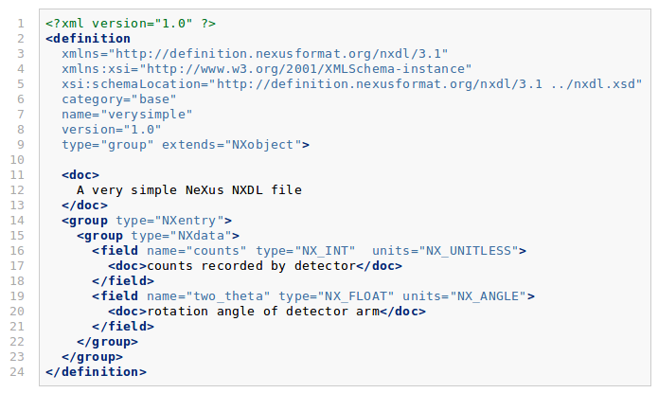
A very simple NXDL file

Slide 9
Data Units
NeXus uses the UDUNITS standard
(http://www.unidata.ucar.edu/software/udunits)
  Very flexible
  Allows mathematical expressions such as g/cm^3
  Supported by C library for programmatic conversion (also Python)
Units appropriate to field: wavelength has NX_WAVELENGTH type units
Units are not presently validated
  But, there are plans to check them using the C library code

Slide 10
Programs that read & write NeXus files
see: http://download.nexusformat.org/doc/html/utilities.html
Anything that can read or write HDF5 files
Data Analysis applications:
  At least 14 (including IDL, Matlab, PyMCA, and NeXpy)
Tools from the HDF Group (hdfgroup.org): HDFview, h5dump, …
Python package: h5py
NeXus command-line utilities (from https://github.com/nexusformat/code)
Validation of NeXus files: cnxvalidate & punx

Slide 11
Examples

Slide 12
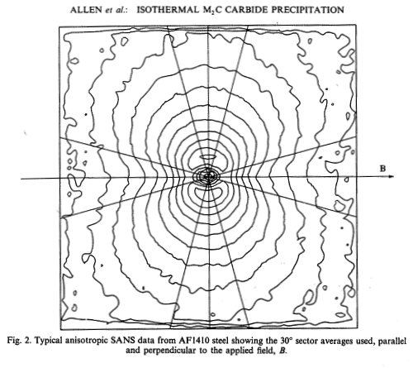
cs_af1410.h5 : NeXus data file
@creator = xml2hdf5.py
@default = AF1410_10
AF1410_10:NXentry
AF1410_a10:NXdata
I:NX_FLOAT64[77]
Idev:NX_FLOAT64[77]
Q:NX_FLOAT64[77]
AF1410_b10:NXdata
I:NX_FLOAT64[76]
Idev:NX_FLOAT64[76]
Q:NX_FLOAT64[76]
sasinstrument:NXinstrument
sascollimation:NXcollimator
sasdetector:NXdetector
sassource:NXsource
sassample:NXsample
AF1410_1h:NXentry
AF1410_a1h:NXdata
AF1410_b1h:NXdata
AF1410_20:NXentry
AF1410_2h:NXentry
AF1410_50:NXentry
AF1410_5h:NXentry
AF1410_8h:NXentry
AF1410_cc:NXentry
AF1410_hf:NXentry
AF1410_qu:NXentry
Example: many samples
AF1410 steel
10 samples (aging series)
two (NIST) SANS each sample
Steel sample, aging series
Area detector image at each aging time
Binned in horizontal & vertical sectors
1-D I(Q) have different lengths
(lots of other metadata in example file)
file: cs_af1410.h5
https://github.com/canSAS-org/NXcanSAS_examples/tree/master/1d_standard
Acta Metall 41 (1993) 1869-1884

Slide 13
Example: multi-dimensional data
AF1410 steel SANS as multi-D
The AF1410 data might be re-written as a multi-dimensional data structure:
  Sector angle (nuclear v. nuclear+magnetic scattering)
  Aging time
  Q
The SANS data would need to be binned to the same Q steps
Eliminates extra structure:
  1 NXentry group remains
  1 NXdata group remains
Could include sector_angle and/or aging_time in the analysis model
cs_af1410_multi.h5 : NeXus data file
@creator = "hypothetical example"
@default = AF1410
AF1410:NXentry
@default = AF1410
AF1410:NXdata
@signal = I
@I_axes = Q
@Q_indices = 2
@aging_time_indices = 0
@sector_angle_indices = 1
I:NX_FLOAT64[10, 2, 77]
Idev:NX_FLOAT64[10, 2, 77]
Q:NX_FLOAT64[77]
aging_time:NX_FLOAT64[10] = [0, .25,
0.5, 1, 2, 5, 8, 10, 20 50, 100]
@units = h
sector_angle:NX_FLOAT64[2] = [0, 90]
@units = degrees
sasinstrument:NXinstrument
sascollimation:NXcollimator
sasdetector:NXdetector
sassource:NXsource
sassample:NXsample

Slide 14
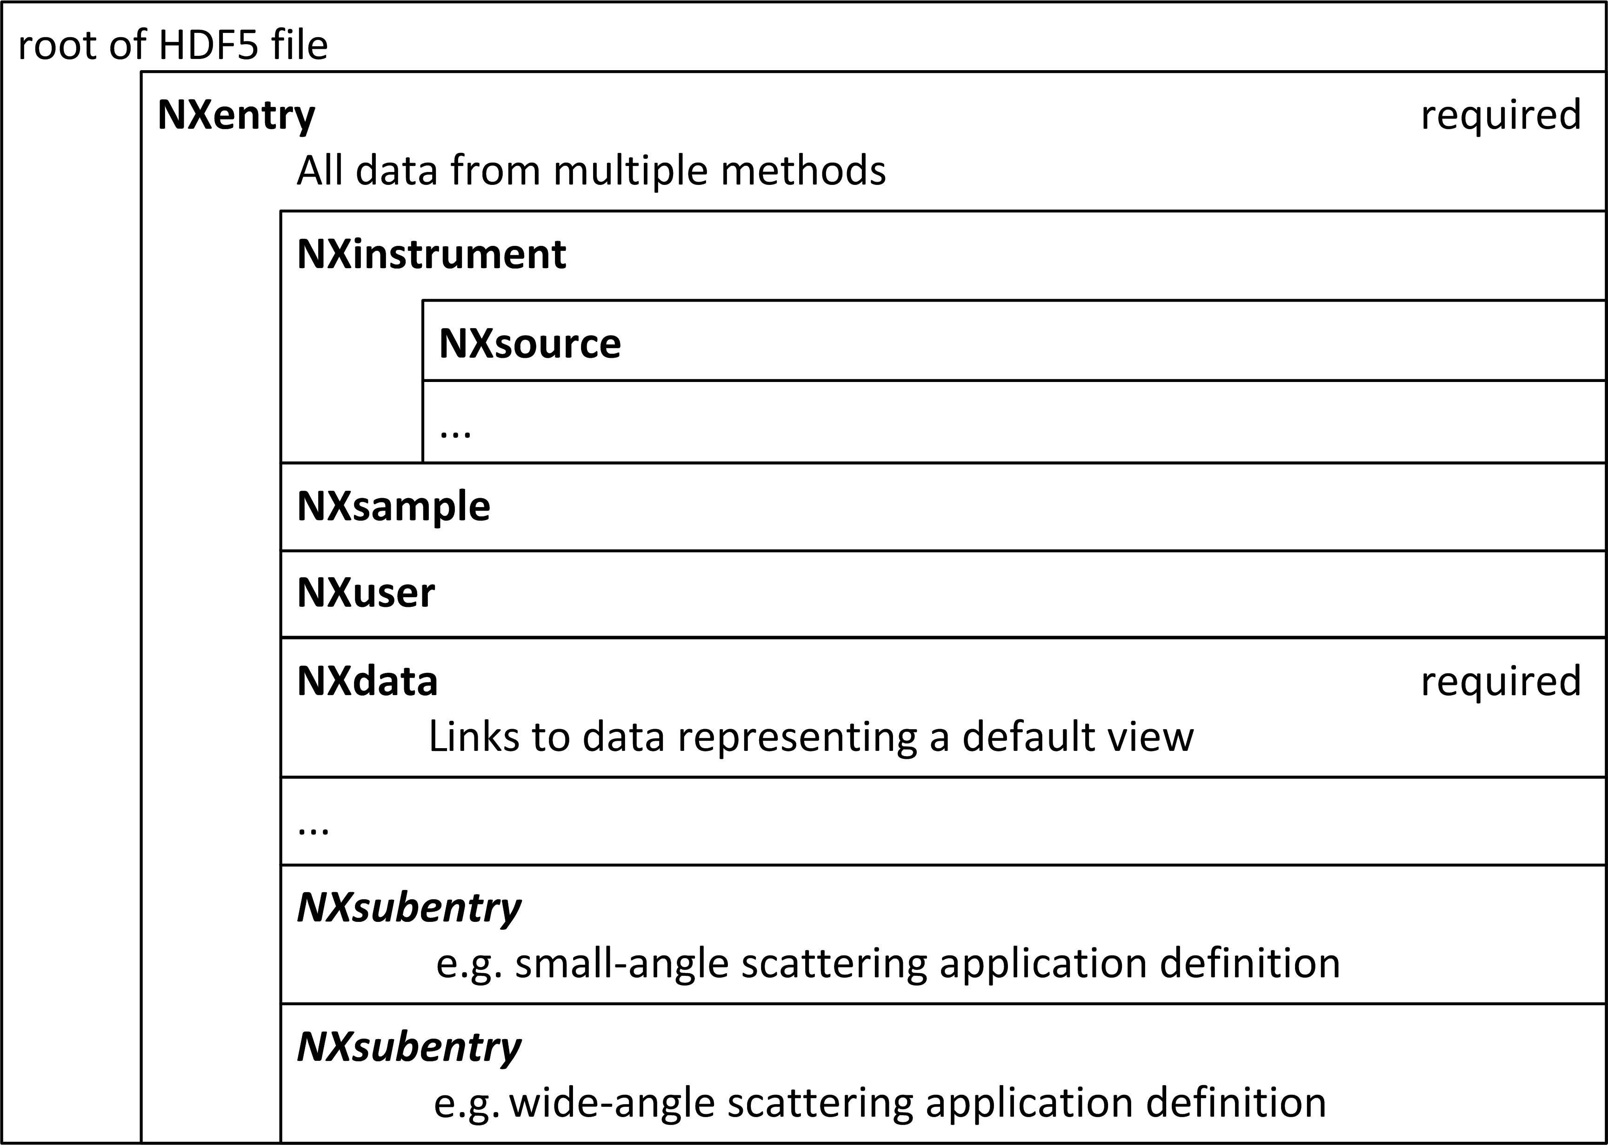
Example: multi-modal data
NeXus structure is flexible
  describe many sets of measurements
Use data groups under a single entry group if from the same sample
(Sample and wavelength data not shown for brevity)
Or, use application definitions
2-D SAS/WAS images
sas-was-example.h5 : NeXus data file
@canSAS_class = "SASroot"
entry:NXentry
@canSAS_class = "SASentry"
sasdata:NXdata
@canSAS_class = "SASdata"
@I_axes = Q, Q
@Q_indices = 0, 1
@signal = I
I:NX_FLOAT64[100,512]
Qx:NX_FLOAT64[100,512]
Qy:NX_FLOAT64[100,512]
Qz:NX_FLOAT64[100,512]
wasdata:NXdata
@I_axes = Q, Q
@Q_indices = 0, 1
@signal = I
I:NX_FLOAT64[256,256]
Q_x:NX_FLOAT64[256,256]
Q_y:NX_FLOAT64[256,256]
Q_z:NX_FLOAT64[256,256]

Slide 15
Examples: How to describe uncertainty
These values are the estimates of uncertainty.
By default, assumed as estimated standard deviation, but could specify as other
Can be added to any dataset (NeXus calls this a field) with an attribute:
  Exact name of uncertainty dataset is flexible
simple uncertainty
uncertainty from multiple sources
I:NX_FLOAT64[91]
@units = 1/cm
@uncertainties = Iesd
Iesd:NX_FLOAT64[91]
@units = 1/cm
Q:NX_FLOAT64[91]
@units = 1/nm
@resolutions = Qdev
Qdev:NX_FLOAT64[91]
@units = 1/nm
I : float[m,n]
@uncertainties=Idev
Idev : float[m,n]
@components=I_uncertainties
I_uncertainties : (group)
electronic : float[m,n]
@basis="Johnson noise"
counting_statistics : float[m,n]
@basis="shot noise"
secondary_standard : float[m,n]
@basis="esd"

Slide 16
Example: metadata
Rich metadata can be added, but is optional
sassample:NXsample
@NX_class = NXsample
@canSAS_name = sassample
@canSAS_class = SASsample
ID:NX_CHAR[34] = AF1410-10 (AF1410 steel aged 10 h)
details:NX_CHAR[128] =
transverse saturation magnetic field (1.6 T) applied in
horizontal direction to clear magnetic domain scattering
sasinstrument:NXinstrument
sascollimation:NXcollimator
sasdetector:NXdetector
sassource:NXsource
incident_wavelength:NX_FLOAT64 = 0.85
@units = nm
radiation:NX_CHAR[7] = neutron
wavelength_spread:NX_FLOAT64 = 25.0
@units = percent

Slide 17
Example: metadata
sasnote:NXnote
citation:NXcollection
@NX_class = NXcollection
@canSAS_name = citation
@tag = citation
journal:NX_CHAR[11] = Acta Metall
@tag = journal
pages:NX_CHAR[9] = 1869-1884
@tag = pages
title:NX_CHAR[92] = Small-Angle Neutron Scattering
Studies of Carbide Precipitation in
Ultrahigh-Strength Steels
@tag = title
volume:NX_CHAR[2] = 41
@tag = volume
year:NX_CHAR[4] = 1993
@tag = year
authors:NXcollection
@NX_class = NXcollection
@canSAS_name = authors
@tag = authors
author_0:NX_CHAR[10] = A.J. Allen
@tag = author
author_1:NX_CHAR[11] = D. Gavillet
@tag = author
author_2:NX_CHAR[13] = J.R. Weertman
@tag = author
citation
NeXus provides the NXnote to describe any additional freeform information not covered by the other base classes
These tags and attributes were supplied ad hoc

Slide 18
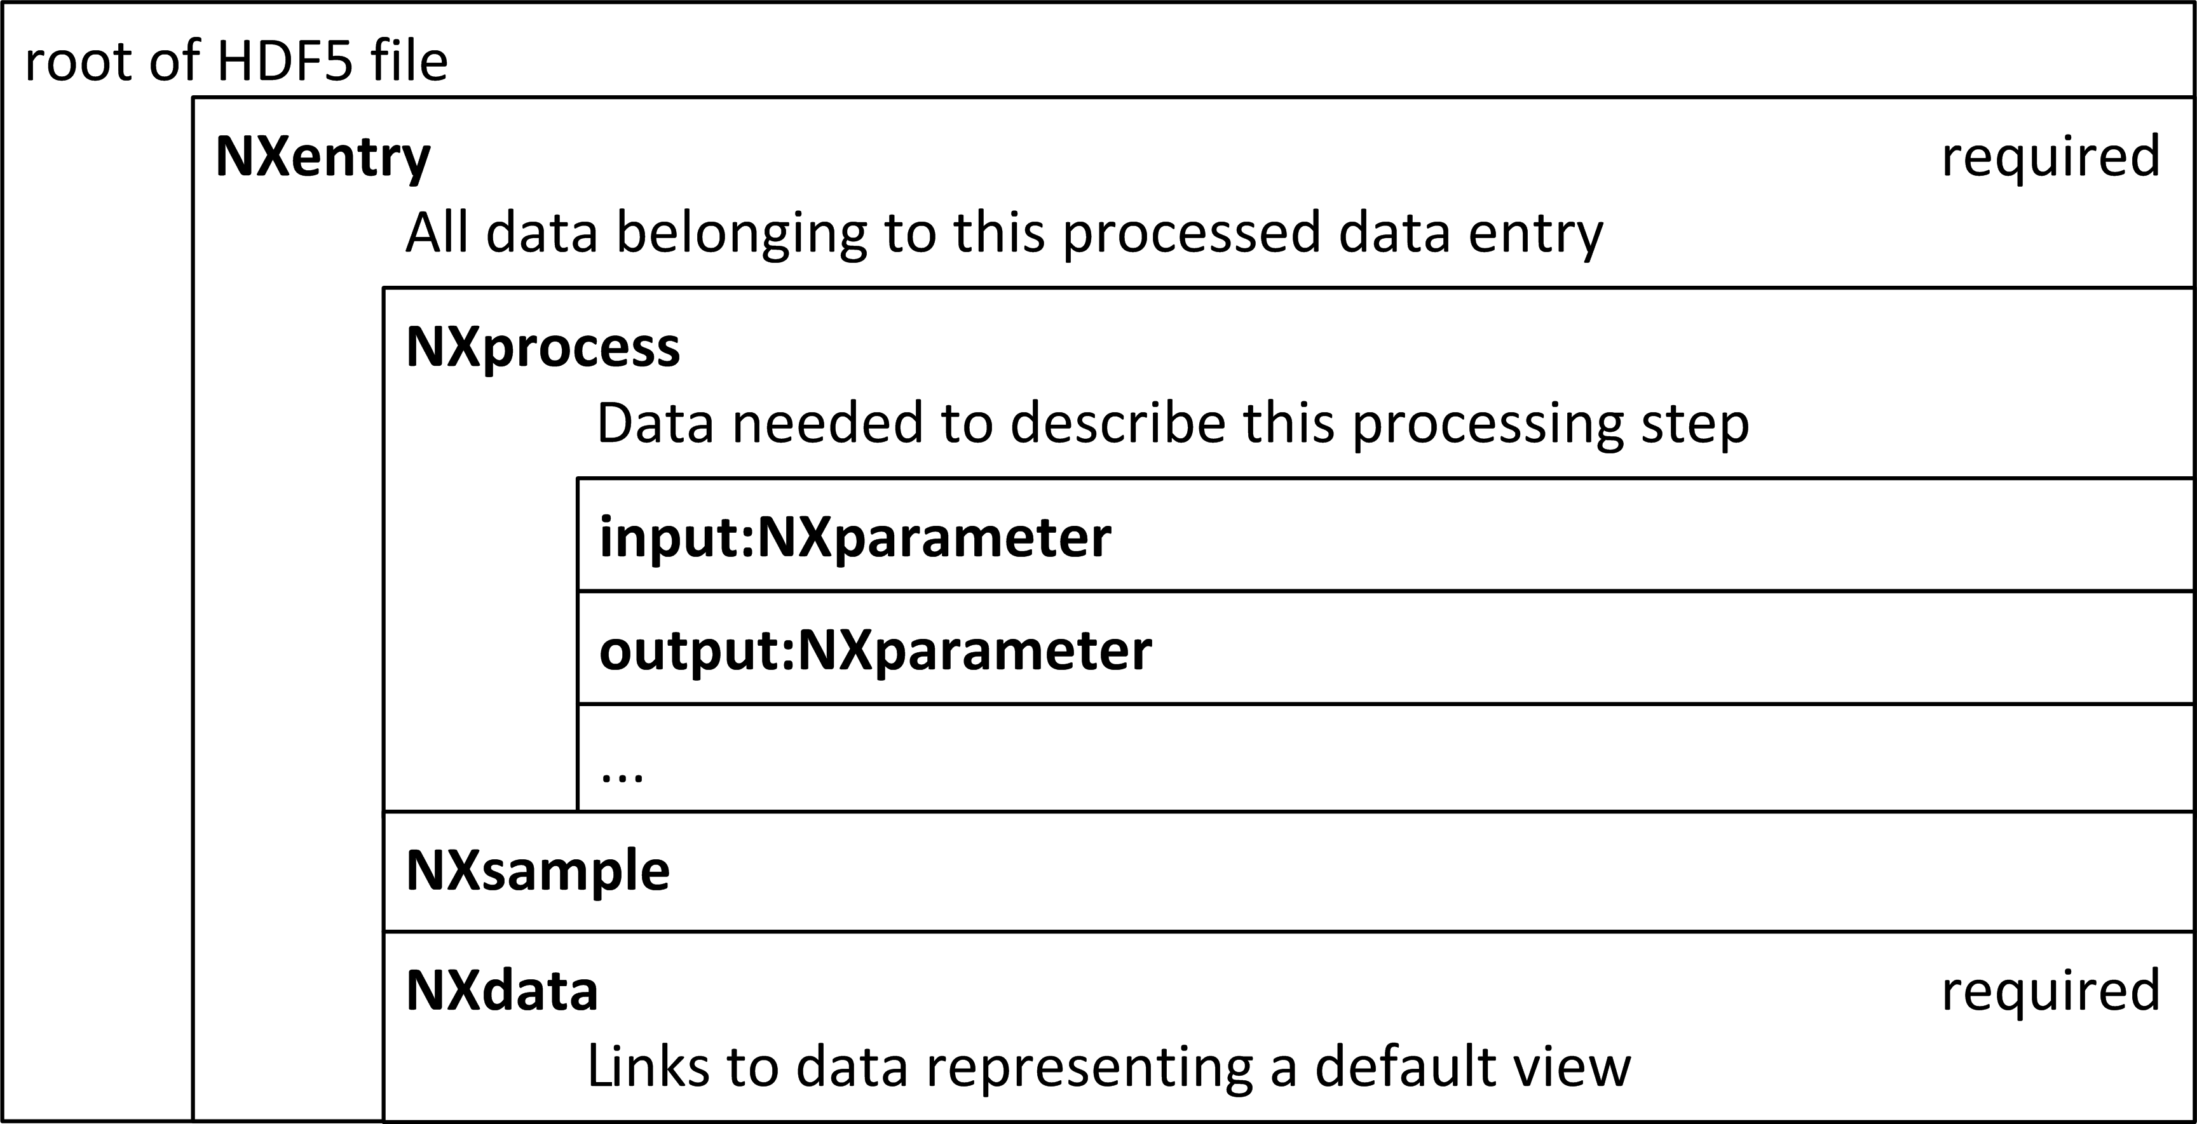
Structure of a NeXus processed data file

Slide 19
NeXus International Advisory Committee
http://www.nexusformat.org/NIAC.html
Terms of Reference
The purpose of the NeXus International Advisory Committee is to supervise the development and maintenance of the NeXus common data format for neutron, x-ray, and muon science.
How to contact the NIAC
Send an email to: nexus-committee@nexusformat.org
Membership
NIAC seeks a balanced representation of the international community. It will consist of at most one voting representative from each major neutron, synchrotron x-ray, and muon facility.
The NIAC invites PSL-II to become a member.

Slide 20
Communications
Mailing lists
See: http://download.nexusformat.org/doc/html/mailinglist.html
Bi-weekly teleconferences
Discuss timely issues: http://www.nexusformat.org/Teleconferences.html
Next one: Tuesday, 12 September, 16:30 CEST (+0200)
NeXus Code Camp
Approximately yearly, next one October 24-26, 2017, Diamond Light Source, UK
NIAC Meeting
Every two years, next one 2018, location not decided yet

Slide 21
Who uses NeXus?
this is a partial list
EPICS Area Detector HDF5 Plugin
Facilities that use NeXus as a primary data format (2015 report):
  Soleil, Diamond, SINQ, SNS, Lujan/LANL, and KEK
Facilities that include NeXus as part of their file suite (2015 report):
  APS, DESY, ISIS, LBNL, and the μSR community

Slide 22
Thank you for your attention.

Slide 23
Slide

Slide 24
Slide

Slide 25
Slide

Slide 26
Slide

