Slide 1


Common Data Model Access
Nick Hauser & Stephane Poirier
ICALEPCS 2011
Grenoble, France
October 9-15

Slide 2
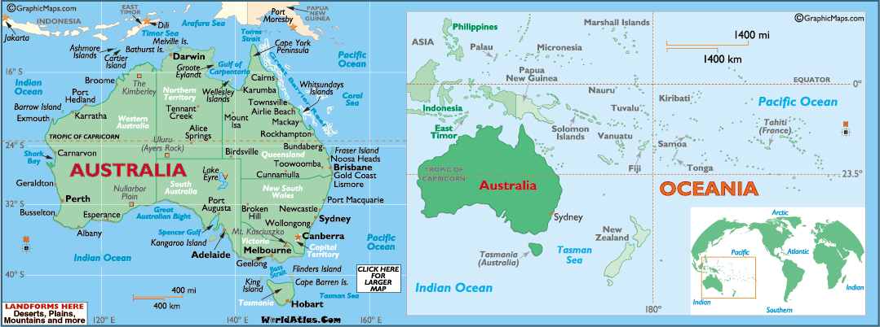
Where is ANSTO?
Approx 16,500km from here

Slide 3
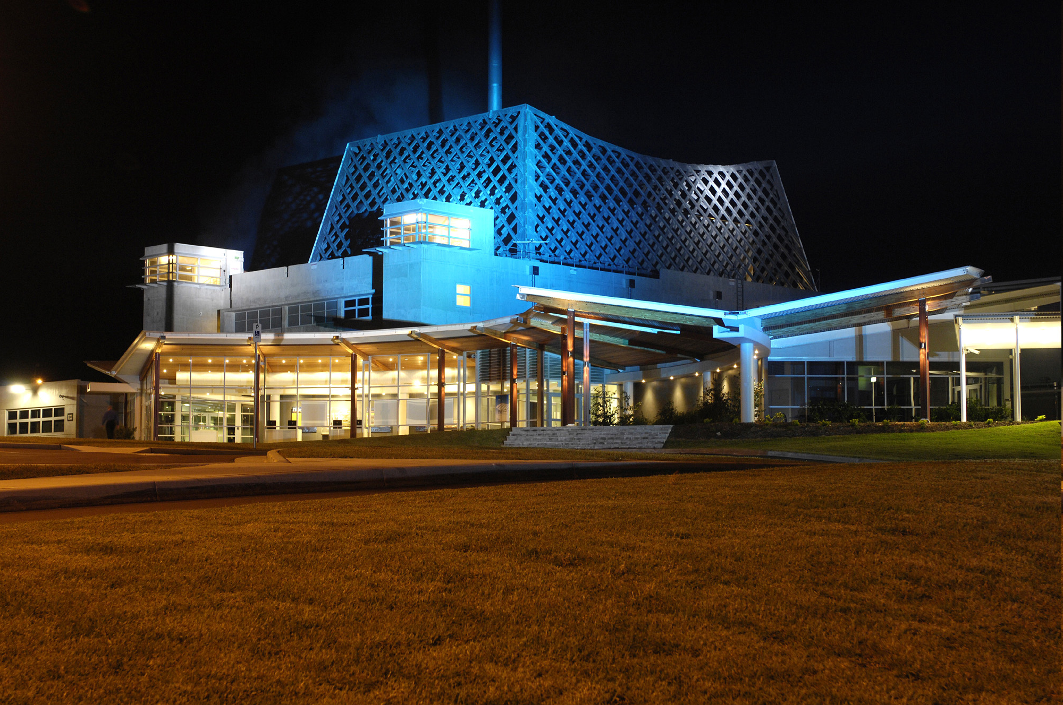
What is ANSTO?
Australian Nuclear Science & Technology

Slide 4

There is nothing more important than data structures
I will, in fact, claim that the difference between a bad programmer and a good one is whether he considers his code or his data structures more important. Bad programmers worry about the code. Good programmers worry about data structures and their relationships.
Torvalds, Linus (2006-06-27). Message to Git mailing list.

Slide 5



ICALEPCS 2011
Collaborate, discover, enjoy.
France and Australia collaborate in a common data model. Across 9 time zones, and 16,968km
Maybe they will collaborate in the Rugby World Cup final?
Collaboration and competition. Clearly both are important. We need a gene pool.

Slide 6

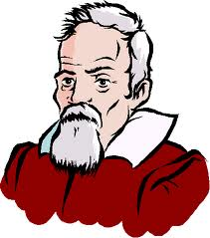
Genesis. In the beginning…
Give me a way to read my experimental data into any analysis package!
Not a new idea
just an implementation of an old one. Yawn. Can you wake me up when this talk is over?

Slide 7

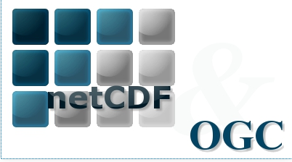
Climate scientists have been doing this for years.
We borrowed their ideas... in particular, the interfaces, and extended them into our domain.

Slide 8


The fable of the two developers
Once upon a time, there were 2 developers...
Data plug-in developer
Data reduction developer

Slide 9
Give me an API to read my institute’s data into an object-oriented data object
Data plug-in developer

Slide 10

Give me a way to write my code once for many instruments and institutes
Data reduction developer

Slide 11
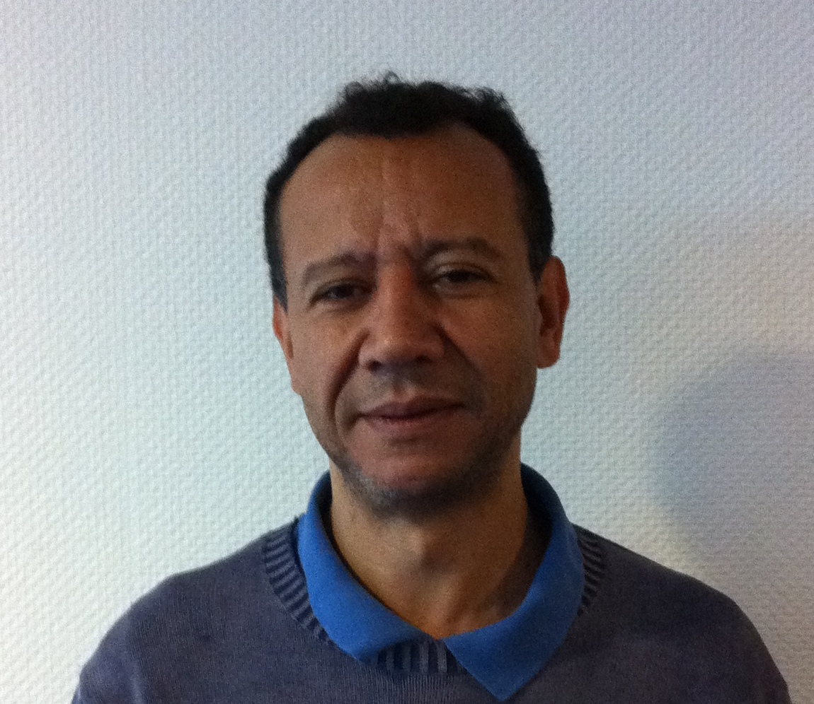
ICALEPCS 2009.
The collaboration begins
Tony Lam, ANSTO meets…
Majïd Ounsy, Soleil

Slide 12
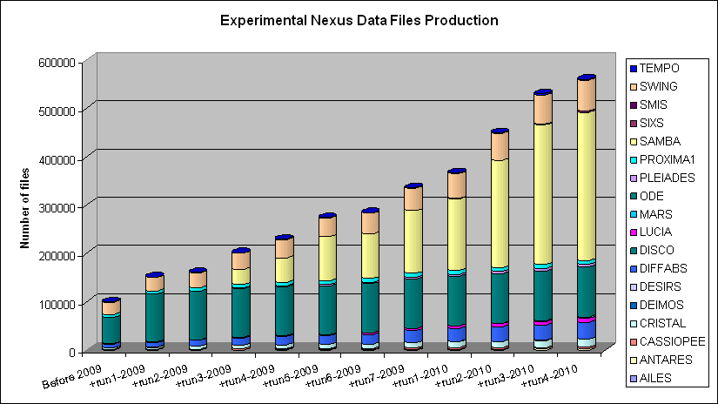

The SOLEIL experience
NeXus/HDF5 data format is the “SOLEIL standard” on all our beamlines since the beginning
We defined a standard internal data file structure for experimental data storage
On acquisition side
all works fine !

Slide 13
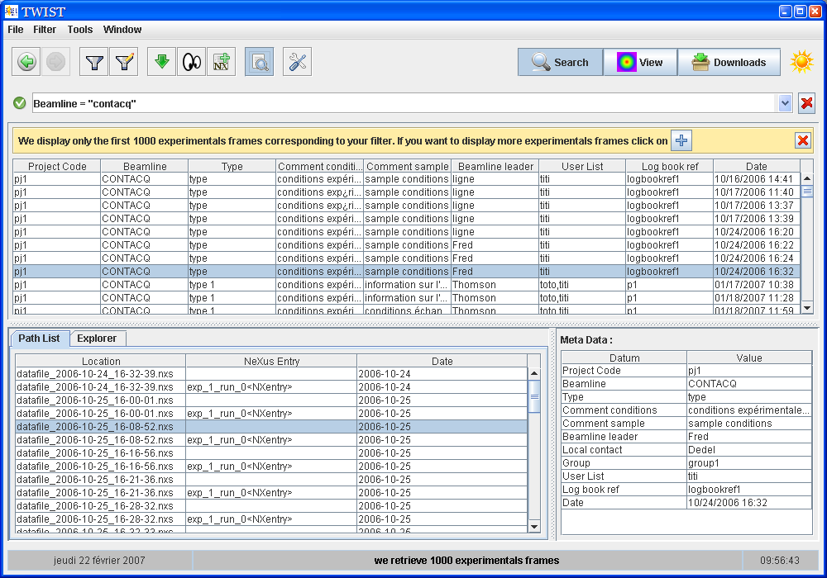
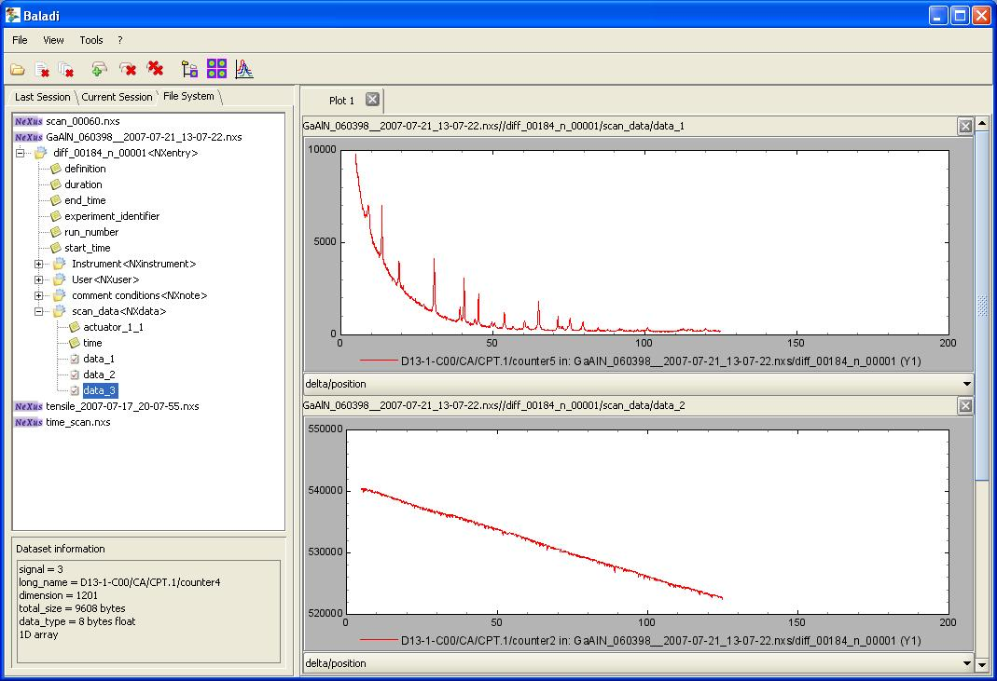
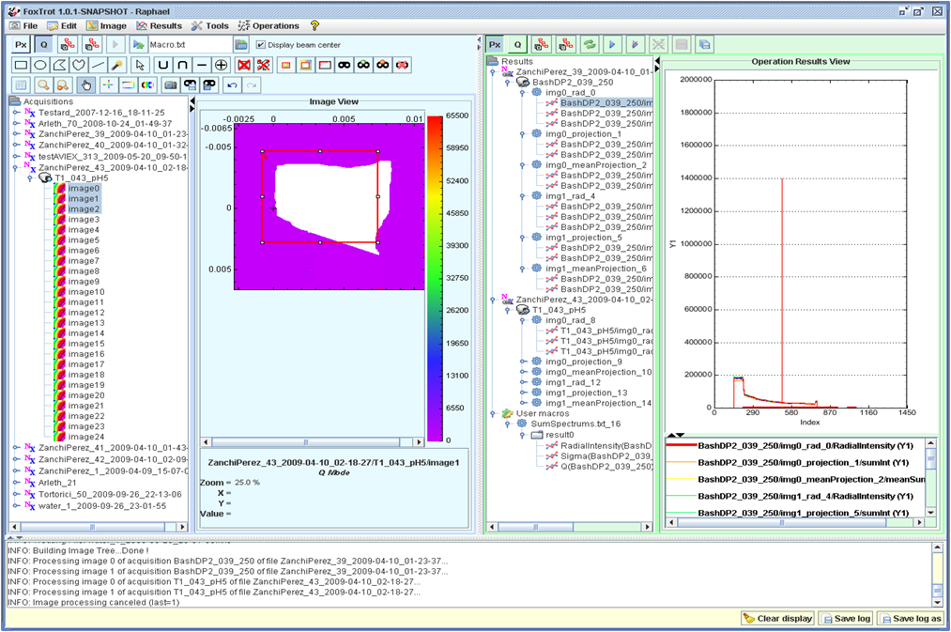

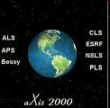
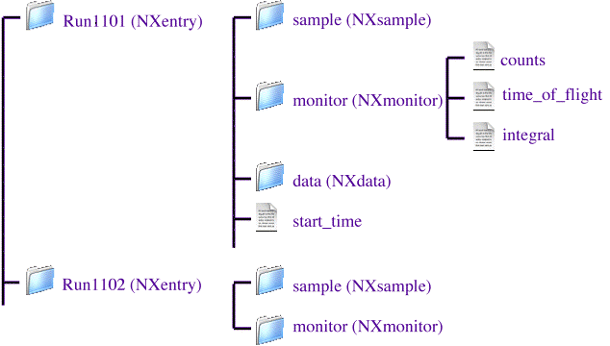

How to exchange data?
File retrieval
File browsing
SAXS Data Analysis
foxtrot Application
Data Analysis
Application B
Data Analysis
Application C
NeXus Application Interface
SOLEIL NeXus Files
ESRF Files
DESY Files
<numéro>

Slide 14

How to process data?
In reality we were blocked even before exchanging data with other institutes!!
SAXS Data Analysis
foxtrot Application
On SWING beamline, data organisation had been fixed by a « SAXS oriented » data acquisition sequence
On CRISTAL beamline, data organisation inside the NeXus file had been fixed by a «Powder diffraction oriented » data acquisition sequence
NeXus Application Interface
Soleil NeXus file created on CRISTAL
Soleil NeXus file created on SWING

Slide 15
What is the CDMA?
A plug-in system that allows support of various data sources
An abstract interface for navigation through data sets
Concrete classes are provided by data source plug-ins
A dictionary mechanism to retrieve measurements and technical values independently of the data structures
A manipulation class for array slicing and dicing
An utility class for array mathematics operations with error propagation calculation

Slide 16
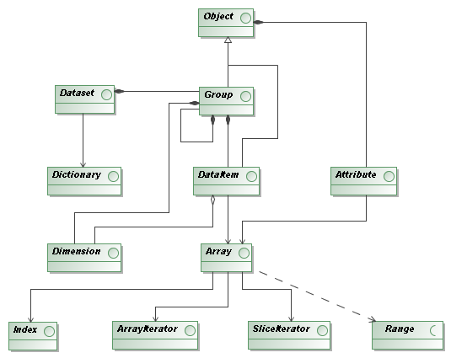
The model - simple
One data model
2 API’s
Reduction developer
Plug-in developer
Separation of concern
Life is easy

Slide 17
Plug-in system
A CDMA plug-in is a piece of code that adds the support of a specific data file format (e.g. NeXus, netCDF, Spec,...)
Plug-ins are loaded at run-time
A client application can load simultanously two (or more) files that required different plug-ins
Available plug-ins : HDF5 (support of netCDF & NeXus), EDF (ESRF Data Format, partially)

Slide 18
Dictionary mechanism
The main point of CDMA is to allow a data analysis application that does not care about file format.
We think it's not sufficient. Applications developers don't have to care about data structures.
To achieve this the CDMA API introduce the notion of dictionary
A dictionary is
  A list of keywords (organized or not in separate groups, it doesn't matter)
  A set of association between keywords and data items in a specific data structure (NeXuS, NetCDF,...)

Slide 19
Dictionary mechanism
Dictionary documents are XML files
A dictionary is defined by the association of two documents:
  A first where some keywords are declared
    It can be a flat list of keywords
    It can be organized in a hierarchical way (a tree of keywords)
  A second where these keywords match scientific measurements paths in the data files
    It's a map where keywords are linked to data structure
Each institute that contribute to this project have to provide:
  A plug-in for its own data format
  One or several mapping documents according a commonly accepted list of keywords

Slide 20
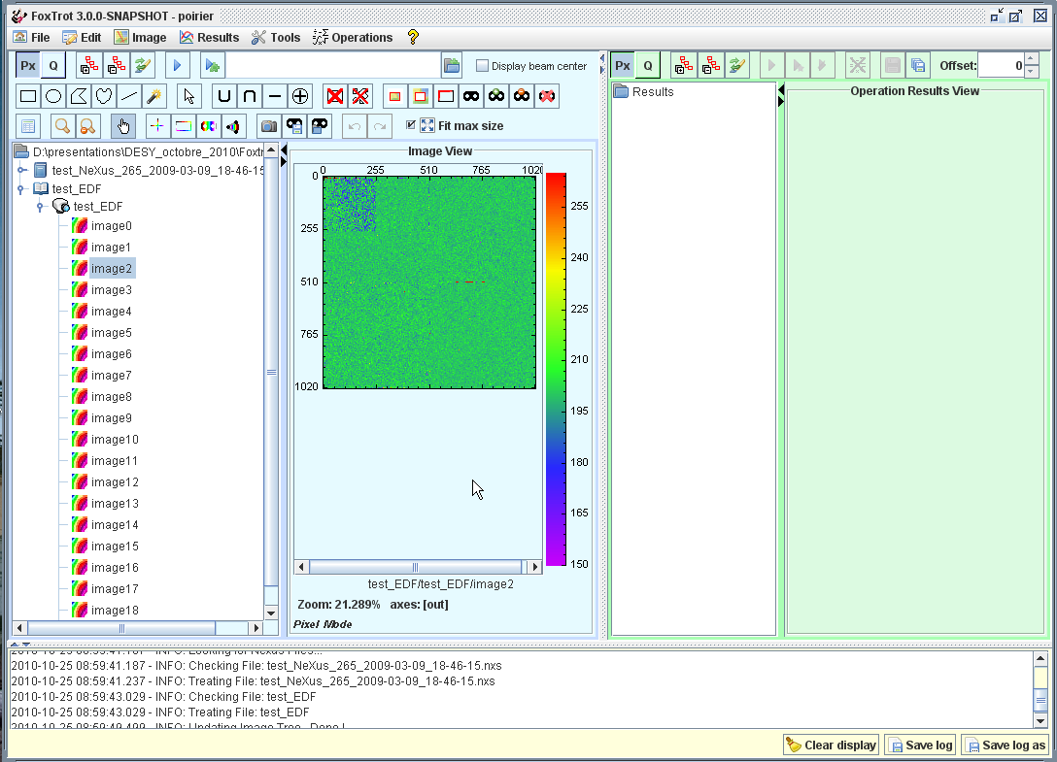

Dictionary mechanism
keywords
Declaration
file
<data-def name="Experiment type"> <!-- ex: EXAFS, SAXS,... -->
<item key="raw_data"/>
<item key="energy"/>
</data-def>
use
needs
CDMA
<map-def name="Experiment type"> <!-- ex: EXAFS, SAXS,... -->
<item key="raw_data">
<path>path/to/raw_data</path>
</item>
<item key="energy">
<path>path/to/wavelength</path>
<call>WavelenghToEnergy</call>
</item>
</map-def>
File format plugin
keywords
Mapping
file
use
0100110
1001110
0100110
11110...
Dataset

Slide 21
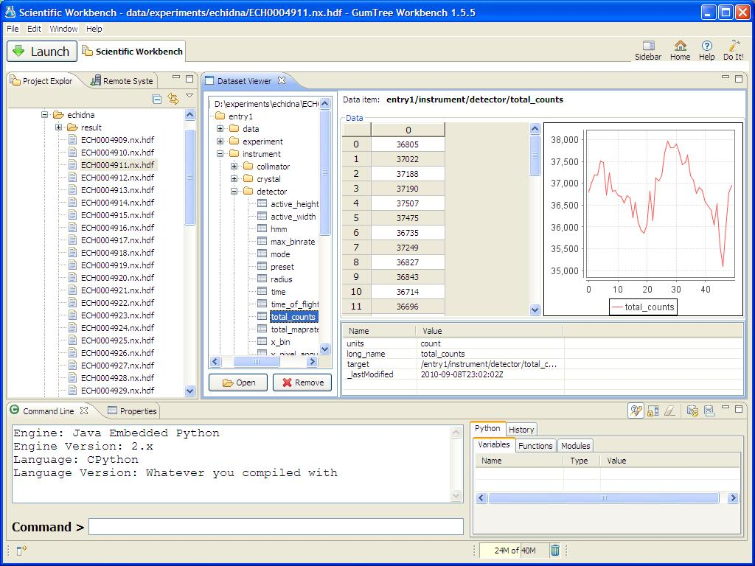
NeXus browse and visualisation

Slide 22
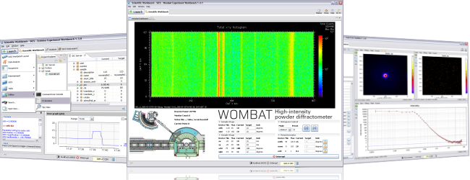
Common data model as an OSGI bundle in the scientific workbench, Gumtree. In production since 2006

Slide 23

ICALEPCS 2011
Collaborate, discover, enjoy.
Software collaboration benefits from “many eyes”.
True for CDMA.

Slide 24
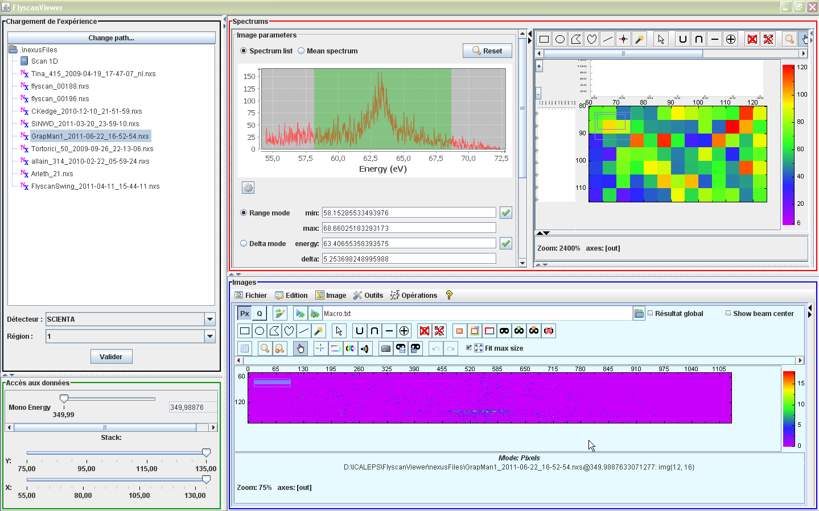
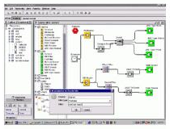




GumTree
Data reduction
Databrowser
Passerelle
?
CDMA
?
?
Control systems
Data storage

Slide 25
Conclusion
CDMA in production at SOLEIL and ANSTO
Sharing of data independent of data structure specification by NeXus or other standards body
C++ port development in progress
DESY will officially join the project giving resources
Python and Matlab port to follow the C++ implementation
Find us at “Common Data Model” Google Group

Slide 26
Common Data Model Access
Credits
ANSTO team - Paul Hathaway, Darren Kelly, Tony Lam, Norman Xiong
SOLEIL team - Stephane Poirier, Majid Ounsy, Clement Rodriguez, Alain Buteau

