Slide 1
The NeXus API and Utilities
Freddie Akeroyd
STFC ISIS Facility
for NeXus Workshop, PSI
10 – 12 May 2010

Slide 2
Introduction
Mark has covered NeXus rules
  How objects are arranged in a hierarchy
  Rules for storing objects
  Metadata e.g. units, axes
We will now cover
  How objects are written and stored in files
  Utilities for manipulating NeXus files

Slide 3
NeXus Files
NeXus hierarchy and objects are stored in files
However data sets vary in size (10kb – 1GB+)
So the same hierarchy can be represented differently in the low level (byte) file content
  Currently as ASCII XML or binary HDF4/HDF5
  Allows user choice of storage efficiency (binary) v text editor readability (ASCII)

Slide 4


Hierarchical Structure of a NeXus file
It looks similar to a file system
Run1101 (NXentry)
sample (NXsample)
counts
monitor (NXmonitor)
integral
data (NXdata)
start_time
Run1102 (NXentry)
sample (NXsample)
monitor (NXmonitor)

Slide 5
The NeXus API (NAPI)
Designed to make it easier to read and write NeXus files
Hides unnecessary features / complexity of underlying file system storage commands
A uniform interface to hide knowledge of the underlying low level storage format
Enforces certain elements of the standard
Core API in C, bindings in other languages

Slide 6
NeXus Objects
There are only three types of NeXus object
Data
  scalar or multidimensional arrays
  integer (1, 2, 4, or 8 bytes), real (single or double), or character
Groups
  folders containing sets of data items and/or other groups
  A group is an instance of a “NeXus classes”
  Have both a name and a class (type)
  All Official NeXus classes have the NX prefix
  Items within a group are referred to as “entries” by the API
Attributes
  meta-data attached to a data item e.g. Units, axes labels

Slide 7
What the API does underneath
Maps objects into their low-level representation equivalents
  e.g. In HDF4 NeXus Data -> SDS (Scientific Data Set), NeXus Group -> Vgroup
Adds additional bookkeeping information
  e.g. NeXus class identifier for HDF5 (in XML/HDF4 it is part of the representation)
  Additional linking metadata (to make tracing links easier)

Slide 8
API Overview
Written in C, but with additional language bindings (C++,JAVA,PYTHON,IDL,...)
open, close, get, put style interface
  like walking a file system tree
Includes “get next” attribute / entry calls
Also enquire array dimensions

Slide 9
NeXus C API
This API and bindings are documented at http://download.nexusformat.org/
All functions defined in file “napi.h”
Also contains typedefs, constants, defines etc.

Slide 10
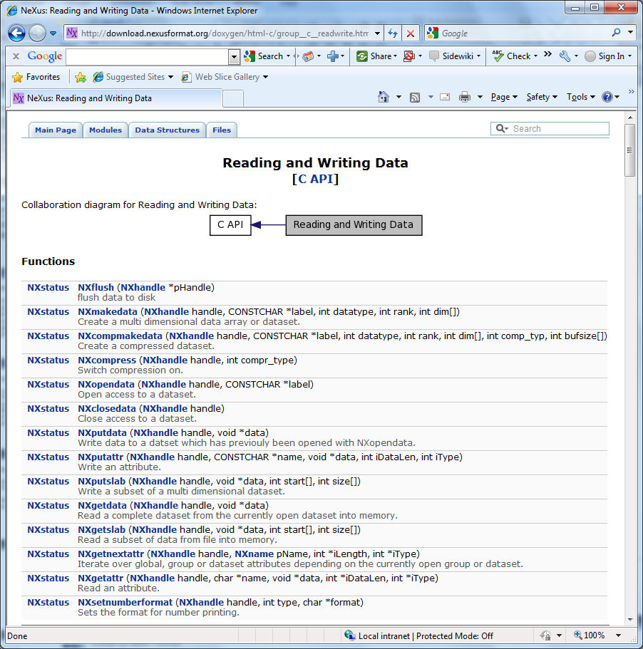
C API Doxygen Documentation http://download.nexusformat.org/doxygen/html-c/

Slide 11
NeXus C typedefs
NXhandle
  Opaque structure identifying a particular file
  Created by NXopen, passed to other routines, deleted by NXclose
NXaccess
  Enumeration of file access modes for NXopen
  read only, read/write, create hdf5, create xml, ...
NXstatus (NX_OK, NX_ERROR, NX_EOD)
NXlink (Information about data/group links)

Slide 12
NeXus Defines
Data type specifiers
  NX_INT32, NX_FLOAT32, ...
Other useful constants/parameters
  NX_MAXRANK – maximum array rank
  NX_UNLIMITED – appendable array dimension

Slide 13
C API Function Groups
General Initialisation and shutdown
Reading and writing groups
Reading and writing data
Meta data routines
Linking
Memory allocation
External linking

Slide 14
Open and Close file (C API)
NXhandle fileid;
If (NXopen(“file.nxs”, NXACC_CREATE5, &fileid) != NX_OK) { error }
If (NXclose(&fileid) != NX_OK) { error }
If opening existing file, uses NX_LOAD_PATH environment variable.
“fileid” is passed to all other API functions

Slide 15
NeXus C++ API
As most people here have O-O experience, the C++ API will be used for remaining examples
  NXhandle encapsulated in NeXus::File class
  C API functionality exposed as member functions
A few difference / extensions from C API
  throws exceptions on NX_ERROR conditions
  supports std::vector<type> and std::string
  can obtain a container of entry/attribute details rather than needing to iterate via “get next”

Slide 16
Open and Close file (C++ API)
// can use nf.open() instead of constructor
try{
NeXus::File nf(“test.nxs”,NXACC_CREATE5);
...
// file closed by destructor or nf.close()
}
If opening an existing file, uses NX_LOAD_PATH environment variable for path searching.

Slide 17
C++ Example
std::vector<int> counts;
try{
NeXus::File nf(“test.nxs”,NXACC_CREATE);
nf.makeGroup(“entry1”, “NXentry”, true);
nf.writeData(“counts”, counts);
}

Slide 18
Create a group (C++ API)
NeXus::File nf(“test.nxs”,NXACC_CREATE5);
nf.makeGroup(“entry1”, ”NXentry”); // just create
nf.openGroup(“entry1”, ”NXentry”); // move inside
// To create and enter a group in one call use
nf.makeGroup(“sample”, ”NXsample”, true);
// now leave the groups
nf.closeGroup(); // leave sample
nf.closeGroup(); // leave entry1

Slide 19
Create a data item (C++ API)
NeXus::File nf(“test.nxs”, NXACC_CREATE5);
std::vector<int> dims;
dims.push_back(100); dims.push_back(100);
int counts_array[100][100];
nf.makeData( “counts”, NX_INT32, dims, true);
nf.putData(counts_array);
nf.putAttr( “axes”, “[px,py]”); // attribute of “counts”
nf.closeData(); // leave “counts”
std::vector<int> px; // fill px with numbers
nf.writeData(“px”, px); // make,open,put,close

Slide 20
Read a data item (C++ API)
NeXus::File nf(“test.nxs”, NXACC_READ);
// call openGroup() and openData()
std::vector<int> px;
nf.getData(px);
// alternative approach
int* counts;
NeXus::Info info = nf.getInfo(); // type and dims
nf.malloc(counts, info);
nf.getData(counts);
nf.free(counts);

Slide 21
Data slabs (C++ API)
Can read or write a portion of a larger dataset using getSlab() and putSlab()
std::vector<int> start, size;
// set start to {5, 5} and size to {10, 10 }
int counts_slice[10][10];
nf.getSlab(counts_slice, start, size);

Slide 22
Appending to arrays
Can define an array that “grows”
Specify NX_UNLIMITED as the slowest varying dimension
Call putSlab() to write each section

Slide 23
Compressing data
Use compMakeData rather than makeData
Specify a compression type (e.g. NX_COMP_LZW)
Specify the dimensions of a “compression chunk”
  A chunk must be read or written in one go by the underlying software
  Trade off final data size V read/write speed
Use setCache to improve HDF5 performance
  At the cost of more program memory
Reading compressed data is identical syntax to reading uncompressed data

Slide 24
Enhanced File Navigation
Go straight to an object and open
  openPath( “/path/to/item”)
Open the group containing an object
  openGroupPath( “/path/to/item”)
Open source group of linked dataset
  openSourceGroup()

Slide 25
Linking items
Items in a file can be linked
They appear at multiple place is the hierarchy, but take no additional space
  Like symbolic links in a filesystem
Target item may have a different name
Use openSourceGroup to open the parent group of the link target
  E.g. If you linked two_theta from NXdetector into NXdata, this would open NXdetector group for you

Slide 26
Data Linking
NXinstrument
NXsource
solid_angle[100]
NXdetector
gas_pressure[100]
two_theta[100]
NXmonochromator
counts[100]
NXdata
two_theta[100]

Slide 27
Link example
NeXus::File nf
NXlink dlink;
// open dataset
nf. getDataID(&dlink);
// navigate to another location
nf. makeNamedLink(“newname”, &dlink);
Similarly use NXgetgroupID for linking groups

Slide 28
External Linking
Can create a group linked to an external URL
  Only a local file is currently supported
  nxfile://filename/path/to/group
  Also uses NX_LOAD_PATH to find “filename”
Use linkExternal() to create group
Use isExternalGroup() if you wish to test if a group is external
openGroup() works as normal

Slide 29
Iterating Through Groups (C++ API)
using namespace std;
NeXus::File nf;
typedef map<string, string> smap_t;
smap_t entries;
// navigate to somewhere
entries = nf.getEntries();
for(smat_t::const_iterator it=entries.begin(); it != entries.end(); ++it) {
cout << “Name “ << it->first <<
“ class “ << it->second << endl;
}

Slide 30
Iterating through groups (C API)
Call NXinitgroupdir to reset search list
Call NXgetnextentry to return name, class and datatype of each item
  returns NX_EOD when no more items
If it is a group, “name” and “class” are set
If it is a data rather than group item, “class” is “SDS” and datatype is set

Slide 31
Iterating attributes (C++ API)
using namespace std;
NeXus::File nf;
vector<NeXus::AttrInfo> attrinfo;
// navigate to an item
attrinfo = getAttrInfos ();
for(int i=0; i<attrinfo.size(); ++i) {
NeXus::AttrInfo& info = attrinfo[i];
cout << “Name “ << info.name << endl;
// info.type is Nxnumtype enumeration
// use nf.getAttr() to read value
}

Slide 32
Iterating attributes (C API)
Call NXinitattrdir to reset search list
Call NXgetnextattr to return name, size and datatype of each item
  returns NX_EOD when no more items
Call NXgetattr to read attribute contents

Slide 33
High Level API
NXU routines
  Utility routines for finding axes and combining make/open/close functionality
  Originally developed in F90 (todo: port to C) yet
NXdict
  Dictionary access API
  Define file structure and item alias in configuration file
  Write data items via dictionary API calls

Slide 34
C++ Streams API
Alternative IOStream like C++ interface
“nf << item” to write; “nf >> item” to read/navigate
Best shown by example

Slide 35
C++ Streams API Write Example
// create entry and data item in new file
std::vector<double> w;
NeXus::File nf(“test.nxs”,NXACC_CREATE5);
nf << Group(“entry1”, “Nxentry”)
<< Data(“dat1”,w, ”int_attr”, 3);
nf.close();
// add additional item
NeXus::File nf1(“test.nxs”,NXACC_RDWR);
nf1 >> Group(“entry1”, “Nxentry”)
>> Data(“dat1”) << Attr(“double_attr”, 6.0)
nf1.close();

Slide 36
C++ Streams API Read Example
double d; int i; std::vector<double> w1;
NeXus::File nf(“test.nxs”,NXACC_READ);
nf >> Group(“entry1”, “NXentry”)
>> Data(“dat1”, w1, “int_attr”, i, “double_attr”, d);

Slide 37
JAVA API
Uses files jnexus.jar and libjnexus.so (jnexus.dll on windows)
The org.nexusformat namespace defines a NeXusFile object with usual API methods
Throws NeXusException on error
When writing strings (NX_CHAR) need to pass the bytes via String.getBytes()
Call NeXusFile.finalise() to explicitly close file

Slide 38
JAVA API (cont)
JAVA API has additional functions:
  groupdir() returns contents of group as HashTable
    (key = name, value = class)
  attrdir() returns attribute details as HashTable
    (key = name, value = AttributeEntry object containing type and length)

Slide 39
JAVA Example
import org.nexusfromat.*;
int iData1[][] = new int[3][10];
int iDim[] = new int[2];
NeXusFile nf = new NeXusFile(“test.txs”, NeXusFile.NXACC_CREATE5);
nf.makegroup(“entry1”,”Nxentry”);
nf.opengroup(“entry1”,”Nxentry”);
iDim[0] = 3; iDim[1] = 10;
nf.makedata(“data1”,NeXusFile.NX_INT32,2,iDim);
nf.opendata(“data1”);
nf.putdata(iData1);

Slide 40
Python API
Thin binding to NeXus C API
nxs module open() returns NeXus file object
Can use strings rather than constants
  ‘r’ -> nxs.ACC_READ, ‘float32’ -> nxs.NX_FLOAT32
getdata() / putdata () use numpy array objects
NeXus class has C API functions plus extras:
  entries() returns dictionary of group contents
  attrs() returns dictionary of attributes

Slide 41
Python Example (write)
import nxs,numpy
nxfile = nxs.open(‘test.nxs’,’w5’) # nxs.ACC_CREATE5
nxfile.makegroup(“entry”,”NXentry”)
nxfile.opengroup(“entry”,”NXentry”)
# val is a numpy double array
nxfile.makedata(“r8_data”,val.dtype,val.shape)
nxfile.opendata(“r8_data”)
nxfile.putdata(val)
nxfile.closedata()

Slide 42
Python Example (read)
import nxs,numpy
nxfile = nxs.open(‘test.nxs’,’r’)
nxfile.openpath(‘/entry/r8_data’)
val = nxfile.getdata()
nxfile.close()
For online documentation type:
help(nxs.napi)
Or visit http://download.nexusformat.org/

Slide 43
Building a C/C++ Program (linux)
  Can be as simple as
  gcc –o test test.c –lNeXus
But probably need to add appropriate –I and –L
Alternatively use the supplied nexus-config command (similar to pkg-config)
gcc `nexus-config –libs –cflags` -o test test.c

Slide 44
Building a C/C++ Program (windows)
Install NeXus via windows installer kit
  Usually to C:\Progam files\NeXus Data Format
  Kit includes HDF DLLs etc.
  Creates a NEXUSDIR environment variable
  Also updates LIB, PATH and INCLUDE
Link against the libNeXus.dll.lib import library in $(NEXUSDIR)\lib
libNeXus-0.dll used at runtime

Slide 45
NeXus tools
nxbrowse - CLI NeXus browser
nxsummary - create summary of nexus file
nxdiff - compare two files
nxconvert – change the low-level representation of a NeXus file (e.g. HDF5 -> XML, HDF4 -> HDF5)
nxtranslate - assembles NeXus file from other files (NeXus importer)
nxextract - convert from NeXus to ASCII and binary (NeXus exporter)
nxvalidate - validates file against definition
nxplot – generic plotter for NeXus files

Slide 46
NXbrowse
Simple command line browser with readline support
  CD, DIR, and DUMP commands
  Pressing <TAB> after typing a command or partial item name lists/completes that name
  Try in “hands on” session

Slide 47
NXsummary
Creates a quick summary of a NeXus file
Items to be printed specified in a configuration file
Optional XML output
Supports simple transforms of items
  e.g. count, sum

Slide 48
NXdiff
Python program to compares two NeXus files
  Example of using the NeXus python API
  Type nxdiff –help for options

Slide 49
NXconvert
Changes the low level representation of a NeXus file
  e.g. HDF5 -> XML, HDF4 -> HDF5
  Type nxconvert –help for options

Slide 50
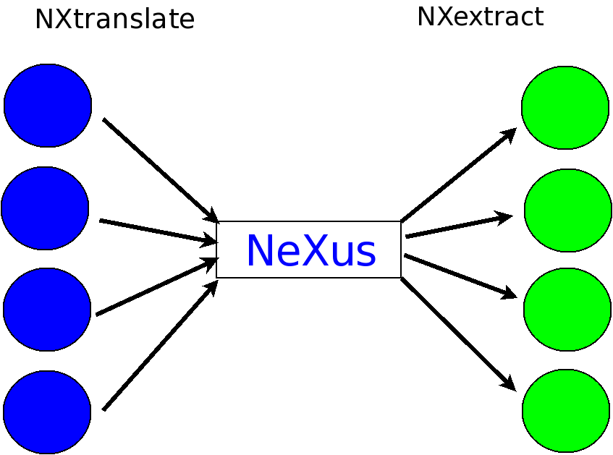

Slide 51
NXtranslate
Anything to NeXus converter (importer)
Placeholder for items specified in XML file
Calls plugins to read and insert the appropriate data files into the output
  Can handle FRM2, IPNS, SPEC, ESRF EDF, XML, binary floats/ints, ASCII column text and other NeXus files
  Easily extended by writing your own plugin

Slide 52
Format of a translation file
The file is similar to a NeXus XML data file, but with some additional attributes to insert data from plugins
  NXS:mime_type specifies the plugin to use
  NXS:source specifes a string to pass to the plugin to initialise it
  NXS:location specifies a string to pass to the plugin to return data
Manual at http://download.nexusformat.org/

Slide 53
Example translation file
<!– simple example to insert a title from one NeXus file into another →
<NXroot>
<entry1 type=“NXentry” NXS:source=“other_file.nxs” NXS:mime_type=“application/x-NeXus”>
<value1 my_attr=“test”>this is a test</ value1>
<value2 NXS:location=“/entry3/title” />
</entry1>
</Nxroot>

Slide 54
NXextract
Exports portions of a NeXus file as binary or ASCII
Process controlled by configuration file
Built-in syntax for looping through elements
Contributed by Stephane Poirier, SOLEIL

Slide 55
Hands on Session
Various examples installed on Linux server
See details on the following document
<to finish>

Slide 56

Additional /Old Slides follow

Slide 57
Create a group (C API)
NXhandle fileid; /* NXopen previously called */
/* error checking for NX_OK skipped */
NXmakegroup(fileid, “entry1”, “NXentry”);
NXopengroup(fileid, “entry1”, “NXentry”);
/* do something with group */
NXclosegroup(fileid);

Slide 58
Create a data item (C API)
NXhandle fileid; /* NXopen already called */
/* group created or opened from before */
int rank= 2; int dims[] = { 100, 100 };
int counts_array[100][100];
NXmakedata(fileid, “counts”, NX_INT32, rank, dims);
NXopendata(fileid, “counts”);
NXputdata(fileid, counts_array);
NXputattr(fileid, “axes”, “[px,py]”, 7, NX_CHAR);
NXclosedata(fileid);

Slide 59
Read a data item (C API)
NXhandle fileid; /* NXopen already called */
/* NXopendata already called */
int datatype, rank, dims[NX_MAXDIMS], *counts;
NXgetinfo(fileid, &rank, dims, &datatype);
NXmalloc(&counts, rank, dims, datatype);
NXgetdata(fileid, counts);
/* do something with counts */
NXfree(&counts);

Slide 60
Example NeXus program in C
#include "napi.h"
int main()
{
int counts[1000][50], n_t, n_p, dims[2], i;
float t[1000], phi[50];
NXhandle file_id;
/* Read in data using local routines */
getdata (n_t, t, n_p, phi, counts);
/* Open output file and output global attributes */
NXopen ("OUTPUT.HDF", NXACC_CREATE, &file_id);
NXputattr (file_id, "user_name", "Joe Bloggs", 10, NX_CHAR);
NXopengroup (file_id, "Entry1", "NXentry");
NXopengroup (file_id, "Data1", "NXdata");
/* Output time channels */
NXputdata (file_id, "time_of_flight", NX_FLOAT32, 1, n_t, t, “microseconds”);
/* Output detector angles */
NXputdata (file_id, "phi", NX_FLOAT32, 1, n_p, phi, “degrees”);
/* Output data */
dims[0] = n_t;
dims[1] = n_p;
NXputdata (file_id, "counts", NX_INT32, 1, dims, counts, “counts”);
NXclosegroup (file_id);
NXclose (file_id);
return;
}

