Slide 1
FORCE & MOTION
CLASS 7 SCIENCE
The science behind every move.
Think • Predict • Explore • Explain
INTERACTIVE-STYLE LESSON PRESENTATION

Slide 2
Quick challenge: what is moving?
No definitions yet. Make a prediction first.
A. A cyclist
B. A school bag
C. A ball
Moves 100 metres in 20 seconds.
Has a mass of 4 kg.
Changes direction after a kick.
Which situation describes motion? Which describes mass? Which shows a force changing motion?
02

Slide 3
Today's mission
By the end, you should be able to explain and compare…
SCALAR & VECTOR
MASS & WEIGHT
DISTANCE & DISPLACEMENT
Magnitude only vs magnitude + direction
Amount of matter vs gravitational force
Total path vs straight-line change in position
SPEED & VELOCITY
ACCELERATION
How fast vs how fast in a direction
How velocity changes over time
03

Slide 4
Force can change motion
A force is a push or pull.
START
APPLY FORCE
RESULT
A ball is at rest.
A player kicks it.
The ball starts moving or changes direction.
Forces can start, stop, speed up, slow down or change the direction of an object.
04

Slide 5
Scalar vs vector quantities
A vector needs a direction as well as a size.
SCALAR
VECTOR
Magnitude only
Examples: mass, time, distance, speed, temperature
Magnitude + direction
Examples: displacement, velocity, acceleration, force
Quick test: “5 m/s” is speed. “5 m/s east” is velocity.
05

Slide 6
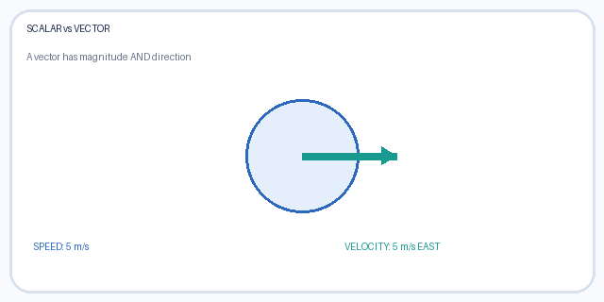
Watch the arrow: direction matters
The size can stay the same while the direction changes.
SCALAR: 5 m/s
VECTOR: 5 m/s EAST
If the arrow turns, has the vector changed? Explain why.

Slide 7
Mass vs weight
Related, but they are not the same quantity.
MASS
WEIGHT
• Amount of matter in an object
• Measured in kilograms (kg)
• Stays the same when location changes
• Gravitational force on an object
• Measured in newtons (N)
• Changes when gravity changes
Weight = mass × gravitational field strength W = mg
Example on Earth: a 2 kg object weighs about 19.6 N if g = 9.8 N/kg.
07

Slide 8
Think like a scientist
Imagine taking the same object from Earth to the Moon.
MASS
WEIGHT
WHY?
Does it change?
Does it change?
Gravity is different.
Turn and talk: explain your answer using the words “matter” and “gravity.”
08

Slide 9
Distance vs displacement
One measures the path; the other measures the change in position.
DISTANCE
DISPLACEMENT
Total length of the route travelled.
Scalar • no direction needed
Straight-line change from start to finish, with direction.
Vector • direction matters
Walk 3 m east, then 3 m west: distance = 6 m; displacement = 0 m.
09

Slide 10
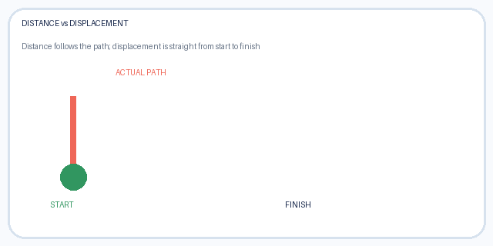
Follow the path
The route can be longer than the straight-line change in position.
DISTANCE = TOTAL PATH
DISPLACEMENT = START TO FINISH
If you return to your starting point, what is your displacement?

Slide 11
Speed vs velocity
Both describe motion, but velocity includes direction.
SPEED
VELOCITY
Speed = distance ÷ time
Example: 4 m/s
Average velocity = displacement ÷ time
Example: 4 m/s north
A runner can have a high speed but zero displacement after one complete lap.
10

Slide 12
Let's calculate!
A student travels 60 m in 12 s.
GIVEN
FORMULA
ANSWER
Distance = 60 m
Time = 12 s
Speed = distance ÷ time
60 ÷ 12 = 5 m/s
Now change the question: if the displacement is 60 m east, what is the average velocity?
11

Slide 13
Acceleration: change in velocity
Acceleration can mean speeding up, slowing down or changing direction.
SPEEDING UP
SLOWING DOWN
TURNING
Velocity increases.
Velocity decreases in the direction of motion.
Direction changes, so velocity changes.
Average acceleration = change in velocity ÷ time taken
12

Slide 14
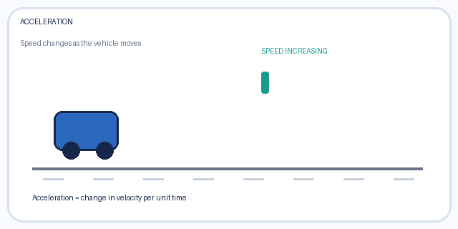
See acceleration
The speed indicator grows as the vehicle moves.
VEHICLE MOVES
SPEED INCREASES
What would the speed indicator do if the vehicle slowed down?

Slide 15
Acceleration calculation
A cyclist's velocity changes from 2 m/s to 8 m/s in 3 s.
INITIAL VELOCITY
FINAL VELOCITY
TIME
u = 2 m/s
v = 8 m/s
t = 3 s
a = (v − u) ÷ t = (8 − 2) ÷ 3 = 2 m/s²
The positive result means velocity increased in the chosen positive direction.
14

Slide 16
Motion graphs: what do they tell us?
A graph can show how motion changes with time.
DISTANCE–TIME
VELOCITY–TIME
FLAT VELOCITY LINE
Steeper line = greater speed.
Slope shows acceleration.
Velocity is constant; acceleration is zero.
Extension / include only if your class has studied graphs.
15

Slide 17
Science myth-busters
Discuss whether each statement is true or false.
• “Mass and weight are the same thing.”
• “A person can travel a distance and end with zero displacement.”
• “An object moving in a circle at constant speed has changing velocity.”
• “Acceleration always means speeding up.”
Explain your reasoning. Don't just say true or false!
16

Slide 18
Quick-fire quiz
Answer individually, then compare with a partner.
• 1. Is temperature scalar or vector?
• 2. What is the SI unit of weight?
• 3. A child walks 10 m north, then 10 m south. What is the displacement?
• 4. A car covers 100 m in 5 s. What is its average speed?
• 5. Velocity changes from 4 m/s to 10 m/s in 2 s. Find acceleration.
ANSWER CHECK
1. Scalar
2. Newton (N)
3. 0 m
4. 20 m/s
5. 3 m/s²
17

Slide 19
Exit ticket
Before you go, complete these three prompts.
I CAN EXPLAIN…
I CAN CALCULATE…
I STILL WONDER…
One pair of quantities that are often confused.
One formula from today's lesson.
One question about motion.
Teacher note: adjust formula depth and graph content to your exact Nepal Class 7 textbook.
18

Slide 20
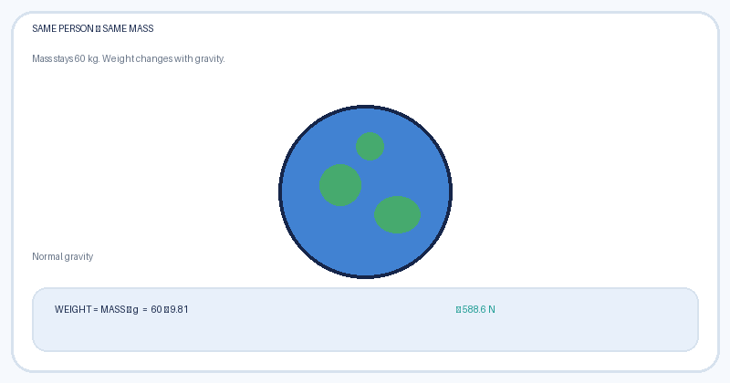
Same mass. Different worlds!
Imagine taking the same 60 kg person to Earth, the Moon and Jupiter.
🌍 EARTH
g ≈ 9.81 N/kg
Weight ≈ 589 N
🌙 MOON
g ≈ 1.62 N/kg
Weight ≈ 97 N
🪐 JUPITER
g ≈ 24.79 N/kg
Weight ≈ 1,487 N
Mass stays 60 kg everywhere. Weight changes because gravitational field strength changes.
Jupiter’s value is an approximate cloud-top gravity; Jupiter has no solid surface like Earth’s.

Slide 21
Your turn: calculate your weight
Use W = mg. Use g = 9.81 on Earth, 1.62 on the Moon and 24.79 on Jupiter.
STEP 1
STEP 2
STEP 3
Write your mass in kilograms.
Multiply mass by the planet’s g value.
Compare the three weights in newtons.
Example: mass = 40 kg
Earth: 40 × 9.81 ≈ 392 N
Moon: 40 × 1.62 ≈ 65 N
Jupiter: 40 × 24.79 ≈ 992 N
THINK ABOUT IT
If your weight changes, does your mass change too?

