Slide 1
Missing Data: PIMA INDIANS DIABETES DATSET DATASET
Presentation of homework no. 4
Tom Rupnik Medjedovič
Neža Kržan
Ljubljana, 10.1.2025

Slide 2

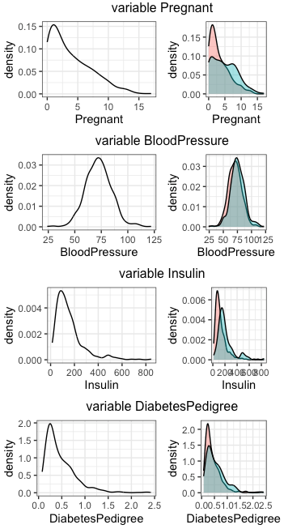
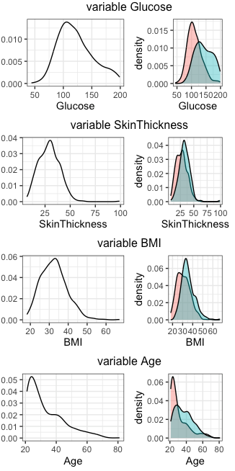

Health Data of Women from the
Pima Indian Tribe
Age: 21-30 31-40 41-50 51-60 61-70 71-81
54% 20% 15% 7% 3% 1%
Pregnant | number of pregnancies
Glucose | plasma glucose concentration
BloodPressure | diastolic blood pressure(mm Hg)
SkinThickness | triceps skin fold thickness
Insulin | 2-hour serum insulin
BMI | Body Mass Index
DiabetesPedigree | genetic predisposition
Age | age
DiabetesClass | Diabetes diagnosis (1 = Positive, 0 = Negative)
dataset primarily used for diabetes research,
explore factors contributing to diabetes development

Slide 3



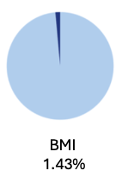
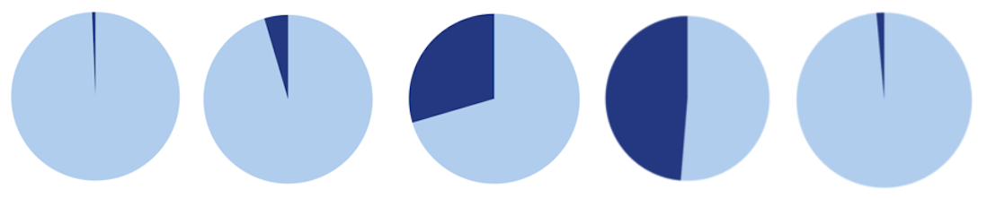
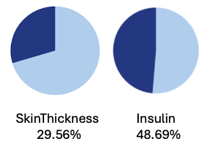


MISSING
DATA
MCAR
Glucose BloodPressure SkinThickness
0.65% 4.56% 29.56%
Insulin BMI
48.69% 1.43%
Number of all
woman: 768
No missing data:
Pregnant,
DiabetesPedigree
Age
MAR/NMAR

Slide 4
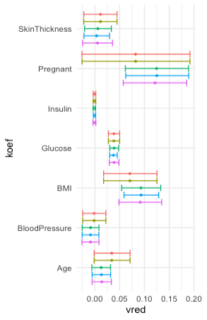
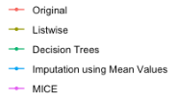
MISSING VALUE IMPUTATION
Based on the results of our analysis, we can divide the methods into two groups.
RandomForest
listwise or pairwise deletion method
RandomForest,
Imputation using Mean Values,
MICE

