Slide 1
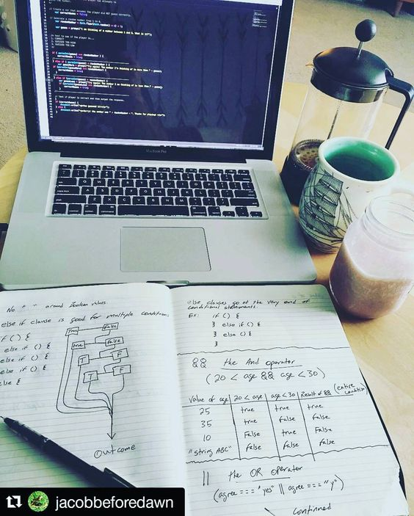
Papahinga lang pero wag susuko , hinihintay ka ng mga programmers

Slide 2

{ Collaboration not competition }
<fb> ProgrammerLang </fb>

Slide 3
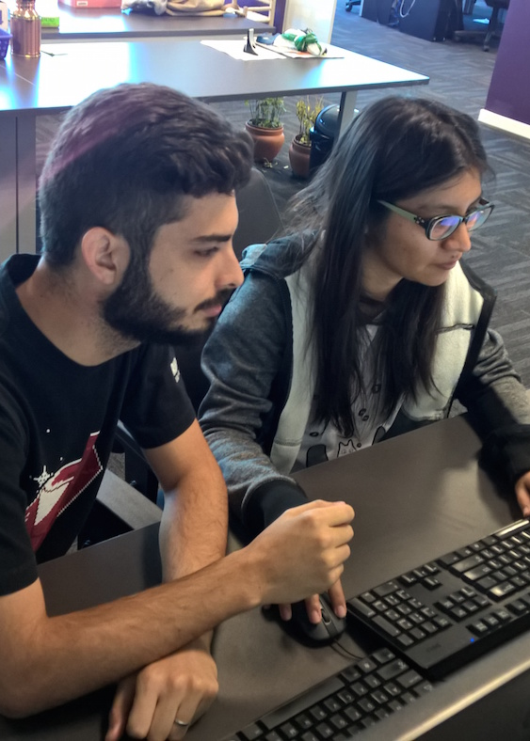
One day darating din yung nakalaan na tao para sa’yo at sasabihing ikaw ang (“Semicolon”); ko
<fb> Programmer Ako -_- </fb>

Slide 4
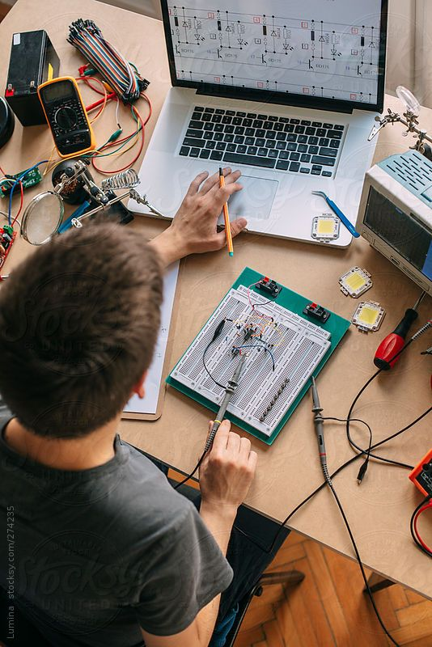
What you do at 8pm matters
<fb> Programmer Ako -_- </fb>

Slide 5
1. REVIEW YOUR CODE 2. REWRITE THE CODE 3. TEST THE CODE 4. SAVE IT
<fb> Programmer Ako -_- </fb>

