Slide 1
CS434/534 Advanced Object Oriented Programming Term Project: RARTIMEJS
Nezih Sunman
Deniz Gokcin

Slide 2
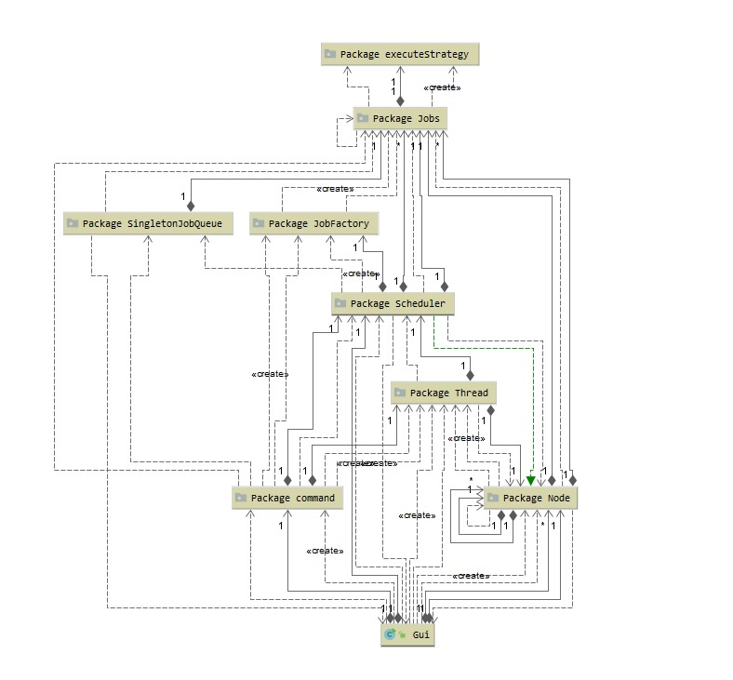
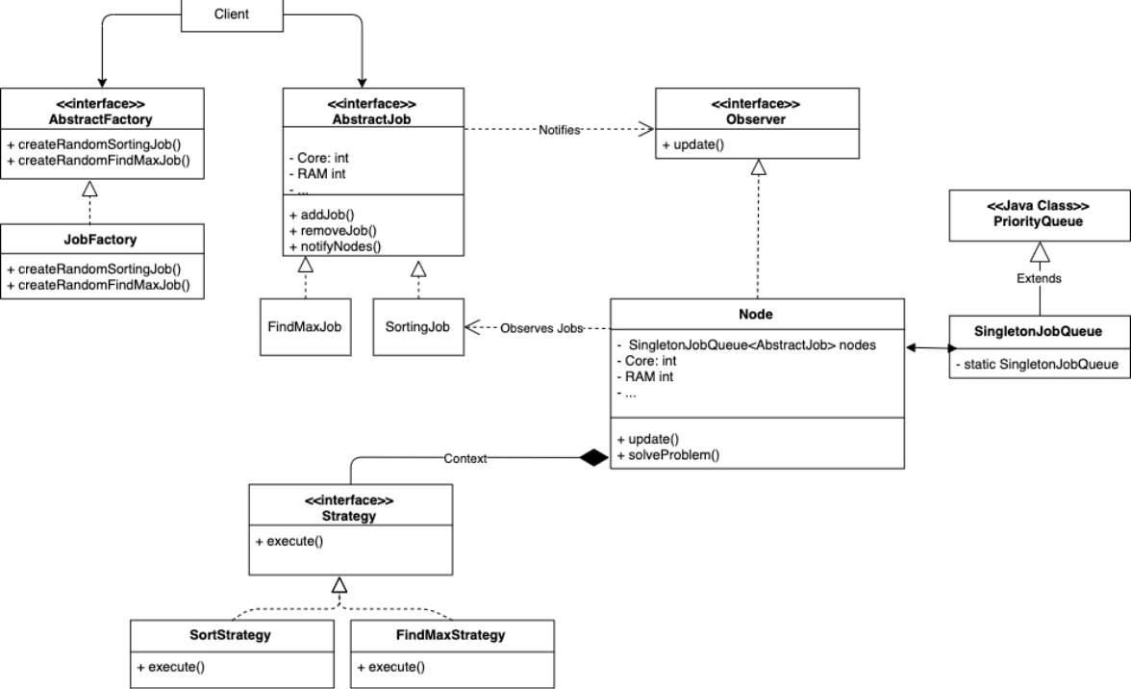
UML Diagrams
Initial Design
Final Design

Slide 3
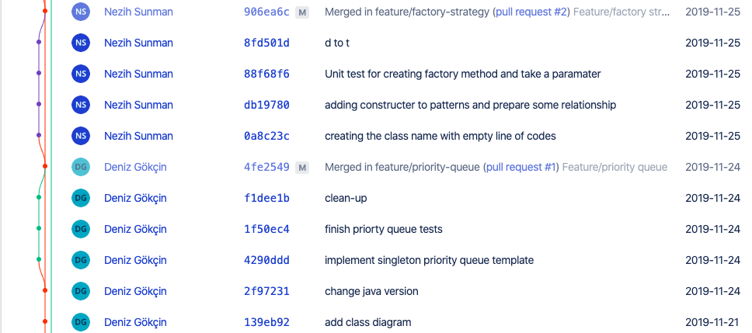
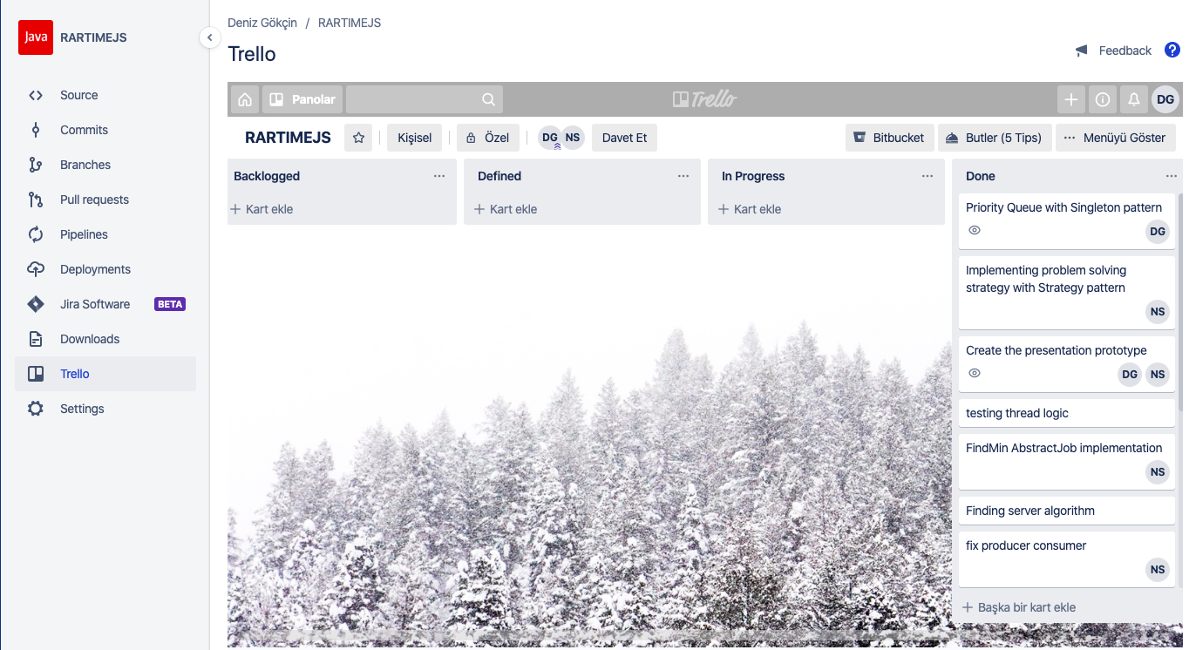
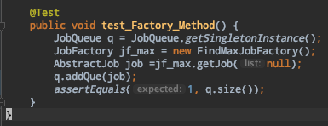
Technology Stack
Source Code Management: Bitbucket with GitFlow convention
Sprint Planning: Trello
Unit Tests: junit

Slide 4
Used Patterns
Goal: Designing a Resource Aware Real Time Job Scheduling for non-uniform HPC Loads, using an object oriented approach.
Singleton: to have a single, globally accessible job queue.
Strategy Pattern: For solving different kinds of jobs with different strategies.
Observer Pattern: For notifying the scheduler on state changes of Nodes.
Abstract Factory: For creating different jobs
Command: For converting the client requests into objects.
Notes:
Singleton: We have a priority queue which pops jobs out of it with respect to their sizes.(Shortest Job First)
Strategy: We have two main Job types: FindMaxJob and SortingJob. Because of strategy pattern, we can solve different jobs with different strategies like bubblesort/selection sort, recursive find max,
Observer with producer/consumer threads for the scheduler to assign a job on node status changes
Abstract Factory to produce families of related objects without specifying their concrete classes

