Slide 1
UX Scenario Document File Version 4.3
Easy Xtream Football
IPTV player for live sport on LG webOS TV
Submission Date | 2026 / 10 / 20
App Ver. | 0.1.12
App Developer Name | Jorge Mtnez
E-mail address | contact@nezor.es

Slide 2
Table of Contents
1. Basic Information
2. Document History
3. App Flow
4. Detailed Login Information
5. Main Page Description
6. Sub Page Description
7. Paid Content
8. In-App Ad
[Appendix] Remote control keys and notes for QA

Slide 3
1. Basic Information
Item | Value
App title | Easy Xtream Football
App ID | es.nezor.easyxtreamfootball
App version | 0.1.12
App type | Web app (HTML5), 1920x1080, no external libraries
Category | Entertainment / Video (IPTV player)
What it does | Plays the live TV and radio channels of an IPTV source the user already has (Xtream Codes account, M3U playlist URL or a direct stream link), with a layout focused on live sport: football first, other sports, radio, favourites, recent channels, electronic programme guide and quality selection.
Content | The app ships no content of its own. All channels come from the source the user connects. For QA, openly licensed test playlists are provided in section 4.
Login | None. No account, no sign-up. The connection data of the user's source is stored only on the TV.
Payments / Ads | None. The optional "Buy me a coffee" card shows a QR code to an external web page; nothing is sold or charged in the app.
Remote control | Standard remote (4-way, OK, BACK, CH+/-, PLAY/PAUSE/STOP, INFO, yellow key) and Magic Remote (pointer, OK, wheel).
Languages | Follows the TV language: 24 languages (English fallback). Can be forced in Settings.
Network | Required (streams, playlists, programme guide, channel logos).
Tested on | LG 32LM637BPLA (webOS 4.9, 2019) with a real IPTV source and the test playlists; webOS TV Simulator 26.

Slide 4
2. Document History
No. | Sent | Version | File Name | Contents
1 | 20.10.2026 | 0.1.12 | UX Scenario - Easy Xtream Football | Initial document

Slide 5
3. App Flow
1. Screens and navigation
Profiles (entry screen) -> OK on a profile -> Channel list -> OK on a channel -> Player
Profiles -> "+ Add profile" -> Add profile form (Xtream / M3U list / Direct link) -> Save -> Channel list
Profiles -> gear button -> Settings -> Language / cache / coffee reminder
Profiles -> globe button -> Language list
Channel list -> magnifier button -> Filters bar (quality, search field, reload)
Channel list -> OK on a folder card -> Folder (all channels of that brand) -> OK on a channel -> Player
Player -> OK -> Player menu (Quality / Audio / Subtitles / Guide / Info / Coffee)
BACK always goes one level up: Player menu -> Player -> Channel list -> Profiles -> leaves the app.
Long OK on a profile card opens Edit / Delete. Long OK on a channel card toggles favourite; long OK in the player toggles favourite too.

Slide 6
4. Detailed Login Information
There is no login, sign-up or activation code. The user connects their own IPTV source in "+ Add profile".
For QA, please add an M3U profile with one of the openly licensed test playlists below (Add profile -> "M3U list" tab -> paste the URL in "Playlist URL" -> Save).
Test playlist | URL to paste in the "M3U list" tab | Contents
Demo videos | https://cdn.jsdelivr.net/gh/nezor11/easy-xtream-football@main/docs/playlists/review-test.m3u | Big Buck Bunny (MP4 1080p), BipBop HLS test pattern (720p), Tears of Steel (SD). Blender Foundation films, CC BY 3.0; Apple HLS sample.
Sports radio | https://cdn.jsdelivr.net/gh/nezor11/easy-xtream-football@main/docs/playlists/sports-radio.m3u | 14 public sports radio stations (audio only) to check the radio view.
Direct link | https://test-streams.mux.dev/x36xhzz/x36xhzz.m3u8 (tab "Direct link") | Single HLS stream (Big Buck Bunny), to check the direct-link profile type.
Notes
- The playlists are fetched over HTTPS from jsDelivr (GitHub CDN). The app also accepts any Xtream Codes account (server URL, username, password) or M3U URL from an IPTV provider.
- The test content is not sport, so it appears in the "More sports" row (the app sorts football and other sports first when channel names allow it).
- Nothing is sent anywhere: the app only talks to the user's source, jsDelivr (playlists, logos) and the image proxy wsrv.nl for logos that fail to load.

Slide 7
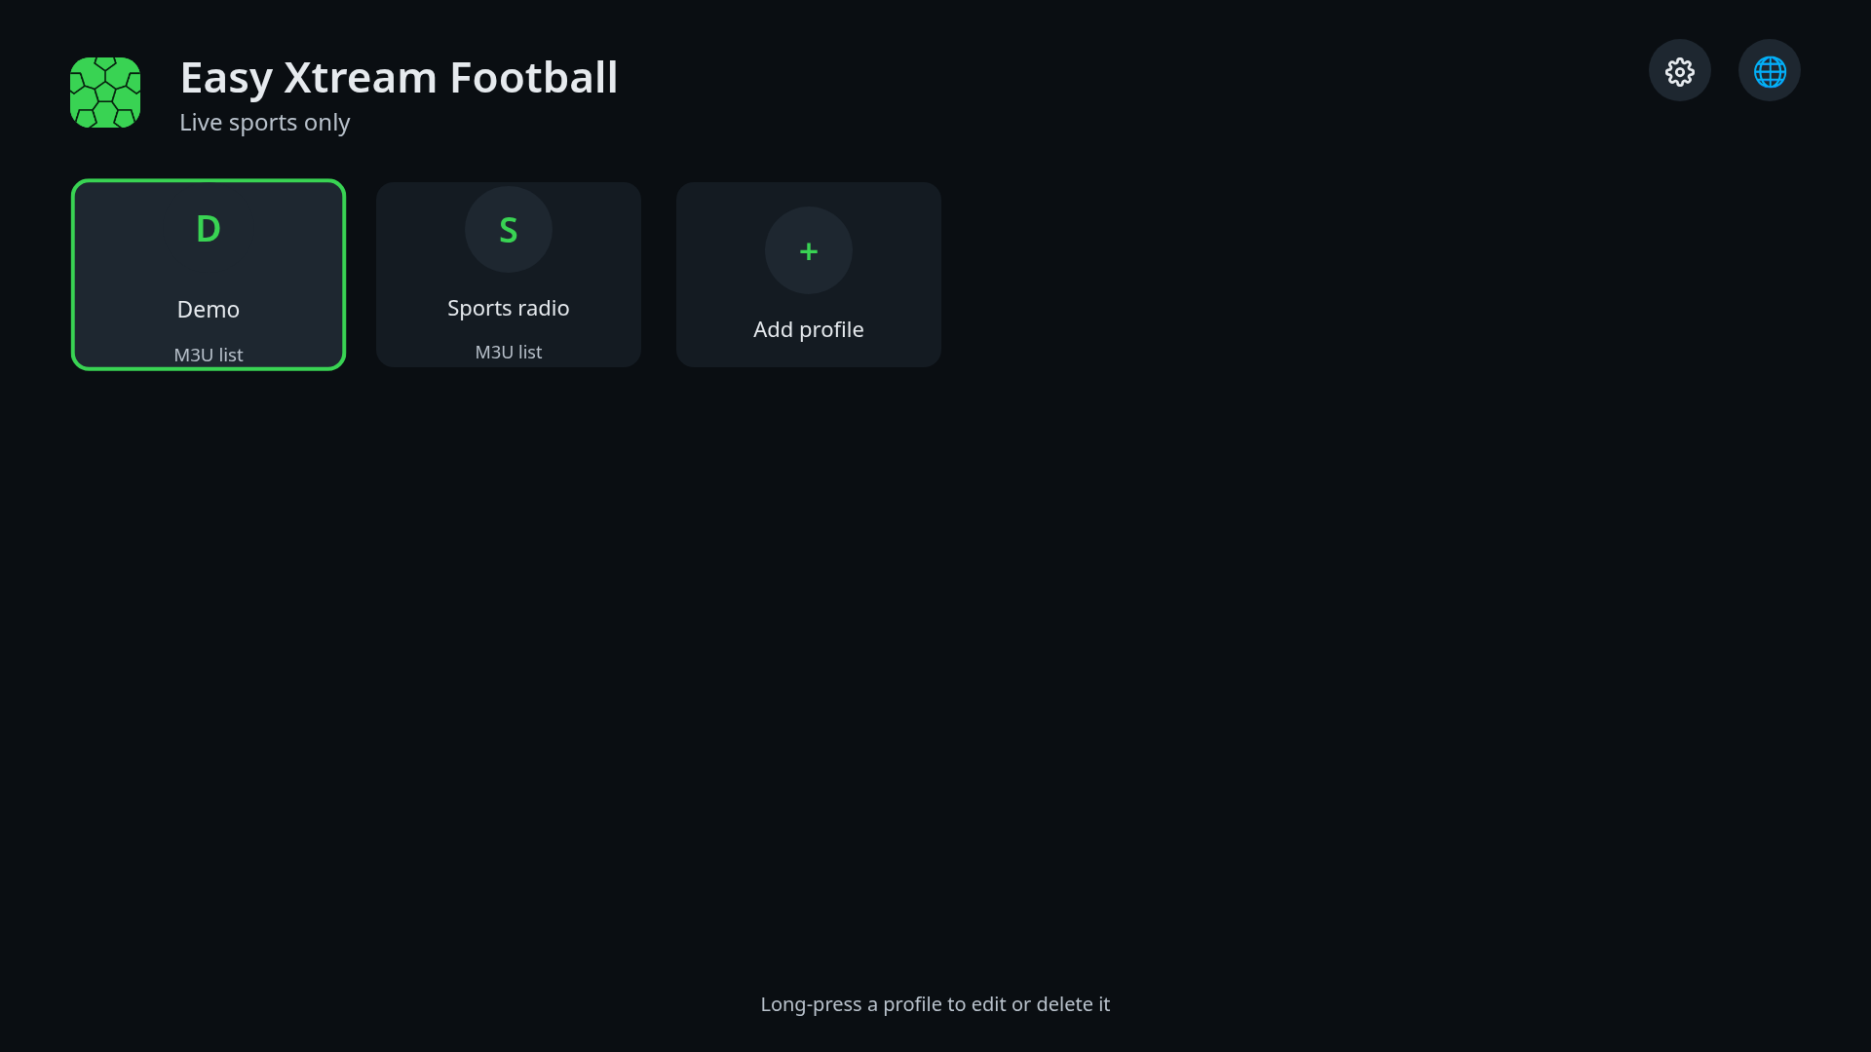
5. Main Page Description
1. Profiles (entry screen)
No | Description
1 | App title and tagline
2 | Settings button (gear): language, cache, coffee reminder
3 | Language button (globe): pick the app language
4 | Profile card: OK opens its channel list; long OK offers Edit / Delete
5 | "+ Add profile": opens the form to connect a source
6 | Hint about long OK
1
2
3
4
5
6
Detailed Information
- Entry screen. Focus starts on the first profile. Arrows move the focus, OK opens, BACK leaves the app (returns to where it was launched from).
- With the Magic Remote the pointer focuses any card or button and OK/click activates it.

Slide 8
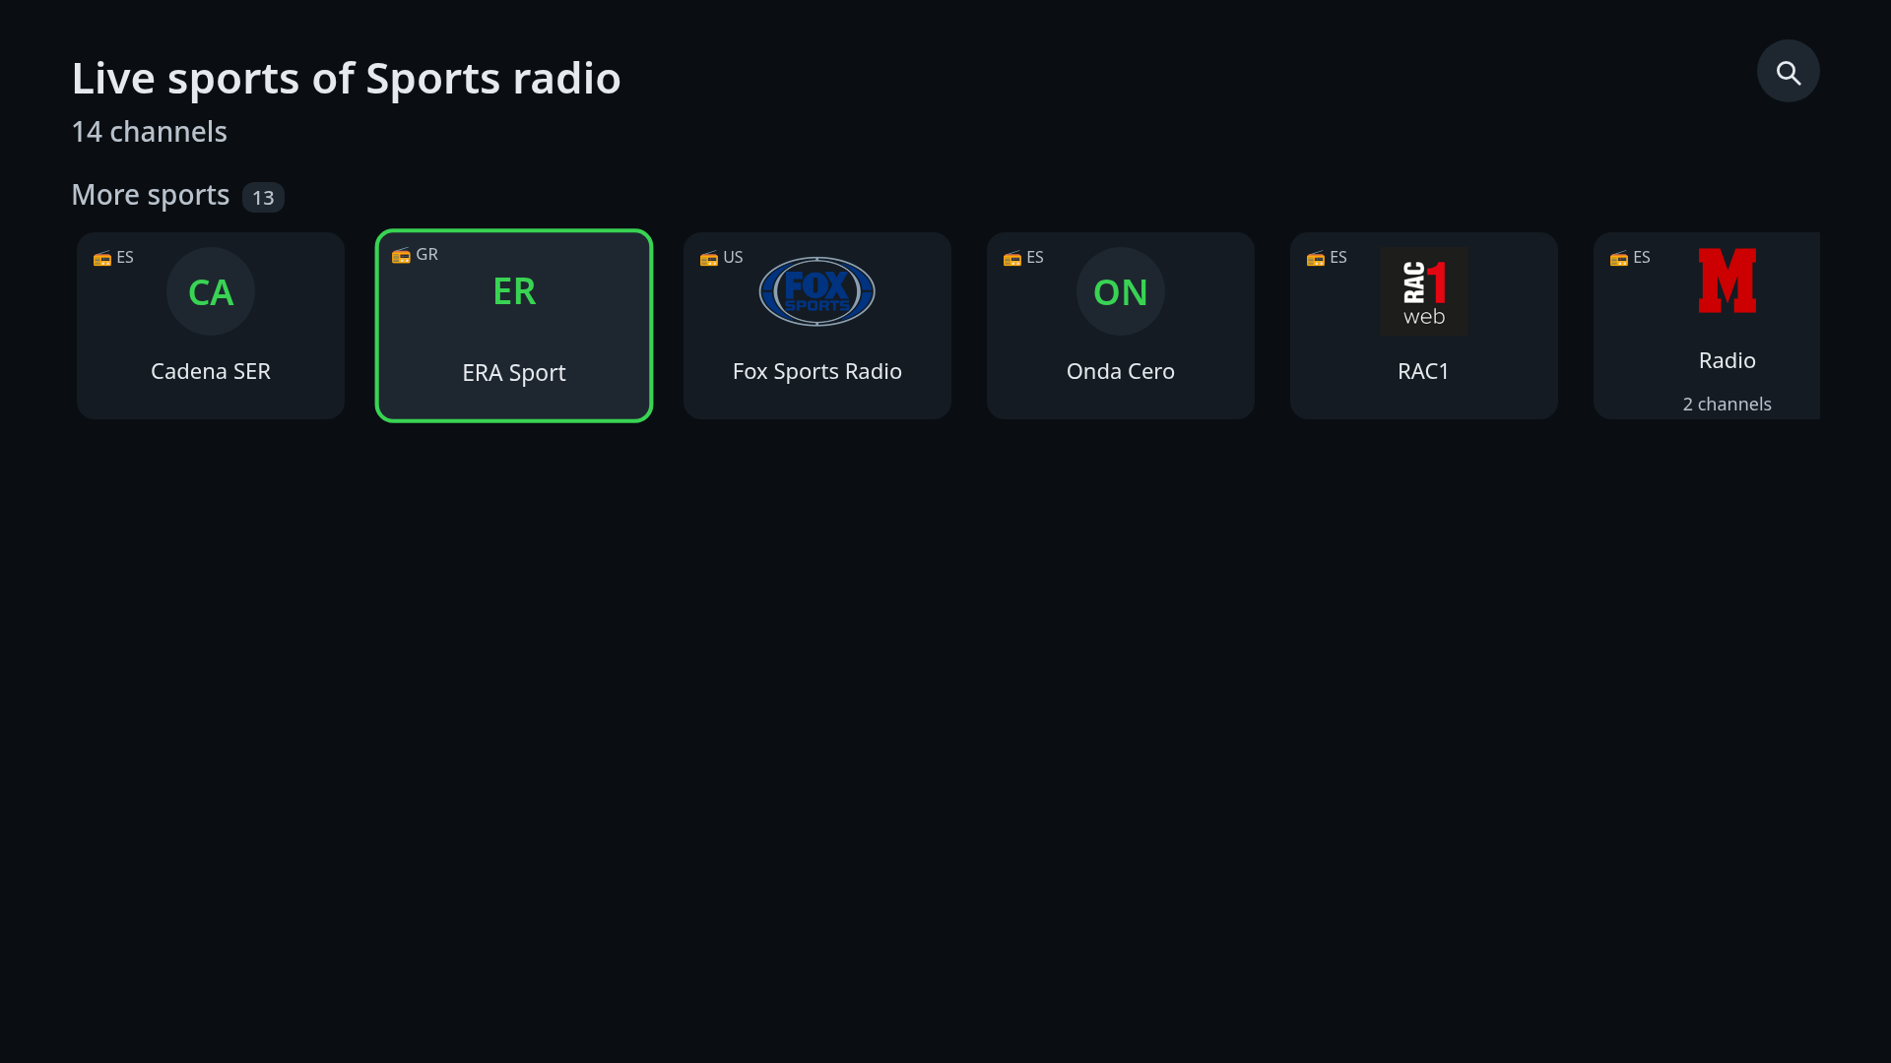
5. Main Page Description
2. Channel list
No | Description
1 | Profile name and channel count
2 | Filters button (magnifier): quality filter, search field, reload
3 | Section rows: Live now, Favourites, Recent, Football, More sports (radio stations carry a radio badge)
4 | Channel card: OK plays it; long OK adds/removes favourite
5 | Folder card (several channels of one brand): OK opens the folder
2
1
3
4
5
Detailed Information
- Horizontal rows scroll with left/right (they wrap around at the ends) and with the Magic Remote wheel; up/down change row. Each card shows the logo or the channel initials, the country and a radio or geo-blocked badge when known.
- A row with many channels can be opened as a folder; BACK returns to the list.

Slide 9
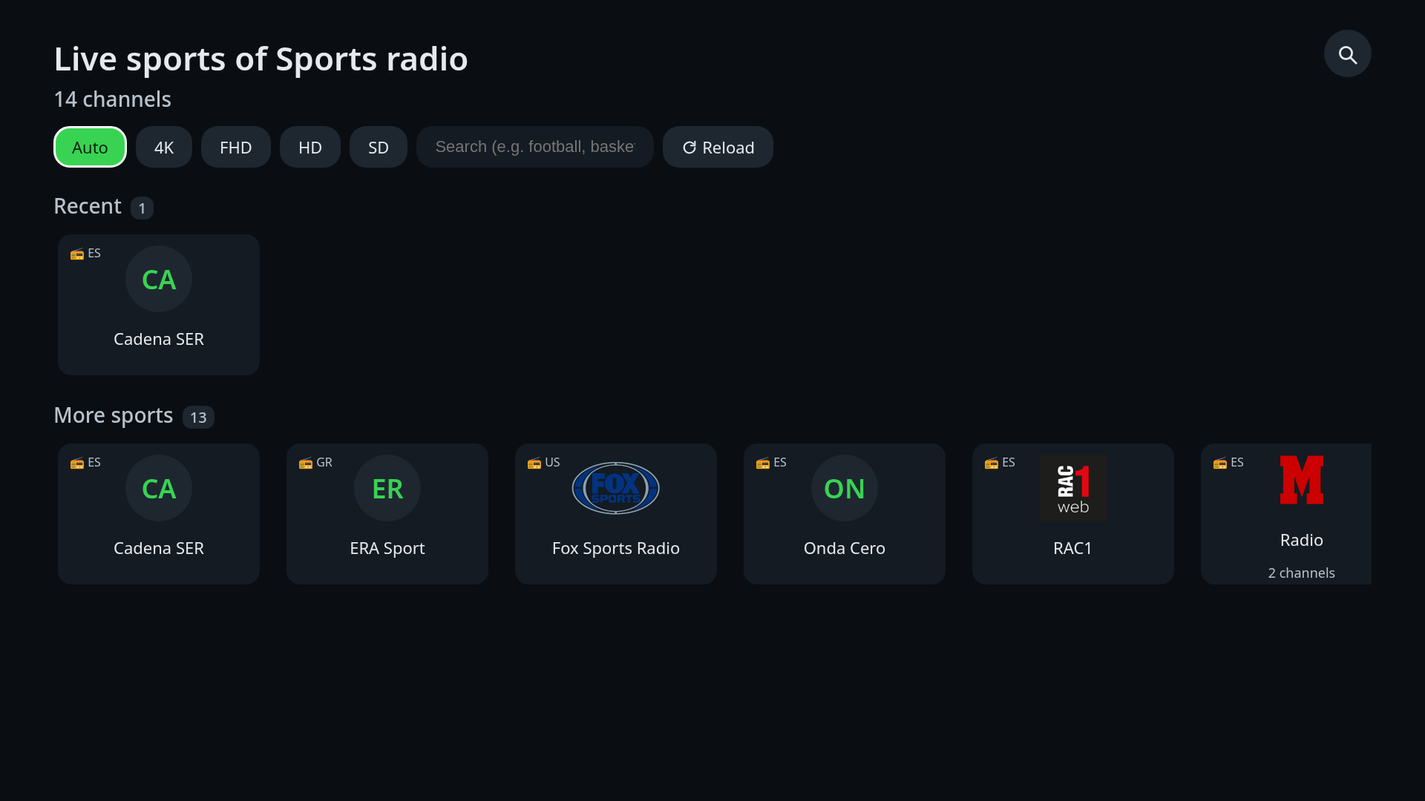
5. Main Page Description
3. Filters bar
No | Description
1 | Quality chips: Auto, 4K, FHD, HD, SD (filters the variants shown)
2 | Search field: typing narrows the list live (LG virtual keyboard)
3 | Reload: downloads the playlist again
1
2
3
Detailed Information
- The magnifier button toggles this bar. BACK or the magnifier closes it.

Slide 10
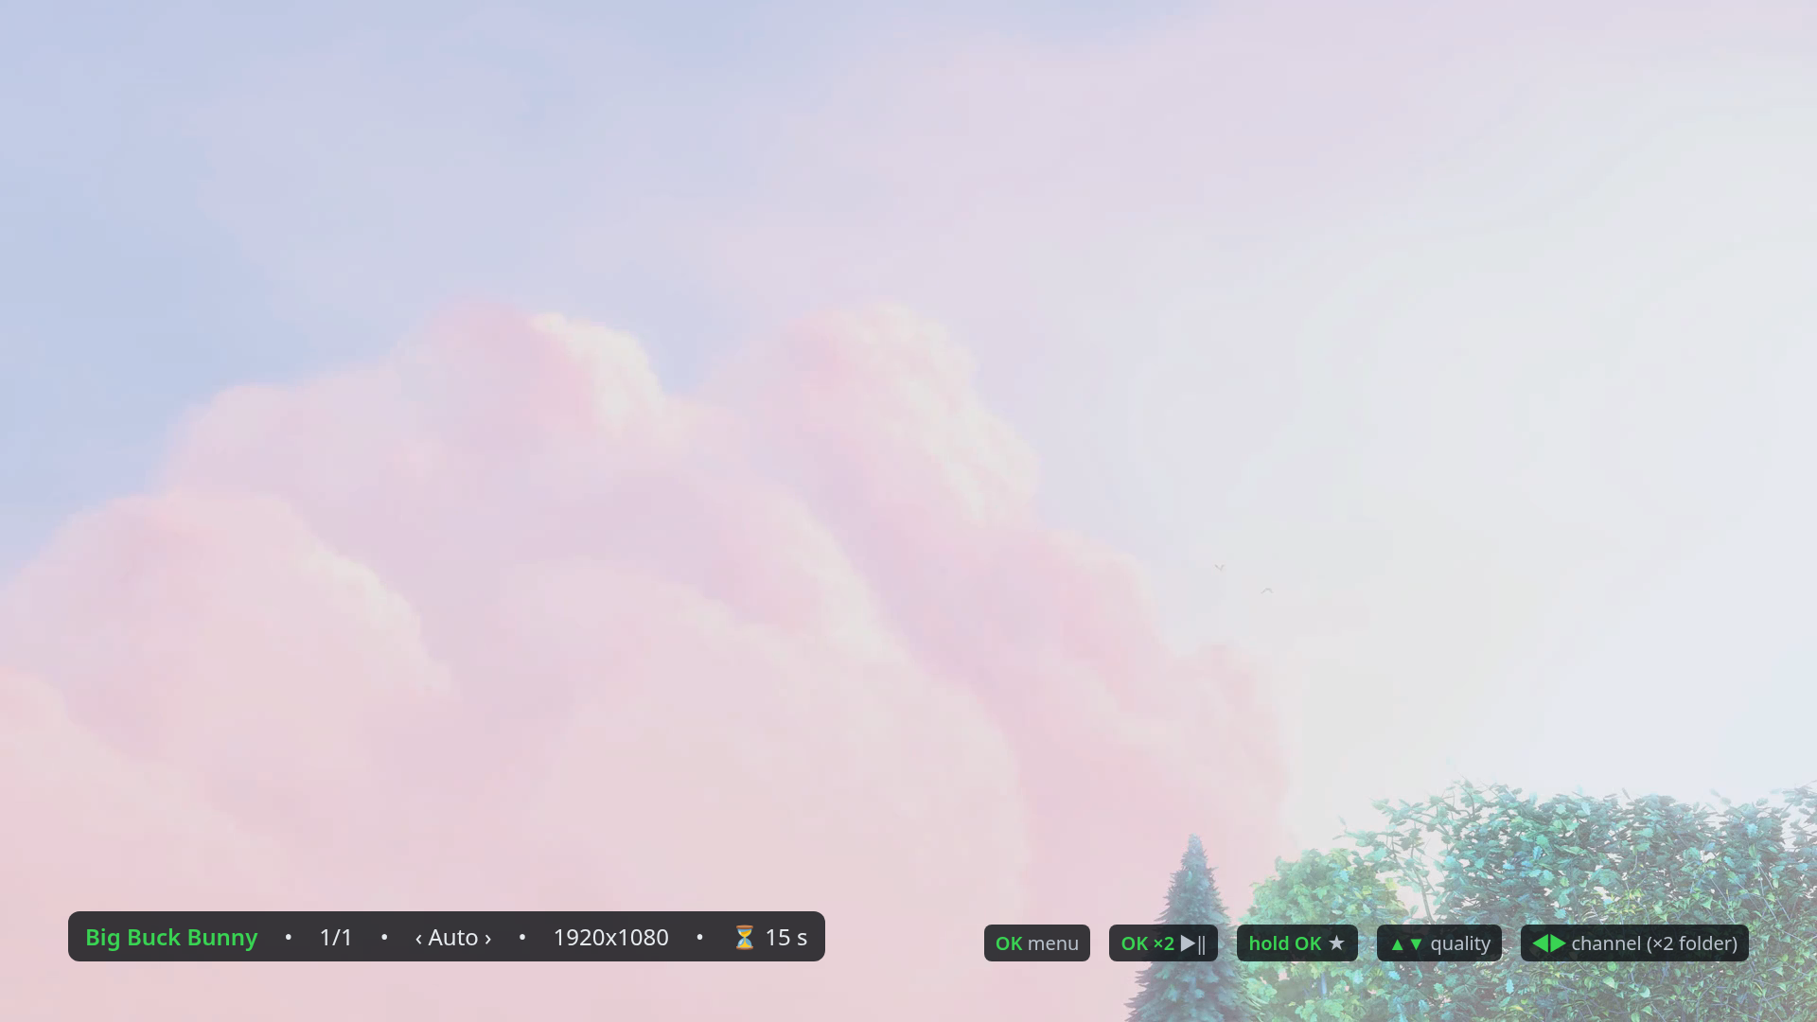
6. Sub Page Description
1. Player
No | Description
1 | Channel info bar: name, position in the row, quality, picture size, network speed and seconds buffered
2 | Key legend (shown for 8 s after opening): OK menu, OK x2 play/pause, long OK favourite, up/down quality, left/right channel
1
2
Detailed Information
- Full-screen playback of the selected channel. Left/right or CH+/- change channel (x2 changes folder), up/down change the quality variant, PLAY/PAUSE or OK x2 pause, STOP or BACK leave the player, INFO hides/shows the info bar, yellow key jumps to the last watched channel.
- Magic Remote: a click on the picture opens the menu; the pointer then works on the menu options.
- If a stream fails (network, 403/404) a message is shown and the app skips to the next channel; if the source is geo-blocked it says so.

Slide 11
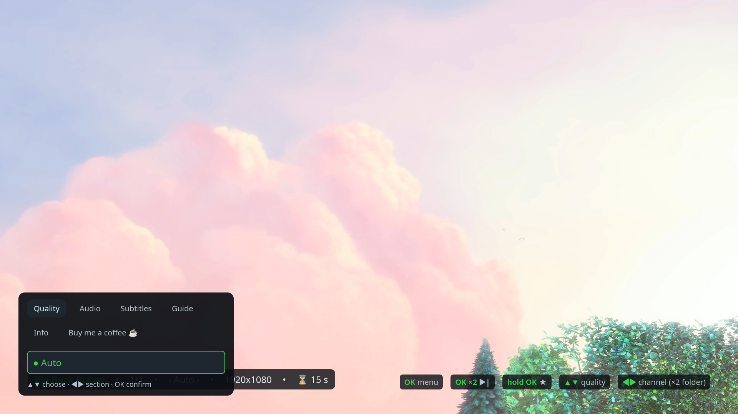
6. Sub Page Description
2. Player menu
No | Description
1 | Tabs: Quality, Audio, Subtitles, Guide, Info, Coffee (left/right)
2 | Options of the selected tab: OK selects (filled bullet = current)
1
2
Detailed Information
- Opened with OK (or a pointer click) over the picture. Quality lists the variants of the channel plus Auto; Audio and Subtitles list the tracks of the stream; Guide shows the programme guide of the channel when the source provides one; Info toggles the info bar; Coffee shows the optional support card (QR code to an external page, nothing is charged in the app).
- BACK closes the menu and returns to the picture.

Slide 12
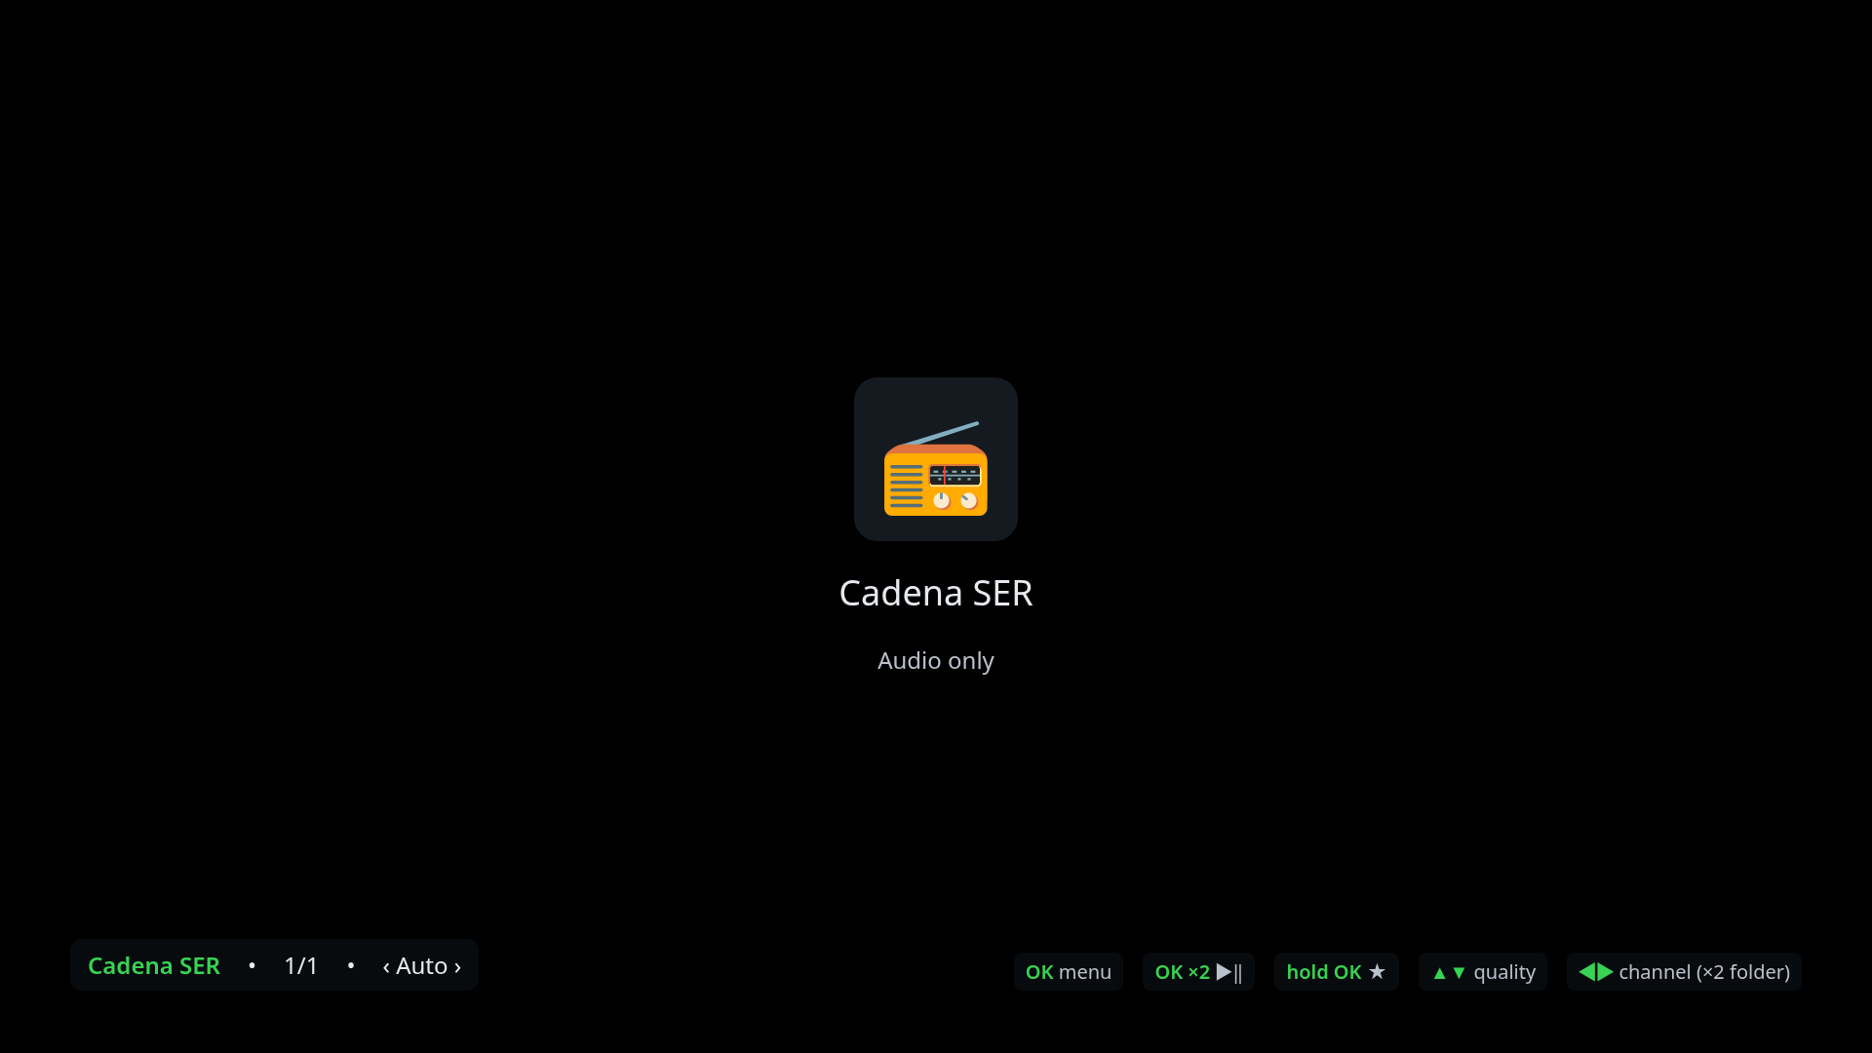
6. Sub Page Description
3. Radio view
No | Description
1 | Station logo (or a radio glyph)
2 | Station name and "audio only" note
3 | Channel info bar
1
2
3
Detailed Information
- Radio stations (audio-only streams) show this view instead of a black picture. Keys and menu are the same as in the player.

Slide 13
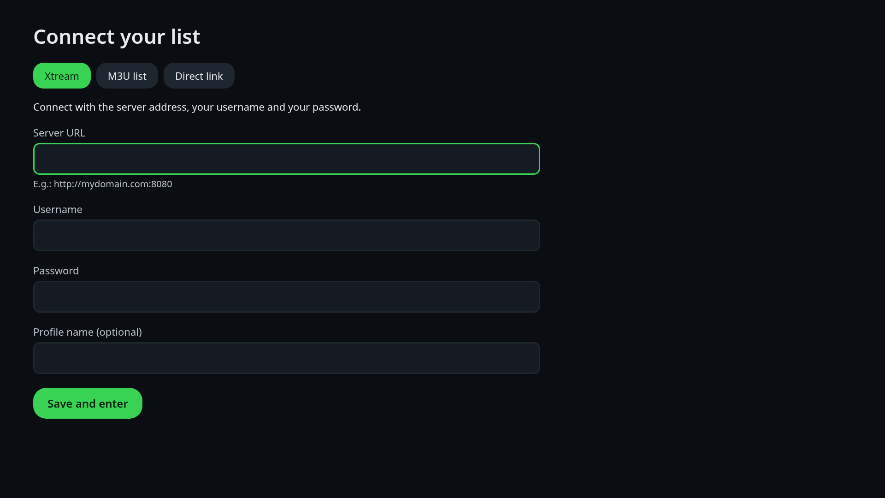
6. Sub Page Description
4. Add profile
No | Description
1 | Screen title
2 | Source type tabs: Xtream (server, username, password), M3U list (playlist URL), Direct link (stream URL)
3 | Text fields: OK opens the LG virtual keyboard; OK/BACK on the keyboard returns to the form
4 | Save: checks the data, downloads the channel list and opens it
1
2
3
4
Detailed Information
- Also used to edit an existing profile (long OK on its card). An error message under the form explains a wrong URL or credentials.
- Test data for QA: see section 4.

Slide 14
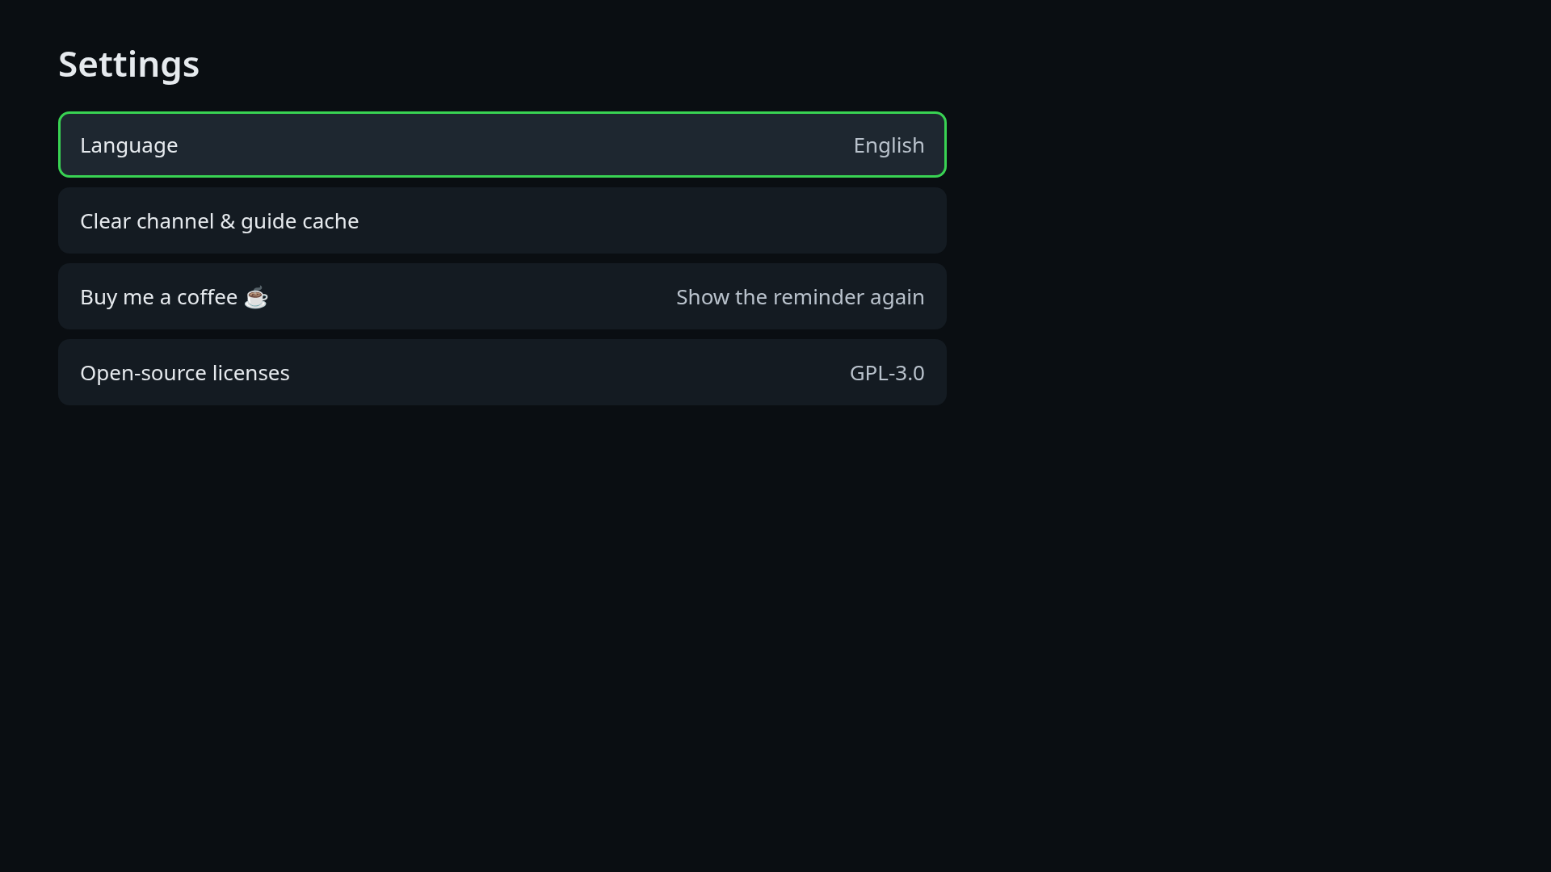
6. Sub Page Description
5. Settings
No | Description
1 | Screen title
2 | Options: Language, Clear channel & guide cache, Buy me a coffee, Show the reminder again, Open-source licences
1
Detailed Information
- Reached with the gear button on the entry screen. Up/down move, OK selects, BACK returns.

Slide 15
7. Paid Content
Not applicable. The app has no paid content, subscriptions or in-app purchases.
The "Buy me a coffee" card (player menu > Coffee, and Settings) only displays a QR code that links to an external web page; the TV app itself never charges anything.

Slide 16
8. In-App Ad
Not applicable. The app shows no advertisements.

Slide 17
[Appendix]
1. Remote control keys
Key | Lists and forms | Player
Arrows | Move the focus (rows wrap around) | Left/right: previous/next channel (x2: folder). Up/down: quality variant
OK | Activate the focused item (long OK: favourite / edit) | Open the menu (x2: play/pause, long: favourite)
BACK | One level up; on the entry screen leaves the app | Close the menu, else leave the player
CH+ / CH- | - | Next / previous channel
PLAY / PAUSE / STOP | - | Play-pause toggle / leave the player
INFO | - | Show or hide the channel info bar
Yellow | - | Jump to the last watched channel
Red / Green / Blue, numbers | Ignored | Ignored
HOME / EXIT / LIVE / VOLUME | Handled by webOS | Handled by webOS
Magic Remote pointer / wheel | Pointer focuses, click activates, wheel scrolls rows and lists | Click opens the menu; pointer and OK work on the menu options

Slide 18
[Appendix]
2. Notes for LG QA
- No login and no account: please use the test playlists of section 4 (openly licensed content).
- The app is a channel player, not a content service: it has no catalogue of its own and shows only what the user's source provides.
- Live streams cannot be seeked; there is no resume, series or DRM content.
- Quality: "Auto" picks the variant that fits the measured network speed and steps down after stalls; the menu allows manual selection. Variants depend on the source (the test playlists have one variant per item).
- The app follows the TV language (24 languages). Screenshots were taken in English.
- Tested on an LG 32LM637BPLA (webOS 4.9) with a real IPTV subscription (MPEG-TS, H.264, AC-3) and with the test playlists; Magic Remote behaviour verified with pointer/wheel events in a desktop browser (no Magic Remote was available for a hardware check).
- Contact for QA questions: contact@nezor.es

