Slide 1
Easy Xtream Football
App Description
IPTV player for live sport on Samsung Smart TV (Tizen web app)
Seller | Nezor (Jorge Martínez)
Contact | contact@nezor.es
App ID | EXFOOTBALL.EasyXtreamFootball
App version | 1.0.0
Date | 2026-10-22

Slide 2
Revision History
Version | Date | Description | Author
1.0 | 2026-10-22 | Initial document for app version 1.0.0 | Jorge Martínez

Slide 3
Contents
1. UI Structure
2. Usage Scenario
3. Menu & function description
4. Key policy
5. How to change languages
6. Notes for QA

Slide 4
1. UI Structure
Depth navigation (RETURN always goes one level up)
Profiles (entry screen)
├─ OK on a profile → Channel list
│ ├─ OK on a channel → Player → ENTER: Player menu (Quality / Audio / Subtitles / Guide / Info / Coffee)
│ ├─ OK on a folder card → Folder (all channels of one brand) → Player
│ └─ magnifier button → Filters bar (quality chips, search field, reload)
├─ "+ Add profile" → Add profile form (Xtream / M3U list / Direct link) → Save → Channel list
├─ gear button → Settings (language, clear cache, coffee reminder, open-source licences)
└─ globe button → Language list
RETURN: Player menu → Player → Channel list → Profiles → exits the app.
Long ENTER on a profile card: Edit / Delete. Long ENTER on a channel card or in the player: toggle favourite.
Radio stations (audio-only streams) open the Radio view instead of the full-screen player.

Slide 5
2. Usage Scenario
No login, no sign-up, no payment: the user connects their own IPTV source
The app ships with NO channels. On first launch the entry screen is empty except "+ Add profile". The user adds a profile with the data of an IPTV source they already have (an Xtream Codes account, an M3U playlist URL or a direct stream link). Nothing is sent to the developer; the data stays on the TV.
For testing, please use the openly licensed playlists below (no account needed):
Step | Action | Expected result
1 | Launch the app | Entry screen "Profiles" with the "+ Add profile" card focused
2 | ENTER on "+ Add profile", choose the tab "M3U list" | Form with Name and Playlist URL fields
3 | Name: any; Playlist URL: https://cdn.jsdelivr.net/gh/nezor11/easy-xtream-football@main/docs/playlists/review-test.m3u | The TV keyboard opens on ENTER; RETURN closes it
4 | ENTER on Save | The playlist is downloaded and the Channel list opens (demo videos: Big Buck Bunny, BipBop HLS, Tears of Steel)
5 | ENTER on a channel | Full-screen playback; info bar and key legend for a few seconds
6 | ENTER on the picture | Player menu: Quality / Audio / Subtitles / Guide / Info / Coffee
7 | RETURN, RETURN, RETURN | Back to the Channel list, then Profiles, then the app exits
8 | Optional: add a second M3U profile with https://cdn.jsdelivr.net/gh/nezor11/easy-xtream-football@main/docs/playlists/sports-radio.m3u | Public sports radio stations; playing one shows the Radio view (logo, name, "audio only")

Slide 6
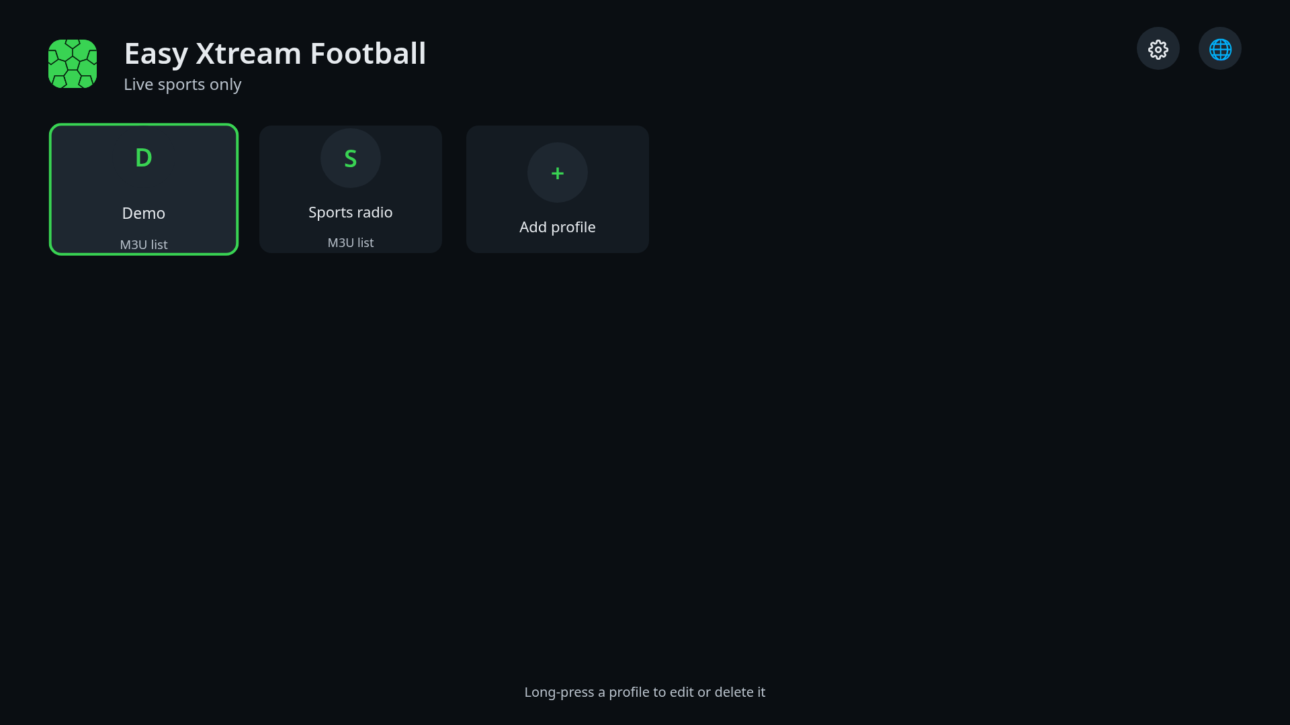
3. Menu & function description
3.1 Profiles (entry screen)
1
2
3
No | Description
1 | App title and tagline
2 | Settings button (gear): language, cache, coffee reminder, licences
3 | Language button (globe): pick the app language
4 | Profile card: ENTER opens its channel list; long ENTER offers Edit / Delete
5 | "+ Add profile": opens the form to connect a source
6 | Hint about long ENTER
4
5
6
Details
- Entry screen. Focus starts on the first profile (or on "+ Add profile" when there is none). Arrows move the focus, ENTER opens, RETURN exits the app.

Slide 7
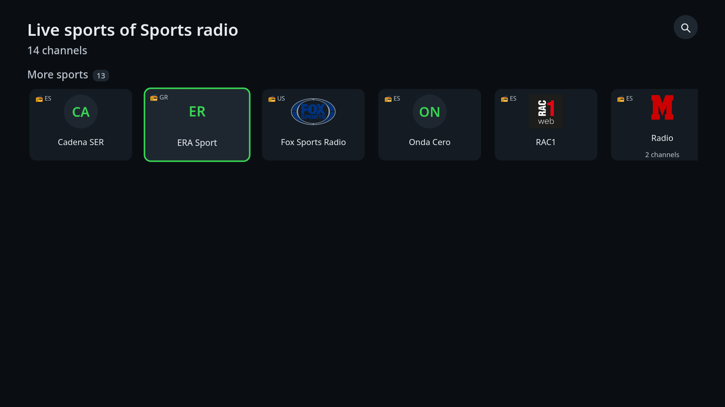
3. Menu & function description
3.2 Channel list
2
No | Description
1 | Profile name and channel count
2 | Filters button (magnifier): quality filter, search field, reload
3 | Section rows: Live now, Favourites, Recent, Football, More sports (radio stations carry a radio badge)
4 | Channel card: ENTER plays it; long ENTER adds/removes favourite
5 | Folder card (several channels of one brand): ENTER opens the folder
1
3
4
5
Details
- Rows scroll with left/right (they wrap around at the ends); up/down change row. Each card shows the logo or the channel initials, the country and a radio or geo-blocked badge when known.
- A row with many channels can be opened as a folder; RETURN returns to the list.

Slide 8
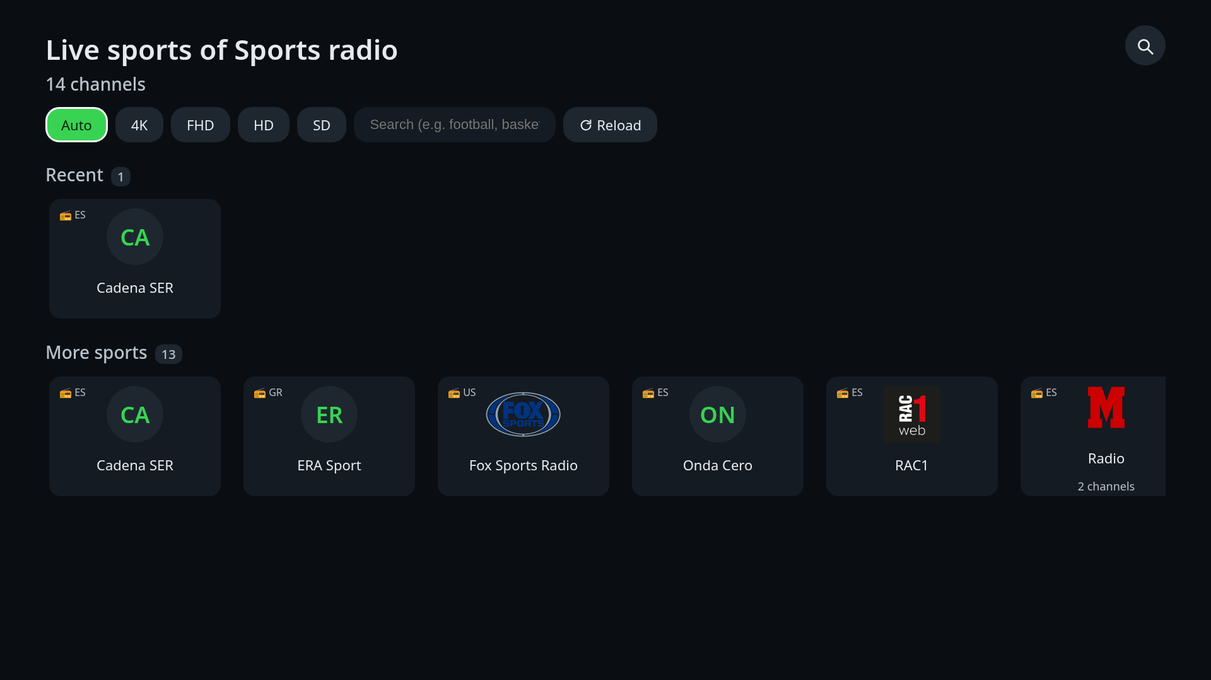
3. Menu & function description
3.3 Filters bar
No | Description
1 | Quality chips: Auto, 4K, FHD, HD, SD (filters the variants shown)
2 | Search field: typing narrows the list live (TV keyboard)
3 | Reload: downloads the playlist again
1
2
3
Details
- The magnifier button toggles this bar. RETURN or the magnifier closes it.

Slide 9
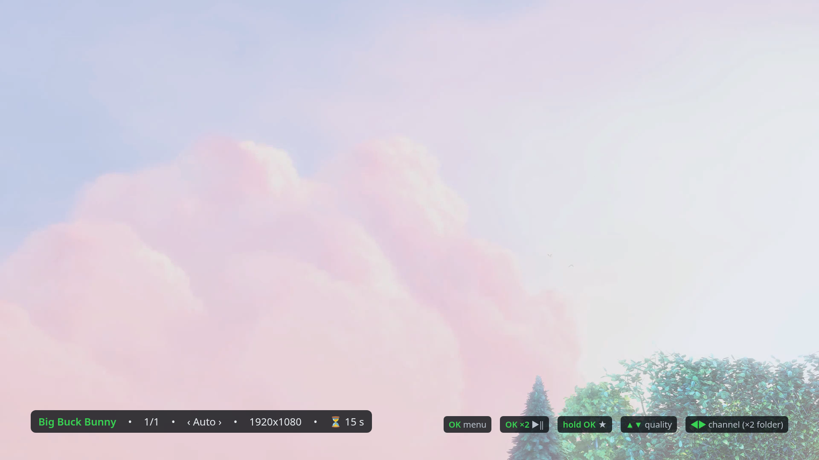
3. Menu & function description
3.4 Player
No | Description
1 | Channel info bar: name, position in the row, quality, picture size, network speed and seconds buffered
2 | Key legend (shown for 8 s after opening): ENTER menu, ENTER x2 play/pause, long ENTER favourite, up/down quality, left/right channel
1
2
Details
- Full-screen playback (AVPlay) of the selected channel. Left/right or CH+/- change channel (x2 changes folder), up/down change the quality variant, PLAY/PAUSE or ENTER x2 pause, STOP or RETURN leave the player, INFO hides/shows the info bar.
- If a stream fails (network, 403/404) a message is shown and the app skips to the next channel; if the source is geo-blocked it says so.

Slide 10
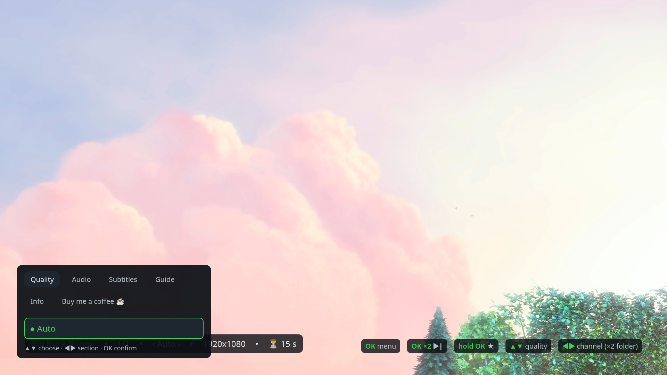
3. Menu & function description
3.5 Player menu
No | Description
1 | Tabs: Quality, Audio, Subtitles, Guide, Info, Coffee (left/right)
2 | Options of the selected tab: ENTER selects (filled bullet = current)
1
2
Details
- Opened with ENTER over the picture. Quality lists the variants of the channel plus Auto; Audio and Subtitles list the tracks of the stream; Guide shows the programme guide of the channel when the source provides one; Info toggles the info bar; Coffee shows the optional support card (QR code to an external web page; nothing is sold or charged in the app).
- RETURN closes the menu and returns to the picture.

Slide 11
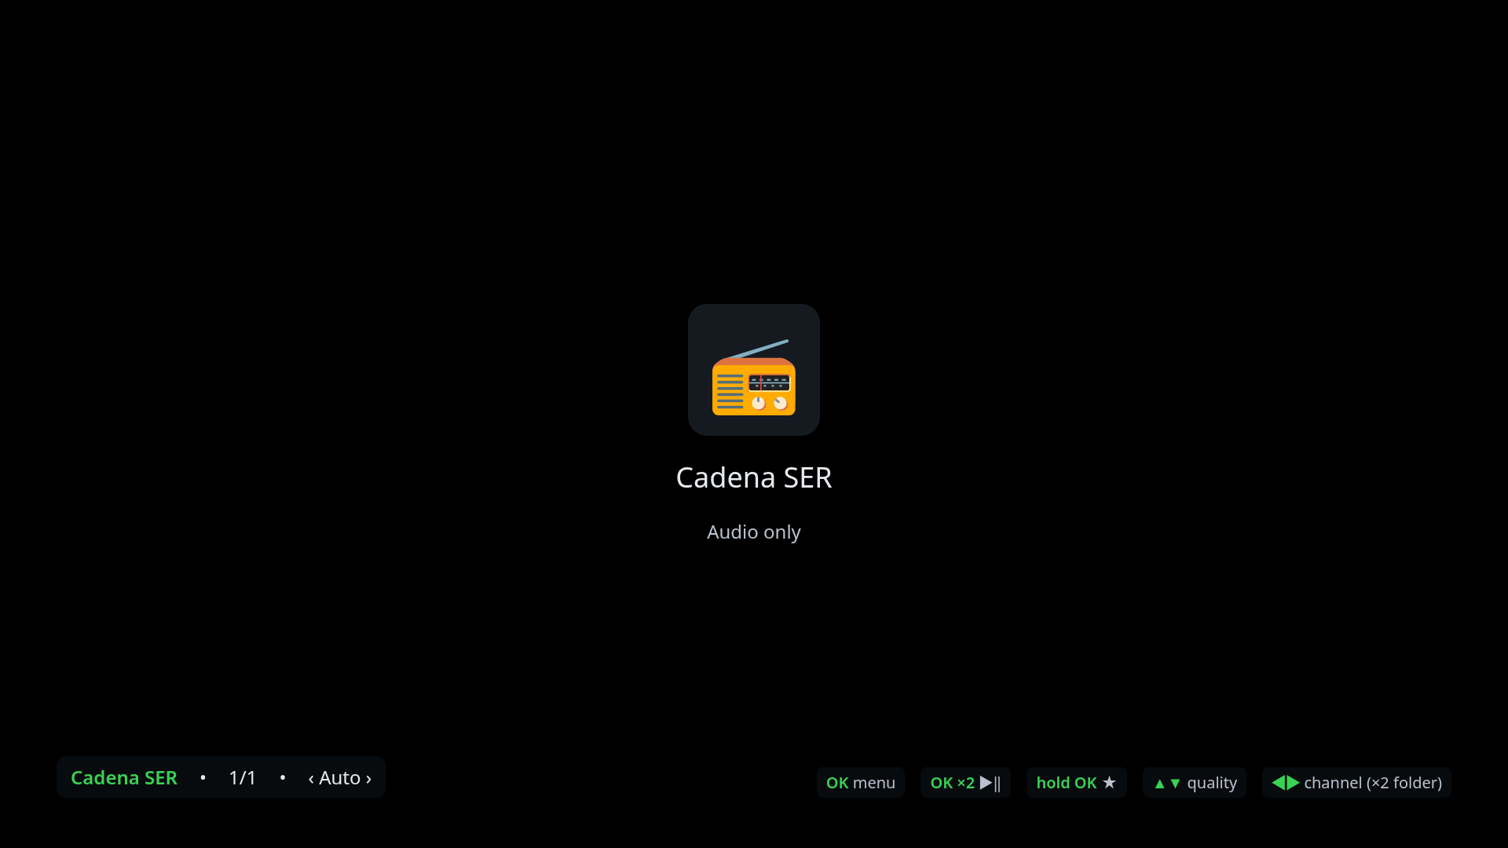
3. Menu & function description
3.6 Radio view
No | Description
1 | Station logo (or a radio glyph)
2 | Station name and "audio only" note
3 | Channel info bar
1
2
3
Details
- Radio stations (audio-only streams) show this view instead of a black picture. Keys and menu are the same as in the player.

Slide 12
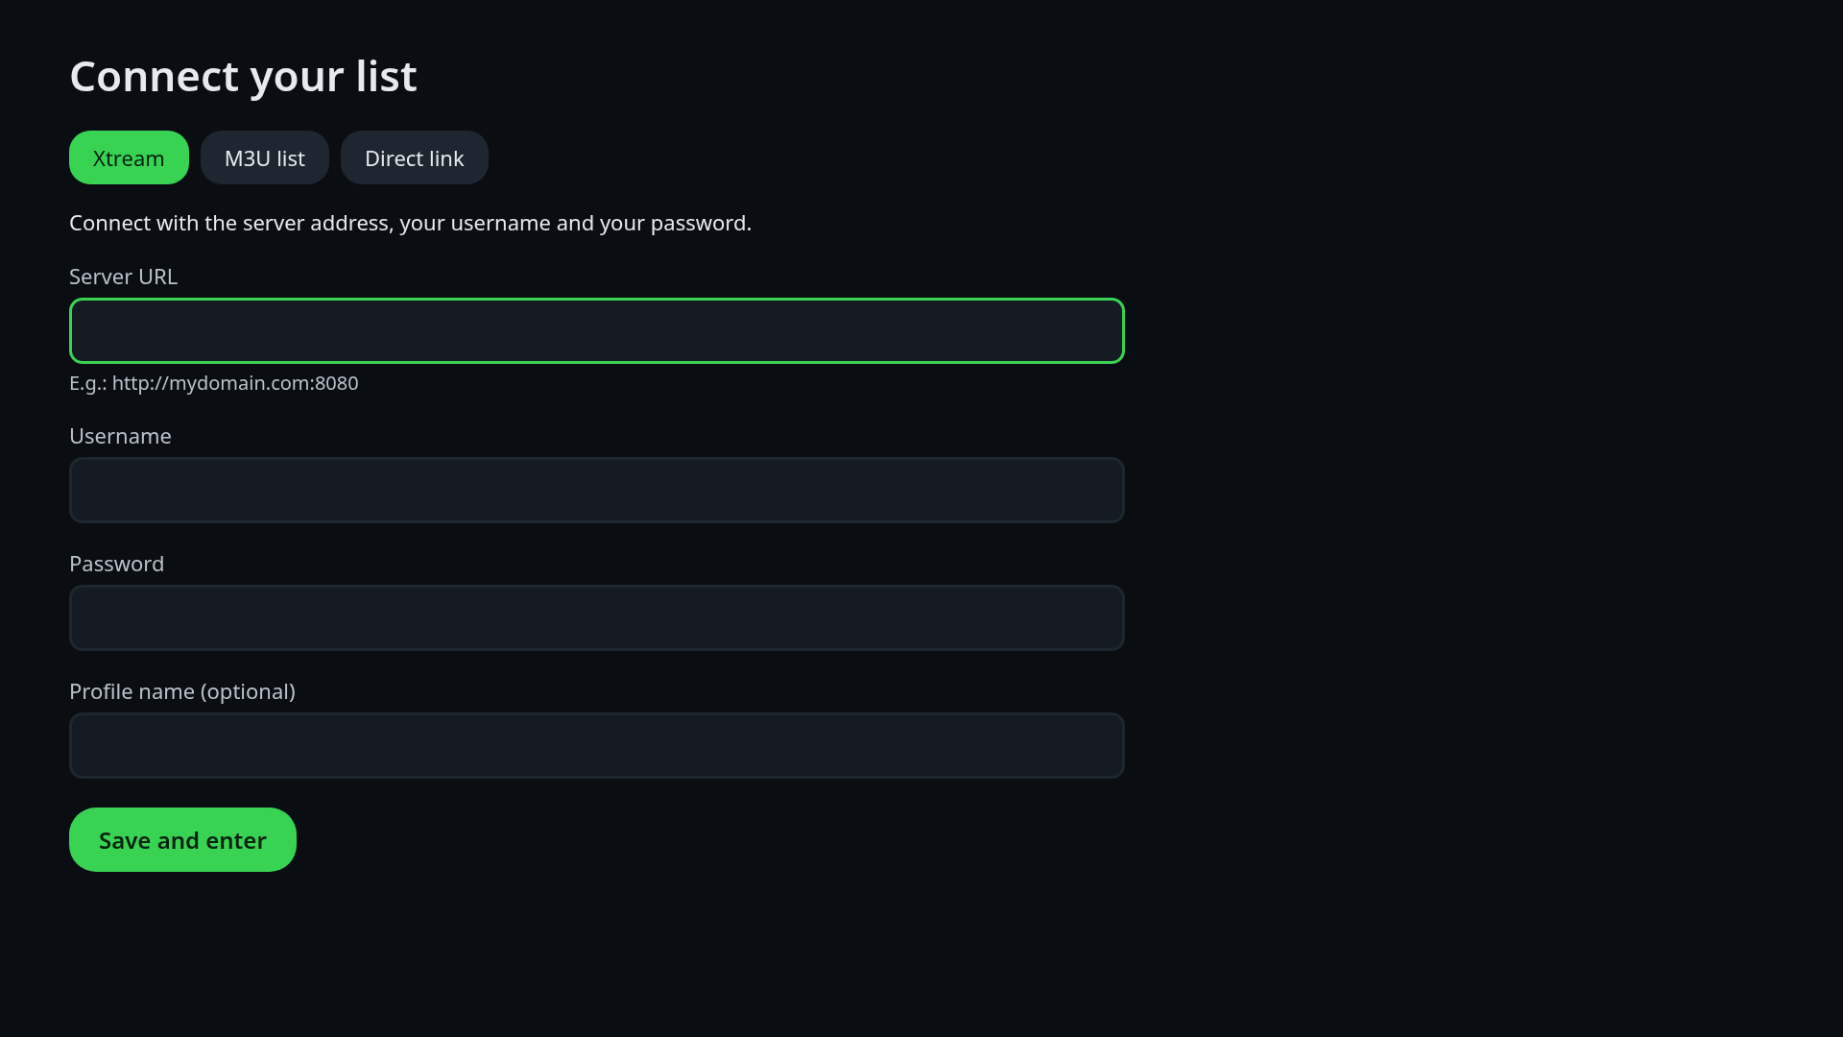
3. Menu & function description
3.7 Add profile
1
No | Description
1 | Screen title
2 | Source type tabs: Xtream (server, username, password), M3U list (playlist URL), Direct link (stream URL)
3 | Text fields: ENTER opens the TV keyboard; Done/RETURN on the keyboard returns to the form
4 | Save: checks the data, downloads the channel list and opens it
2
3
4
Details
- Also used to edit an existing profile (long ENTER on its card). An error message under the form explains a wrong URL or credentials.
- Test data for QA: see section 2.

Slide 13
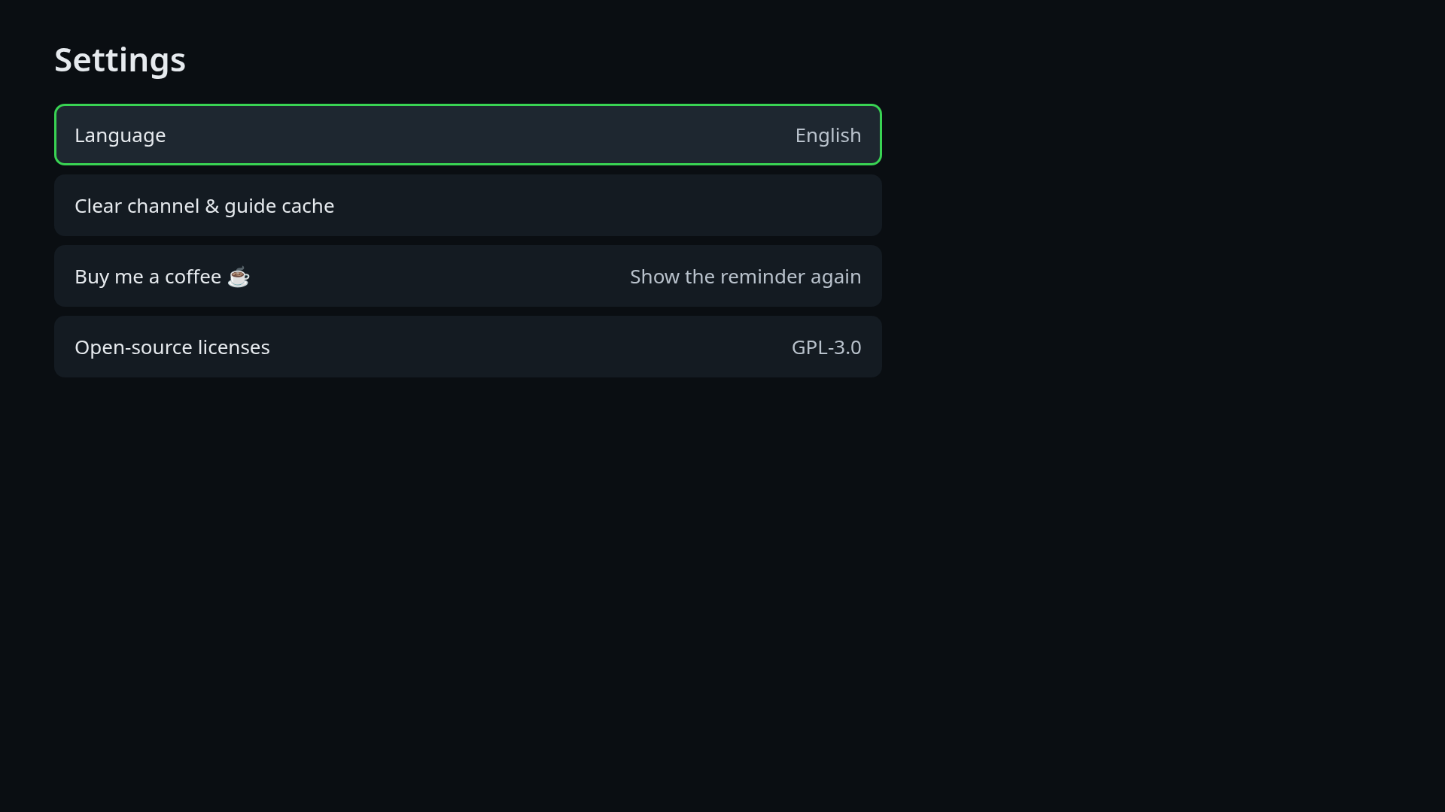
3. Menu & function description
3.8 Settings
1
No | Description
1 | Screen title
2 | Options: Language, Clear channel & guide cache, Buy me a coffee, Show the reminder again, Open-source licences
Details
- Reached with the gear button on the entry screen. Up/down move, ENTER selects, RETURN returns.

Slide 14
4. Key policy
Samsung standard remote (Smart Remote and full remote)
Key | Lists and forms | Player
Arrows | Move the focus (rows wrap around) | Left/right: previous/next channel (x2: folder). Up/down: quality variant
ENTER | Activate the focused item (long ENTER: favourite / edit) | Open the menu (x2: play/pause, long: favourite)
RETURN | One level up; on the entry screen exits the app | Close the menu, else leave the player
CH+ / CH- | - | Next / previous channel
PLAY / PAUSE / STOP | - | Play-pause toggle / leave the player
INFO | - | Show or hide the channel info bar
Colour keys, numbers | Ignored | Ignored
HOME / EXIT / VOLUME / MUTE | Handled by the TV | Handled by the TV
Pointer / mouse | Not used | Not used

Slide 15
5. How to change languages
The app follows the TV menu language automatically (24 languages, English fallback). It can also be forced from inside the app:
Step | Action
1 | On the entry screen, move the focus to the globe button (top right) and press ENTER
2 | Pick a language in the list and press ENTER; the whole UI changes immediately
3 | Alternatively: gear button → Settings → Language
Languages | Albanian, Arabic, Basque, Catalan, Chinese (Taiwan), Croatian, Dutch, English, French, Galician, German, Greek, Hindi, Indonesian, Italian, Polish, Portuguese, Romanian, Russian, Serbian, Spanish, Thai, Turkish, Vietnamese

Slide 16
6. Notes for QA
- No login and no account: please use the test playlists of section 2 (openly licensed content served by jsDelivr and public CDNs; no geo-blocking).
- The app is a channel player, not a content service: it has no catalogue of its own and shows only what the user's source provides.
- Free app: no in-app purchase, no subscription, no advertising. The "Buy me a coffee" card only shows a QR code to an external web page.
- Live streams cannot be seeked; there is no resume, series or DRM content.
- Quality: "Auto" picks the variant that fits the measured network speed and steps down after stalls; the menu allows manual selection. Variants depend on the source (the test playlists have one variant per item).
- Privilege APIs used: internet, system information (TV model / language), input device key capture (CH+/-, media keys, INFO).
- Tested on a Samsung Smart Monitor M7 LS32AM700U (Tizen 5.5) with a real IPTV subscription (MPEG-TS, H.264, AC-3 / E-AC-3) and with the test playlists.
- Screenshots in this document were taken from the same web app in a desktop browser at 1920x1080 (identical UI).
- Contact for QA questions: contact@nezor.es

