Slide 1

Pathogensurveillance: An Automated
Computational Pipeline for Identification,
Population Genomics, and Monitoring of
Pathogens
Zachary Foster, Camilo Parada-Rojas, Martha Sudermann, Fernanda Bocardo, Ricardo Alcala-Briseno, Hung Phan, Marina Witherell, Alexandra Weisberg, Melodie Putnam, Jeff Chang, Niklaus Grünwald

Slide 2
Using whole genome sequencing data for epidemiology
Whole genome sequencing presents both opportunities and challenges when compared to gene-based methods such as (q)PCR, SSRs, and gene sequencing.
Potential:
    Increasingly abundant and cheap
    Increasingly reliable
    Less biased against unknowns
    High resolution
    More information
    Less dependent on experimental design
    More relevant in the future
Challenges:
    Still more expensive then gene-based methods
    Large data sets
    Difficult to analyze and interpret
    Computationally expensive to analyze
    Lower throughput

Slide 3
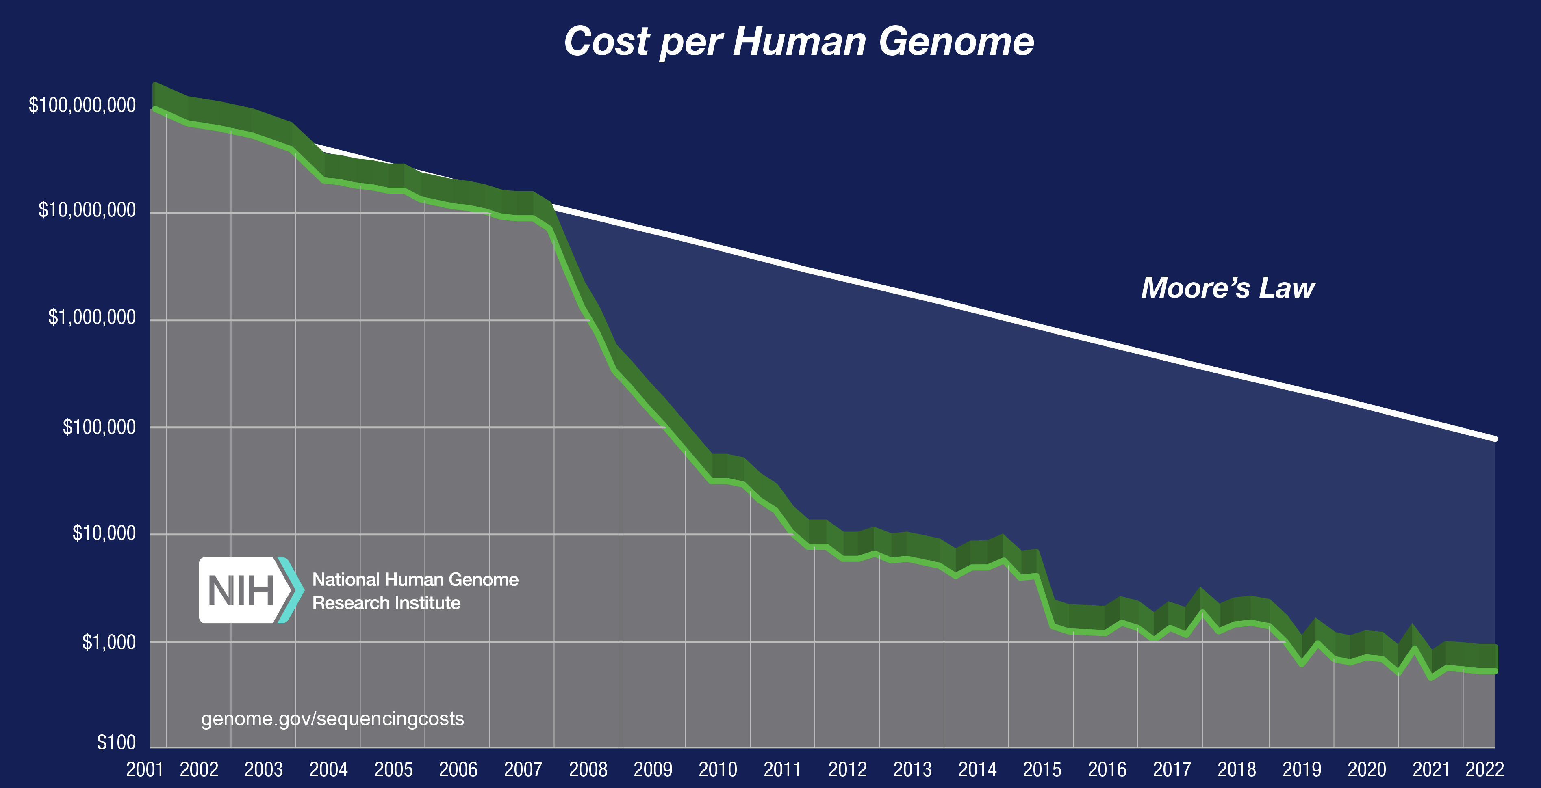
The cost of whole genome sequencing
Reagent cost for bacterial genome: $10-$25 (Moeller et al. 2022)
Reagent cost for human-sized genome: $100-$500
Image credit: https://www.genome.gov/about-genomics/fact-sheets/DNA-Sequencing-Costs-Data

Slide 4
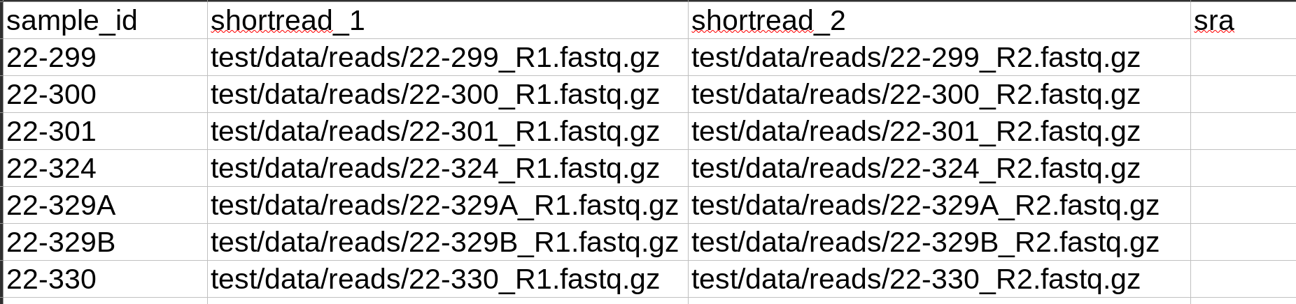
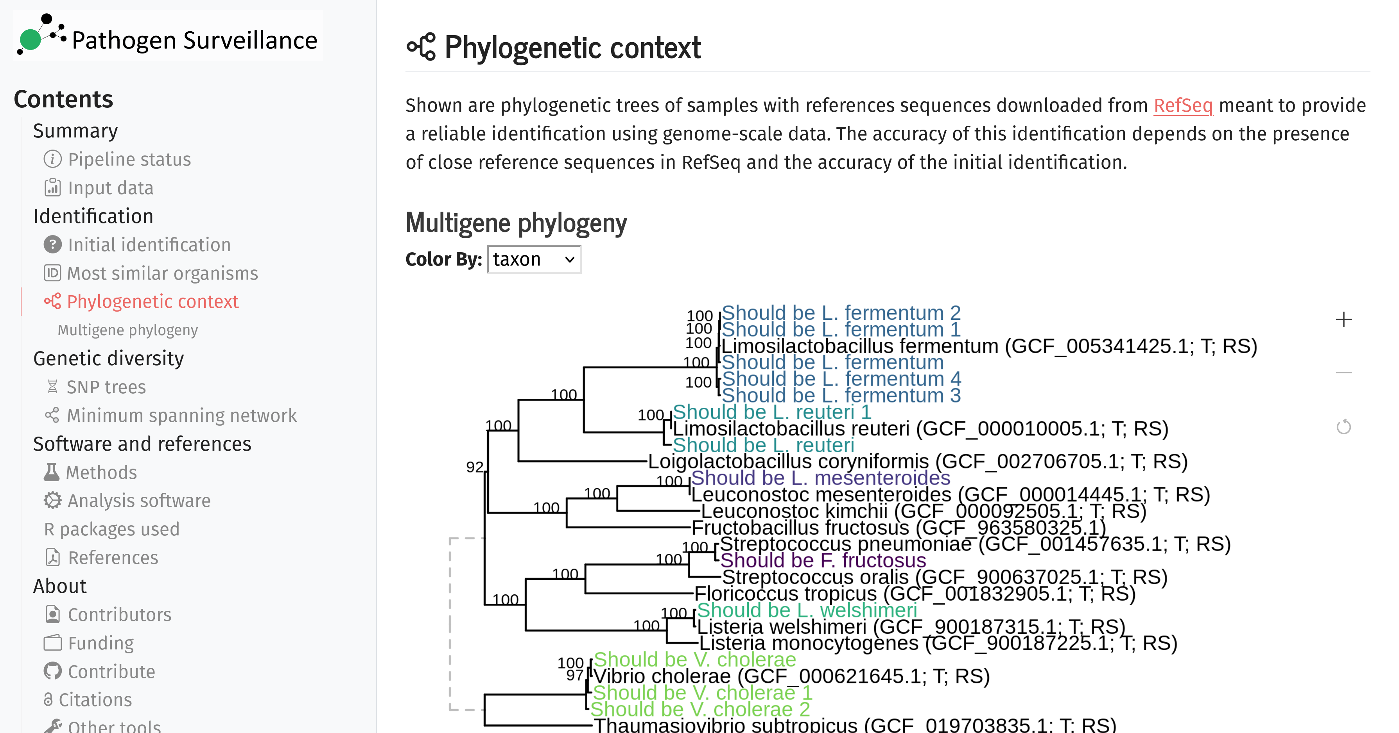
Introducing pathogensurveillance
Software to bulk analyze raw whole genome sequencing data
Takes raw reads as input
Outputs PDF/HTML reports with plots/tables
Identifies unknown organisms
Works on eukaryotes and prokaryotes
Designed to be simple to use while still being flexible for advanced users
Can be run without command line
Easy to install
Can be run on clusters, commercial clouds, and personal computers

Slide 5
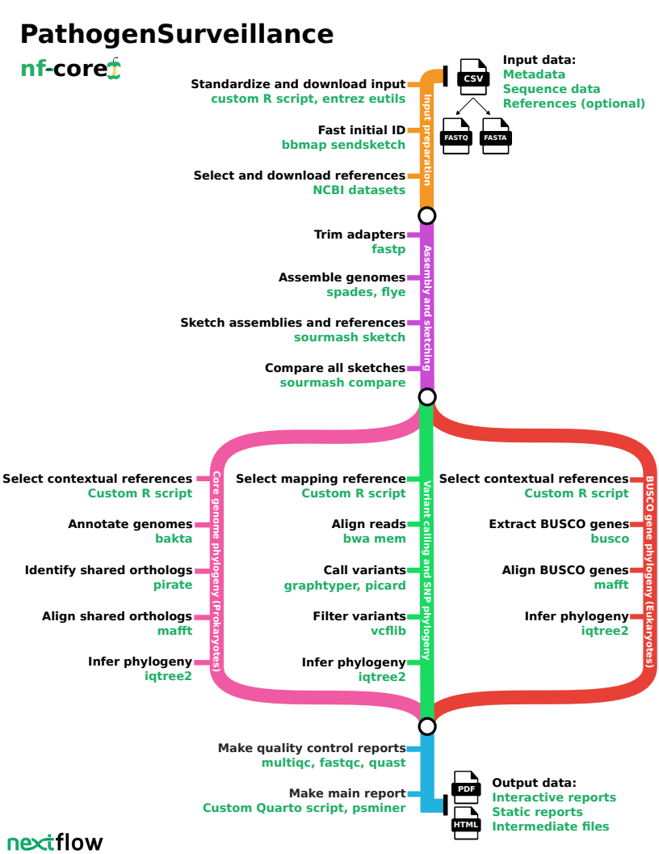
What pathogensurveillance does
Identifies unknown organisms
Compares organisms to similar publicly available reference genomes
Compares groups of organisms to each other
Outputs results as human-friendly HTML or PDF reports for each user-defined group of genomes
Outputs intermediate data for use by advanced users
Runs in parallel whenever possible and caches past results

Slide 6
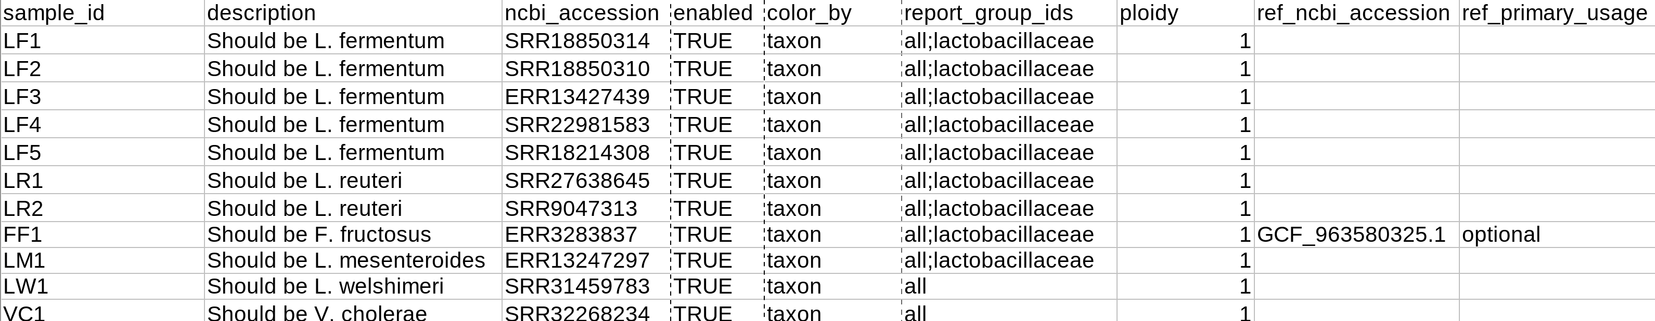
What the input looks like
A TSV/CSV table with information on where to find input data
Accepts local paths, remote URLs, NCBI accessions, and NCBI queries
Accepts Illumina, Nanopore, and Pacbio data
Can make multiple reports per run using the `report_group_ids` column
Optional user-defined references, which can be local paths, remote URLs, NCBI accessions, or NCBI queries
Very flexible and forgiving input format

Slide 7
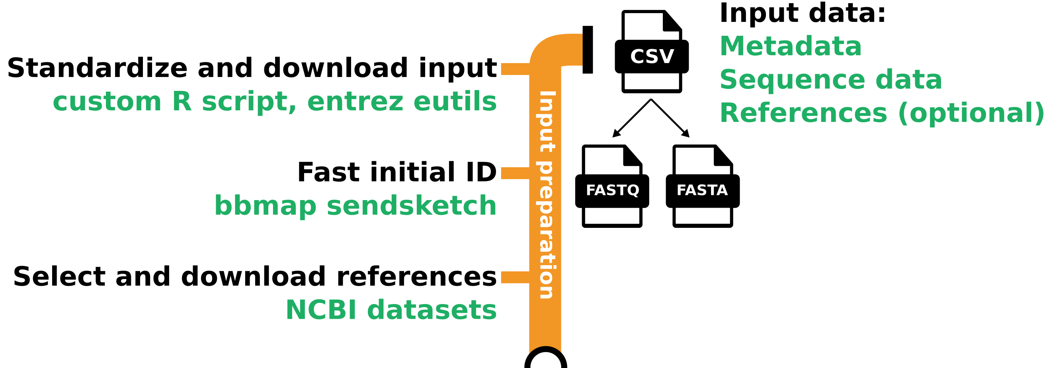
Input parsing and initial identification
The input table is extensively checked and standardized
Missing information is inferred or looked up, such as unique IDs, sequencing data types, and SRA runs from NCBI biosample accessions
NCBI queries are executed and replaced with their results
Sendsketch is used to provide an initial identification

Slide 8
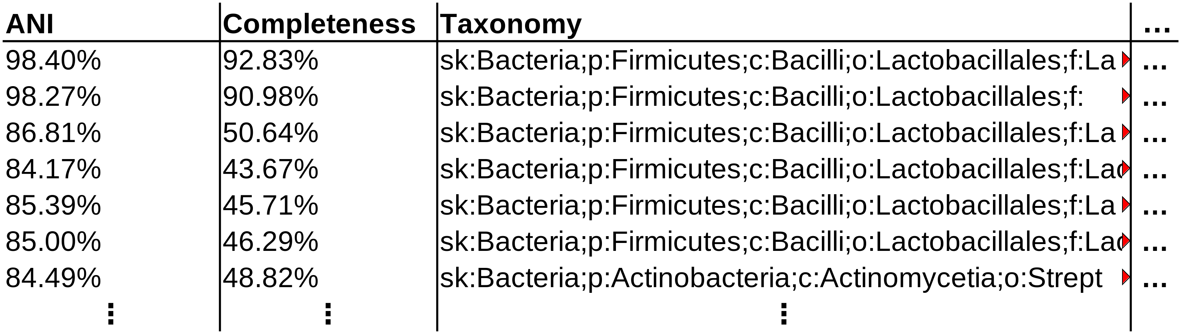
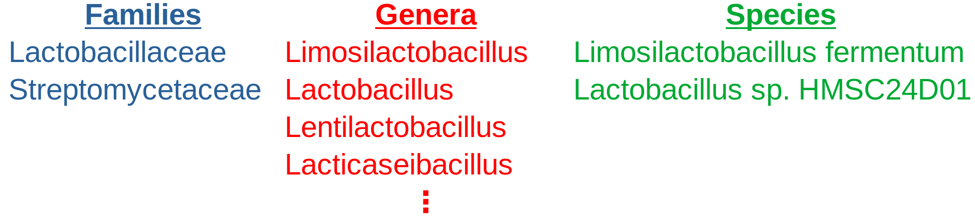
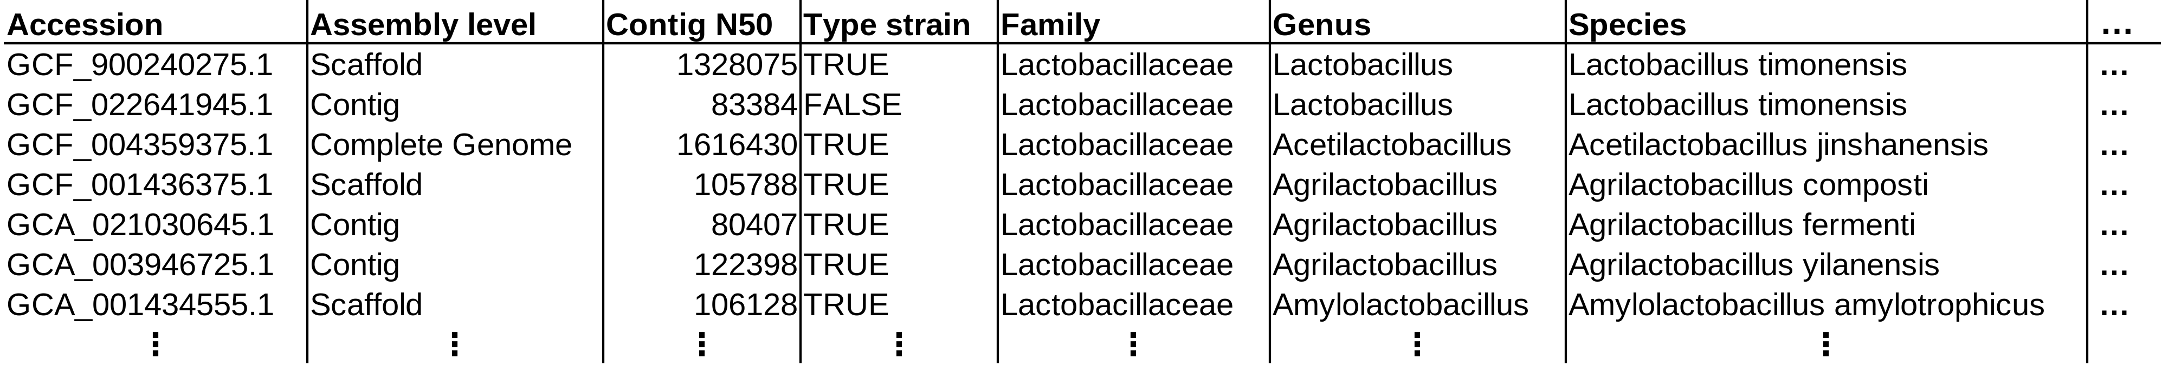
Selecting references to download from NCBI
1) Sketch raw reads with sendsketch:
4) Pick representatives for every family, genus, and species
Settings:
n_ref_genera = 3
n_ref_species = 3
n_ref_strains = 1
Lactobacillaceae
├─Limosilactobacillus
│ ├─Limosilactobacillus fermentum
│ ├─Limosilactobacillus reuteri
│ ├─Limosilactobacillus mucosae
│ └─Limosilactobacillus secaliphilus
⋮
├─Secundilactobacillus
│ ├─Secundilactobacillus silagincola
│ ├─Secundilactobacillus mixtipabuli
│ └─Secundilactobacillus odoratitofui
├─Periweissella
│ └─Periweissella cryptocerci
├─Loigolactobacillus
│ └─Loigolactobacillus coryniformis
└─Companilactobacillus
└─Companilactobacillus heilongjiangensis
Streptomycetaceae
├─Streptomyces
│ ├─Streptomyces rapamycinicus
│ ├─Streptomyces iranensis
│ └─Streptomyces solisilvae
├─Kitasatospora
│ └─Kitasatospora cathayae
├─Actinacidiphila
│ └─Actinacidiphila reveromycinica
└─Peterkaempfera
└─Peterkaempfera bronchialis
2) Extract all taxa from sensketch results based on ANI
3) Download metadata for all assemblies for every family found

Slide 9
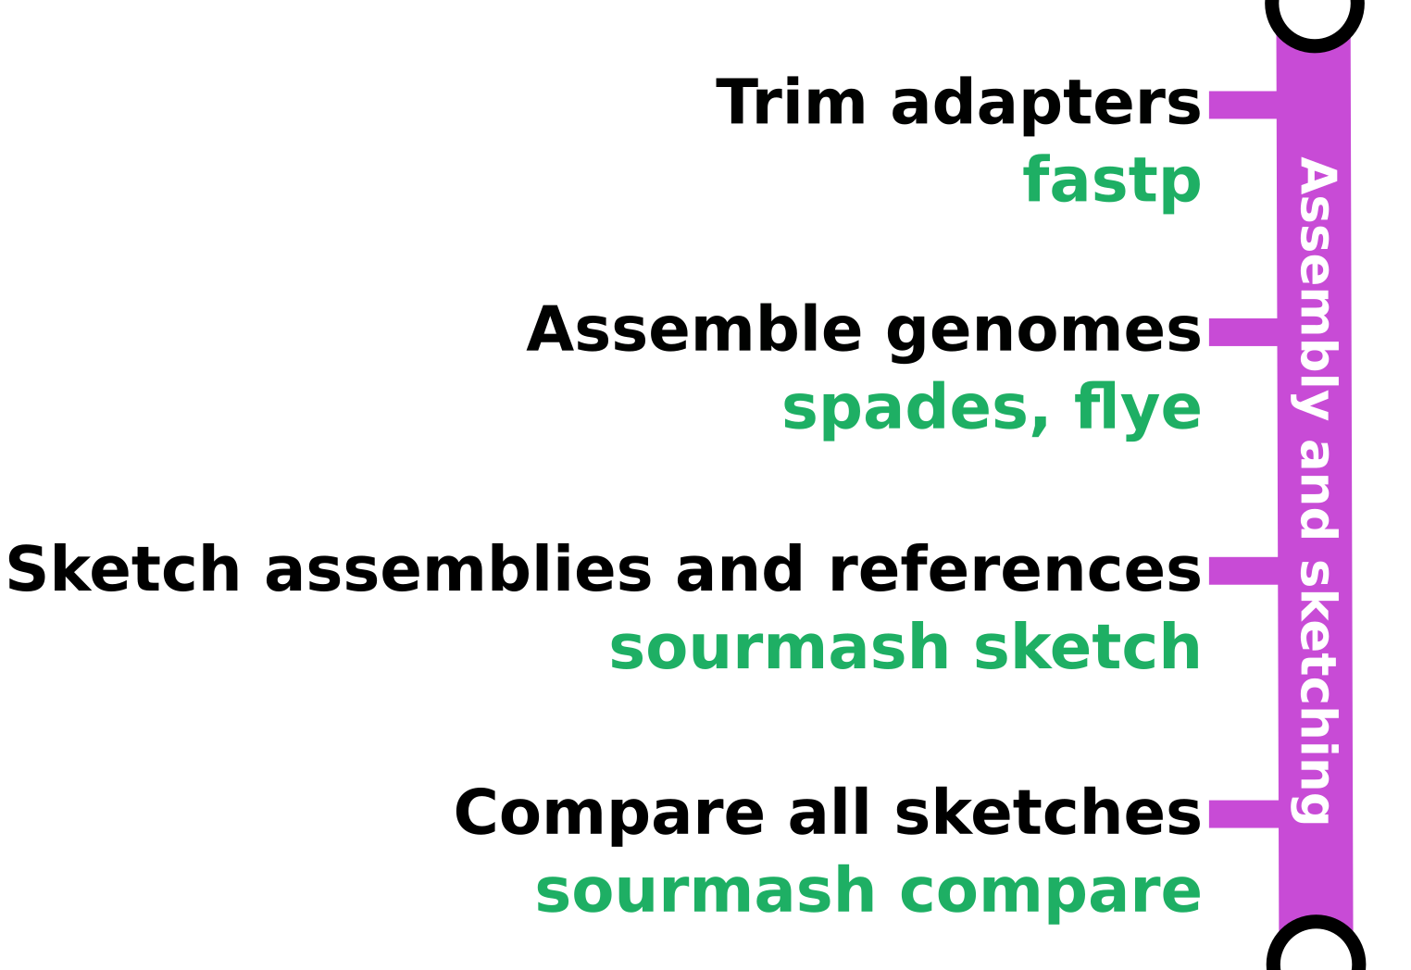
Genome assembly and sketch-based comparisons
Raw reads are filtered with fastp and assembled using spades or flye
Sourmash sketch is used to sketch sample assemblies, downloaded reference assembles, and user-defined reference assemblies
All sketchs are compared to each other to create an estimated ANI matrix

Slide 10
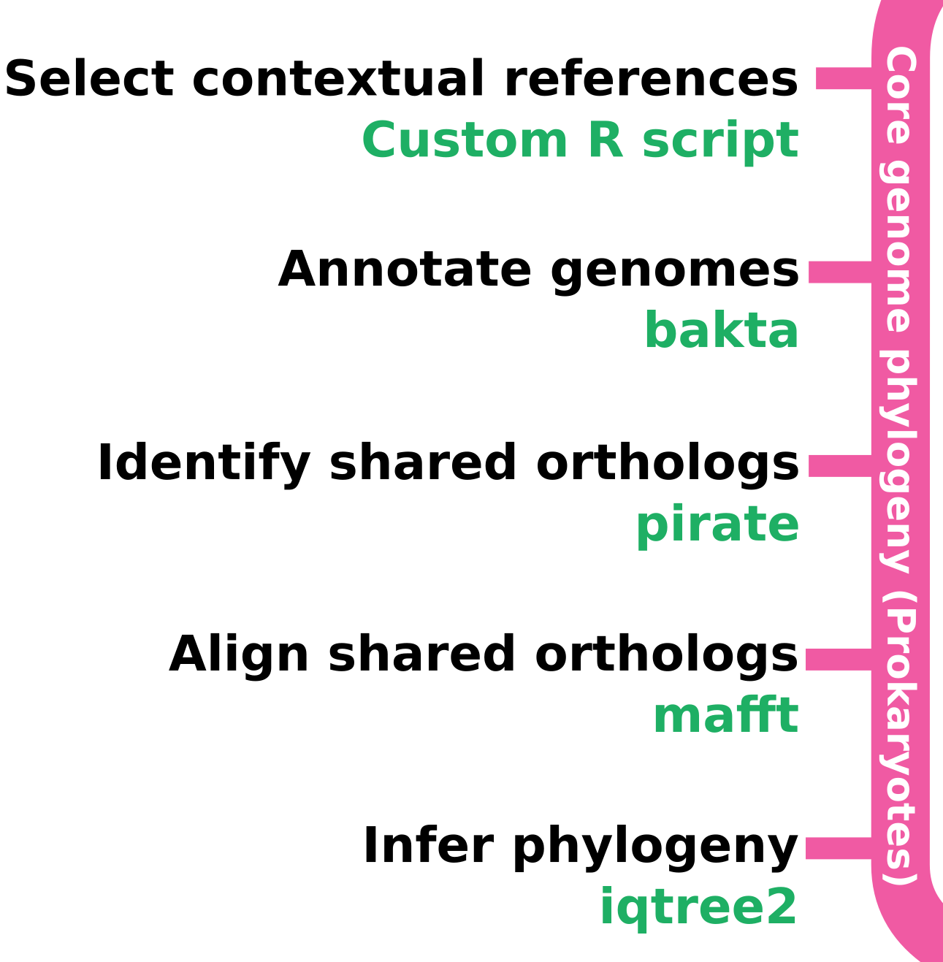
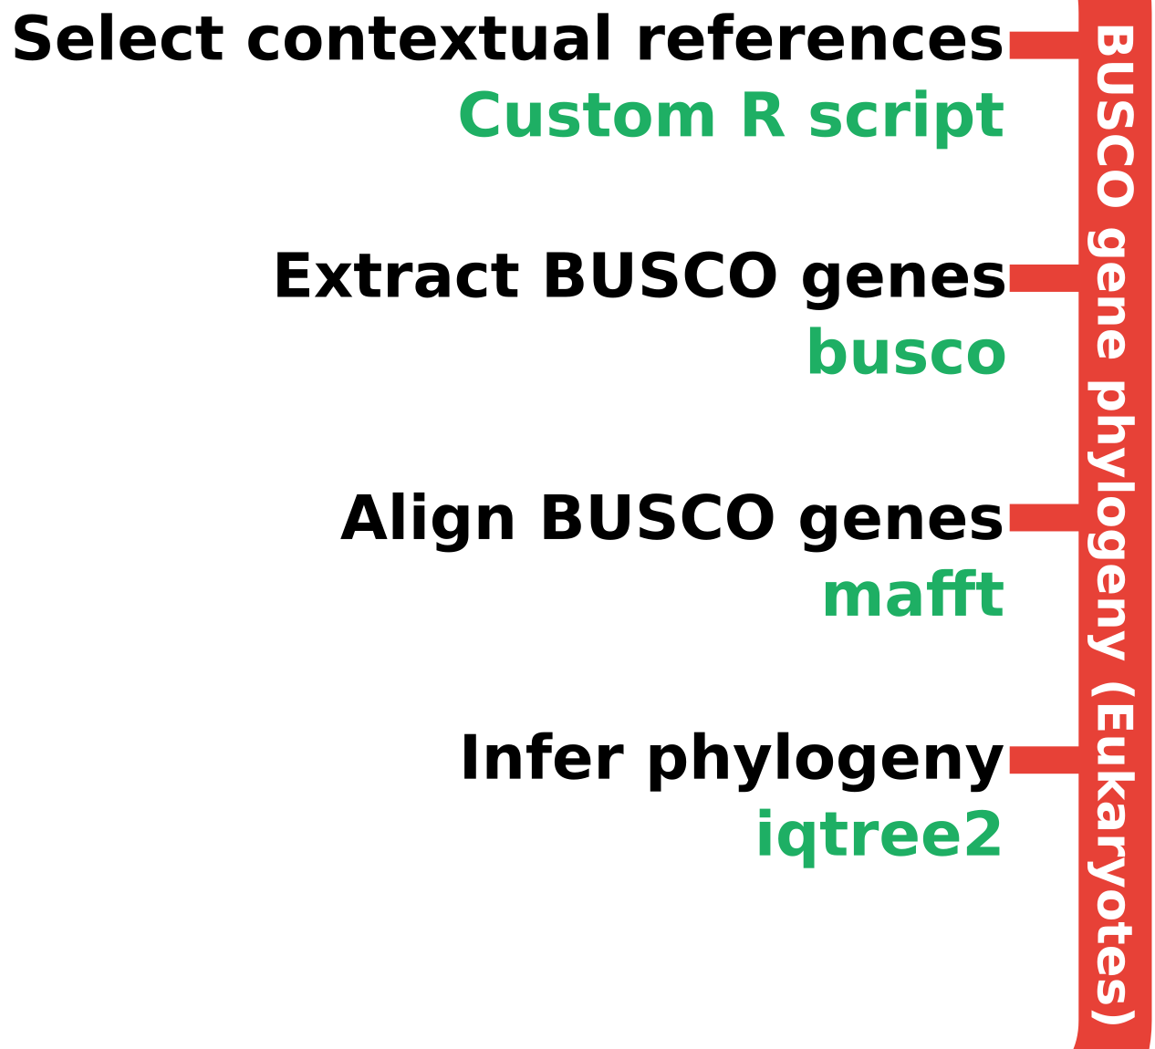
Multi-gene phylogeny: putting sample in context
A subset of references are selected to provide context based on ANI estimates from sourmash
Core genes are inferred using bakta and pirate for prokaryotes
BUSCO genes are extracted for eukaryotes
Shared genes are used to make phylogenies with iqtree2

Slide 11
Contextual reference selection algorithm
Contextual references are used to put samples in the context of the tree of life
They are chosen for a group of samples as a whole
Some number of the most similar references to each sample are included
The rest of the references are chosen such that each sample has a reference at a range of ANI values compared to itself
The fewest possible references are chosen for the group that fit this criteria

Slide 12
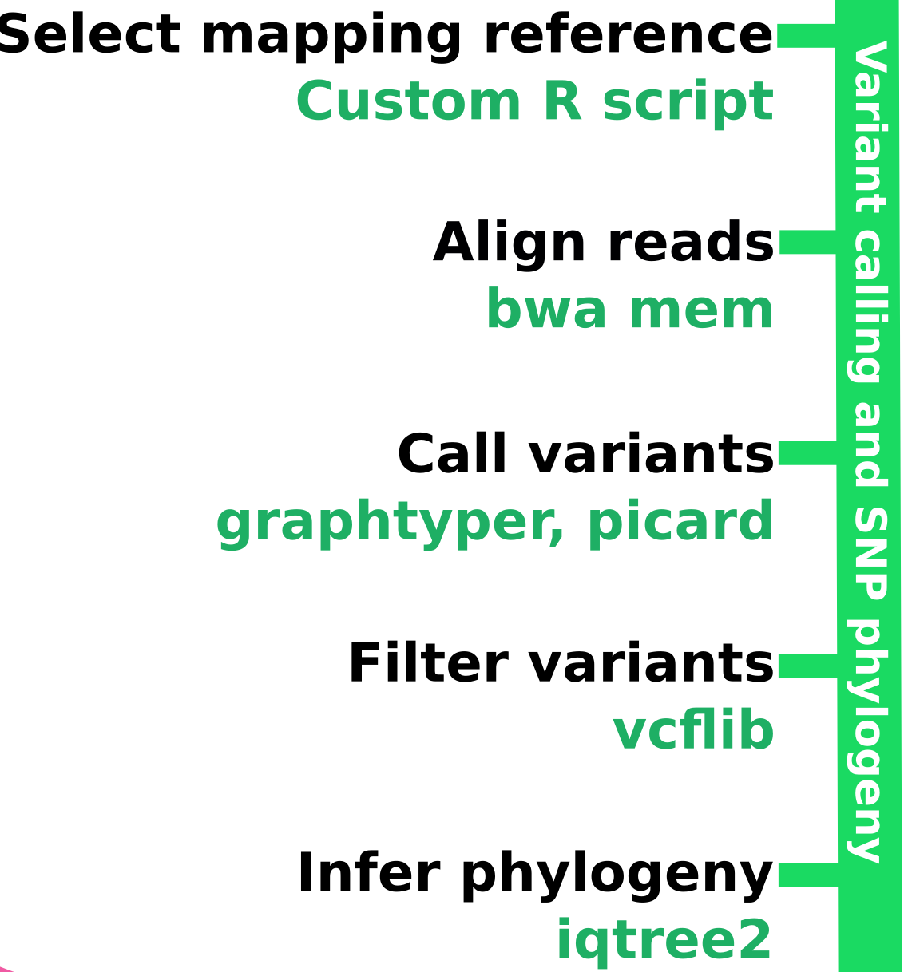
Variant calling: high-resolution comparison of samples
Samples are grouped with references in such a way that minimizes the number of references used
Reads are aligned to the best reference using `bwa mem`
Variants are called using `graphtyper genotype`
The resulting VCF file is converted to a multiple
sequence alignment
Samples are split into clusters
based on shared genes and
a tree is made with each cluster

Slide 13
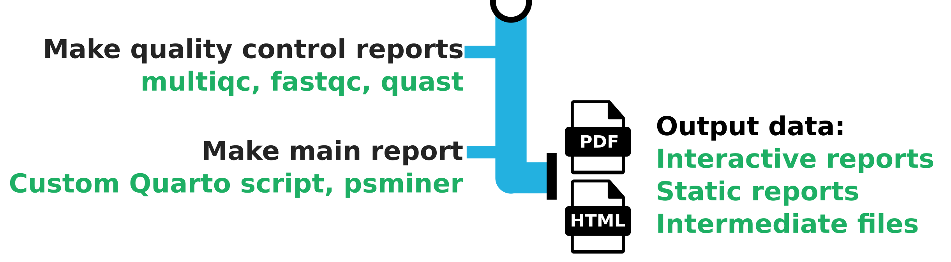
Output report and other files
The primary output is an interactive HTML report generated from a quarto document using R and javascript based visualizations
HTML reports are also provided from quality control tools like Quast and MultiQC
All intermediate files are available in an organized directory structure and named by unique IDs

Slide 14
How the pipeline is run: on the command line (interactive)

Slide 15
What the output looks like (interactive)

Slide 16
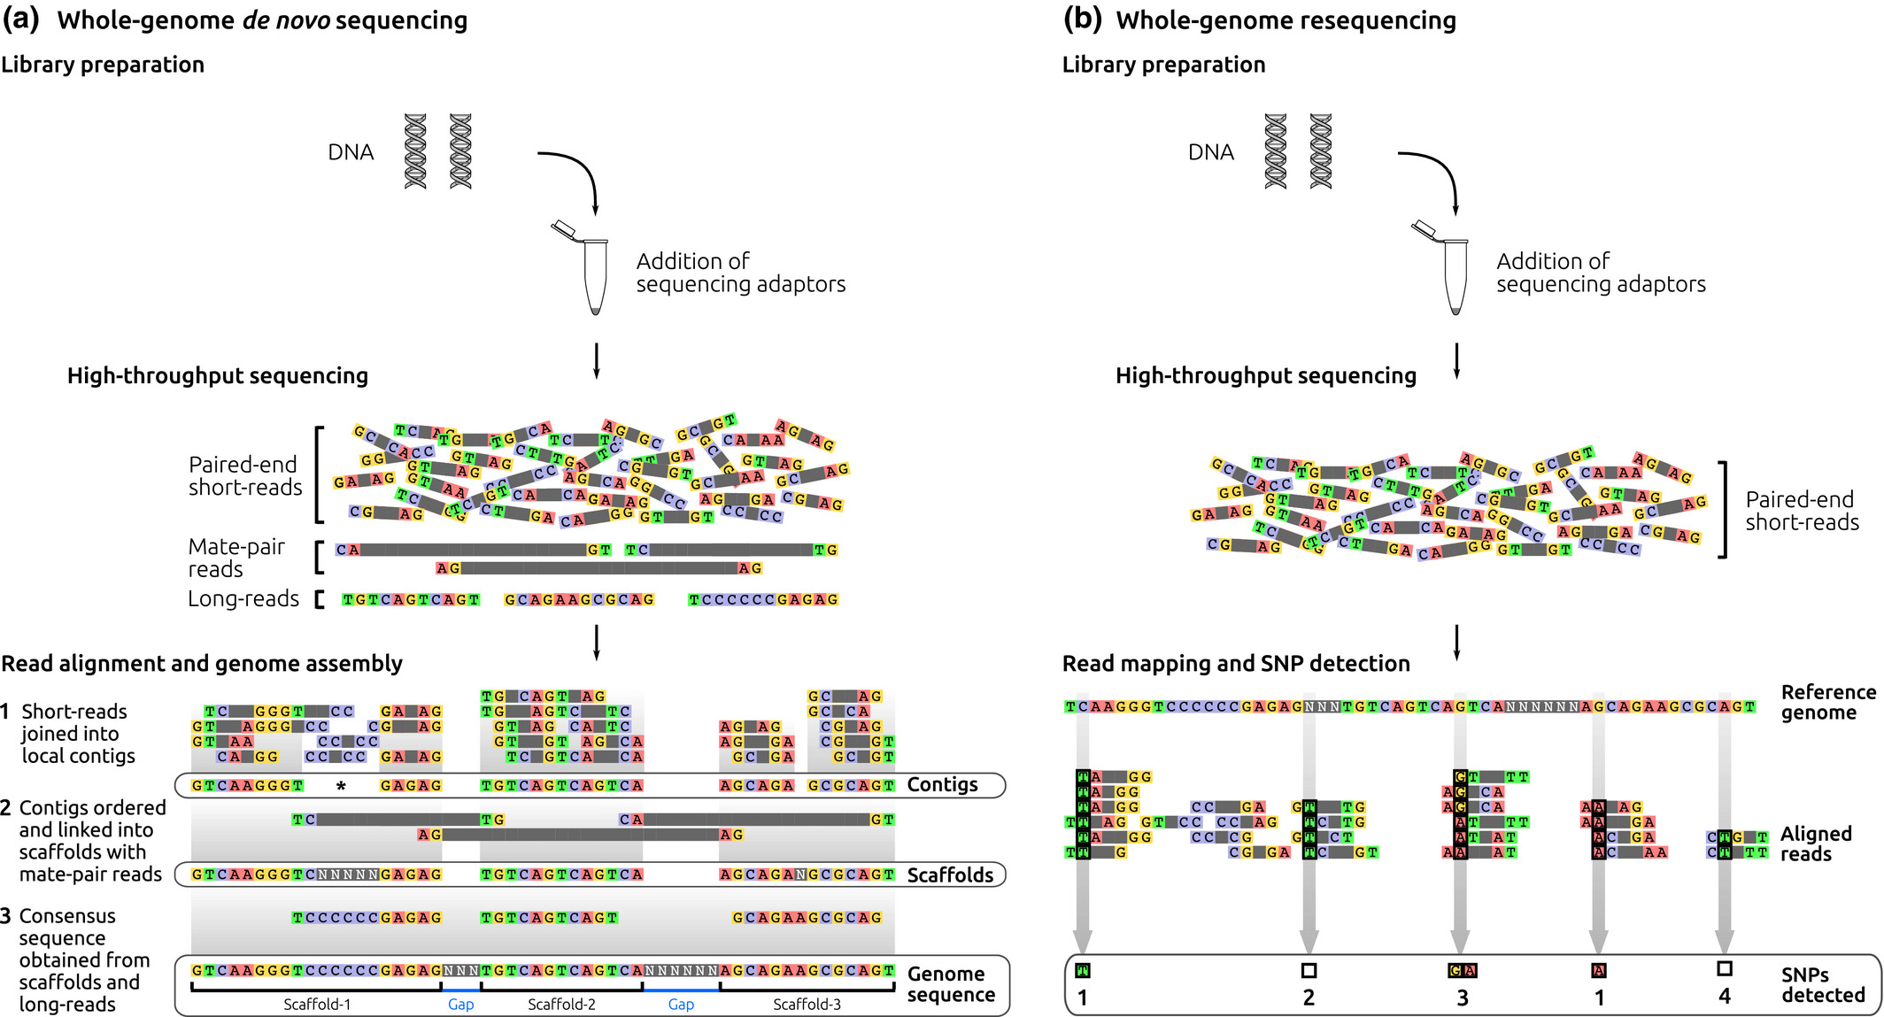
Whole genome sequencing review
Image credit: Whole-genome sequencing approaches for conservation biology: Advantages, limitations and practical recommendations. Angela P. Fuentes-Pardo, Daniel E. Ruzzante

Slide 17
Future directions
Finish the report output
Identify presence of genes of interest
Map samples with the location of similar organisms in public databases
Handle host DNA correctly for samples from infected tissue
Explore contamination/metagenomics (e.g. viruses)

Slide 18
Acknowledgments
Programmers:
Camilo Parada-Rojas
Martha Sudermann
Ricardo Alcala-Briseno
Hung Phan
Testers:
Marina Witherell
Pipeline analysis design:
Fernanda Bocardo
Alexandra Weisberg
Consulting:
Melodie Putnam
Alexandra Weisberg
Project leadership:
Niklaus Grünwald, Jeff Chang

