Slide 1
Workflow tools
make
  Present on every operating systems
  General tool for complex tasks
  Easy to write, but can be difficult to read
ClusterFlow
  Not optimized for HPC (i.e. using slurm)
NextFlow
  Developed in bioinformatics/genomics in mind
  General domain specific language on top of java/groovy
  Easy to write, and many tools are already integrated (i.e. slurm)
  Easy to read also

Slide 2
NextFlow - the tool of choice
NGI already developing RNA-Seq in NextFlow
Active developer group behind
Looks it is quite straightforward to implement new workflows (no serious problems so far)

Slide 3
NextFlow

Slide 4
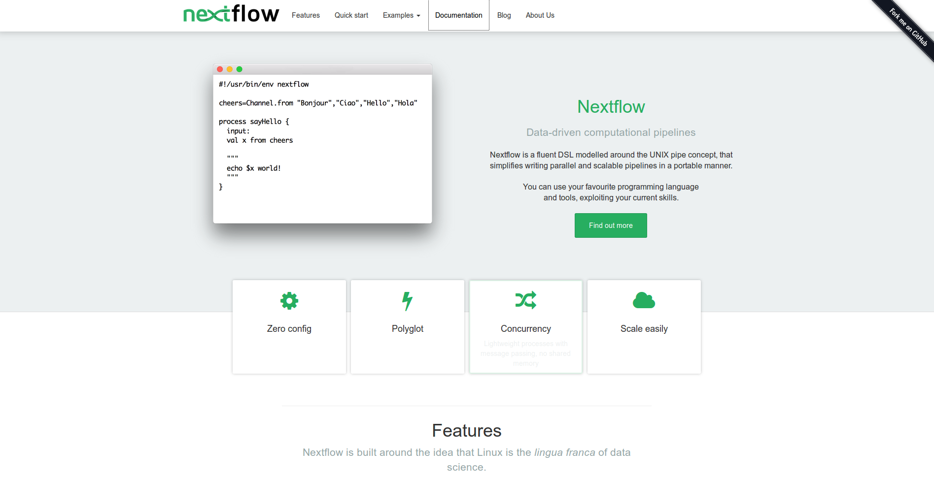
NextFlow implementation

Slide 5
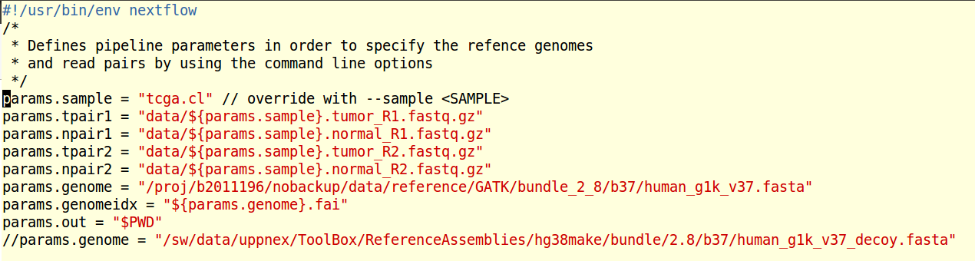
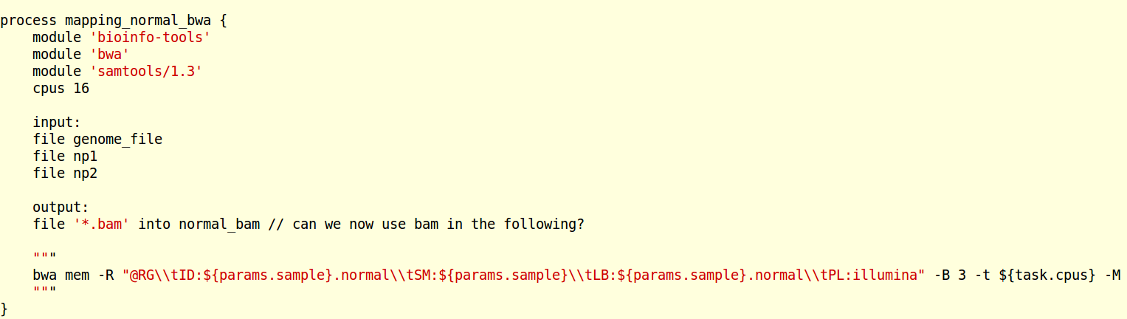
NextFlow: actual implementation

Slide 6
Integration to other software
NGI pipeline:
  Add new engines: it is not only CAW, but RNA-Seq on the road
  Needs changes in Charon database (we want to see things in genomics status)
MultiQC:
  Powerful tool already used in germline workflow

Slide 7
There is already some progress...
Testing MuTect2, prototyping its use (Malin)
ASCAT – sample homogeneity test (Malin)
Skeleton in NextFlow (Pall)
NGI Pipeline on the road (Szilva)
Structural Variants to come (Pelin)

