Slide 1

Predicting Kickstarter Project Success
Springboard Capstone: Nicole Fimmen

Slide 2
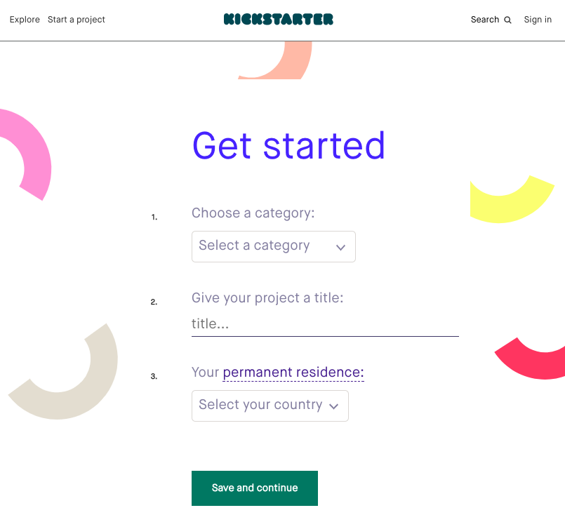
What is Kickstarter?
Kickstarer's mission is to help bring creative projects to life. Projects have many forms including food and publishing to music, fashion and technology.
Notes:
Since launching in 2009, 14 million people have backed a project, $3.4 billion has been pledged, and 134,135 projects have been successfully funded.

Slide 3
Will my project get funded?
Kickstarter is all or nothing. If a project doesn't get every dollar, the project will not be successful.

Slide 4
How to Predict Project Success
Explore the data set
Analyze the variables
Apply predictive modeling

Slide 5
Data Set
108,129 projects
33% successfully funded projects
May 2009 – 2015
US only projects
Variables: product description, keywords, goal amount and various project timelines
Notes:
Kaggle Competition data set
85% of the projects is US currency

Slide 6
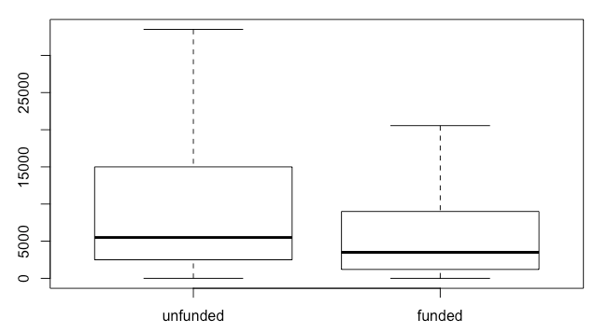
Data: Goal Amount
Successful projects ask for less money.
Unfunded average amount $3,500
Funded average amount $5,500

Slide 7
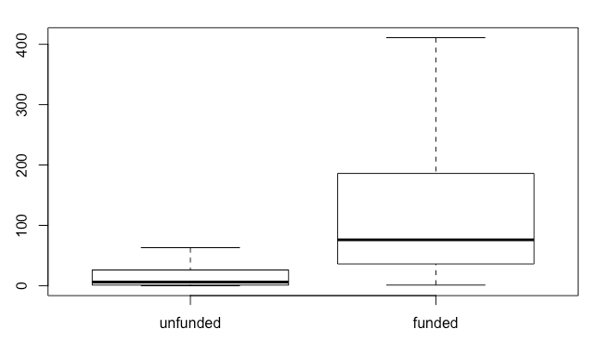
Data: Backers
Successful projects have more backers.
Unfunded an average of 6
Funded an average of 76
Notes:
No surprise. A wide base of support is needed for success.

Slide 8
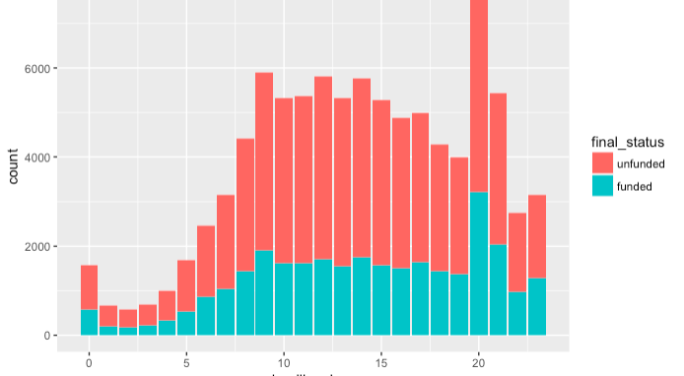
Analyze: Time
Successful projects have a deadline before 10pm.
8pm is the most common deadline hour.
Notes:
Deadline hour – 8pm the most common

Slide 9
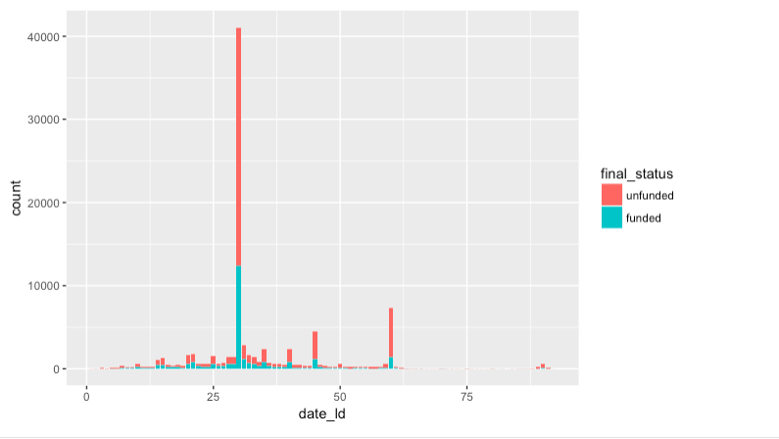
Analyze: Project Length
Successful projects are typically less than 30 days.
30 days is the most successful project length.

Slide 10
Comparing Models
3 unsuccessful models.
Accuracy for each:
CART: %67.7
Random Forest: %67.7
Logistic regression: %67.6

Slide 11
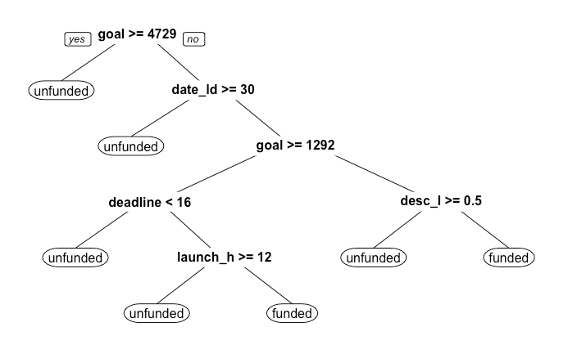
Model: Insights
Most influential variables for project success.
CART Model:
Goal
Project length (date_ld)
Deadline hour
Launch hour
“I” in description
(desc_I)

Slide 12
Results
More research is needed.
Time variables related to product launch and deadline were not as important as expected.
Notes:
Important variables –
Backers count
Funding requested
30 days

Slide 13
Next steps
The key to predicting a project’s success is most likely within the keywords and description.
Continued analysis with sentiment and popularity of specific words is needed.

Slide 14
Appendix
Project files – Github
Report
R Code
Data source - Kaggle

